Slide 1
Biofilm-Grown Burkholderia cepacia Complex Cells Survive Antibiotic Treatment by Avoiding Production of Reactive Oxygen Species
Kevin Wyllie and Veronica Pacheco

Slide 2
OUTLINE
Introduction: Bcc- Opportunistic Pathogens
Bcc - Difficult to Eradicate
Tenacity of Bcc Species
Strains and Cultured Conditions
Minimal Inhibitory Concentration
Persister Cells Quantified
Transcriptomic Analysis on Persister Cells Treated with Tobramycin
Induction of ROS by Tobramycin
ICL Mutant
Conclusion: An Understanding Antimicrobial Tolerance

Slide 3
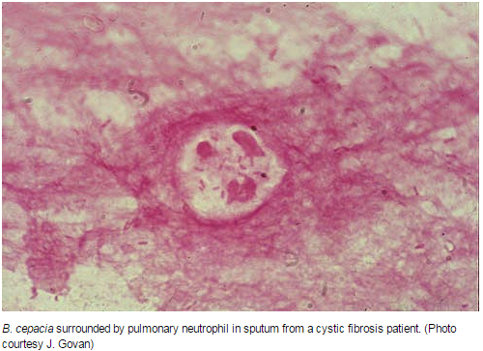
Bcc Species are Opportunistic Pathogens
Burkholderia cepacia complex (Bcc) - a group of 17 phenotypically similar species
Severe lung infections in cystic fibrosis patients
Persistence depends on specific species
B. cenocepacia possesses high transmissibility and mortality
http://www.apsnet.org/publications/apsnetfeatures/Pages/Burkholderiacepacia.aspx

Slide 4
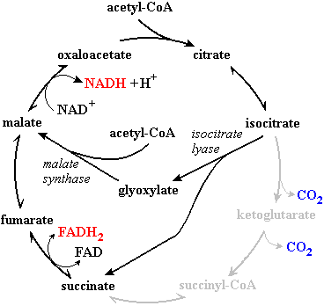
Bcc Species are Especially Difficult to Eradicate
Bcc species exhibit a resistance to a wide range of antibiotics
  Changes in lipopolysaccharide structure
  Drug efflux pumps
  Beta-lactamases
  Altered penicillin binding proteins
Shunting from the TCA cycle to the glyoxylate cycle counteracts the mechanism of many antibiotics
Biofilms lessen exposure to antibiotics
Persister cells survive treatment, then repopulate
  Phenotypic variant
  Very small fraction of populations
http://www.chembio.uoguelph.ca/educmat/chm452/lecture9.htm

Slide 5
This Study Examines the Tenacity of Bcc Species
How numerous are persister cells in Bcc biofilms?
What is the molecular basis of antimicrobial resistance in Bcc persisters?
How can persisters be eradicated from these biofilms?

Slide 6
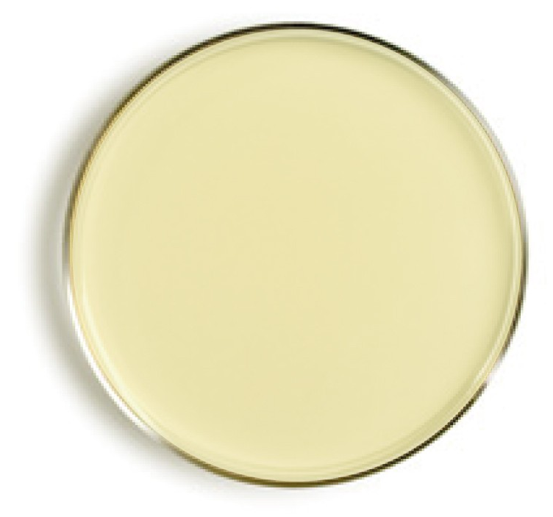
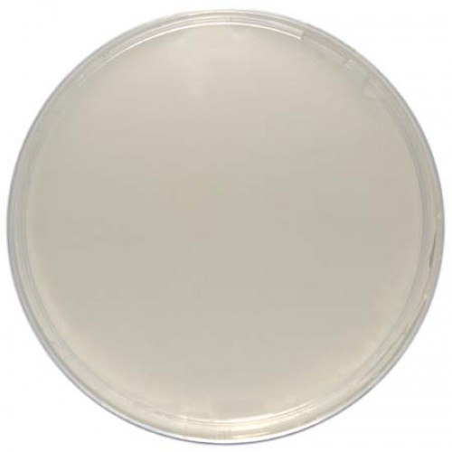
The Strains Were Cultured in 37° C Conditions
18 strains in this study
  all in the bacteria group Burkholderia cepacia
Luria-Bertani agar or Mueller Hinton agar
Cultured at 37 degrees Celsius
Diluted in Luria-Bertani broth
Incubated aerobically at 37 degrees Celsius
Mutant strains treated with:
  LB agar with 800μg/ml trimethoprim
  LB broth with 800μg/ml trimethoprim and 0.2% rhamnose
http://www.mkldiagnostics.com/media/catalog/product/cache/2/image/9df78eab33525d08d6e5fb8d27136e95/l/u/luria_bertani2_3.jpg

Slide 7
Minimal Inhibitory Concentration was Determined through Broth Microdilution
Tested:
  Tobramycin and Ciprofloxacin
  Itaconate and 3-nitropropionate
  2-Thenoyltrifluoroacetone
“Lowest concentration for which no significant difference in optical density was observed between the inoculated and blank wells after 24hr incubation”
Performed in duplicate and replicates
Never differed more than 2 fold

Slide 8
Persister Cells are Quantified using LB Plates
24 hr old biofilms and planktonic cultures were treated with: tobramycin and ciprofloxacin
After 24 hr, supernatant removed and treated with:
  120μl antibiotic solution in physiological saline
  120μl physiological saline (Control)
Harvested cells through vortexing and sonication
Quantified by plating on LB
Additional steps for planktonic cultures:
  another 24hr growth for optical density of 1

Slide 9
A Transcriptomic Analysis was Performed on Persister
Cells Treated with Tobramycin
B. cenocepacia biofilms grown, 24 hours
Incubated in the presence of tobramycin (4x MIC) or control, 24 hours
Cells collected by vortexing
RNA preparation
  Extraction, Ambion RiboPure Bacteria Kit
  Purification (DNase treatment), 1 hour
  Concentration, Microcon YM-50 filters
  Amplification, Ambion MessageAmp II-Bacteria Kit
cDNA synthesis (reverse transcription)
Dye incorporation and hybridization against genomic DNA
Scanning, normalization, T-test

Slide 10
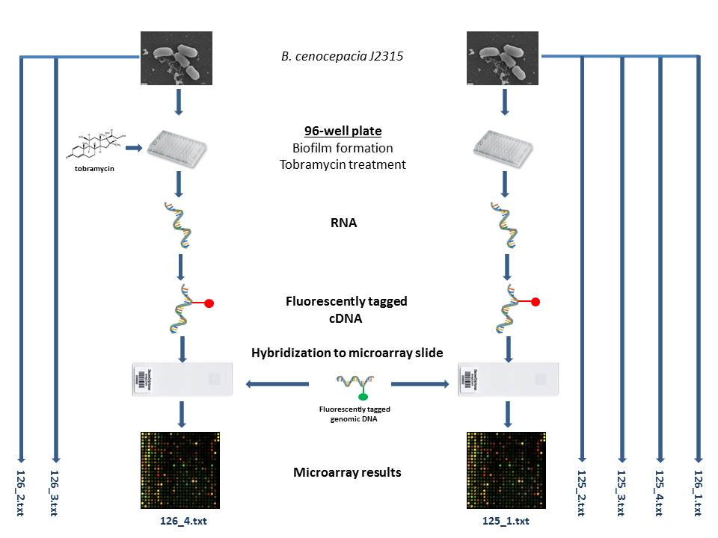
A Transcriptomic Analysis was Performed on Persister
Cells Treated with Tobramycin

Slide 11
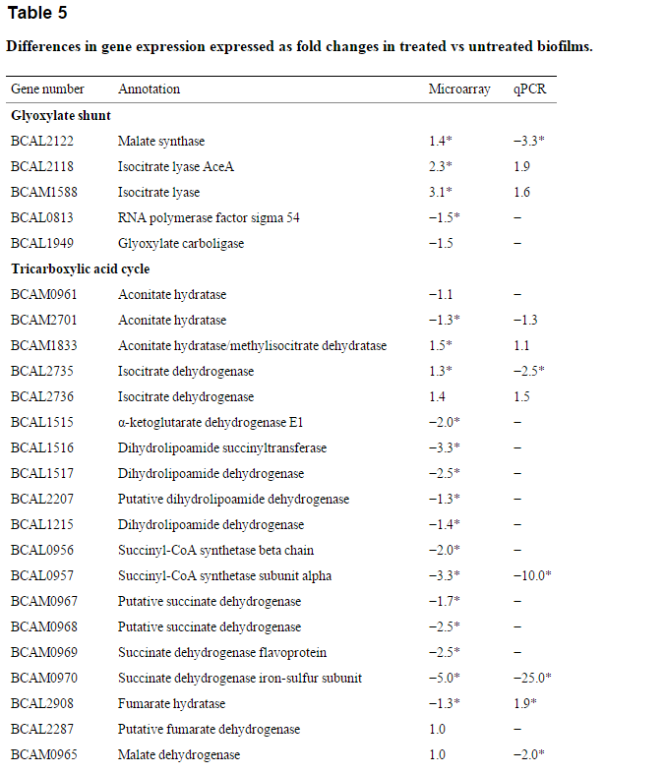
Transcriptomic Analysis of Persister Cells Revealed Gene Expression Changes in Response to Tobramycin Treatment
2688 genes significantly upregulated (30.8%)
2413 genes significantly downregulated (27.6%)
Downregulation of genes involved in TCA cycle
Upregulation of genes responding to oxidative stress

Slide 12
Validate the Microarray Results by Examining Gene Using RT-qPCR
11 genes selected→ RNA extracted→ cDNA synthesized
Forward and Reverse primers through comparison of B. cenocepacia J2315 in BLAST
Used Bio-Rad CFX96 Real-Time System C1000 Thermal Cycler
600 nM primer concentration
Each sample spotted in duplicate
Control samples had no added cDNA
3 min denaturation→ 40 amp cycles
http://www.ncbi.nlm.nih.gov/pmc/articles/PMC3596321/

Slide 13
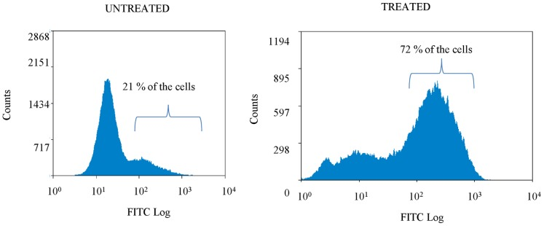
DCFHDA Confirms the Induction of ROS by Tobramycin
ROS= reactive oxygen species
Stained biofilms with 2’,7’- dichlorodihydro-fluorescein diacetate (DCFHDA)
Cyan ADP flow cytometer
50,000 cells per sample
Results: Tobramycin increased ROS production in treated sessile cells
Protection against ROS is important in survival of persister cells
http://www.ncbi.nlm.nih.gov/pmc/articles/PMC3596321/

Slide 14
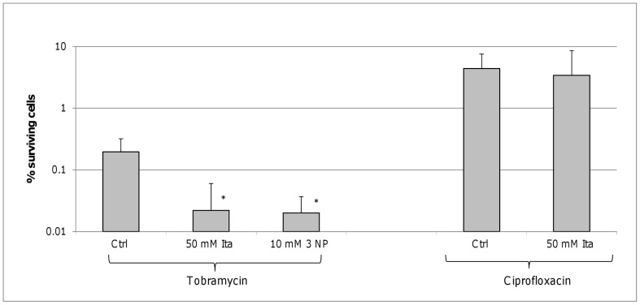
The ICL Mutant Constructed by Deleting BCAL2118 and BCAM1588
Aim: Create unmarked nonpolar gene deletions
Target gene to be cloned into pGPI-SceI-XCm plasmid
HotStar HiFidelity polymerase kit
Double mutant
pDAI-SceI-SacB plasmid present → tetracycline-resistant
Loss of integrated plasmid → trimethoprim-susceptible
http://www.ncbi.nlm.nih.gov/pmc/articles/PMC3596321/

Slide 15
The Persister Cells Findings Give an Understanding Antimicrobial Tolerance
TCA cycle was downregulated
Gene expression in the electron transport chain was downregulated
  as a result, avoids the production of ROS
Genes in the production of NADPH were upregulated
Glyoxylate shunt and ICL encoding genes were upregulated
Less persister cells survived when in the presence of ICL and SDH
Overall:
  mechanism is widespread throughout the various species
  new approaches to the treatment of persister-related infections

