Slide 1
Analysis via New Gene Database Verifies Gene Expression Changes in Response to Rifamycin Drug in Shigella flexneri
Trixie Roque, Jake Woodlee,
Erich Yanoschik, Kristin Zebrowski
Departments of Biology and Computer Science
Loyola Marymount University
December 15, 2015

Slide 2
Outline
Shigella flexneri, a genetic relative of E.coli, is one of the leading causes of death in developing countries.
Our project involved creating a database for this species using various tools.
A variety of methods from the course were used to identify as many missing genes from the exports as possible.
Our analysis through GenMAPP sought to compare results with what was found in microarray data by Fu et al., 2012.
Results from running microarray data through the new database validated results from the previous study.

Slide 3
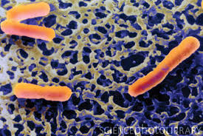
Shigella flexneri Causes Major Health Concerns in Developing Countries
The Shigella species cause bacillary dysentery and shigellosis in man.
The colon and rectum are the targets of infection.
160 million occurrences are reported annually.
Due to the lack of adequate treatment strategies, the World Health Organization has made an anti-Shigella vaccine a priority.
Figure 1. Scanning electron micrograph of S. flexneri.
Image from http://www.cdc.gov/ncezid/dfwed/PDFs/Shigella-Overview-508.pdf

Slide 4
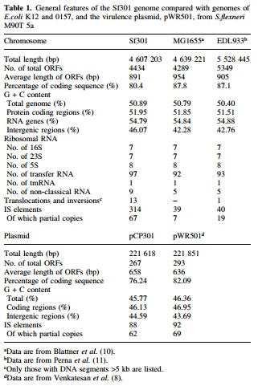
Numerical Comparison of the Chromosomes of S. flexneri and E. coli Reveal their Similarities and Differences
Notes:
One of the charts from our Genome paper that demonstrates the genome similarity between E. coli and S. flexneri.

Slide 5
Outline
Shigella flexneri, a genetic relative of E.coli, is one of the leading causes of death in developing countries.
Our project involved creating a database for this species using various tools.
A variety of methods from the course were used to identify as many missing genes from the exports as possible.
Our analysis through GenMAPP sought to compare results with what was found in microarray data by Fu et al., 2012.
Results from running microarray data through the new database validated results from the previous study.

Slide 6
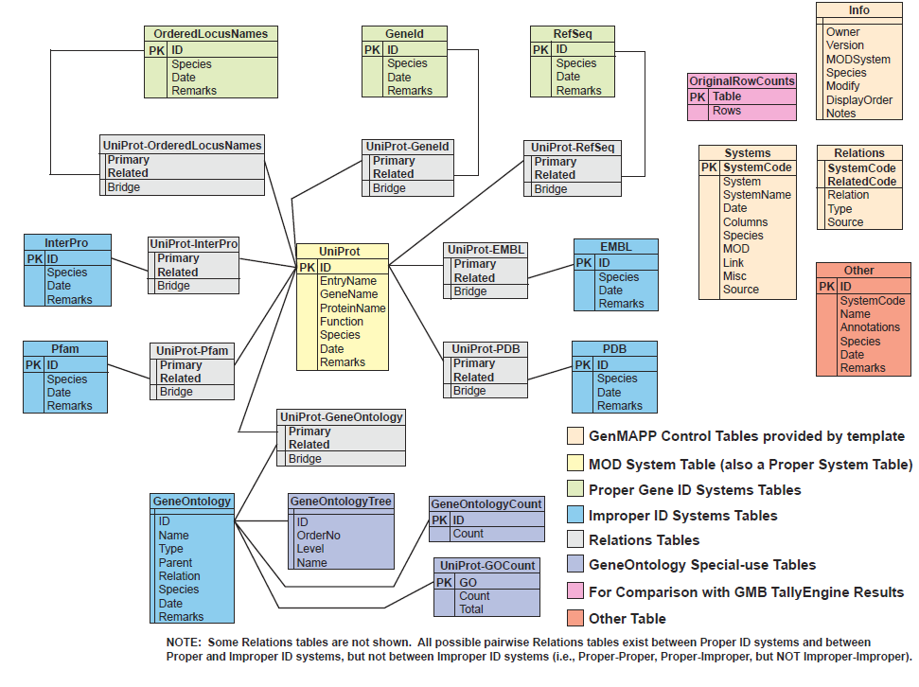
S. flexneri Relational Database Schema Gives a Tree-like Structure to the Tables in the .gdb File
Notes:
Jake

Slide 7
OrderedLocusNames Differ Slightly Between TallyEngine and XMLPipeDB Match
Match regex:
java -jar xmlpipedb-match-1.1.1/xmlpipedb-match-1.1.1.jar "(CP|SF?)[0-9][0-9][0-9][0-9](\.[0-9])?(/|</name>)" < uniprot-proteome%3AUP000001006.xml > shigella_flexneri_results.txt
 | Number of OrderedLocus IDs
XMLPipeDB Match | 7569
TallyEngine (UniProt) | 7660
TallyEngine (PostgreSQL) | 7660
OriginalRowCounts | 7661
external MOD | 5984
PGAdmin III query:
select count(value) from (select value from genenametype where type = 'ordered locus' and value ~ '(CP|SF?)[0-9][0-9][0-9][0-9](\.[0-9])?' union select extra as value from (select propertytype.value as extra from propertytype inner join dbreferencetype on propertytype.dbreferencetype_property_hjid = dbreferencetype.hjid where dbreferencetype.type = 'EnsemblBacteria' and dbreferencetype.id ~ 'AAN[0-9][0-9][0-9][0-9][0-9]' and propertytype.type = 'gene ID' and propertytype.value ~ 'SF[0-9][0-9][0-9][0-9]') as f left join (select value from genenametype where type = 'ordered locus' and value ~ '(CP|SF?)[0-9][0-9][0-9][0-9](\.[0-9])?') as g on f.extra = g.value where g.value is null) as combined;
Notes:
Trixie

Slide 8
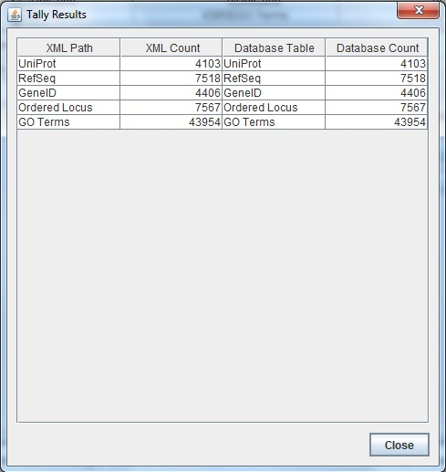
TallyEngine Provides a Table to Summarize the Counts for Important IDs
Notes:
Trixie

Slide 9
Outline
Shigella flexneri, a genetic relative of E.coli, is one of the leading causes of death in developing countries.
Our project involved creating a database for this specie using various tools.
A variety of methods from the course were used to identify as many missing genes from the exports as possible.
Our analysis through GenMAPP sought to compare results with what was found in microarray data by Fu et al., 2012.
Results from running microarray data through the new database validated results from the previous study.

Slide 10
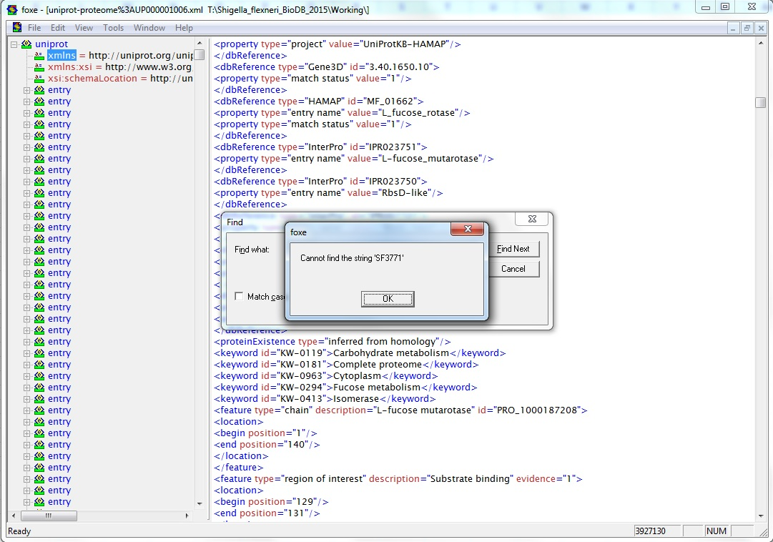
GenMAPP Users Originally Reported 416 Genes Not Found
Only ~92 new IDs were found on the XML file using the Excel method described in the QA protocol.
A combination of SF#### and S#### were not found in the XML file and so were not exported.
The ~92 genes were observed to be within the <dbReference/> tag with the ID “EnsemblBacteria”.
Notes:
Trixie

Slide 11
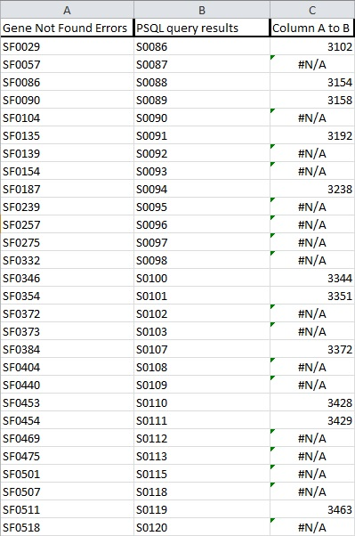

Excel was Used to Identify 92 Missing IDs from the Export
Notes:
Trixie

Slide 12
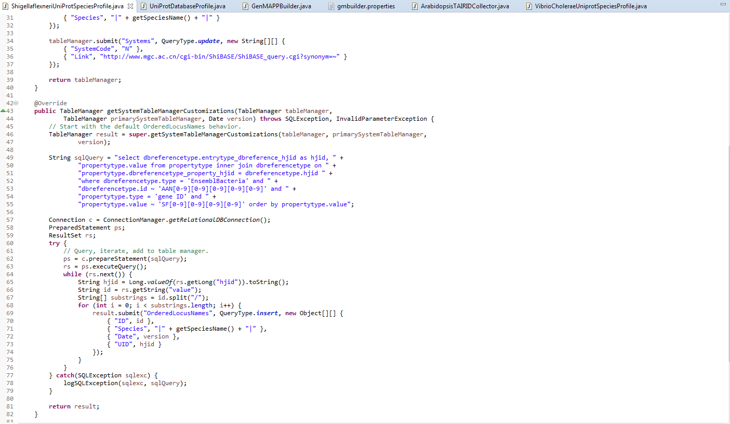
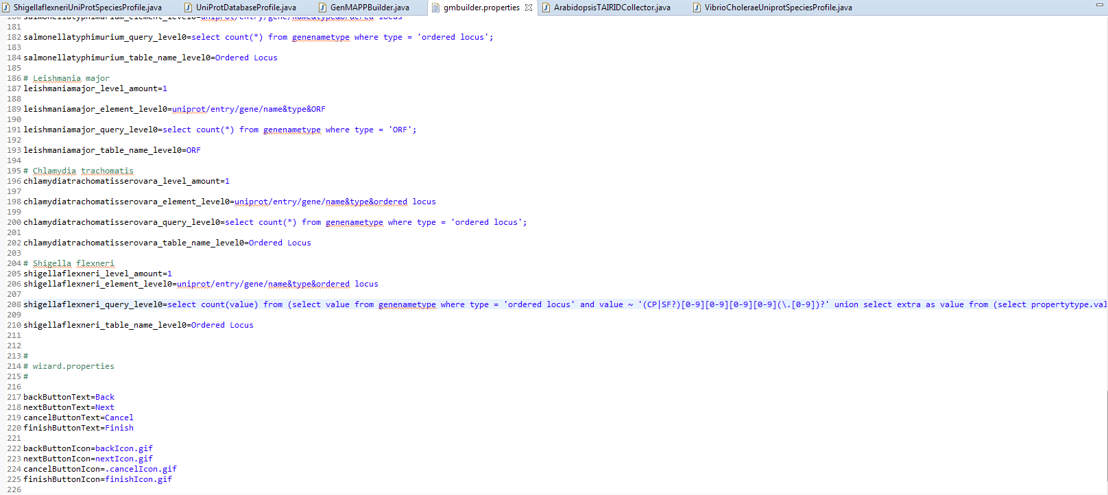
Changes Were Made in GenMAPPBuilder to Capture Legal IDs
GenMAPPBuilder
TallyEngine
Notes:
Jake

Slide 13
Outline
Shigella flexneri, a genetic relative of E.coli, is one of the leading causes of death in developing countries.
Our project involved creating a database for this specie using various tools.
A variety of methods from the course were used to identify as many missing genes from the exports as possible.
Our analysis through GenMAPP sought to compare results with what was found in microarray data by Fu et al., 2012.
Results from running microarray data through the new database validated results from the previous study.

Slide 14
Rifamycin Antibiotic Is Often Used to treat Shigella
4 known species of Shigella
  Intracellular pathogen
  Genes required to invade and spread inside cell are encoded by a virulence plasmid (VP).
Infection can be controlled by rifamycin antibiotic.
  Pros to rifamycin: low absorption, low toxicity, low interaction
  2 compounds were used: rifampin (RP) and rifaximin (RX)
  Drug binds to β-subunit of RNA polymerase and inhibit synthesis.

Slide 15
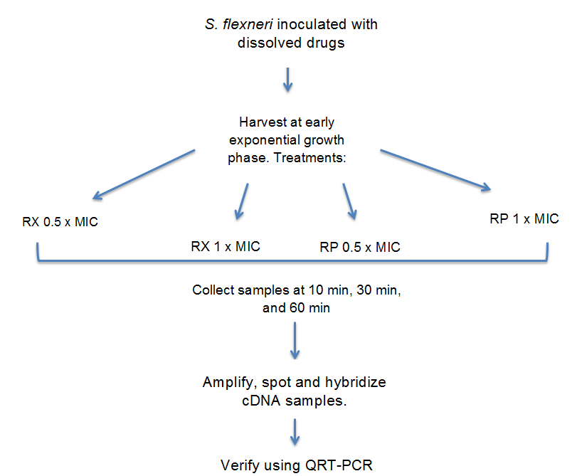
Experimental Method Yielded 72 Total Samples

Slide 16
Analysis Sought to Compare Results With a 2012 Study by Fu et al.
2012 study by Fu et al. showed:
  Virulence genes were commonly up-regulated.
  Normal cell growth and metabolism genes were commonly down-regulated.
Data showed drugs rapidly cease RNA synthesis leading to rapid inhibition of translation parts.
Notes:
42% of shared induced genes were encoded by the virulence plasmid.

Slide 17
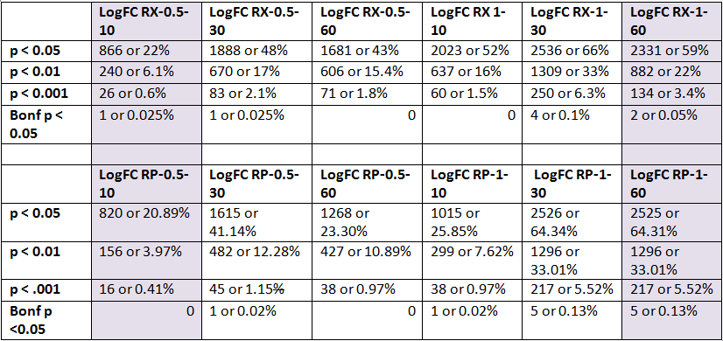
Two Treatments Were Chosen for GenMAPP Based on Sanity Check Results
Table 1. Comparing % genes significantly changed at different p values.

Slide 18
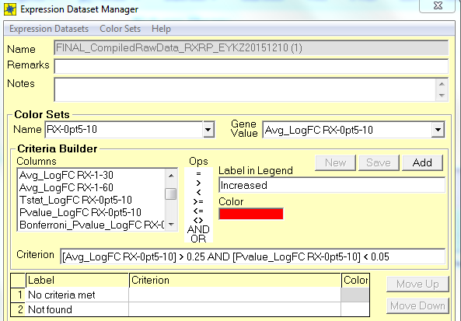
Two Criteria Were Created to Make Color Sets in GenMAPP
Criteria
Increased [Avg_LogFC] > 0.25 and [P value] < 0.05
Decreased [Avg_LogFC] < -0.25 and [P value] < 0.05
Figure #. Example color set corresponding to RX-0pt5-10 data.

Slide 19
Outline
Shigella flexneri, a genetic relative of E.coli, is one of the leading causes of death in developing countries.
Our project involved creating a database for this specie using various tools.
A variety of methods from the course were used to identify as many missing genes from the exports as possible.
Our analysis through GenMAPP sought to compare results with what was found in microarray data by Fu et al., 2012.
Results from running microarray data through the new database validated results from the previous study.

Slide 20
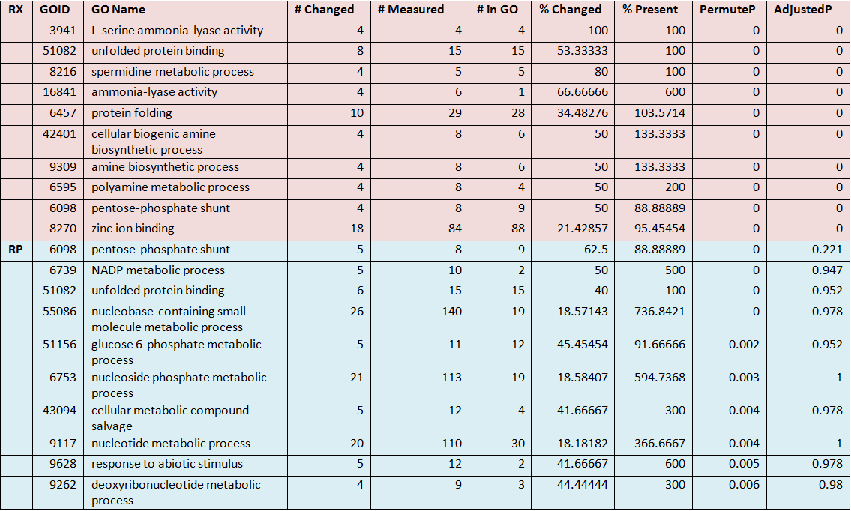
RX and RP 0.5-10 Shows Metabolic Processes Increased

Slide 21
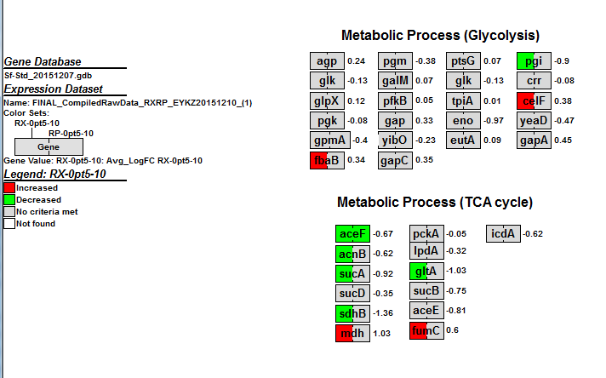
A Gene MAPP Was Created for RX and RP 0.5-10

Slide 22
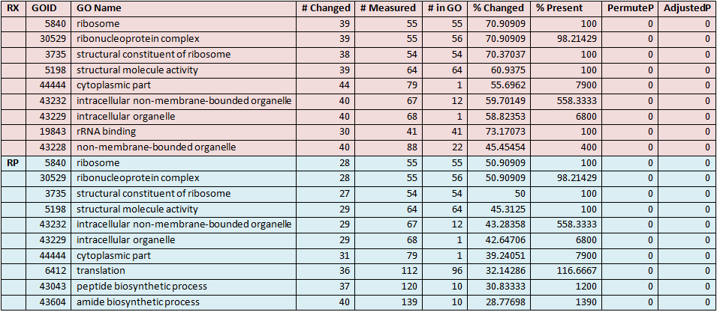
RX and RP 0.5-10 Shows Ribosomal Activity Decreased

Slide 23
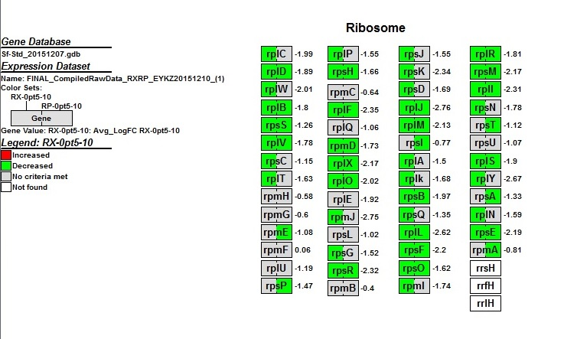
A Gene MAPP Was Created for RX and RP 0.5-10

Slide 24
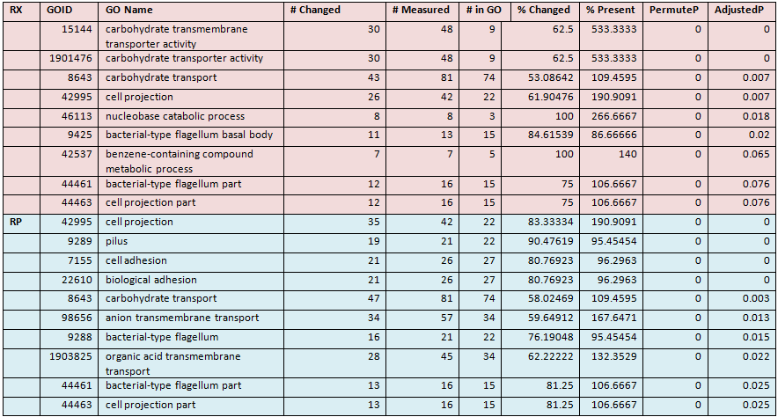
RX and RP-1-60 Shows Flagella Production Increased

Slide 25
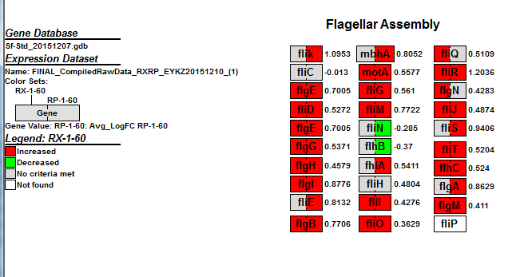
A Gene MAPP Was Created for RX and RP-1-60

Slide 26
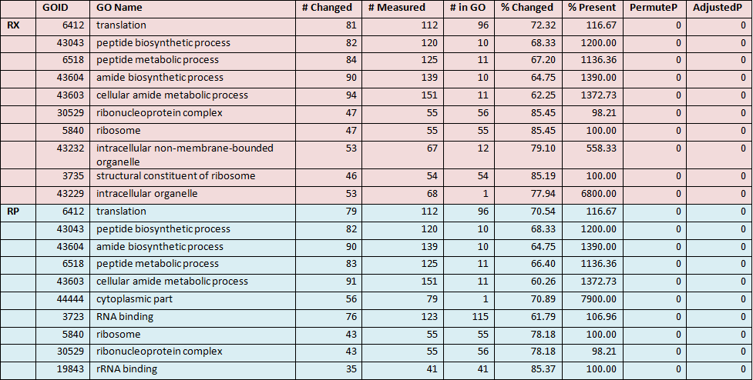
RX and RP-1-60 Shows Metabolic Activity Decreased

Slide 27
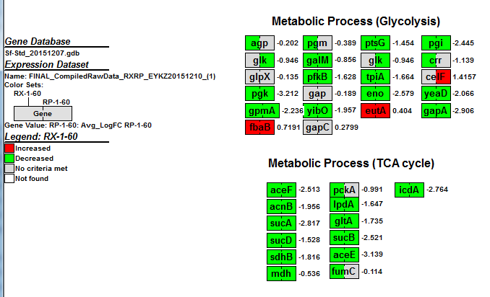
A Gene MAPP Was Created for RX and RP-1-60

Slide 28
Overall, Our Analysis Was Consistent With The
Previous Study
RX and RP showed similar effects at both time points and both concentrations.
  At 0.5 x MIC at 10 minutes, metabolic processes increased for RX while ribosomal activity substantially decreased.
  At 1 x MIC at 60 minutes, flagellar production increased and metabolic activity decreased.
Results were consistent overall with the study.

Slide 29
Acknowledgments
We would like to acknowledge Dr. Dahlquist and Dondi for their advice and support on this project.
We would also like to thank the Fall 2015 Biological Databases class for listening!

Slide 30
References
Fu H, Liu L, Zhang X, Zhu Y, Zhao L, Peng J, et al. (2012) Common Changes in Global Gene Expression Induced by RNA Polymerase Inhibitors in shigella flexneri. PLoS ONE 7(3): e33240. doi:10.1371/journal.pone.0033240
Jin, Q., Yuan, Z., Xu, J., Wang, Y., Shen, Y., Lu, W., … Yu, J. (2002). Genome sequence of Shigella flexneri 2a: insights into pathogenicity through comparison with genomes of Escherichia coli K12 and O157. Nucleic Acids Research, 30(20), 4432–4441.
S. flexneri image from: http://www.cdc.gov/ncezid/dfwed/PDFs/Shigella-Overview-508.pdf.

