Slide 1
Snapshot of iron response in Shewanella oneidensis by gene network reconstruction
Emily Simso and Ronald Legaspi
Departments of Biology and Computer Science
Loyola Marymount University
November 17, 2015
Notes:
Ron and Emily
Introduce ourselves.
We’ll be talking about the Microarray Paper that covers our bacteria Shewanella oneidensis.
Snapshot of iron response in Shewanella oneidensis by gene network reconstruction.

Slide 2
Overview
Defining necessary vocabulary
The significance of Shewanella oneidensis as a model organism
Experimental design for the study
Studying iron depletion in an anaerobic state
Analyzing results through figures and tables
Discussion and significance of results, contextualized with other organisms
Notes:
Ron
The overview of what we are going to cover in our presentation.
Firstly we will talk about some key vocabulary that will help with understanding our paper. The significance of our particular bacterial species. The experimental design, essentially what the researchers did to S. oneidensis samples. We will be analyzing the methods/results of the experiment by going over the figures and tables throughout the paper. Finally we will go over the discussion and the significance of the results.

Slide 3
Overview
Defining necessary vocabulary
The significance of Shewanella oneidensis as a model organism
Experimental design for the study
Studying iron depletion in an anaerobic state
Analyzing results through figures and tables
Discussion and significance of results, contextualized with other organisms
Notes:
To start off, let’s define some vocabulary.

Slide 4
Defining necessary vocabulary
Iron chelator
Induced
Repressed
Repletion
Depletion
Up-regulated
Down-regulated
Aerobic
Anaerobic
Notes:
Iron chelator: ions or molecules that bond to iron (or other metals) - Iron chelators were used to rapidly sequester intra- and extra-cellular iron
Induced: to bring about - genes were induced responding to iron depletion
Repressed: to inhibit - genes were repressed responding to iron repletion
Repletion: filled, increased (ferrous sulfate)
Depletion: decreased (Iron chelator)
Up regulated: increased in expression
Down regulated: decrease in expression
Aerobic: having or requiring free oxygen
Anaerobic: not needing free oxygen

Slide 5
Overview
Defining necessary vocabulary
The significance of Shewanella oneidensis as a model organism
Experimental design for the study
Studying iron depletion in an anaerobic state
Analyzing results through figures and tables
Discussion and significance of results, contextualized with other organisms

Slide 6
The significance of Shewanella oneidensis as a model organism
S. oneidensis is a pathogen to both fish and humans
Iron-regulated metabolisms are often needed for virulent organisms
  Vibrio cholerae
  Bacillus cereus
Could be used to remediate U.S. Department of Energy’s uranium-contaminated sites due to grouping of transcriptional regulators
Notes:
S. oneidensis has been shown to be a fish pathogen as well as an opportunistic human pathogen [19,20]. Iron-regulated metabolisms are essential for the virulence of Vibrio cholerae [21], Bacillus cereus [22], Neisseria menin- gitidis [23] and Shigella species [24]. It is possible that iron may play a similar role in S. oneidensis as it does in other pathogenic γ-proteobacteria (e.g. Vibrio and Shigella)
More research can be done on the transcriptional regulators in anaerobic energy metabolism.

Slide 7
Overview
Defining necessary vocabulary
The significance of Shewanella oneidensis as a model organism
Experimental design for the study
Studying iron depletion in an anaerobic state
Analyzing results through figures and tables
Discussion and significance of results, contextualized with other organisms
Notes:
Emily

Slide 8
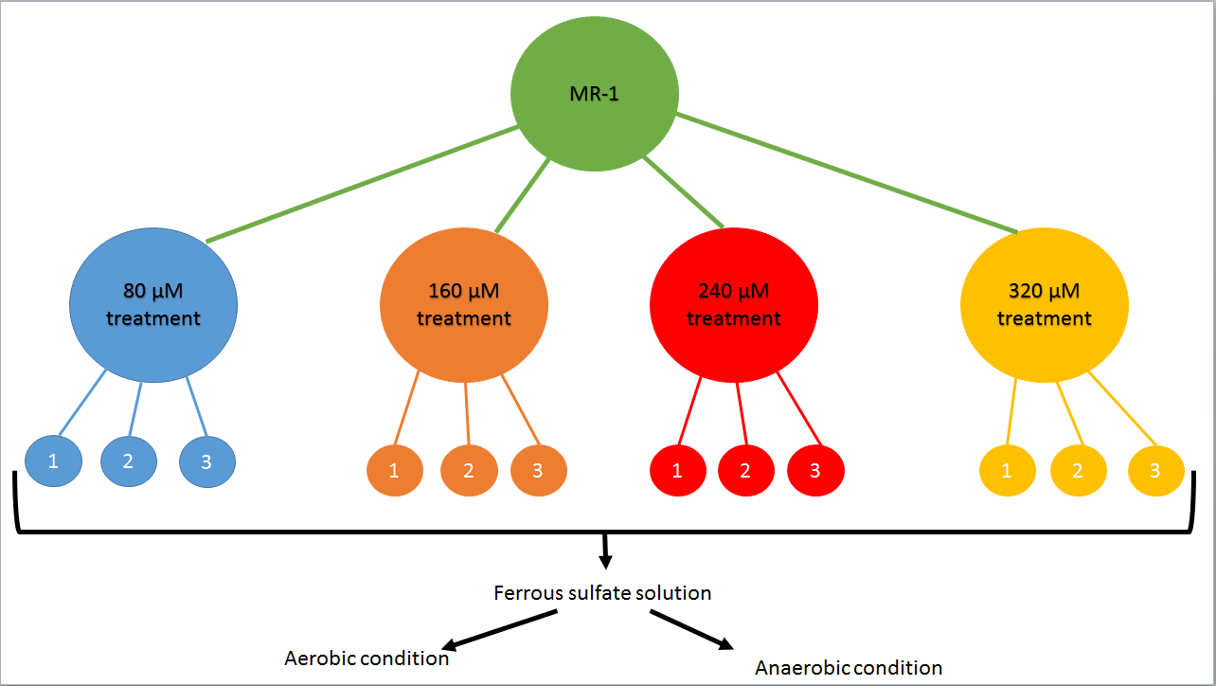
Experimental design for the study
Notes:
Emily
wild-type S. oneidensis MR-1
4 biological replicates of each condition
Testing the aerobic versus anaerobic states of the organism - wanted to use anaerobic pathway for the rest of the study because S. oneidensis used an anaerobic metabolism pathway
Aerobic culturing: LB medium at 30 C
Anaerobic culturing: 10mM lactate as electron donor and an electron acceptor
First used 2,2’-dipyridyl to deplete the iron
Used ferrous sulfate the replete the iron levels
Could also then see which concentration could be used for the rest of the experiment

Slide 9
Overview
Defining necessary vocabulary
The significance of Shewanella oneidensis as a model organism
Experimental design for the study
Studying iron depletion in an anaerobic state
Analyzing results through figures and tables
Discussion and significance of results, contextualized with other organisms
Notes:
Emily

Slide 10
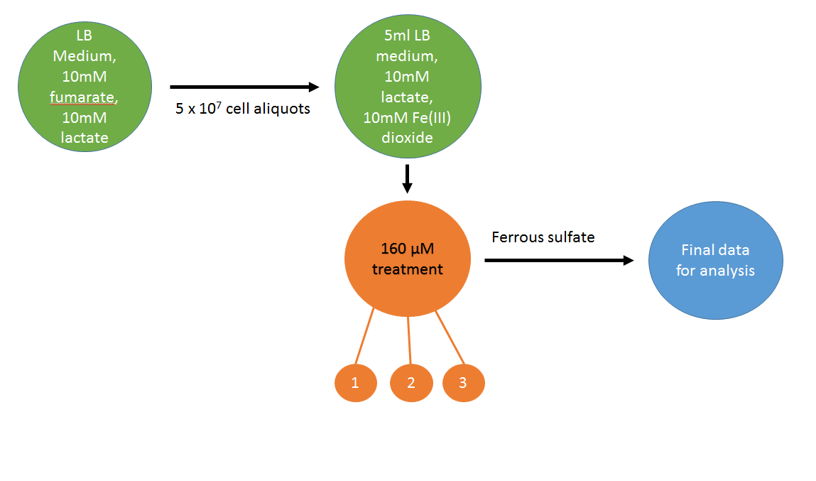
Studying iron depletion in an anaerobic state
Notes:
Emily
This will be used for the microarray data
Looked at iron depletion in the anaerobic state
Anaerobic culturing: 10ml LB medium with 10mM fumarate and 10mM lactate, spun and washed with LB medium and then divided - transferred to 5mL LB medium with 10mM lactate and 10mM Fe(III) dioxide
Had a control of uninoculated medium containing 10mM Fe(III)
Used 160 M concentration (had best results from previous trial)

Slide 11
Overview
Defining necessary vocabulary
The significance of Shewanella oneidensis as a model organism
Experimental design for the study
Studying iron depletion in an anaerobic state
Analyzing results through figures and tables
Discussion and significance of results, contextualized with other organisms
Notes:
Ron
Now we’ll be going over the multitude of figures and tables that described the methods and results of the experiment and enlightened us on what the writers were actually studying.

Slide 12
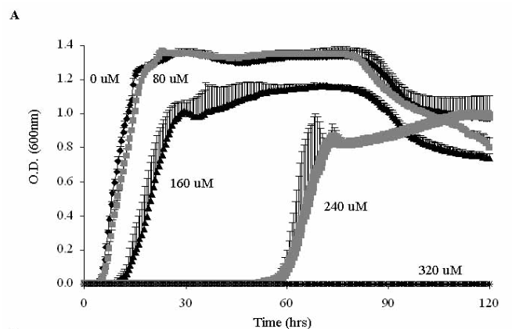
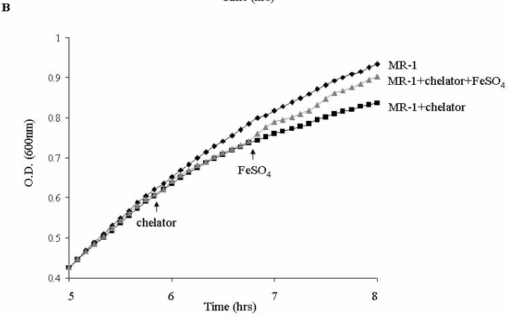
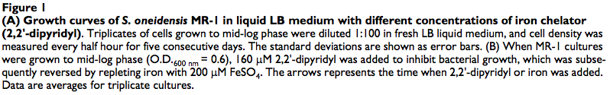
￼
Notes:
Ron
One of the first figures we will be discussing is a graphical interpretation of the growth rate under the treatments of the iron chelator. Figure 1A (on the left) represent the growth rate of Shewanella oneidensis under the 4 treatments, which are distinguishable by the concentration of iron chelator. The control is untreated and resembles the growth of Shewanella under the 80 microMolar treatment of iron chelator. 320 microMolar treatment completely stopped growth of Shewanella oneidensis.
1A) Showing the four treatments (80, 160, 240, and 320) and the control (0). Used 2,2’-dipyridyl to deplete iron levels in the environment - challenge to cell proliferation and survival. Extended lag phase, slower growth rate at mid-log phase, and lower cell density at stationary phase. Clear inhibition at 160, 240, and 320 (cell growth completely stopped in last condition)
1B) Control (MR-1), MR-1+chelator+FeSO4 (growth was slowed and then recovered), MR-1+chelator (slower growth). Used 160 concentration. Meant to test whether iron depletion led to rapid physiological change.

Slide 13
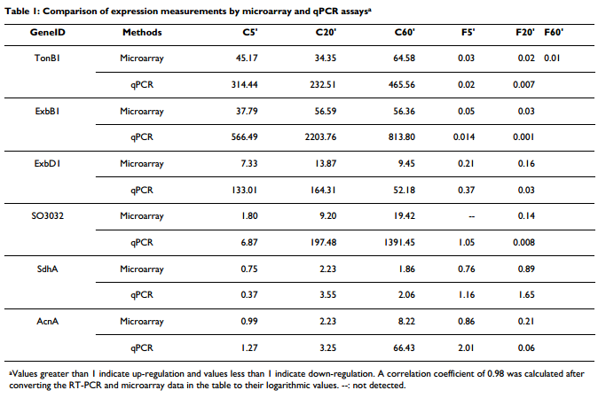
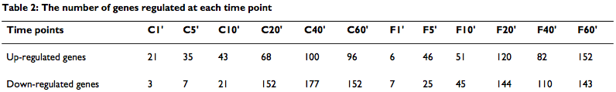
Notes:
Emily
Table 1: used for microarray experiments, MR-1 cultures at mid-log phase were treated with 160 uM 2,2’-dipyridyl, iron was repleted after 1 hour with ferrous sulfate. Samples were collected at multiple time points. RT-PCR used to validate microarray data. Values greater than one are up regulation and lower than one are down regulation.
Table 2: significant differential gene expression at the time points. Iron response is very rapid (21 genes up regulated at first time point). Able to use this data that more genes are involved in iron stimulon and regulon than previously deduced.

Slide 14
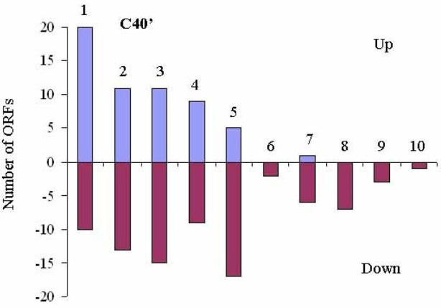
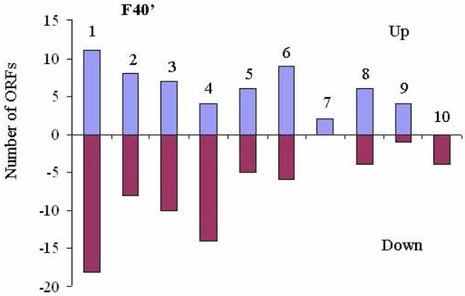

Notes:
Ron
Predominant groups: transport and binding proteins (for iron acquisition systems), regulatory functions, energy metabolism, adaptation to atypical conditions, biosynthesis of cofactors or proteins.

Slide 15
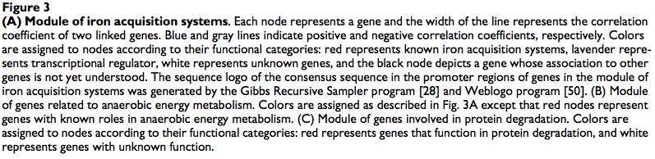
Three major modules in gene co-expression network
Notes:
Emily
Table shows relevant genes and how they were up or down regulated either during the depletion or repletion phase
Motifs show how genes are connected to each other - colors refer to function

Slide 16
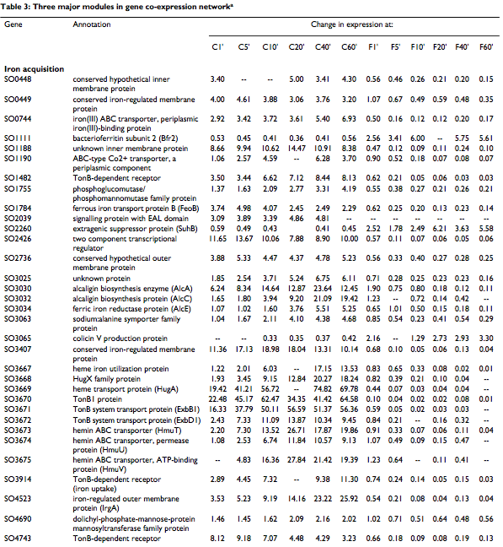
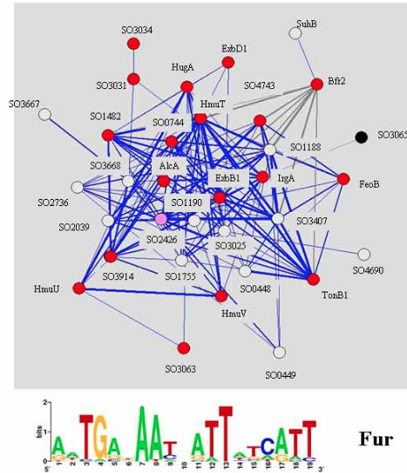
Notes:
Emily
3A) Almost all iron acquisition systems, these genes are highly co-regulated under iron depletion and repletion conditions. Fur (Ferric Uptake Regulator) is a global transcription factor that maintains iron homeostasis. A “Fur box” is present on genes that involve iron levels, such as the genes in this table.

Slide 17
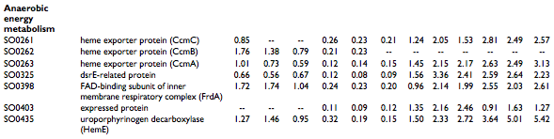
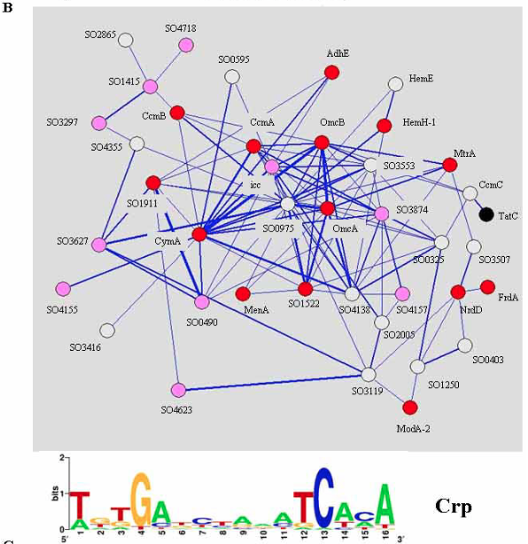
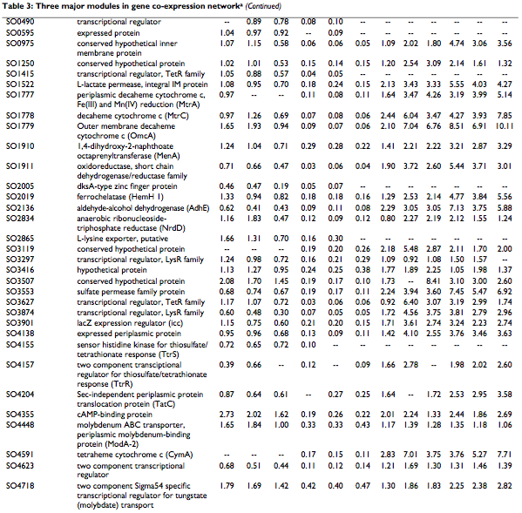
Notes:
Emily
3B) Genes are expressed by iron depletion and induced by repletion, contribute to anaerobic energy metabolism. Also had 10 transcriptional factors clustered around their functional genes - they function to regulate the process. A Crp global transcription factor helps monitor these genes. Found a conserved CRP-binding site at the promoter of the genes in this module through a sequence search of the DNA. This suggests that inactivation of Crp could lead to repression of multiple branches of anaerobic energy metabolism pathways - leads to deficiency in reducing electron acceptors.

Slide 18
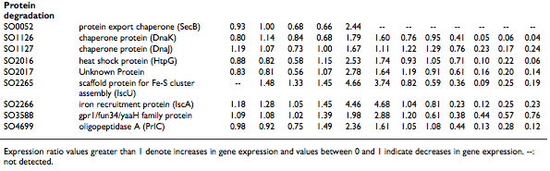
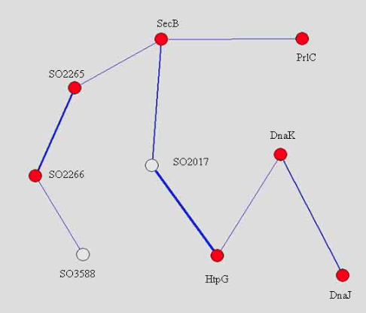
Notes:
Emily
3C) Protein degradation - induced by iron depletion and repressed by iron repletion. Include heat shock proteins.

Slide 19
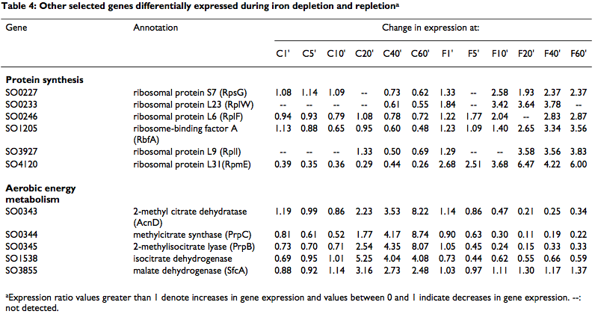
Notes:
Ron
Genes encoding ribosomal proteins induced by iron repletion - correlates with rapid resumption of bacterial growth after iron addition
Genes related to aerobic energy metabolism induced by iron depletion and repressed with iron repletion - energy required for coping with iron depletion is greater than that required for normal growth

Slide 20
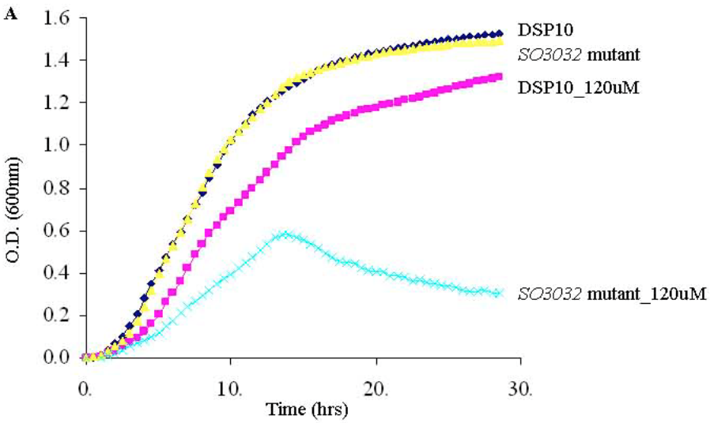
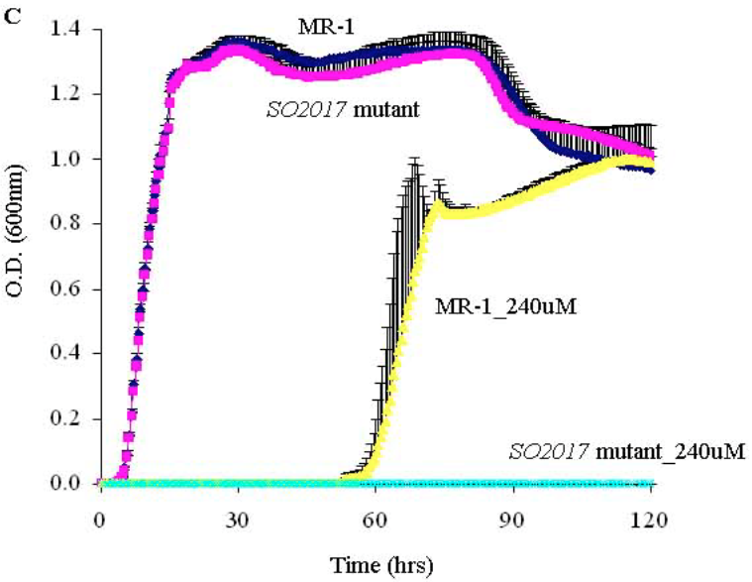
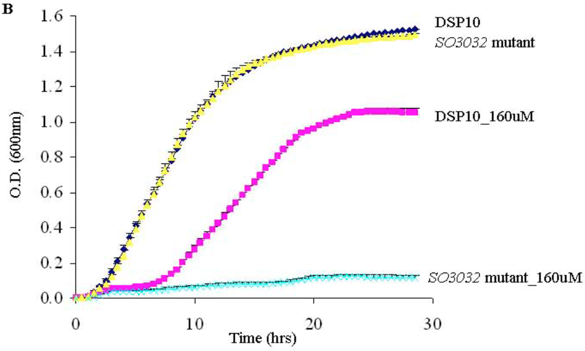
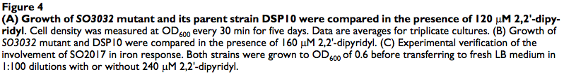
Notes:
Ron
Looked at SO3032 to test the importance of iron acquisition genes under iron depleted conditions (DSP10 is parent strand). SO3032 was unable to grow in the presence of 120 uM iron chelator (A) and had only some growth under 160 uM conditions - less than A (B) - need SO3032 for survival of iron starvation
Graph C shows gene encoding a protein - SO2017 (located in the same operon as the heat shock protein). Mutant strand cannot grow in the presence of 2,2’-dipyridyl - lack of SO2017 prohibited the cell’s ability to survive iron depletion

Slide 21
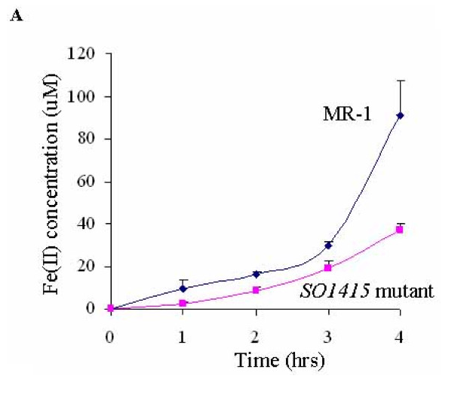
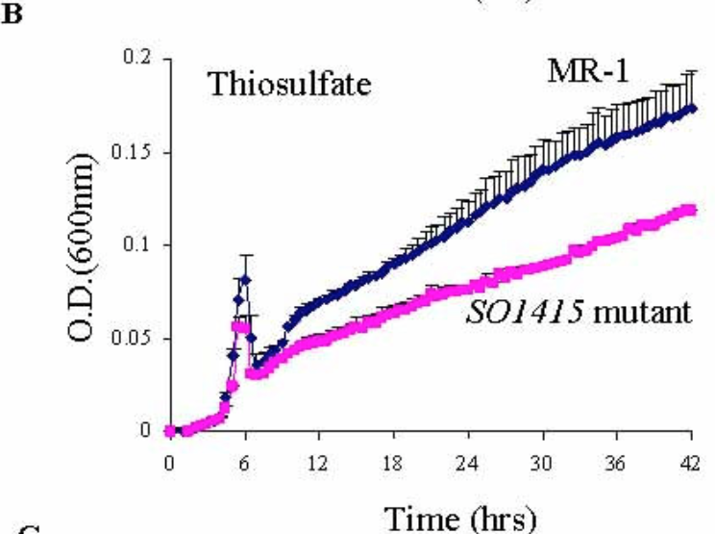
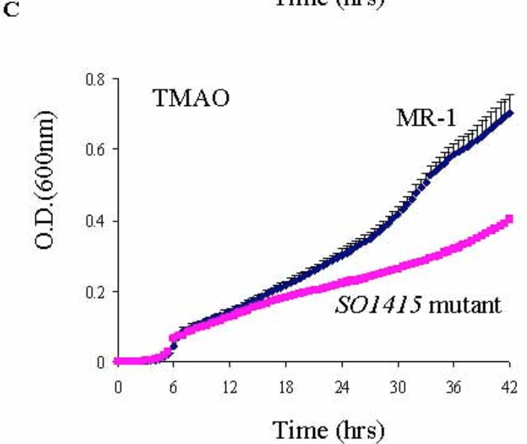
Notes:
Ron
A) Disruption of SO1415 impared anaerobic Fe(III) reduction - produced less than half the amount of Fe(II)
B and C) SO1415 is involved in regulating specific branches of anaerobic energy metabolism - used 10 mM lactate as the electron donor and a non-metal electron acceptor (5 options). Both show significant growth deficiency.

Slide 22
Overview
Defining necessary vocabulary
The significance of Shewanella oneidensis as a model organism
Experimental design for the study
Studying iron depletion in an anaerobic state
Analyzing results through figures and tables
Discussion and significance of results, contextualized with other organisms
Notes:
Emily

Slide 23
Discussion and significance of results, contextualized with other organisms
Anaerobic energy metabolism model
New role of Crp
Lack of oxidative stress
Fur-independent results
Rapid uptake of iron in S. oneidensis
Notes:
Emily
Gradually limiting oxygen induces an anaerobic response but S. oneidensis continues to grow and cell density increases during iron depletion (this should limit concentration of oxygen and up-regulate expression of genes as anaerobic response). So, an anaerobic energy model may function as iron-storage proteins to release previously stored iron in proteins during iron depletion to increase overall levels
In E.coli - Crp influences different biological processes and responds to glucose levels as global transcription factor but in S. oneidensis, Crp is part of anaerobic energy metabolism
Should have seen protein degradation - concentration of iron may not have been high enough
In other organisms, Fur-independence has been studied, but in S. oneidensis, it is implied that transcriptional factors other than Fur are needed for iron response
Based upon response times of the organism to depletion/repletion

Slide 24
References
Biology Online. N.p., 27 May 2009. Web. 15 Nov. 2015. <www.biology-online.org/dictionary>.
Yang, Y., Harris, D. P., Luo, F., Xiong, W., Joachimiak, M., Wu, L., … Zhou, J. (2009). Snapshot of iron response in Shewanella oneidensis by gene network reconstruction. BMC Genomics, 10, 131. http://doi.org/10.1186/1471-2164-10-131

Slide 25
Questions?

