Slide 1
xmlpipedb updates and v. cholera export
Nicole Anguiano
11/28/16
BIOL 367T
BIOL 367T: Semester Overview

Slide 2
Outline
XMLPipeDB allows for the building of relational databases from an XML schema.
XMLPipeDB and GODBPostProcessor were utilized to update GMBuilder to allow for a new export.
A new export of V. cholerae was performed and vetted for confidence.
Following the export, changes were made to the XMLPipeDB website.

Slide 3
Outline
XMLPipeDB allows for the building of relational databases from an XML schema.
XMLPipeDB and GODBPostProcessor were utilized to update GMBuilder to allow for a new export.
A new export of V. cholerae was performed and vetted for confidence.
Following the export, changes were made to the XMLPipeDB website and documentation.

Slide 4
XMLPipeDB provides a series of tools for manipulating XML data.
XSD2DB: Converts an XML Schema Definition (XSD) or Document Type Definition (DTD) to an SQL file.
GODBPostProcessor: Edits the output of XSD2DB for use with GMBuilder.
Match Utility: Used to vet exported Gene Databases before they are used in GenMAPP.
XMLPipeDB Utilities: A set of tools for manipulating databases using hibernate.

Slide 5
Outline
XMLPipeDB allows for the building of relational databases from an XML schema.
XMLPipeDB and GODBPostProcessor were utilized to update GMBuilder to allow for a new export.
A new export of V. cholerae was performed and vetted for confidence.
Following the export, changes were made to the XMLPipeDB website.

Slide 6
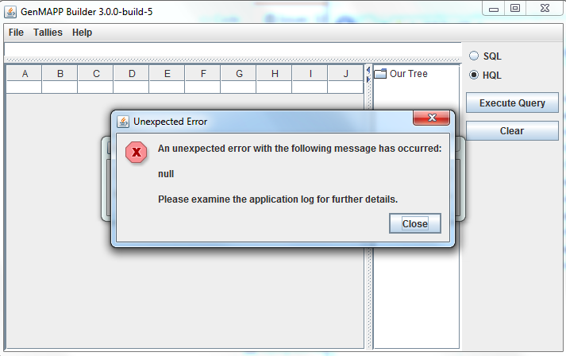
An unexpected error occurred upon attempting export.

Slide 7
GMBuilder needed to be updated to allow for a new export of V. cholerae.
GMBuilder failed to process the GO OBO-XML files due to a change in the schema.
  It contained a single new term: “holds_over_chain”.
To update GMBuilder to allow for the new term, xsd2db would need to be run on the new dtd schema for the OBO-XML file.
GO is no longer linking to their dtd schema.
  As a result, edits would need to be performed manually on an old copy of the schema.

Slide 8
XSD2DB and GODBPostProcessor allowed for updates to the dtd schema.
An existing copy of the DTD contained on github was edited to add the new element.
XSD2DB was run on the new schema, and outputted a series of files that needed further processing by GODBPostProcessor.
Following processing, a jar file could be built from the output of XSD2DB.
  The jar replaced godb.jar in GMBuilder, and a .sql file produced by GODBPostProcessor replaced godb.sql.
Documentation on this process was written and posted on the wiki.

Slide 9
Outline
XMLPipeDB allows for the building of relational databases from an XML schema.
XMLPipeDB and GODBPostProcessor were utilized to update GMBuilder to allow for a new export.
A new export of V. cholerae was performed and vetted for confidence.
Following the export, changes were made to the XMLPipeDB website.

Slide 10
OrderedLocusName IDs
Type | Number of IDs
XMLPipeDB match | 3832
TallyEngine (UniProtXML) | 3830
TallyEngine (Database) | 3830
OriginalRowCounts Table in GDB | 3832
Match Command:
java –jar xmlpipedb-match-1.1.1.jar “VC_A?[0-9][0-9][0-9][0-9](.1|)” < uniprot-organism%3A243277.xml
SQL Query:
select count(*) from genenametype where type = ‘ordered locus’ and value ~ ‘VC_A?[0-9][0-9][0-9][0-9]’;
Notes:
Two less because:
VC_1738/VC1739
VC_A0015/VC_A0016

Slide 11
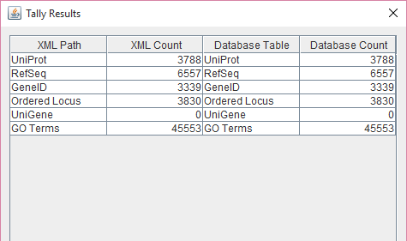
TallyBuilder shows 3,830 Ordered Locus Names.

Slide 12
The discrepancy between the number of IDs is due to formatting in postgres.
In the Postgres database, two cells contain two gene IDs each:
  VC_1738/VC_1739
  VC_A0015/VC_A0016
Accounting for those cells returns the same number of OrderedLocusName IDs as returned from match and the GDB: 3832.
The SQL command accounts for the one value that contains a “.1”.

Slide 13
Outline
XMLPipeDB allows for the building of relational databases from an XML schema.
XMLPipeDB and GODBPostProcessor were utilized to update GMBuilder to allow for a new export.
A new export of V. cholerae was performed and vetted for confidence.
Following the export, changes were made to the XMLPipeDB website.

Slide 14
The XMLPipeDB website was converted to Jekyll.
The XMLPipeDB website was initially using Ant and Maven.
The content of the site was ported over to Jekyll.
  Also fixed out of date links.
The site is now being hosted on github:
  http://lmu-bioinformatics.github.io/xmlpipedb/
A redirect from the current webpage to the github site is planned.

Slide 15
The SchemaSpy representation of GMBuilder was updated.
SchemaSpy generates a visual representation of a database schema, outputted in html.
  Also detects any anomalies that may be present.
SchemaSpy was run on the newly updated GO OBO-XML and GMBuilder databases, and the content was placed on the website.
Documentation was also written for SchemaSpy, to allow for ease of use the next time it is run.

Slide 16
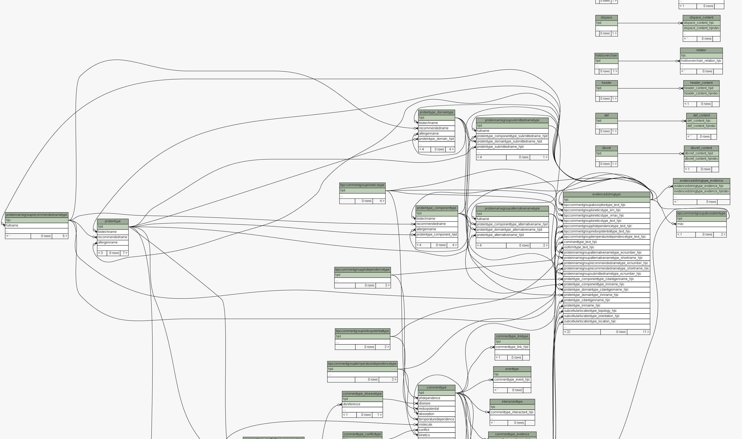

Slide 17
Summary
XMLPipeDB provides a series of tools that allow a building of relational databases from an XML schema.
XMLPipeDB and GODBPostProcessor were used to add in the new element that was preventing GMBuilder from processing the Gene Ontology OBO-XML files.
A new export of V. cholerae was performed and vetted.
The XMLPipeDB website was converted to Jekyll and migrated to a github domain.
The documentation was updated for SchemaSpy and GMBuilder to allow for easier updating in the future.

Slide 18
Acknowledgements
Dr. Kam D. Dahlquist
Dr. John David N. Dionisio
LMU
All of you!

Slide 19
References
XMLPipeDB Github: https://github.com/lmu-bioinformatics/xmlpipedb
SchemaSpy: http://schemaspy.sourceforge.net/
BIOL 367 Wiki: https://xmlpipedb.cs.lmu.edu/biodb/fall2015/index.php/Main_Page

Slide 20
Any Questions?

