Slide 1
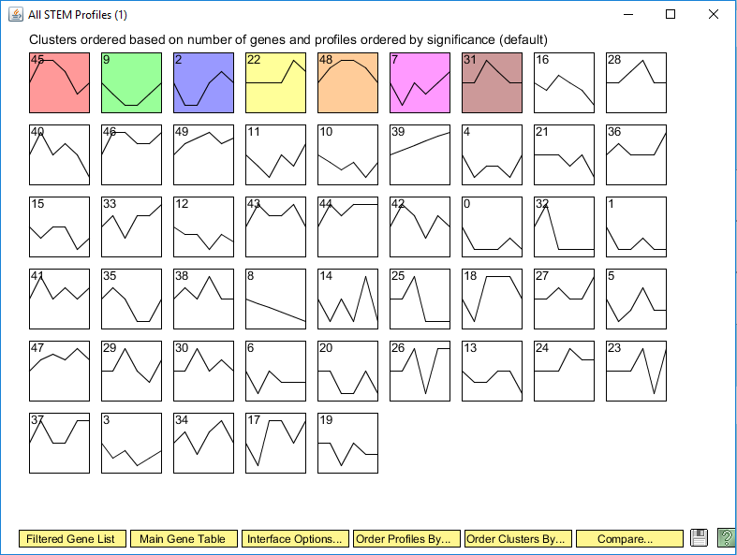
All Stem Profiles

Slide 2
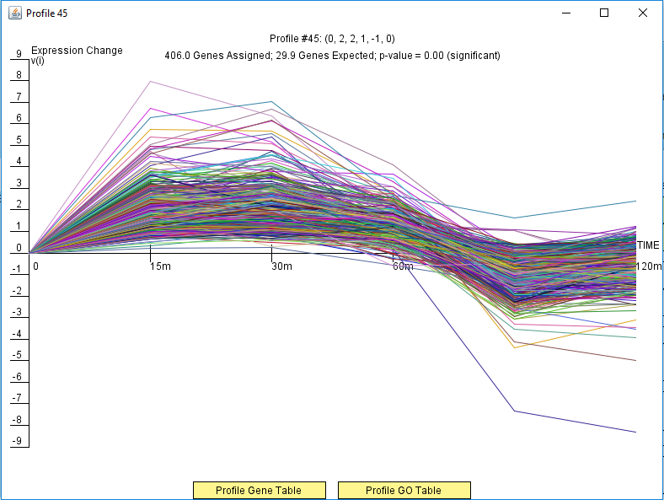
Profile #45 from STEM

Slide 3
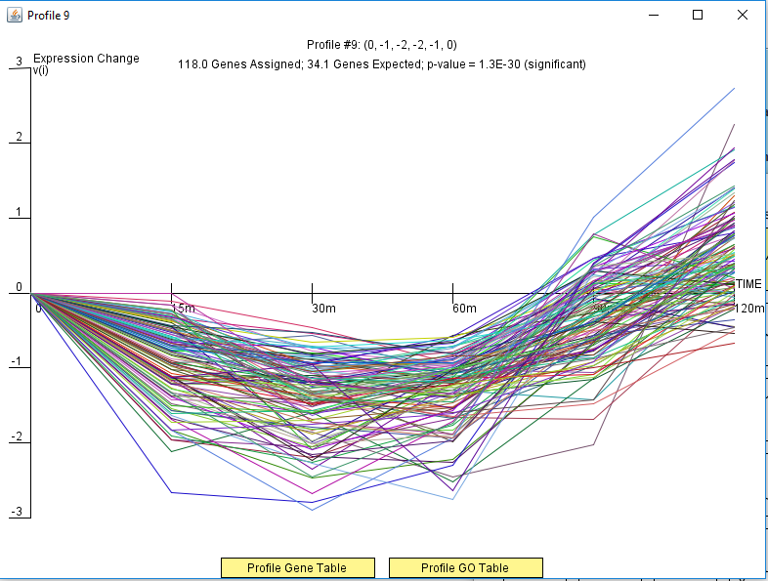
Profile #9 from STEM

Slide 4
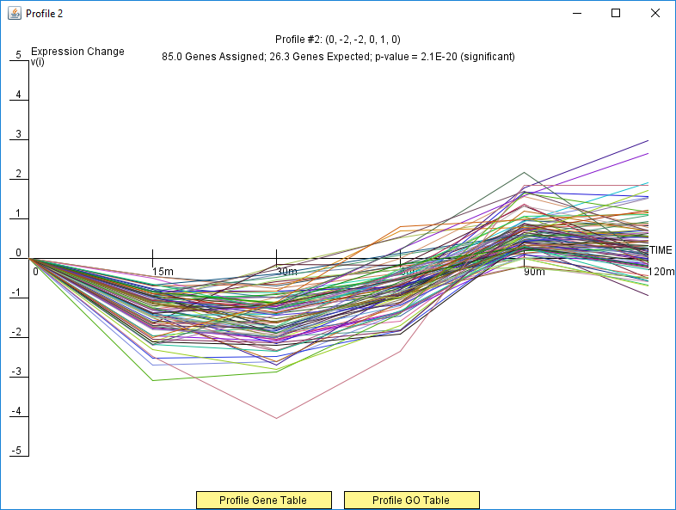
Profile #2 from STEM

Slide 5
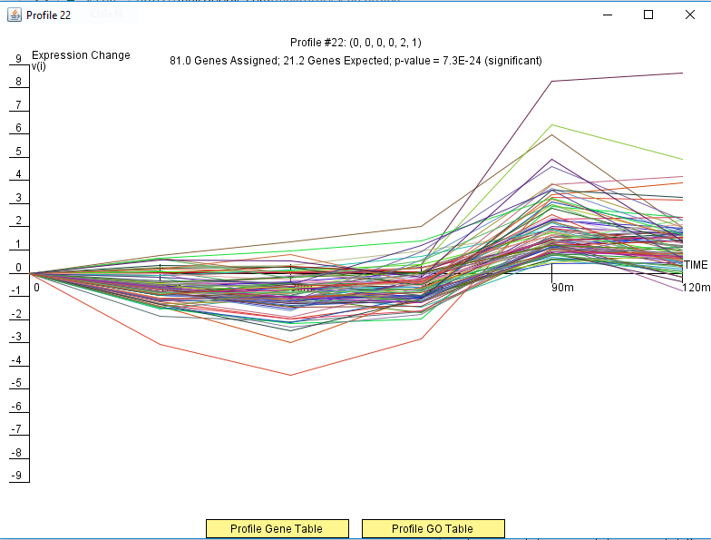
Profile #22 from STEM

Slide 6
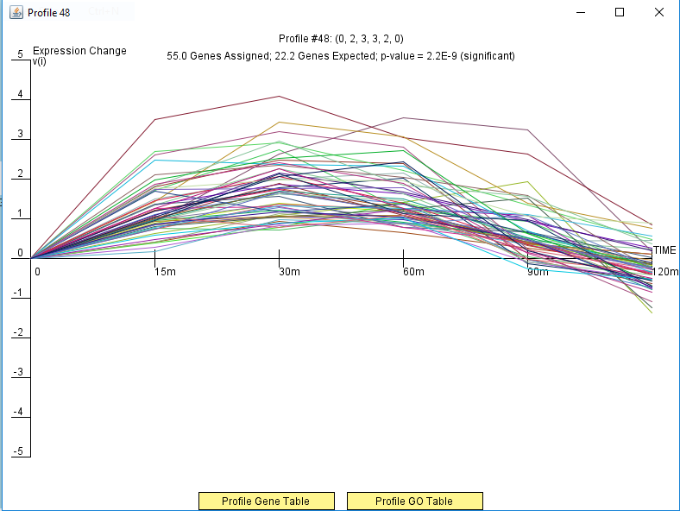
Profile #48 from STEM

Slide 7
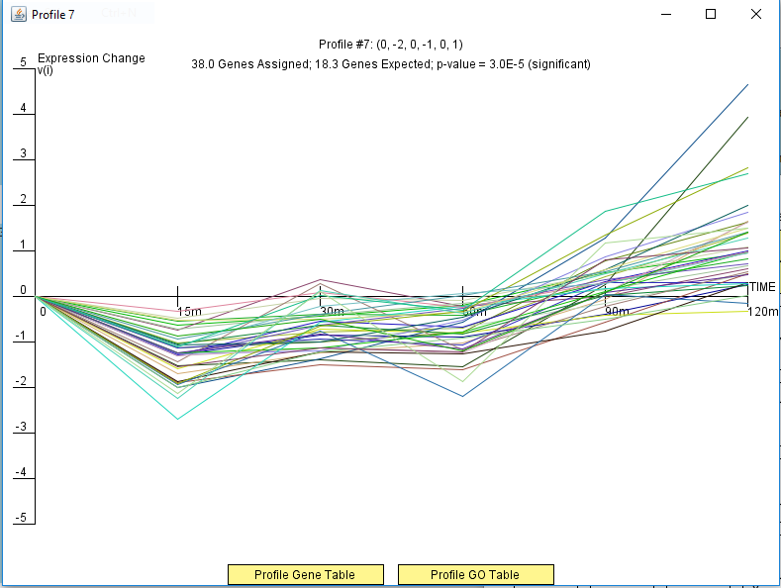
Profile #7 from STEM

Slide 8
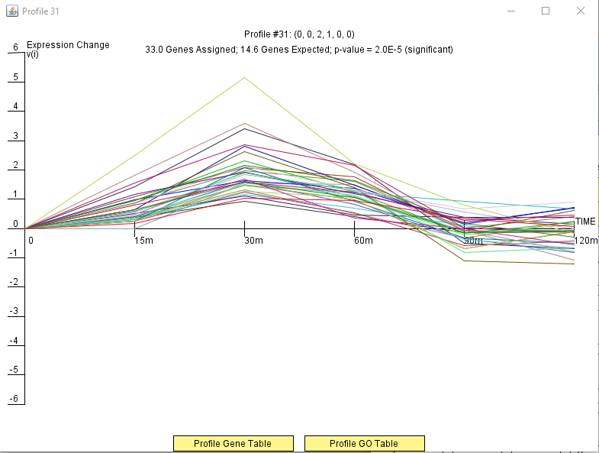
Profile #31 from STEM

Slide 9
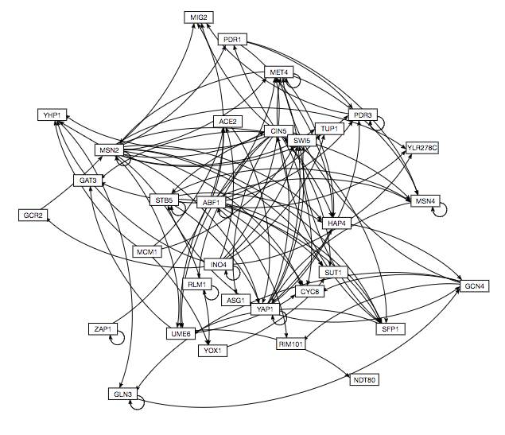
Transcription Factors Regulatory Network from GRNsite

