Slide 1
Percentage of total genes satisfying different p value requirements for wild type microarray data

Slide 2
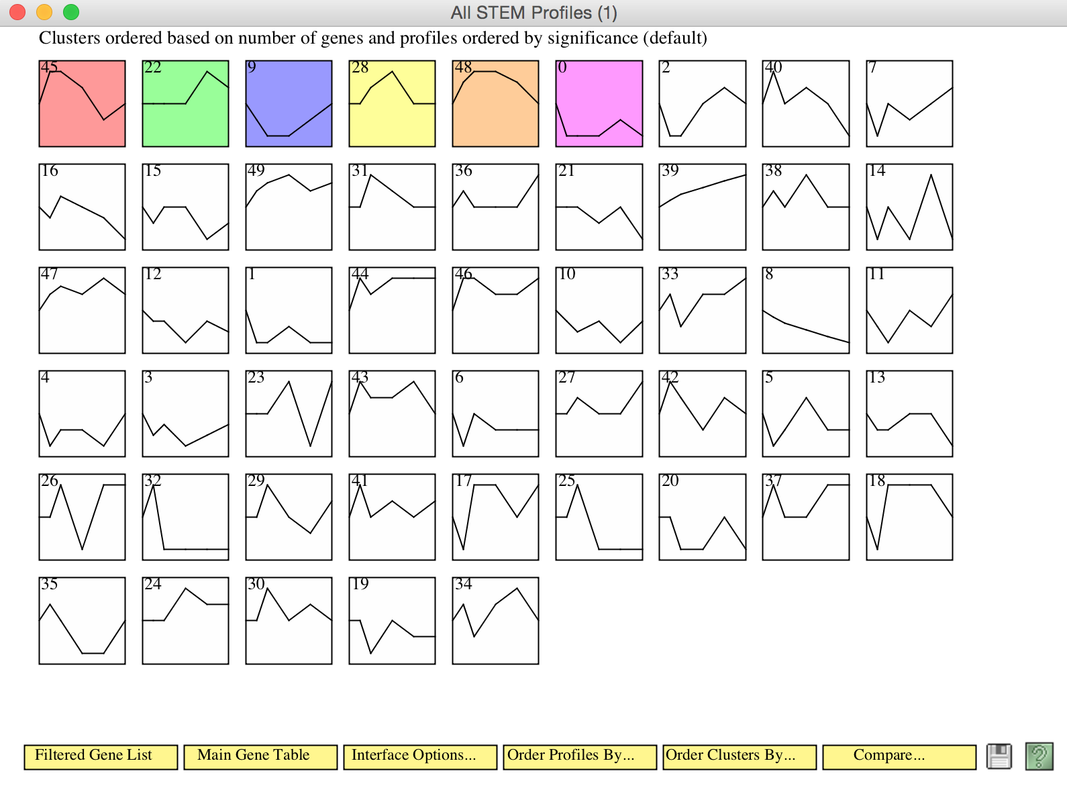
Stem profiles available for wild type data

Slide 3
Change in expression following cold shock of profile 45 genes

Slide 4
Change in expression following cold shock of profile 22 genes

Slide 5
Change in expression following cold shock of profile 22 genes

Slide 6
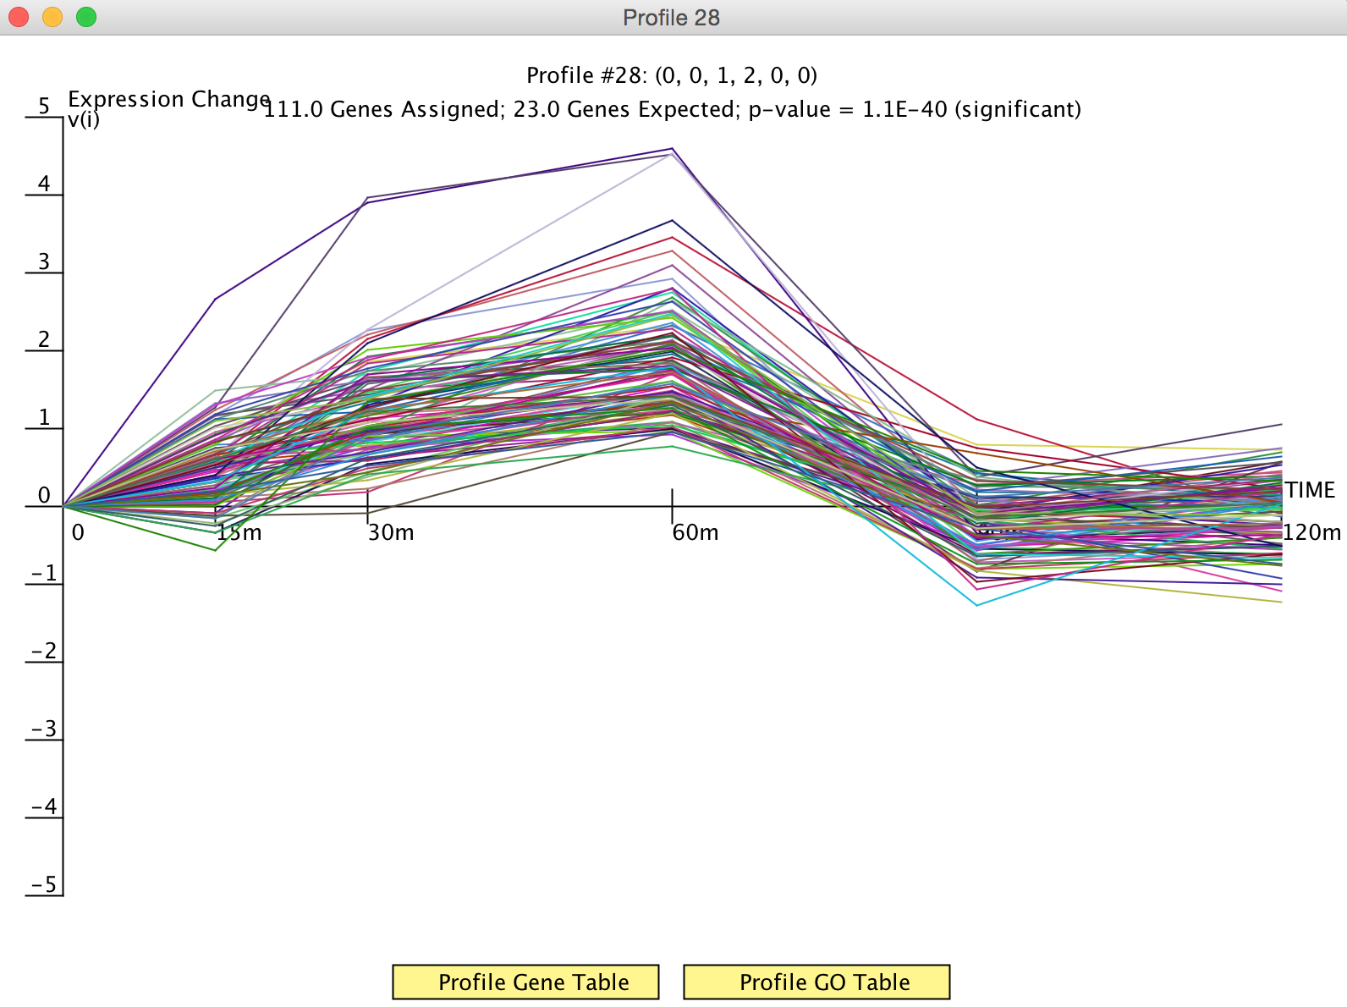
Change in expression following cold shock of profile 28 genes

Slide 7
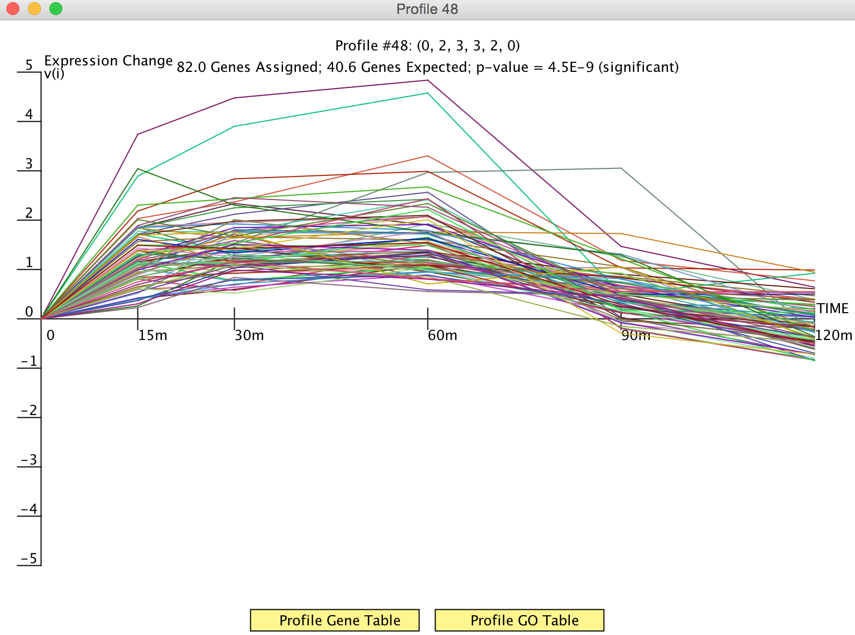
Change in expression following cold shock of profile 48 genes

Slide 8
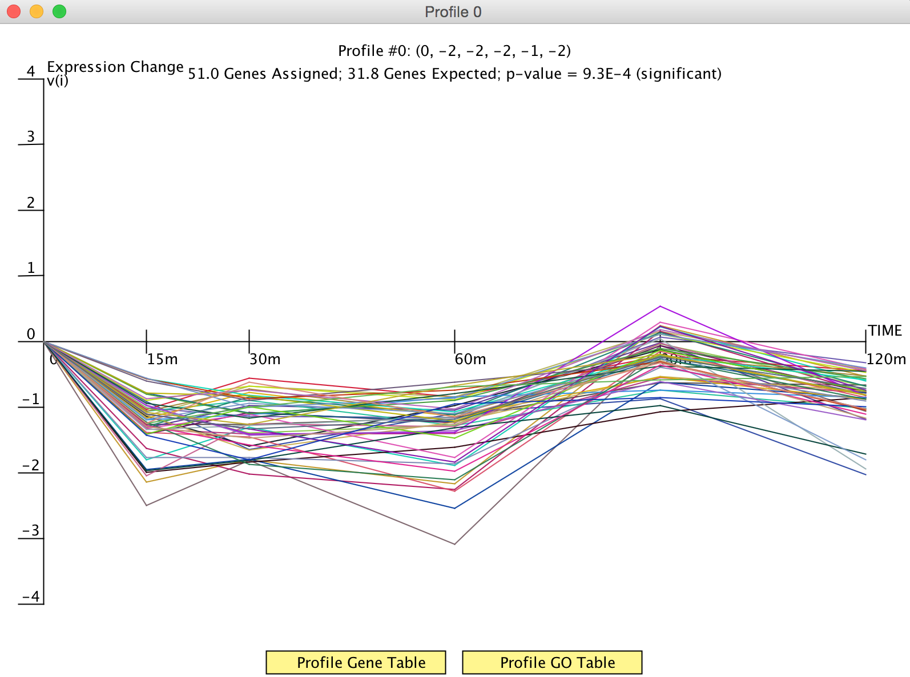
Change in expression following cold shock of profile 0 genes

