Slide 1
Percentage of total genes satisfying different p value requirements for wild type microarray data
ANOVA | WT | wt
p < 0.05 | 2528 (40.85%) | 2528 (40.85%)
p < 0.01 | 1652 (26.70%) | 1652 (26.70%)
p < 0.001 | 919 (14.85%) | 919 (14.85%)
p < 0.0001 | 496 (8.01%) | 496 (8.01%)
Benjamini & Hochberg-corrected p < 0.05 | 1822 (29.44%) | 1822 (29.44%)
Bonferroni-corrected p < 0.05 | 248 (4.01%) | 248 (4.01%)

Slide 2
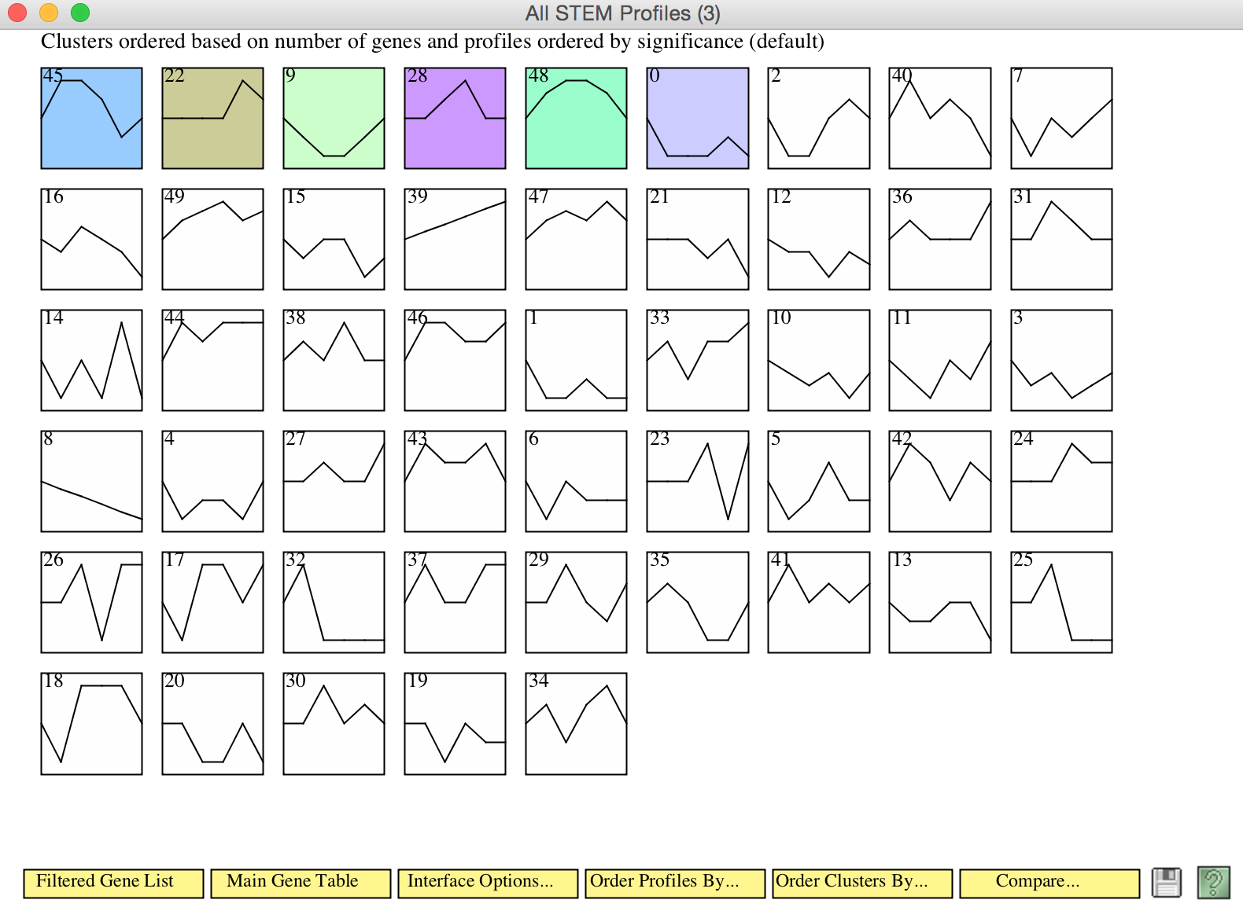
Stem profiles available for wild type data

Slide 3
Change in expression following cold shock of profile 45 genes

Slide 4
Change in expression following cold shock of profile 22 genes

Slide 5
Change in expression following cold shock of profile 9 genes

Slide 6
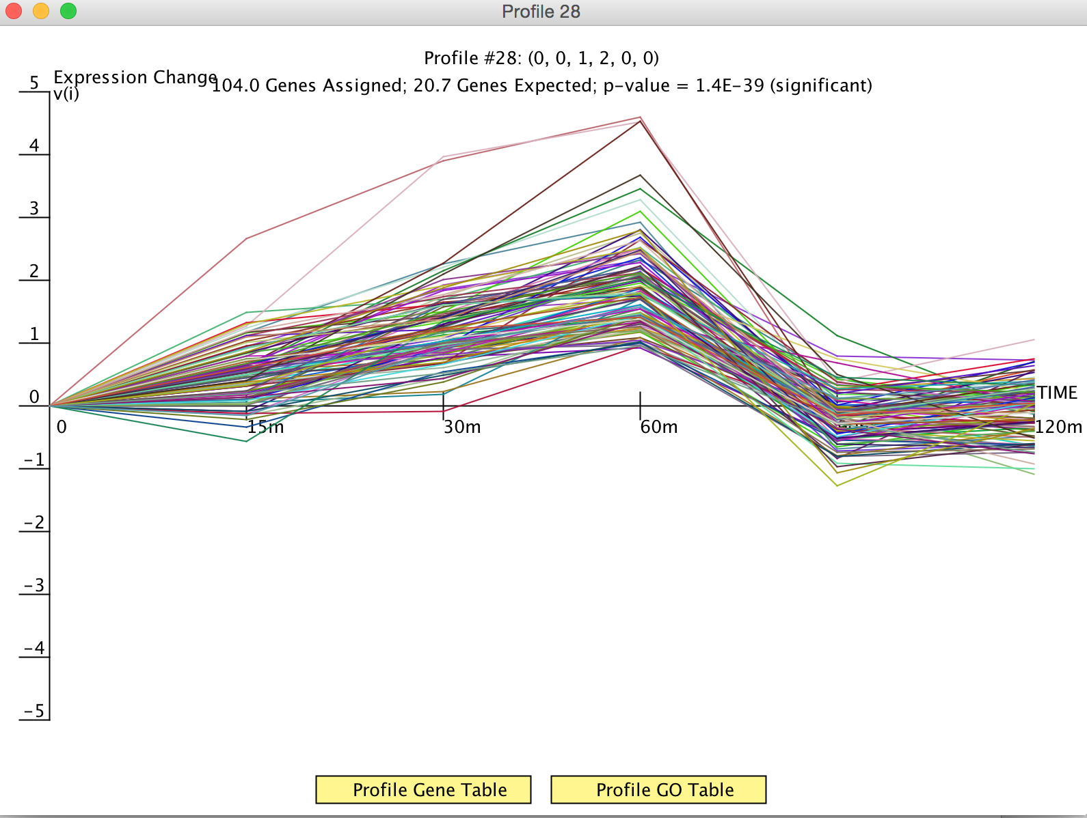
Change in expression following cold shock of profile 28 genes

Slide 7
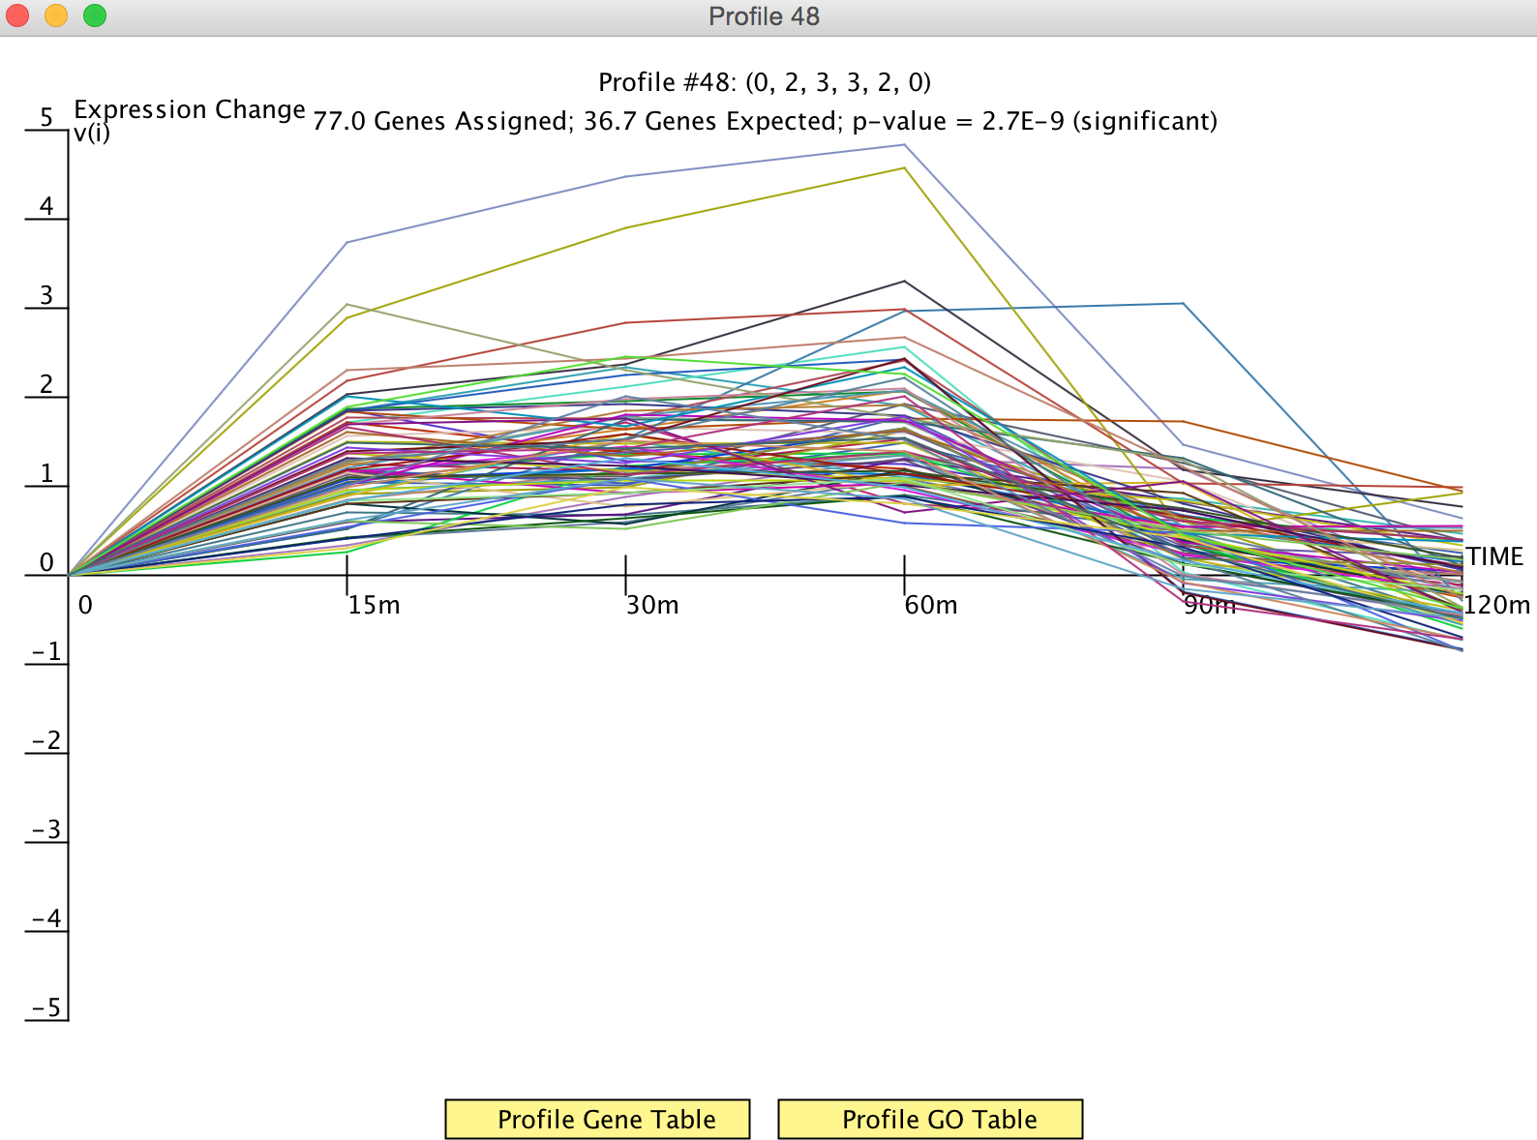
Change in expression following cold shock of profile 48 genes

Slide 8
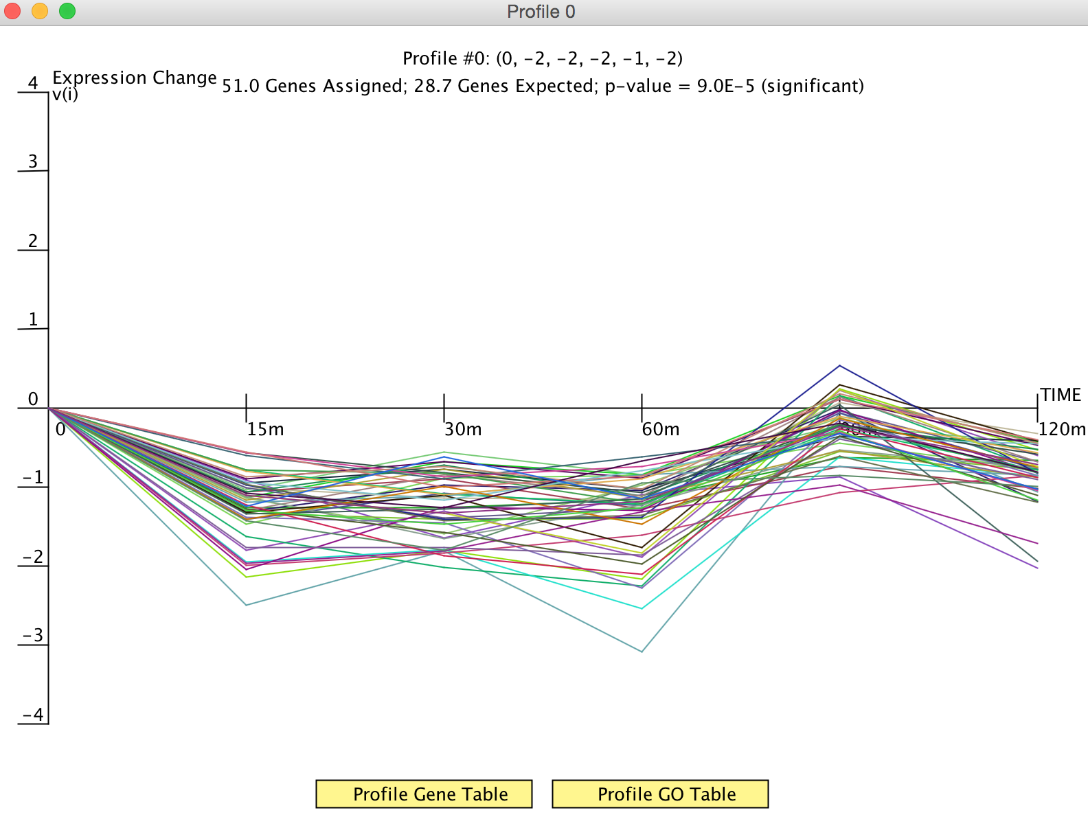
Change in expression following cold shock of profile 0 genes

