Slide 1
Table 1: Comparison between p-values for wild type. vs. dASH1
ANOVA | WT | dASH1
p < 0.05 | 2528 (40.847%) | 1630 (26.34%)
p < 0.01 | 1652 (26.693%) | 880 (14.22%)
p < 0.001 | 919 (14.849%) | 356 (5.75%)
p < 0.0001 | 498 (6.189%) | 142 (2.29%)
Benjamini & Hochberg-corrected p < 0.05 | 2006 (32.412%) | 730 (11.80%)
Bonferroni-corrected p < 0.05 | 248 (4.007%) | 53 (0.856%)

Slide 2
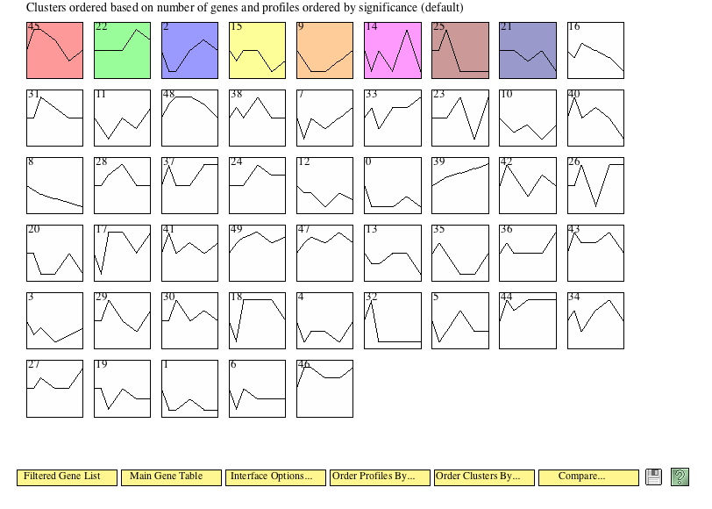
Figure 1: Summary table of STEM Result Profiles for dASH1

Slide 3
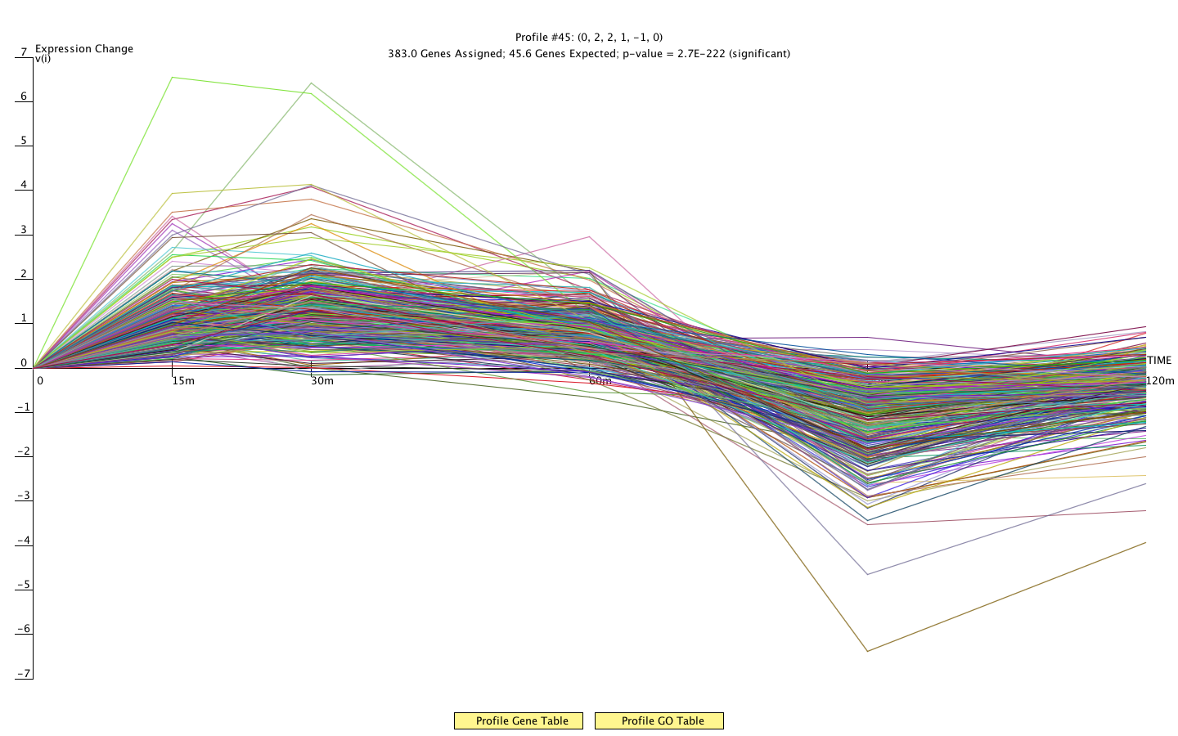
Figure 2:Plot of STEM profile #45. Showing all genes in the profile.

Slide 4
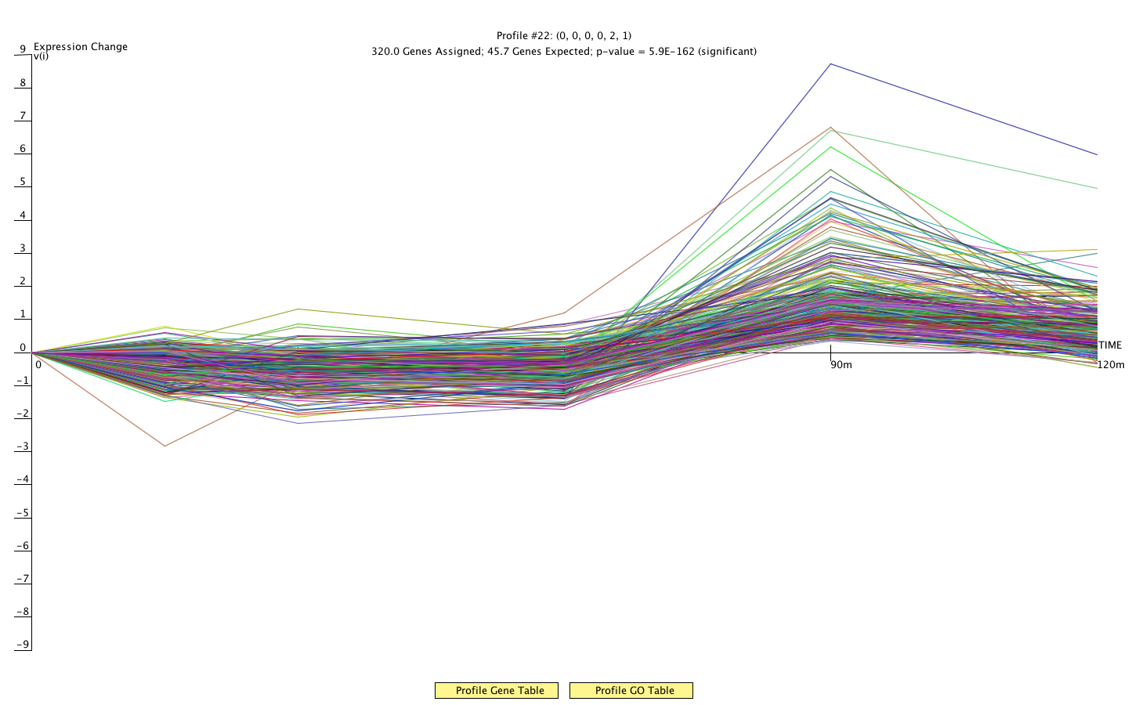
Figure 3:Plot of STEM profile #22. Showing all genes in the profile.

Slide 5
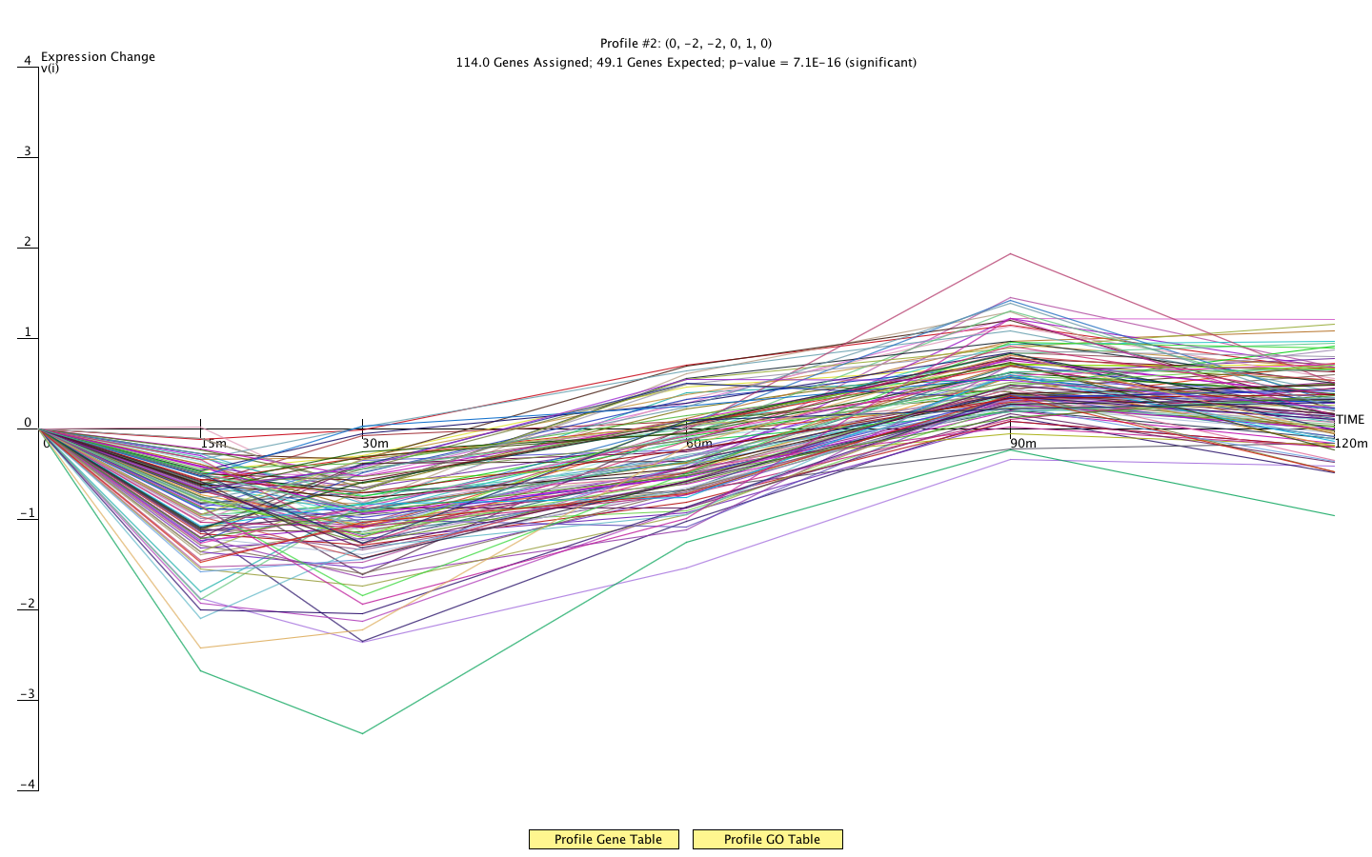
Figure 4:Plot of STEM profile #2. Showing all genes in the profile.

Slide 6
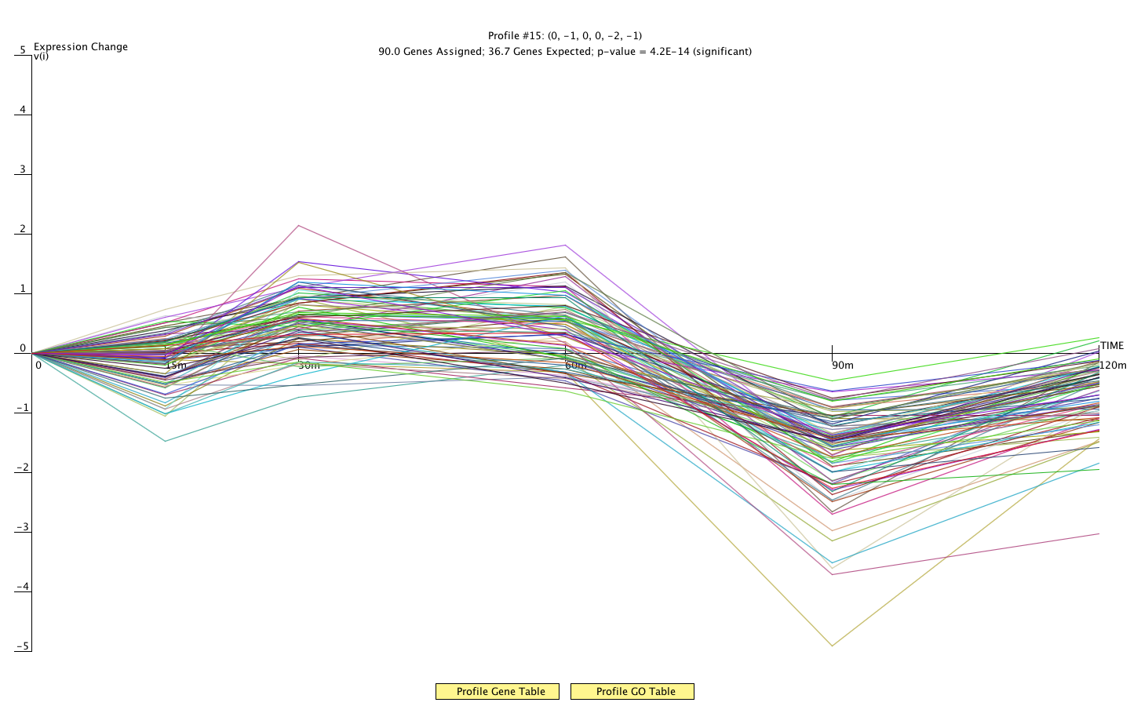
Figure 5:Plot of STEM profile #15. Showing all genes in the profile.

Slide 7
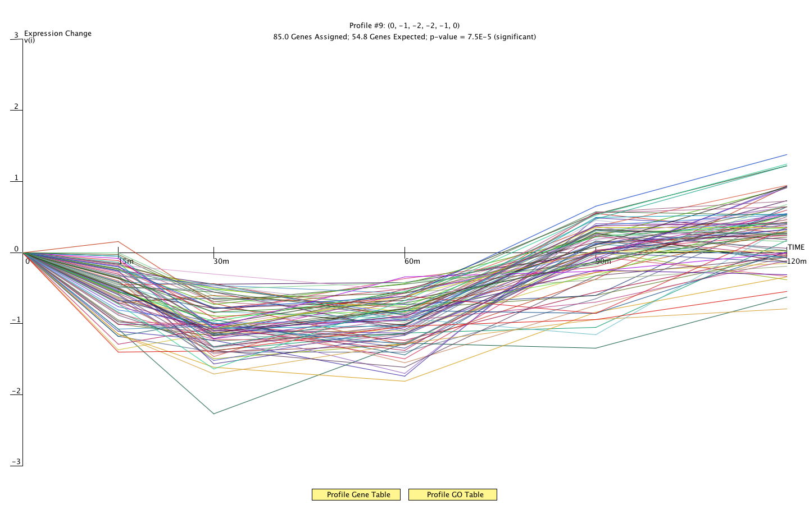
Figure 6:Plot of STEM profile #9. Showing all genes in the profile.

Slide 8
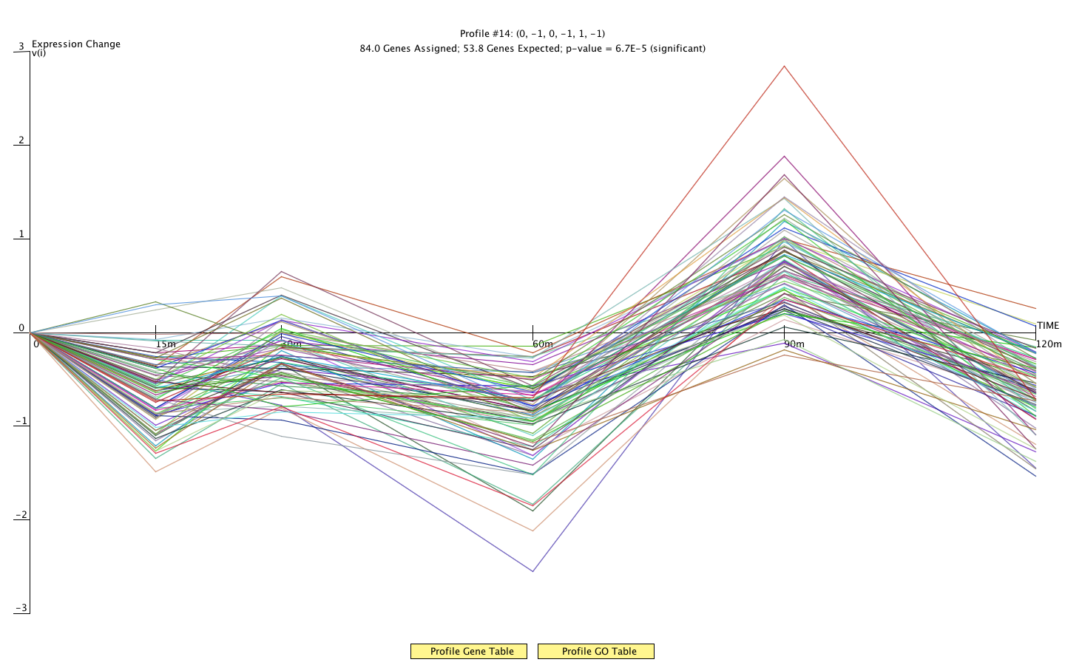
Figure 7:Plot of STEM profile #14. Showing all genes in the profile.

Slide 9
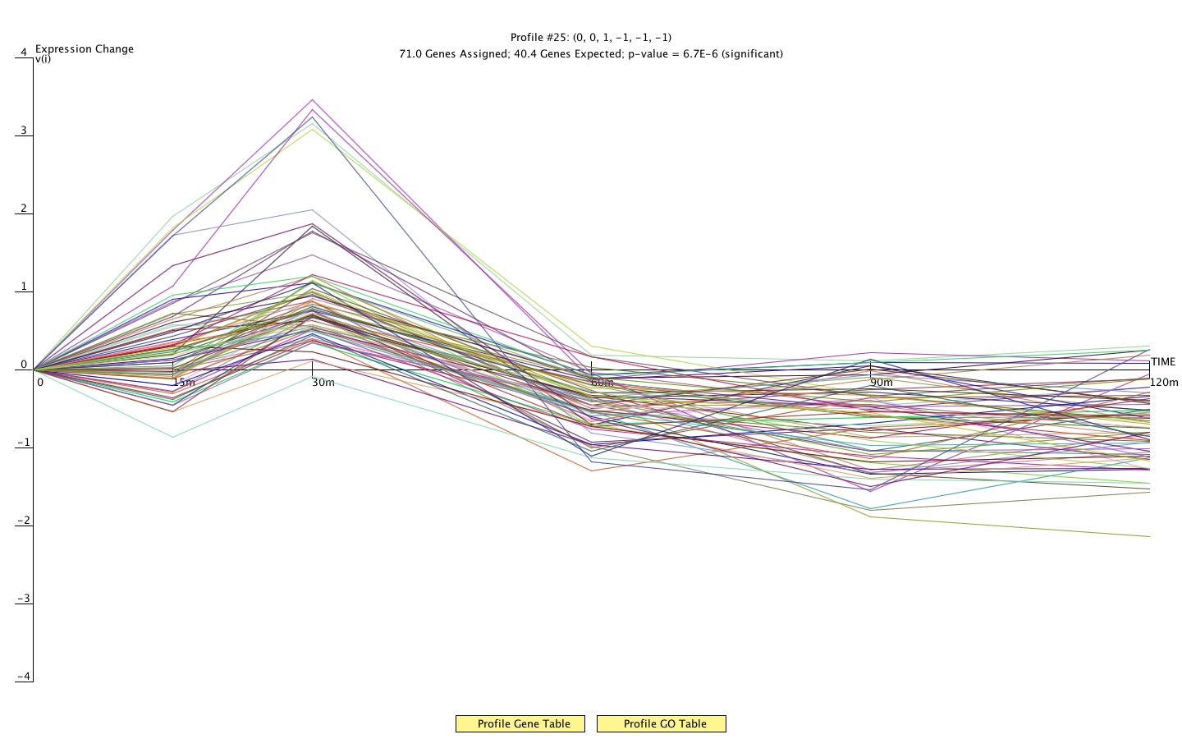
Figure 8:Plot of STEM profile #25. Showing all genes in the profile.

Slide 10
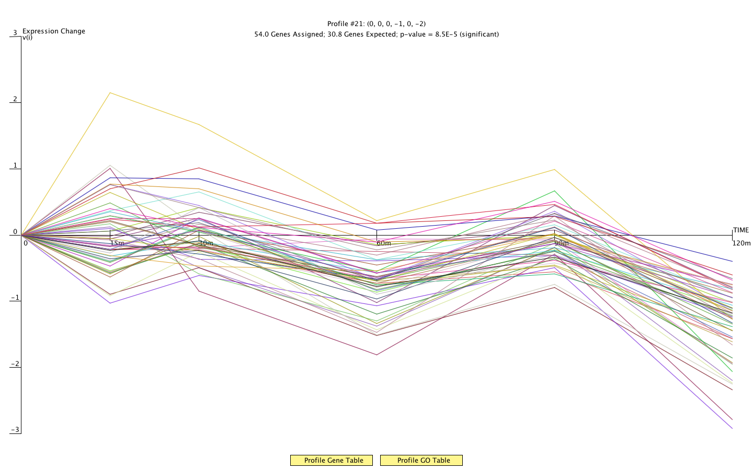
Figure 9:Plot of STEM profile #21. Showing all genes in the profile.

