Slide 1

Generating Information of Genes from Databases Relating to Cold-Shock Expression Responses
Eddie Azinge, John Lopez, and Corinne Wong
Seaver College of Science and Engineering
Dina Bashoura
Bellarmine College of Liberal Arts
December 12, 2017
BIOL/CMSI 367
Loyola Marymount University

Slide 2
Outline
Gene expressions change to help cell in response to stresses.
GRNsight can aid in interpretation and understanding of genome responses.
Various steps were implemented to organize work.
Data analysis results show a significant change in gene expression of dGLN3, including some significant up-regulation.
Data results were opened on GRNsight to generate weighted and unweighted gene regulatory networks.
After the desired information was selected, it was pulled from the databases to be implemented on GRNsight.

Slide 3
Outline
Gene expressions change to help cell in response to stresses.
GRNsight can aid in interpretation and understanding of genome responses.
Various steps were implemented to organize work.
Data analysis results show a significant change in gene expression of dGLN3, including some significant up-regulation.
Data results were opened on GRNsight to generate weighted and unweighted gene regulatory networks.
After the desired information was selected, it was pulled from the databases to be implemented on GRNsight.

Slide 4
Gene Expression in Organisms Change in Response to Stresses
Understanding gene interactions helps understand how genome responds to stress
Yeast gene clusters with similar functions show cooperative regulation in response to cold shock
Yeast gene expression up or down regulates in response to cold shock
  Help transcription and translation to make proteins
  Up-regulate stress response induced genes
(Sahara, et al., 2002)
Notes:
Helping production of proteins helps to maintain integrity and basic functions of cells
Up-regulating stress induced genes helps cells adapt and gain tolerance to low temperature

Slide 5
Outline
Gene expressions change to help cell in response to stresses.
GRNsight can aid in interpretation and understanding of genome responses.
Various steps were implemented to organize work.
Data analysis results show a significant change in gene expression of dGLN3, including some significant up-regulation.
Data results were opened on GRNsight to generate weighted and unweighted gene regulatory networks.
After the desired information was selected, it was pulled from the databases to be implemented on GRNsight.

Slide 6
GRNsight Provides Platform to Clarify Interactions
Still unknown
  Transcription factors regulating and controlling genome response to cold-shock in yeast
  Reasons for up or down regulation of some genes
GRNsight provides map of interactions and connections between genes
Learn about interactions and connect them to stress responses
Notes:
HSP12 & HSP26 are heat shock factor proteins that are up-regulated during cold-shock in yeast = bizarre

Slide 7
Providing Gene Information on GRNsight Can Make It More Effective
Various databases provide in-depth information about organism genes
  UniProt
  NCBI
  Enembl
  SGD
  JASPAR
Selecting information from reliable databases is beneficial to users
  Make information easily accessible from GRNsight page
  Can learn important or relevant information about each gene
More efficient and informative

Slide 8
Outline
Gene expressions change to help cell in response to stresses.
GRNsight can aid in interpretation and understanding of genome responses.
Various steps were implemented to organize work.
Data analysis results show a significant change in gene expression of dGLN3, including some significant up-regulation.
Data results were opened on GRNsight to generate weighted and unweighted gene regulatory networks.
After the desired information was selected, it was pulled from the databases to be implemented on GRNsight.

Slide 9
Flowchart of Data Analysis and Quality Assurance
Initial Research
Set Up Analysis
Data Analysis
Results
Got organized
Researched yeast response to cold shock
Presented research of journal article
Made corrections to ANOVA results and STEM
Reviewed STEM results to analyze TF candidates from YEASTRACT
Chose dGLN3 profile 45 as cluster to analyze
Determined which information to pull from databases
Retrieved GOlist for profile 45 showing gene functions
Created a gene regulatory network of transcription factors
Created adjacency matrix and network through YEASTRACT
Reviewed results with Dr. Dahlquist and made corrections
Generated visual matrix on GRNsight with both the magnitude and direction of regulation
Notes:
MILESTONE 1
Organization = creating Gene hAPI page, setting up communication and milestones
MILESTONE 2
…
MILESTONE 3
Using the YEASTRACT Database to determine which transcription factors are candidates for regulating the genes in a cluster from stem (part of Week 10 that we postponed
MILESTONE 4
Figure out what we needed to pull, how we were gonna pull it
Needed to coordinate with JASPAR team and Page Design team
Trial and error
Concluded couldn’t pull all that originally desired
Using the YEASTRACT Database to develop a candidate gene regulatory network (part of Week 10 that we postponed).
Using the GRNmap software to model the gene regulatory network (confer with Dr. Dahlquist when you are ready for this).
Visualizing the results with GRNsight.

Slide 10
Flowchart of Tasks - Coders
Initial Research
Developer Environment Setup
Gene Page Integration
Current and Future Work
Analyzed Week 9 Homework responses
Adapted bash commands to Javascript (ES6)
Created Git branch
Set Milestones
Installed GRNsight
Ported ES6 code to ES5
Integrated jQuery
Established API structure
Extracted data
Extending API for more data
Testing API functionality
Finishing Touches
Notes:
MILESTONE 1
Organization = creating Gene hAPI page, setting up communication and milestones
MILESTONE 2
…
MILESTONE 3
…
MILESTONE 4
Figure out what we needed to pull, how we were gonna pull it
Needed to coordinate with JASPAR team and Page Design team
Trial and error
Concluded couldn’t pull all that originally desired

Slide 11
Outline
Gene expressions change to help cell in response to stresses.
GRNsight can aid in interpretation and understanding of genome responses.
Various steps were implemented to organize work.
Data analysis results show a significant change in gene expression of dGLN3, including significant up-regulation.
Data results were opened on GRNsight to generate weighted and unweighted gene regulatory networks.
After the desired information was selected, it was pulled from the databases to be implemented on GRNsight.

Slide 12
dGLN3 Had Significant Change in Gene Expression
ANOVA | WT | dGLN3
p < 0.05 | 2528 (40.85%) | 2135 (34.50%)
p < 0.01 | 1652 (26.70%) | 1204 (19.45%)
p < 0.001 | 919 (14.85%) | 514 (8.31%)
p < 0.0001 | 496 (8.01%) | 180 (2.91%)
Benjamini & Hochberg-corrected p < 0.05 | 1822 (29.44%) | 1185 (19.15%)
Bonferroni-corrected p < 0.05 | 248 (4.01%) | 45 (0.73%)
Notes:
The purpose of the witin-stain ANOVA test is to determine if any genes had a gene expression change that was significantly different than zero at any timepoint.
Talk about decreasing p value, increasing significance, of gene expression change. Increasing the CONFIDENCE in our data = lower p value.
B&H: Decreases False discovery rate Reduce the chances of having false positives LESS STRINGENT
Bonferroni corrected p value: corrects for multiple testing problem. MORE STRINGENT https://xkcd.com/882/

Slide 13
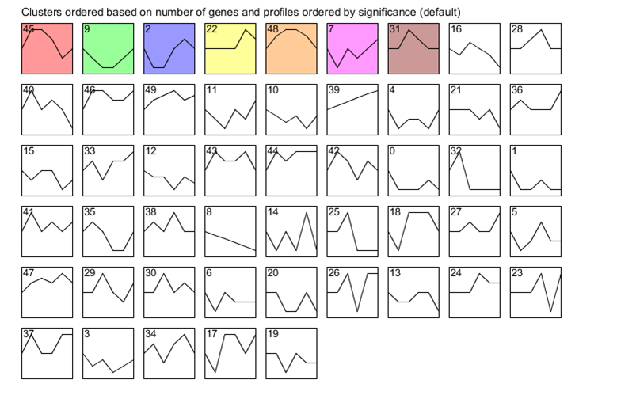
Overall Clustering Results From STEM

Slide 14
Overall Clustering Results From STEM

Slide 15
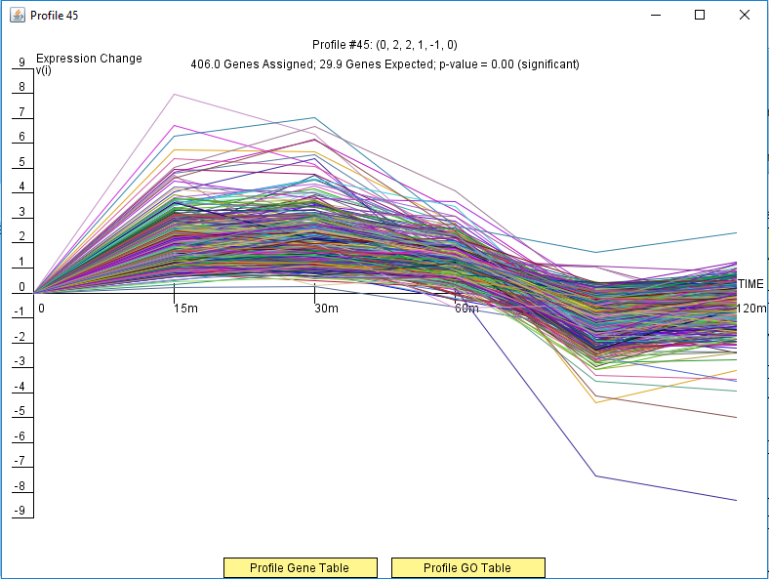
Profile #45 Shows Significant Up Regulation of Genes in Cluster

Slide 16
Gene Ontology List Generated From STEM Shows Gene Functions in Cluster
Category Name | #Genes Category | #Genes Assigned | #Genes Expected | #Genes Enriched | p-value | Corrected p-value | Fold
Gene expression | 382 | 189.0 | 123.3 | +65.7 | 1.8E-17 | <0.001 | 1.5
RNA processing | 170 | 115.0 | 54.9 | +60.1 | 1.7E-24 | <0.001 | 2.1
RNA phosphodiester bond hydrolysis | 50 | 37.0 | 16.1 | +20.9 | 8.0E-10 | <0.001 | 2.3
Notes:
Function of genes
Gene ontology term related to cluster - told function of genes
TFs
P value corrected: accounts for when multiple test

Slide 17
Regulatory Transcription Factors In Network and P-Values For Enrichment
Transcription Factors | ACE2 | CIN5 | GLN3 | HAP4 | MSN2 | PDR1 | PDR3
P - Values | 6.7E-14 | 0.6462266 | 1.21E-13 | 0.004451 | 0 | 6.245E-11 | 8.92E-13
Transcription Factors | SFP1 | SWI5 | UME6 | YAP1 | YHP1 | YLR278C | YOX1 | ZAP1
P - Values | 0 | 2.782E-10 | 3.323E-11 | 2.84E-13 | 0 | 3.666E-10 | 0 | 8.553E-06
Notes:
6.7E-14
0.6462266
1.21E-13
0.004451
0
6.245E-11
8.92E-13
0
2.782E-10
3.323E-11
2.84E-13
0
3.666E-10
0
8.553E-06

Slide 18
Outline
Gene expressions change to help cell in response to stresses.
GRNsight can aid in interpretation and understanding of genome responses.
Various steps were implemented to organize work.
Data analysis results show a significant change in gene expression of dGLN3, including some significant up-regulation.
Data results were opened on GRNsight to generate weighted and unweighted gene regulatory networks.
After the desired information was selected, it was pulled from the databases to be implemented on GRNsight.

Slide 19
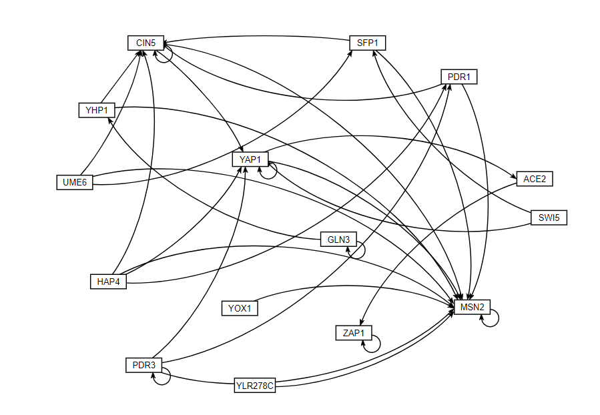
Unweighted Network of Transcription Factors Visualized From GRNsight

Slide 20
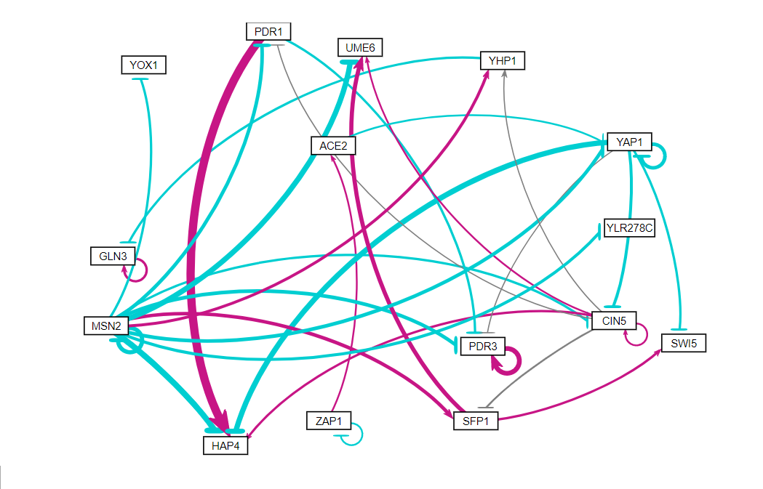
Weighted Network Visualized In GRNsight Showing Magnitude and Direction of Regulation

Slide 21
Outline
Gene expressions change to help cell in response to stresses.
GRNsight can aid in interpretation and understanding of genome responses.
Various steps were implemented to organize work.
Data analysis results show a significant change in gene expression of dGLN3, including some significant up-regulation.
Data results were opened on GRNsight to generate weighted and unweighted gene regulatory networks.
After the desired information was selected, it was pulled from the databases to be implemented on GRNsight.

Slide 22
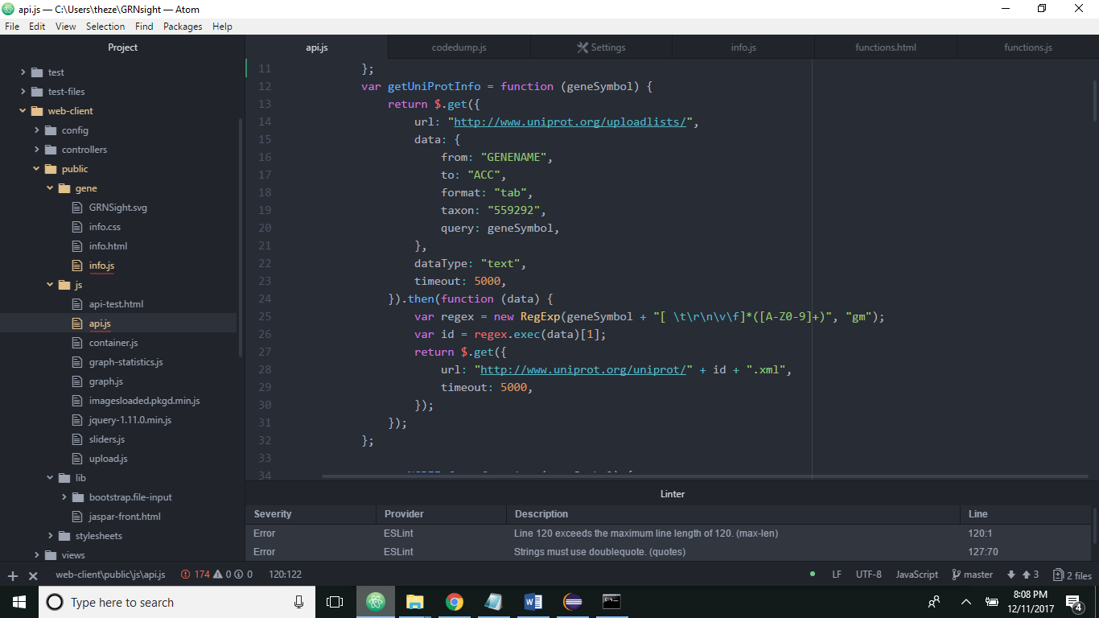
The first step was to obtain the necessary URLs and pull the XML/JSON from there.
Similar to our Week 9 assignment
Required knowledge of regular expressions to parse pieces of data
Resulted in either an XML or JSON document

Slide 23
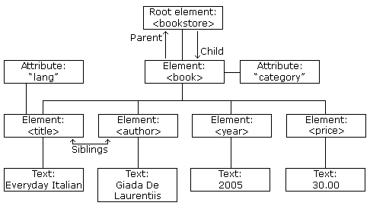
To extract the XML, we had to manipulate the Document Object Model.
Had to examine XML documents and each element’s relationship with another.
Travelling along nodes allowed us to access the ones we needed.
https://www.w3schools.com/xml/nodetree.gif

Slide 24
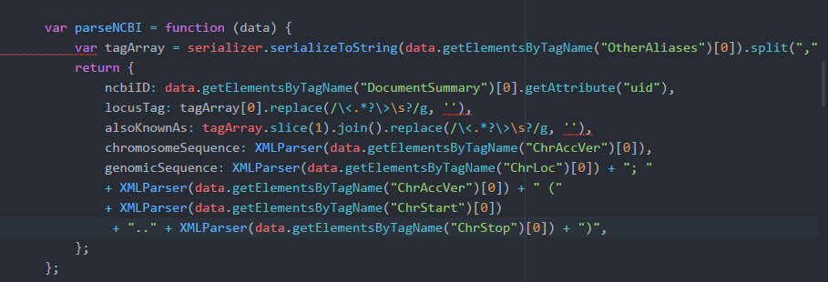
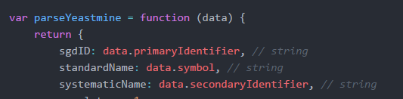
Data results had to be manipulated to extract purely the answers.
Created an XML Parser that serialized lines of XML to strings
Some required manipulation of arrays
All required the use of regular expressions
JSON properties involved calling them and finding them

Slide 25
Conclusion
Gene expressions change to help cell in response to stresses.
GRNsight can aid in interpretation and understanding of genome responses.
Various steps were implemented to organize work, including coding, data analyzing, and quality assurance.
Data analysis results show a significant change in gene expression of dGLN3, including some significant up-regulation.
Data results were opened on GRNsight to generate weighted and unweighted gene regulatory networks.
After the desired information was selected, it was pulled from the databases to be implemented on GRNsight.

Slide 26
Future Directions
Having all information available to users from one page
Providing all the needed and important information
Reducing need of users to bounce between databases
  Make research more efficient
Make applicable and functional for all organisms and genes

Slide 27
Acknowledgments
BIOL/CMSI 367 Biological Databases and Teams Associated
Loyola Marymount University, Los Angeles, CA
Kam D. Dahlquist
John David N. Dionisio

Slide 28
References
Sahara, T., Goda, T., & Ohgiya, S. (2002). Comprehensive expression analysis of time-dependent genetic responses in yeast cells to low temperature. Journal of Biological Chemistry, 277(51), 50015-50021.
Dahlquist, K. D., Dionisio, J. D. N., Fitzpatrick, B. G., Anguiano, N. A., Varshneya, A., Southwick, B. J., & Samdarshi, M. (2016). GRNsight: a web application and service for visualizing models of small-to medium-scale gene regulatory networks. PeerJ Computer Science, 2, e85.
Teixeira, M. C., Monteiro, P. T., Guerreiro, J. F., Gonçalves, J. P., Mira, N. P., dos Santos, S. C., ... & Madeira, S. C. (2013). The YEASTRACT database: an upgraded information system for the analysis of gene and genomic transcription regulation in Saccharomyces cerevisiae. Nucleic acids research, 42(D1), D161-D166.
NCBI. (2017). SPT15 TATA-binding protein [ Saccharomyces cerevisiae S288C ]. Retrieved December 2017, from https://www.ncbi.nlm.nih.gov/gene/856891
Saccharomyces Genome Database. (2017). SPT15/YER148W Overview. Retrieved December 2017, from https://www.yeastgenome.org/locus/S000000950
Ensembl. (2017). Gene: SPT15 YER148W. Retrieved December 2017, from https://www.ensembl.org/Saccharomyces_cerevisiae/Gene/Summary?db=core;g=YER148W;r=V:465303-466025;t=YER148W
UniPort. (2017). UniProtKB - P13393 (TBP_YEAST). Retrieved December 2017, from http://www.uniprot.org/uniprot/P13393
About JASPAR. (2017). JASPAR. Retrieved on December 2017, from http://jaspar.genereg.net/about/

