Slide 1
Review of Circadian Gene Database
Hayden Hinsch: Psychology/Pre-Med
Simon Wroblewski: Computer Science
Frank R. Seaver College of Science and Engineering
BIOL/CMSI 367: Biological Databases
Loyola Marymount University Seaver 120
October 3/5, 2017

Slide 2
Outline
General Information
- Type of database
- Maintenance of database
- Sources of funding
Quality of Science
- Content Domain
- Relevance of content
General Utility
- Collaboration
- Accessibility of data
- “User-friendliness”

Slide 3
Outline
General Information
- Type of database
- Maintenance of database
- Sources of funding
Quality of Science
- Content Domain
- Relevance of content
General Utility
- Collaboration
- Accessibility of data
- “User-friendliness”

Slide 4
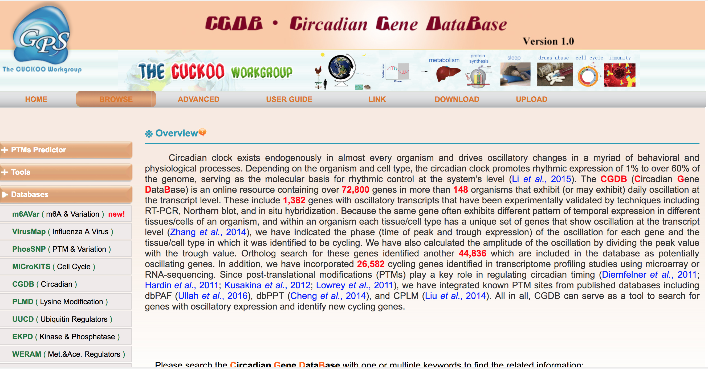
CGDB:Circadian Gene Database
http://cgdb.biocuckoo.org/index.php

Slide 5
Type of Database
This is a circadian gene database
The database includes circadian gene DNA and protein sequences, model organisms specific to each circadian gene, clear descriptions of the circadian gene functions, and circadian gene tags specific to this database and other databases.
Data Sources
The database is a secondary source of data.
The data is manually curated (human curation).
The curation is performed by the in-house staff.
http://cgdb.biocuckoo.org/index.php
http://cgdb.biocuckoo.org/view.php?id=021036, https://academic.oup.com/nar/article/45/D1/D397/2333922/CGDB-a-database-of-circadian-genes-in-eukaryotes

Slide 6
Database Maintenance
The database is maintained by the Cuckoo Workgroup.
The Cuckoo Workgroup is a private organization.
The organization consists of a small lab group.
The Cuckoo Workgroup maintains multiple databases in addition to the Circadian Gene Database.
http://www.biocuckoo.org/people.php

Slide 7
Sources of Funding
National Basic Research Program
Natural Science Foundation of China
International Science & Technology Cooperation Program of China
Natural Science Foundation of Anhui Province
National Natural Science Foundation of China
https://academic.oup.com/nar/article/45/D1/D397/2333922/CGDB-a-database-of-circadian-genes-in-eukaryotes

Slide 8
Outline
General Information
- Type of database
- Maintenance of database
- Sources of funding
Quality of Science
- Content Domain
- Relevance of content
General Utility
- Collaboration
- Accessibility of data
- “User-friendliness”

Slide 9
Content Domain
The database contains over 72,800 experimentally verified genes with rhythmic expression.
The database owners point out that there is a lack of comprehensive databases which cycle genes across phyla and these owners claim to fill that need.
The species covered in the database include plants, animals, and fungi.
https://academic.oup.com/nar/article/45/D1/D397/2333922/CGDB-a-database-of-circadian-genes-in-eukaryotes, http://cgdb.biocuckoo.org/browse.php

Slide 10
Relevance of Content
There is a need in the scientific community for this database at this time due to the fact that disruptions in circadian rhythms have been possibly entwined with diseases and disorders such as but not limited to psychiatric disorders and cancer.
This content is covered by other databases already, but not a comprehensive database for the circadian genes across phyla.
https://academic.oup.com/nar/article/45/D1/D397/2333922/CGDB-a-database-of-circadian-genes-in-eukaryotes#51198539, https://academic.oup.com/nar/article/45/D1/D397/2333922/CGDB-a-database-of-circadian-genes-in-eukaryotes#51198539

Slide 11
Relevance of Content Continued
The database first went online in 2004.
The database is updated when new cycling genes are experimentally characterized. It appears that the database is updated monthly.
The database was last updated October 1, 2017.
https://academic.oup.com/nar/article/45/D1/D397/2333922/CGDB-a-database-of-circadian-genes-in-eukaryotes#51198539, https://academic.oup.com/nar/article/45/D1/D397/2333922/CGDB-a-database-of-circadian-genes-in-eukaryotes#51198539, http://cgdb.biocuckoo.org/index.php

Slide 12
Outline
General Information
- Type of database
- Maintenance of database
- Sources of funding
Quality of Science
- Content Domain
- Relevance of content
General Utility
- Collaboration
- Accessibility of data
- “User-friendliness”

Slide 13
Collaboration with Other Databases
• http://circadb.hogeneschlab.org/
• http://www.wgpembroke.com/shiny/SCNseq/
• https://www3.nd.edu/~bioclock/
• http://circadiomics.igb.uci.edu/
• http://diurnal.mocklerlab.org/
• http://www.bioinfo.mpg.de/euclis/
• http://www.dbcryptochrome.org/
http://www.ensembl.org/index.html
http://cgdb.biocuckoo.org/links.php

Slide 14
Convenience of Data
The data is fairly convenient to browse.
Convenience of Download
  The convenience of data depends on your preference. When downloading the data a new browser tab is opened with all of the protein sequences listed for each gene which is fairly easy to read. The only con is that you will have to copy and paste the data into another file to store it.
  •All downloads come in the .txt format.
  •The data type is standard.
http://cgdb.biocuckoo.org/browse.php, http://cgdb.biocuckoo.org/download.php, http://cgdb.biocuckoo.org/download.php

Slide 15
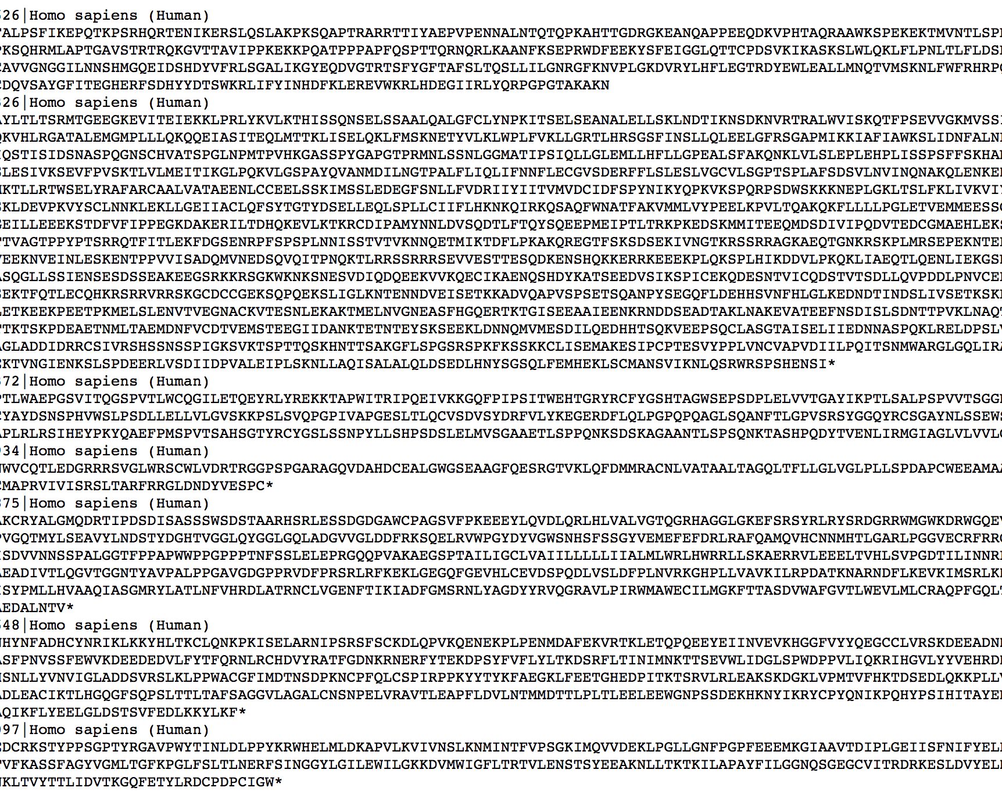
Data Format
Here is a screenshot of the download of some of the data.
.txt standard formatting
Lists gene identifiers
Lists species
http://cgdb.biocuckoo.org/download/all/Homo%20sapiens%20(Human).txt

Slide 16
“User-Friendliness”
• Although the website is not especially visually pleasing, it is rather straight forward to navigate.
• The website contains a user guide which is easy to find and very straight forward.
• The search options are fairly sensible. It is possible to run a search query with broad keywords of species or genes in order to find what you are looking for, however a knowledge of what you are looking for is definitely required.
http://cgdb.biocuckoo.org/advance.php,http://cgdb.biocuckoo.org/faq.php

Slide 17
License Agreement
No license agreement.
If publishing data from database, must cite:
  CGDB: a database of circadian genes in eukaryotes Shujing Li, Ke Shui, Ying Zhang, Yongqiang Lv, Wankun Deng, Shahid Ullah, Luoying Zhang and Yu Xue. Nucleic Acids Res. 2016; 10.1093/nar/gkw1028.
http://cgdb.biocuckoo.org/index.php

Slide 18
Summary
This was a database which contained relevant information in reference to circadian rhythms.
The information within the database is up-to-date.
We would direct a colleague unfamiliar with the field to use this database. It contains interesting information that is easily accessible.
This is a professional database.

Slide 19
Acknowledgments
1. Simon and Hayden worked together in person and over text multiple times to complete this assignment.
2. Simon and Hayden utilized the CGDB: Circadian Gene DataBase to complete the requirements for this assignment.
3. Simon and Hayden also used the Week 5 assignment page to make sure the assignment requirements were fulfilled.
4. Special thanks to Dr. Dahlquist, Dr. Dionisio and BIOL/CMSI 367 for presentation guidelines and instruction.

Slide 20
References
1. http://www.bioinfo.mpg.de/euclis/
2. CGDB: a database of circadian genes in eukaryotes Shujing Li, Ke Shui, Ying Zhang, Yongqiang Lv, Wankun Deng, Shahid Ullah, Luoying Zhang and Yu Xue. Nucleic Acids Res. 2016; 10.1093/nar/gkw1028.
3. https://academic.oup.com/nar/article/45/D1/D397/2333922/CGDB-a- database-of-circadian-genes-in-eukaryotes
4. https://academic.oup.com/nar/article/45/D1/D397/2333922/CGDB-a-database-of-circadian-genes-in-eukaryotes#51198539
5. http://cgdb.biocuckoo.org/
6. http://cgdb.biocuckoo.org/advance.php

Slide 21
References
7. http://cgdb.biocuckoo.org/browse.php
8. http://cgdb.biocuckoo.org/download.php
9. http://cgdb.biocuckoo.org/faq.php
10. http://cgdb.biocuckoo.org/index.php
11. http://cgdb.biocuckoo.org/links.php
12. http://www.biocuckoo.org/people.php
13. http://cgdb.biocuckoo.org/result.php?type=simple&page=1
14. http://cgdb.biocuckoo.org/view.php?id=021036

Slide 22
References
15. http://circadb.hogeneschlab.org/
16. http://circadiomics.igb.uci.edu/
17. http://diurnal.mocklerlab.org/
18. http://www.dbcryptochrome.org/
19. http://www.ensembl.org/index.html
20. https://fileinfo.com/extension/txt
21. http://www.wgpembroke.com/shiny/SCNseq/
22. https://xmlpipedb.cs.lmu.edu/biodb/fall2017/index.php/Week_5

