Slide 1
dGLN3 ANOVA Comparison to Wild Type Strain
ANOVA | WT | dGLN3
p < 0.05 | 2528 (40.85%) | 2135 (34.50%)
p < 0.01 | 1652 (26.70%) | 1204 (19.45%)
p < 0.001 | 919 (14.85%) | 514 (8.31%)
p < 0.0001 | 496 (8.01%) | 180 (2.91%)
Benjamini & Hochberg-corrected p < 0.05 | 1822 (29.44%) | 1185 (19.15%)
Bonferroni-corrected p < 0.05 | 248 (4.01%) | 45 (0.73%)

Slide 2
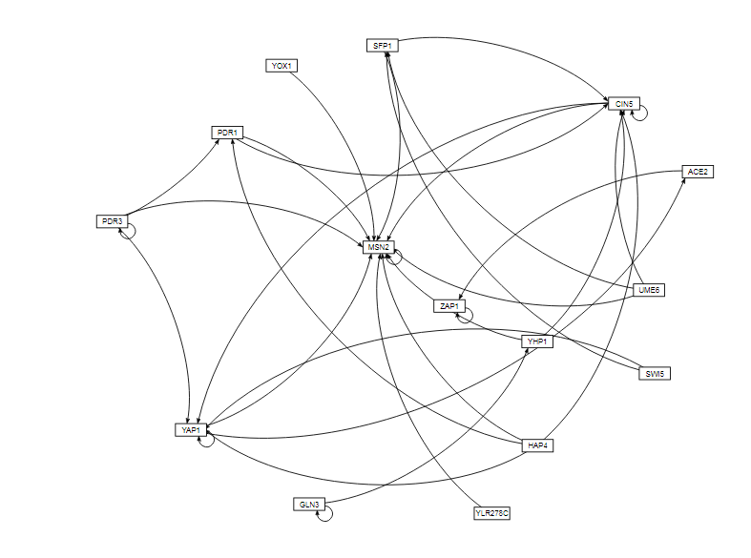
Transcription Factors Gene Network From GRNsight

Slide 3
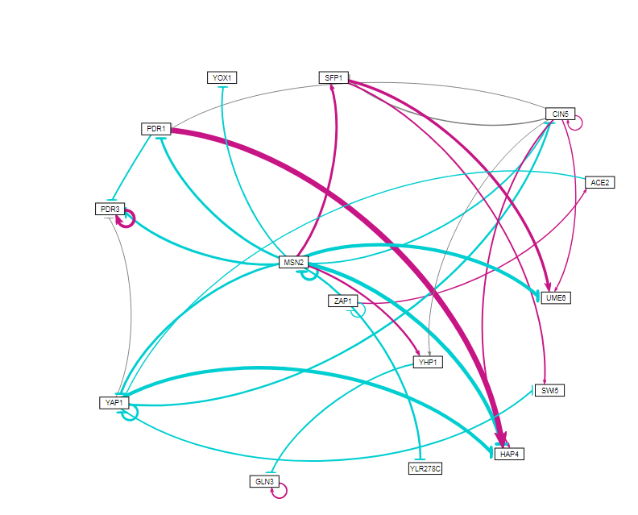
Transcription Factors Gene Network From GRNsight

