Slide 1
Visualizing the Impact of Arsenite/As(III) on
Saccharomyces cerevisiae Strain W303-1A Using Multiple Classification Methods
Marcus Avila
Ivy Macaraeg
DeLisa Madere
John "Joey" Nimmers-Minor
Naomi Tesfaiohannes
BIOL-367-01: Biological Databases
Seaver 120: SCSE Computer Lab
Notes:
DELISA

Slide 2
Overview of what will be discussed in our presentation
Overview of What Will Be Discussed in our Presentation
Data from Thorsen et al. and its scientific relevance was analyzed by Sulfiknight group members
Data was extracted and organized for analysis
Statistical analysis was performed on data and was organized by different methodologies, and visualization of this data can be seen through an MS Access database
Results from each methodology can show how different transcription factors function in S. cerevisiae's response to arsenic
This response can be analyzed in future research
Results found in Sulfiknight analysis contain similarities as well as differences found in the original research paper
Notes:
DELISA
Introduction
Review of the research paper used to inspire this work
Importance of this experiment
Team roles and responsibilities
Materials and Methods
Procedural Overview
Extraction of the data from the original source
Statistical analysis of microarray dataset
Creation of MS Access database containing production and degradation rates.
Analysis of data using various expression pattern methodologies
STEM, YEASTRACT, GRNsight, GRNmap
Visualization of different relationships among multiple databases through a schema
Results
ANOVA, STEM, Gene Ontology (GO) results, YEASTRACT p-values, GRNsight, Final schema
Discussion
Saccharomyces cerevisiae response to arsenic and future direction
Conclusion
How the acquired results differ from the results contributed by the original research paper

Slide 3
Overview of What Will Be Discussed in our Presentation
Data from Thorsen et al. and its scientific relevance was analyzed by Sulfiknight group members
Data was extracted and organized for analysis
Statistical analysis was performed on data and was organized by different methodologies, and visualization of this data can be seen through an MS Access database
Results from each methodology can show how different transcription factors function in S. cerevisiae's response to arsenic
This response can be analyzed in future research
Results found in Sulfiknight analysis contain similarities as well as differences found in the original research paper
Notes:
DELISA

Slide 4
The Importance of this Experiment was to Gain a Detailed Insight on Yeast Response to Arsenite
Organisms are exposed to toxic agents in their environment so forming a tolerance is essential for survival
Saccharomyces cerevisiae bypasses this toxicity through:
Plasma membrane protein Acr3p, from collecting glutathione-conjugated As(III) in the vacuole using Ycf1p (ABC transporter) and reducing the As(III) levels in aquaglyceroporin Fps1p
Modification of the cytosolic redox and glutathione levels
Notes:
DELISA

Slide 5
Met4p and Yap1p are Major Components in the Cell's Response to Arsenite
Met4p is significant in cadmium tolerance, controlling sulfur assimilation and glutathione biosynthesis
Met4p plays a role in As(III) tolerance, but more significant role in cadmium
Yap1p can regulate transcription for protein encoding genes with antioxidant properties, including YCF1 and ACR3 (arsenic-specific detoxification)
Acr3 sequesters glutathione-conjugated As(III) in a vacuole and Ycf1p transports it as well as helps in reducing As(III) influx
Notes:
DELISA
Include purpose

Slide 6
Introduction of Each Member's Role for this Assignment
Quality Assurance- Naomi Tesfaiohannes & Joey Nimmers-Minor
Worked on the database along with the Data Analysts
Understood the details of the microarray dataset being analyzed
Designer- DeLisa Madere
Coordinated with other coders to create the sample to data sheet
Assisted the Quality Assurance members with ACCESS database
Created the schema
Data Analyst- Ivy Macaraeg & Marcus Avila
Re-analyzed the data from the paper
Created a sample-data relationship table
Project Manager- Naomi Tesfaiohannes
Checked in with the other members of the team to monitor progress
Was familiar with each member's milestone goals
Discussed possible delays in getting work done (Thanksgiving vacation)
Notes:
Naomi

Slide 7
Materials and Methods-Tasks and Milestones
Collect/understand and prepare data for analysis from original research paper
Collaborate with other groups to create a reference table, highlighting yeast strains and treatment of multiple research papers.
Conduct ANOVA and Bonferroni test to test for statistical significance of microarray data
Create a database of all relevant time-course microarray data, as well as the production and degradation rates with specified formatting structure
Run a YEASTRACT analysis in order to determine which transcription factors regulated a certain cluster of genes
Run a STEM analysis to cluster/group genes with significantly similar gene ontology terms and expression patterns
Create a GRNSight visualization matrix of the results obtained from the YEASTRACT analysis
Run a GRNMap to predict how genes will produce and degrade over time in relation to their effect on each other
Create a database schema to analyze relationships across different databases from the other groups
Notes:
Naomi

Slide 8
Overview of what will be discussed in our presentation
Overview of What Will Be Discussed in our Presentation
Data from Thorsen et al. and its scientific relevance was analyzed by Sulfiknight group members
Data was extracted and organized for analysis
Statistical analysis was performed on data and was organized by different methodologies, and visualization of this data can be seen through an MS Access database
Results from each methodology can show how different transcription factors function in S. cerevisiae's response to arsenic
This response can be analyzed in future research
Results found in Sulfiknight analysis contain similarities as well as differences found in the original research paper
Notes:
Naomi
Introduction
Review of the research paper used to inspire this work
Importance of this experiment
Team roles and responsibilities
Materials and Methods
Procedural Overview
Extraction of the data from the original source
Statistical analysis of microarray dataset
Creation of MS Access database containing production and degradation rates.
Analysis of data using various expression pattern methodologies
STEM, YEASTRACT, GRNsight, GRNmap
Visualization of different relationships among multiple databases through a schema
Results
ANOVA, STEM, Gene Ontology (GO) results, YEASTRACT p-values, GRNsight, Final schema
Discussion
Saccharomyces cerevisiae response to arsenic and future direction
Conclusion
How the acquired results differ from the results contributed by the original research paper

Slide 9
Materials and Methods: Data Collection and Preparation
Download
Download the data provided by the original research/experiment paper.
Analyze
Analyze each data set in order to understand what test was happening at what time, both in terms of the yeast strain being used (wild type/mutated, stressed/non-stressed) and how long the experiment has been occurring.
Edit
In Microsoft Excel, edit title headers in individual data tables in order to be consistent across all data.
Convert all gene names to their ORF gene names
Notes:
Naomi

Slide 10
Materials and Methods: Collaboration and
Reference Assimilation
Collaborate with other groups to create a reference table, including
Author name
Publication year
Paper title
Time points
Yeast strain
Concentration of the treatment
Treatment type
Number of replicates
Citation
Notes:
DeLisa

Slide 11
Overview of what will be discussed in our presentation
Overview of What Will Be Discussed in our Presentation
Data from Thorsen et al. and its scientific relevance was analyzed by Sulfiknight group members
Data was extracted and organized for analysis
Statistical analysis was performed on data and was organized by different methodologies, and visualization of this data can be seen through an MS Access database
Results from each methodology can show how different transcription factors function in S. cerevisiae's response to arsenic
This response can be analyzed in future research
Results found in Sulfiknight analysis contain similarities as well as differences found in the original research paper
Notes:
DeLisa
Introduction
Review of the research paper used to inspire this work
Importance of this experiment
Team roles and responsibilities
Materials and Methods
Procedural Overview
Extraction of the data from the original source
Statistical analysis of microarray dataset
Creation of MS Access database containing production and degradation rates.
Analysis of data using various expression pattern methodologies
STEM, YEASTRACT, GRNsight, GRNmap
Visualization of different relationships among multiple databases through a schema
Results
ANOVA, STEM, Gene Ontology (GO) results, YEASTRACT p-values, GRNsight, Final schema
Discussion
Saccharomyces cerevisiae response to arsenic and future direction
Conclusion
How the acquired results differ from the results contributed by the original research paper

Slide 12
Materials and Methods: Statistical Analysis
1
2
ANOVA Test​
Using Excel, run an ANOVA statistical test in order to find if gene expression/repression was due to chance or due to stimulus effect at any timepoint (in comparison to a control.)​
Bonferroni Test
Using Excel, conduct a Bonferroni statistical correction, testing for expression significance with a greater stringency.
Notes:
DeLisa

Slide 13
Materials and Methods: Creation of microarray database, using relevant data at time points specified in original experiment papers
1
2
Download a Microsoft Access database including gene expression rates of DCIN, DGLN, DHAP, DZAP mutated yeast as well as and wild-type yeast strains​
This included gene degradation and production rates​
Expression data obtained from Dahlquist, 2018
Add significant expression data obtained from the original research/experiment paper. ​
This data includes gene expression at different time points while being affected by As(III) at 1 mM over different time points (15 mins, 30 mins, 60 mins and, 1080 mins).​
All data headers/titles were specifically formatted to allow for database synchronization/combination later​
Notes:
Joey

Slide 14
Materials and Methods: STEM analysis and cluster creation based on gene ontology and expression patterns
Download
Run
Collect and Analyze
Record
Download gene ontology and gene association files provided by Dr. Kam Dahlquist.​
Run the stem interface with gene files, using corrected Thorsen, 2018 data, made previously.​
Collect and analyze all significant STEM profiles/clusters (represented by the colored profiles).
Take screenshots/pictures of each significant result.​
Notes:
Joey

Slide 15
Materials and Methods: Running a YEASTRACT analysis to test for transcription factor relationships
3
1
2
Using the data from the STEM analysis, the significant gene IDs can be ranked by their transcription
factors
Significant transcription factors are saved and placed in the Gene Regulatory Matrix on YEASTRACT​
This matrix is run, saved, and used to create the GRNsight matrix visualization.​
Notes:
Joey

Slide 16
Materials and Methods: Visualizing the YEASTRACT results using GRNsight
Open
Format
Transpose
Submit
Open the matrix file collected from the YEASTRACT analysis​
Format the text to columns and specify data separation by semicolons (not delineated)
Transpose the adjacency matrix acquired from YEASTRACT in order to have the "transcriptORS" in the going horizontally and the "transcriptEES" going in the vertical direction.​
Submit the formatted Excel filed and matrix to GRNSight and collect the results, deleting and "floating" nodes without any connections.​
Notes:
Joey

Slide 17
Materials and Methods: Predicting gene production and degradation over time using GRNmap
Using production and degradation data provided by Dr. Kam Dahlquist, a GRNmap must be made to predict how these rates will affect the genes over time
The input for GRNmap required very specific Data Sheets:
Production Sheet
Degradation Sheet
Individual Yeast Gene Expression Sheet
Network "Derived from YEASTRACT" Sheet
Network Weights/Prediction Sheet
Optimization Parameters Sheet
Threshold b Parameters Sheet
Formatting and instructions on corrections on the Excel sheet inputs were instructed and approved by Dr. Kam Dahlquist
Once approved, the file can be submitted to GRNsight to create the production/degradation prediction figure(s)
Notes:
Joey

Slide 18
Materials and Methods: Creating a Final, Collaborative Database Schema
The final, collaborative database schema included the microarray data from all three class research groups
All databases were downloaded and using MS Access, a query was created to connect all 3 databases as well as degradation rates, production rates an gene expression data provided by Dr. Kam Dahlquist.
Using the common data type, the gene ID, all Gene ID columns were linked to visualize the relationships.
Notes:
Joey

Slide 19
Overview of what will be discussed in our presentation
Overview of What Will Be Discussed in our Presentation
Data from Thorsen et al. and its scientific relevance was analyzed by Sulfiknight group members
Data was extracted and organized for analysis
Statistical analysis was performed on data and was organized by different methodologies, and visualization of this data can be seen through an MS Access database
Results from each methodology can show how different transcription factors function in S. cerevisiae's response to arsenic
This response can be analyzed in future research
Results found in Sulfiknight analysis contain similarities as well as differences found in the original research paper
Notes:
IVY
Introduction
Review of the research paper used to inspire this work
Importance of this experiment
Team roles and responsibilities
Materials and Methods
Procedural Overview
Extraction of the data from the original source
Statistical analysis of microarray dataset
Creation of MS Access database containing production and degradation rates.
Analysis of data using various expression pattern methodologies
STEM, YEASTRACT, GRNsight, GRNmap
Visualization of different relationships among multiple databases through a schema
Results
ANOVA, STEM, Gene Ontology (GO) results, YEASTRACT p-values, GRNsight, Final schema
Discussion
Saccharomyces cerevisiae response to arsenic and future direction
Conclusion
How the acquired results differ from the results contributed by the original research paper

Slide 20
ANOVA results find varying levels of statistical significance for stressed WT and non-stressed WT
ANOVA | Stressed WT 1mM vs. Non-Stressed WT (numbers out of 4785)
p < 0.05 | 1067 (22.3%)
p < 0.01 | 534 (11.2%)
p < 0.001 | 239 (4.99%)
p < 0.0001 | 112 (2.34%)
B & H p < 0.05 | 375 (7.84%)
Bonferroni p < 0.05 | 25 (0.522%)
Table 1: ANOVA results showing significant changes in gene expression
Notes:
IVY
Even with the unadjusted p-value, only about 20% p-values were significant.
Bonferroni was less than 1%

Slide 21
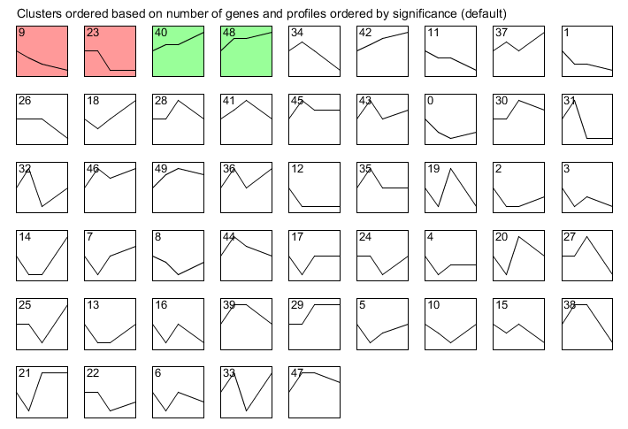
There were four significant profiles from the Thorsen data
Figure 1: STEM produced 4 significant profiles. Profiles 9 and 23 both show similar gene repression, while Profiles 40 and 48 both show similar gene expression increase so each pair was combined for further analysis.
Notes:
IVY
Inputted data into STEM and only produced 4 significant profiles, these were chosen for analysis because they were most significant
Profiles and 9 and 23 had the most genes in them, probably about 150, downregulation of gene expression
Profiles 40 and 48 had the least amount of genes, only about 30 or less, upregulation of gene expression

Slide 22
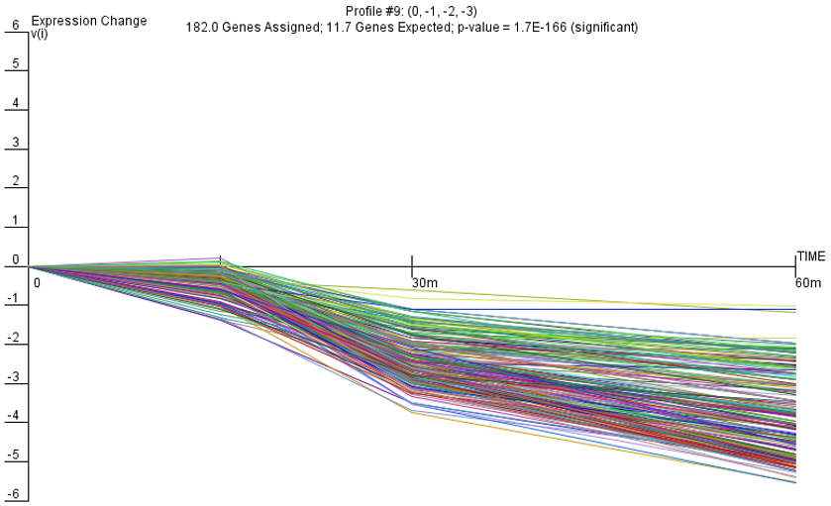
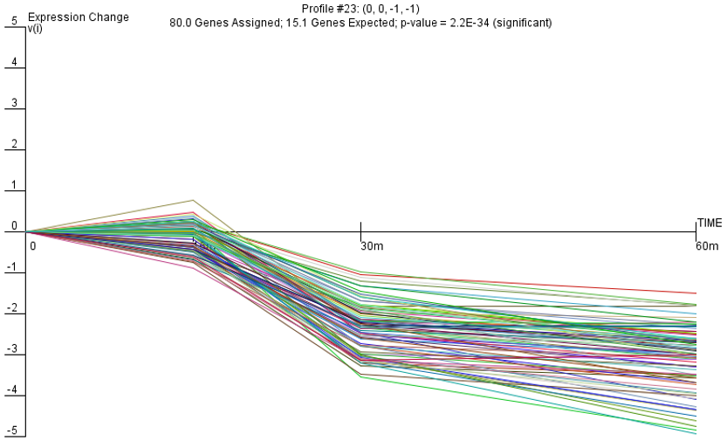
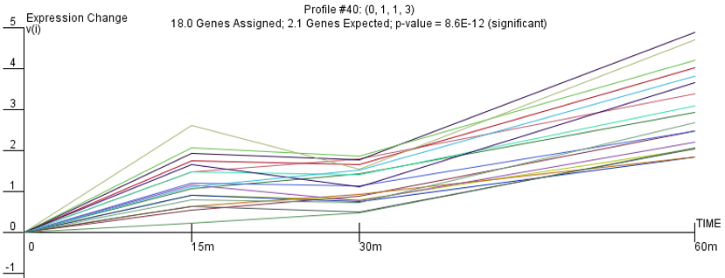
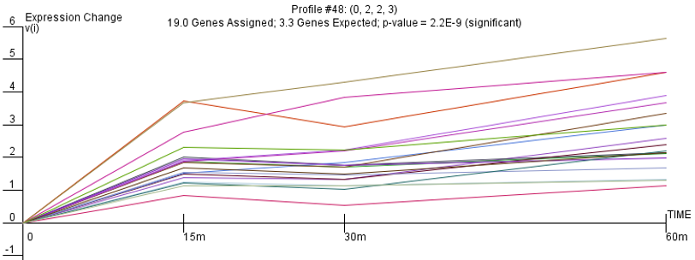
Significant STEM profiles show regulation of gene expression
Figure 2: Gene repression over time after exposure to arsenic for 182 genes of Profile 9; p = 1.7x10⁻¹⁶⁶.
Figure 3: Gene repression over time after exposure to arsenic for 80 genes of Profile 23; p = 2.2x10⁻³⁴.
Figure 4: Gene expression increase over time after exposure to arsenic for 18 genes of Profile 40; p = 8.6x10⁻¹².
Figure 5: Gene expression increase over time after exposure to arsenic for 19 genes of Profile 48; p = 2.2x10⁻⁹.
Notes:
IVY
Top 2- 9 and 23, bottom 2- 40 and 48
Most genes involved were for down regulation
1080 m timepoint was deleted for easiness of visualization
From now on, the stem profiles will associated in pairs 9 and 23, 40 and 48

Slide 23
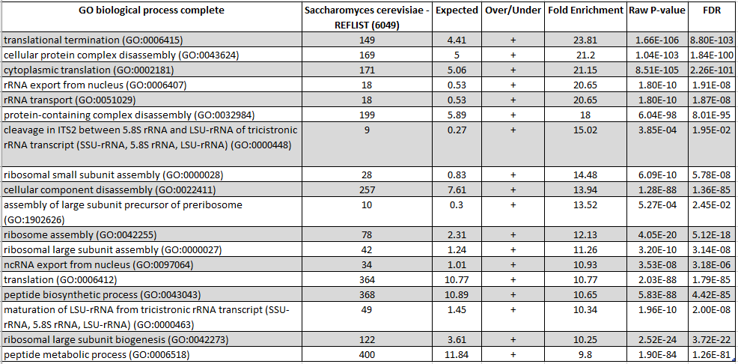
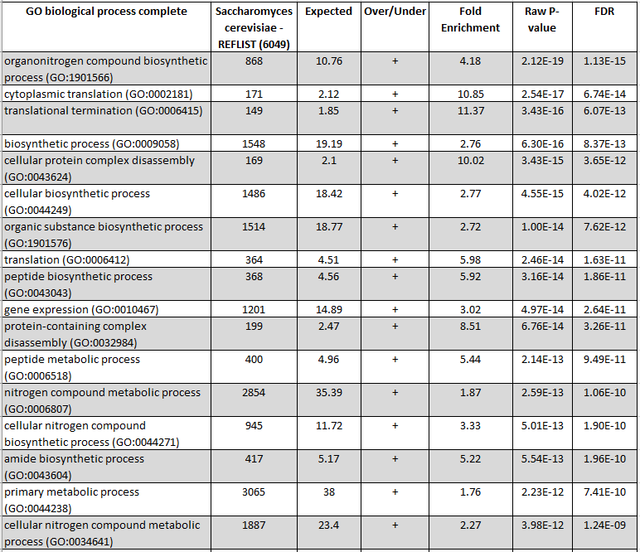
GO Results from Profiles 9 and 23
Table 2: GO results from Profile 9 suggesting gene regulation in response to arsenic exposure through significant translational termination and cellular component disassembly. The respective biological processes have the highest fold enrichment.
Table 3: GO results from Profile 23 suggesting gene regulation in response to arsenic exposure through significant cytoplasmic translation, translation termination, and cellular protein complex disassembly. The respective biological processes have the highest fold enrichment.
Notes:
MARCUS

Slide 24
GO Results from Profiles 40 and 48
Table 4: GO results from Profile 40 suggesting gene regulation in response to arsenic exposure through significant increase of cysteine biosynthesis process and cellular aldehyde metabolic process. The respective biological processes produce the highest fold enrichment.
Table 5: GO results from Profile 48 suggesting gene regulation in response to arsenic exposure through significant increase of response to abiotic stimulus. The respective biological processes produce the highest fold enrichment.
Notes:
MARCUS

Slide 25
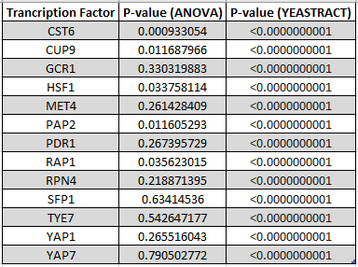
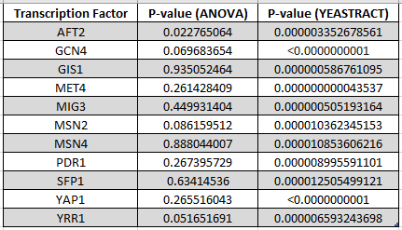
Regulatory Transcription Factors and their P-values
Table 6: Results of ANOVA and YEASTRACT analyses of genes in Profiles 9 and 23, highlighting the transcription factors present during the introduction of As(III) to Yeast strains
Table 7: Results of ANOVA and YEASTRACT analyses of genes in Profiles 40 and 48, highlighting the transcription factors present during the introduction of As(III) to Yeast strains
Notes:
MARCUS

Slide 26
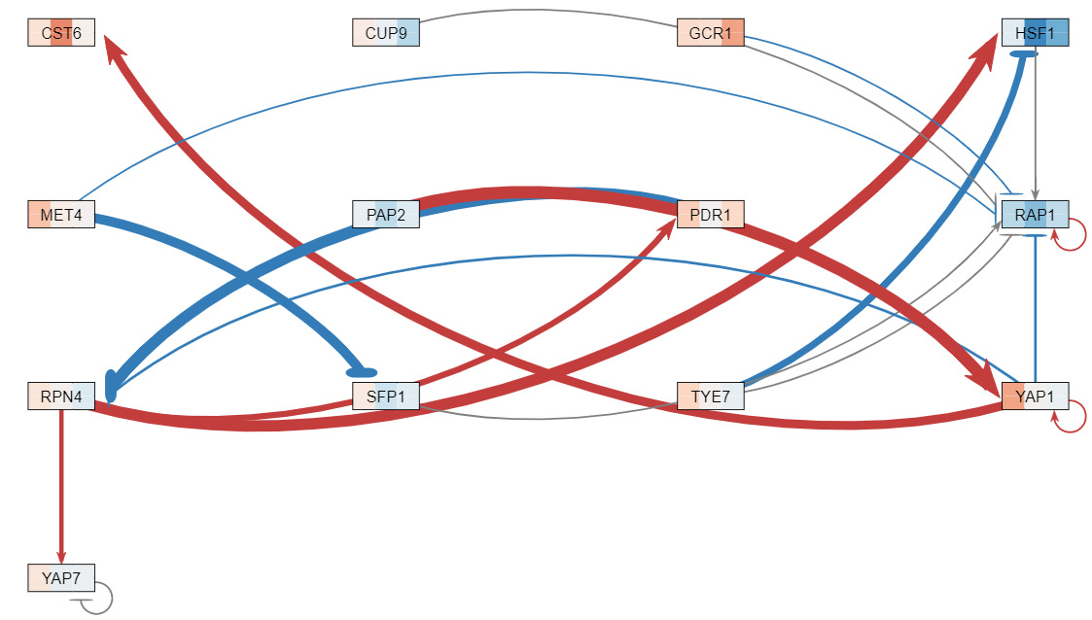
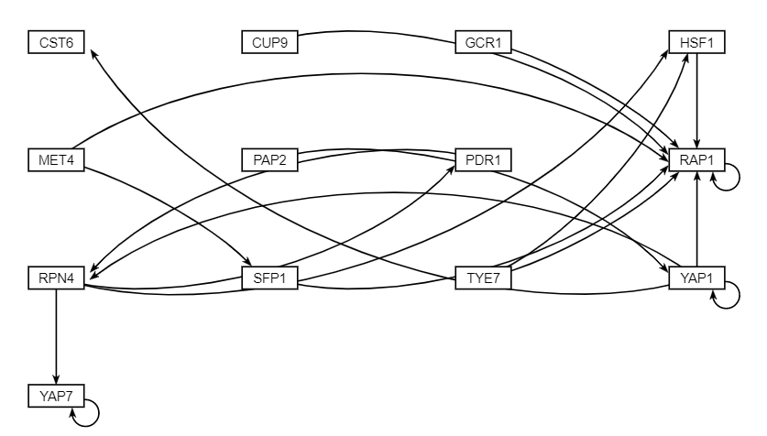
GRNsight produced weighted and unweighted gene regulation networks for Profiles 9 and 23
Figure 6: Weighted network results from inputting combined Profiles 9 and 23 to GRNsight, including gene repression (blue) and increased expression (red).
Figure 7: Resulting unweighted network from inputting combined Profiles 9 and 23 to GRNsight. Suggests highest gene regulation for RAP1.
Notes:
MARCUS

Slide 27
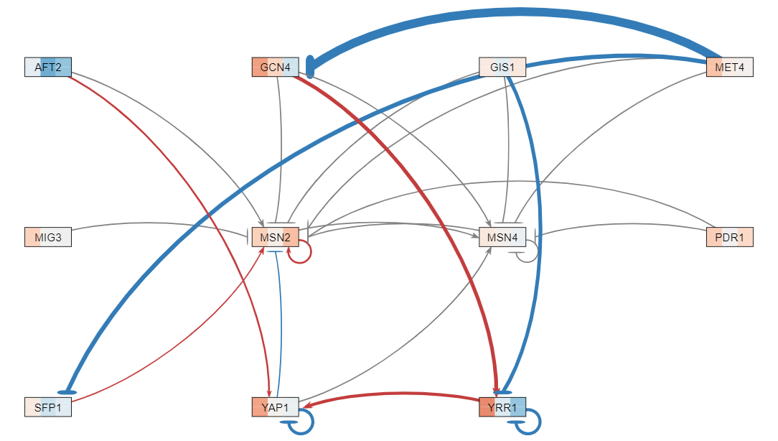
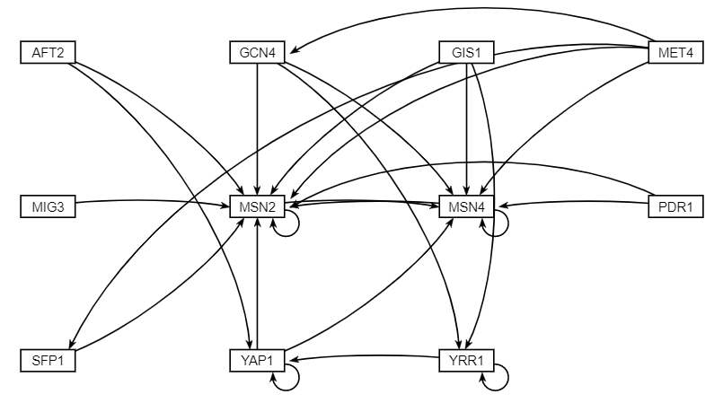
GRNsight produced weighted and unweighted gene regulation networks for Profiles 40 and 48
Figure 8: Resulting network from inputting combined Profiles 40 and 48 to GRNsight, including gene repression (blue) and increased expression (red).
Figure 9: Resulting network from inputting combined Profile 40 and 48 to GRNsight. Suggests highest gene regulation for MSN2 and MSN4.
Notes:
MARCUS

Slide 28
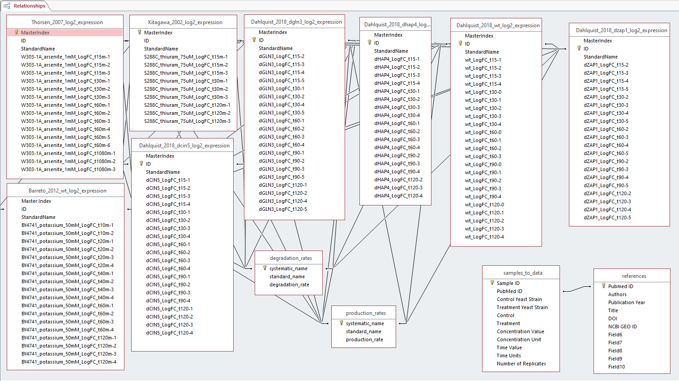
Final schema visualizes the collected databases between each dataset
Figure 10: The final schema shows the relationships between different datasets among each group relating the datasets including the degradation rates, production rates, and fold change expressions.
Notes:
DeLisa
-production rates
-degradation rates
-incomplete because the samples-to-data sheet isn't linked to the data

Slide 29
Overview of What Will Be Discussed in our Presentation
Data from Thorsen et al. and its scientific relevance was analyzed by Sulfiknight group members
Data was extracted and organized for analysis
Statistical analysis was performed on data and was organized by different methodologies, and visualization of this data can be seen through an MS Access database
Results from each methodology can show how different transcription factors function in S. cerevisiae's response to arsenic
This response can be analyzed in future research
Results found in Sulfiknight analysis contain similarities as well as differences found in the original research paper
Notes:
Naomi
Introduction
Review of the research paper used to inspire this work
Importance of this experiment
Team roles and responsibilities
Materials and Methods
Procedural Overview
Extraction of the data from the original source
Statistical analysis of microarray dataset
Creation of MS Access database containing production and degradation rates.
Analysis of data using various expression pattern methodologies
STEM, YEASTRACT, GRNsight, GRNmap
Visualization of different relationships among multiple databases through a schema
Results
ANOVA, STEM, Gene Ontology (GO) results, YEASTRACT p-values, GRNsight, Final schema
Discussion
Saccharomyces cerevisiae response to arsenic and future direction
Conclusion
How the acquired results differ from the results contributed by the original research paper

Slide 30
Stressed and non-stressed WT data from Thorsen et al. shows the response of S. cerevisiae to arsenic
Based on the Bonferroni criteria, only 0.522% of regulatory genes at the 15, 30, 60, and 1080 minutes were significant
STEM results show:
Most significant the transcription factors were involved in the down-regulation in gene expression, and these factors were mainly involved with translational termination and cellular component disassembly (Profiles 9 and 23)
Other factors controlled the cell's response to oxidative-reduction metabolism and to abiotic stressors (Profiles 40 and 48)
Multiple transcription factors were involved in regulation
For Profiles 9 and 23: PAP2, RPN4, YAP1, RAP1 (inhibition)
For Profiles 40 and 48: MET4, GIS1, MSN2 (inhibition), MSN4 (inhibition)
MS Access schema shows how data across groups can be used for future research
Future directions:
Analyze the datasheets that were not included in this assignment
Have this database accessible on GRNsight for future research
Find IDs that can be linked within the ACCESS schema
Notes:
Naomi

Slide 31
Overview of What Will Be Discussed in our Presentation
Data from Thorsen et al. and its scientific relevance was analyzed by Sulfiknight group members
Data was extracted and organized for analysis
Statistical analysis was performed on data and was organized by different methodologies, and visualization of this data can be seen through an MS Access database
Results from each methodology can show how different transcription factors function in S. cerevisiae's response to arsenic
This response can be analyzed in future research
Results found in Sulfiknight analysis contain similarities as well as differences found in the original research paper
Notes:
Naomi
Introduction
Review of the research paper used to inspire this work
Importance of this experiment
Team roles and responsibilities
Materials and Methods
Procedural Overview
Extraction of the data from the original source
Statistical analysis of microarray dataset
Creation of MS Access database containing production and degradation rates.
Analysis of data using various expression pattern methodologies
STEM, YEASTRACT, GRNsight, GRNmap
Visualization of different relationships among multiple databases through a schema
Results
ANOVA, STEM, Gene Ontology (GO) results, YEASTRACT p-values, GRNsight, Final schema
Discussion
Saccharomyces cerevisiae response to arsenic and future direction
Conclusion
How the acquired results differ from the results contributed by the original research paper

Slide 32
The paper's results and our reanalysis of the data
The yeast cells were exposed to two concentrations of sodium As(III)
0.2mM and 1mM
Some genes were related to arsenic detoxification and structural components of the sulfur assimilation and GSH biosynthesis pathway
Due to the results showing that As-(III)-exposed cells channel a large part of assimilated sulfur
The paper focused on Met4 and Yap1 while there are many other transcription factors
CUP9, GCR1, HSF1, SFP1, etc.
Difficulty with navigating key parts of the research
Strain name
Could only work on one dataset that compiled everything
Multiple datasheets were available, but we used Set A
Notes:
Naomi

Slide 33
Acknowledgments
Dr. Kam Dahlquist
Skinny Genes and FunGals
Seaver College of Science and Engineering
LMU Computer Science Department
Loyola Marymount University
https://www.lmu.edu/
http://www.yeastract.com/index.php
http://geneontology.org/
Notes:
Naomi

Slide 34
Sources used for this presentation
Barreto, L., Canadell, D., Valverde‐Saubí, D., Casamayor, A., & Ariño, J. (2012). The short‐term response of yeast to potassium starvation. Environmental microbiology, 14(11), 3026-3042. DOI: 10.1111/j.1462-2920.2012.02887.x
Kitagawa, E., Takahashi, J., Momose, Y., & Iwahashi, H. (2002). Effects of the pesticide thiuram: genome-wide screening of indicator genes by yeast DNA microarray. Environmental science & technology, 36(18), 3908-3915. DOI: 10.1021/es015705v
Thorsen, M., Lagniel, G., Kristiansson, E., Junot, C., Nerman, O., Labarre, J., & Tamás, M. J. (2007). Quantitative transcriptome, proteome, and sulfur metabolite profiling of the Saccharomyces cerevisiae response to arsenite. Physiological genomics, 30(1), 35-43. DOI: 10.1152/physiolgenomics.00236.2006
Notes:
Naomi

