Slide 1
ANOVA | STRAIN
p < 0.05 | 40.1%
p < 0.01 | 25.6%
p < 0.001 | 11.9%
p < 0.0001 | 4.5%
B & H p < 0.05 | 28.0%
Bonferroni p < 0.05 | 1.2%

Slide 2
NSR1 | Results
Unadjusted P Value | 0.0163642
Bonferroni | 101.2780918
B & H | 0.055525
15m | 30m | 60m | 90m | 120m
2.69945 | 3.2508 | 3.519975 | -1.10057 | -1.79767
There is evidence of a change in gene expression due to the cold shock

Slide 3
HSF1 | Results
Unadjusted P Value | 0.0021576
Bonferroni | 13.35315898
B & H | 0.013982
15m | 30m | 60m | 90m | 120m
-1.03265 | -1.2029 | -0.73115 | -0.16 | 1.1701
There is evidence of a change in gene expression due to the cold shock

Slide 4
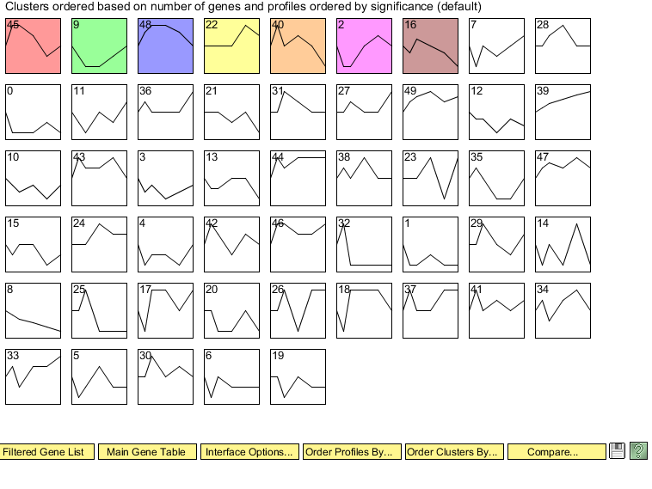

Slide 5
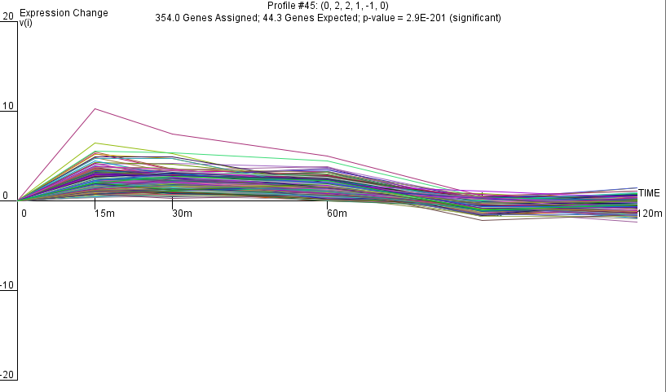

Slide 6
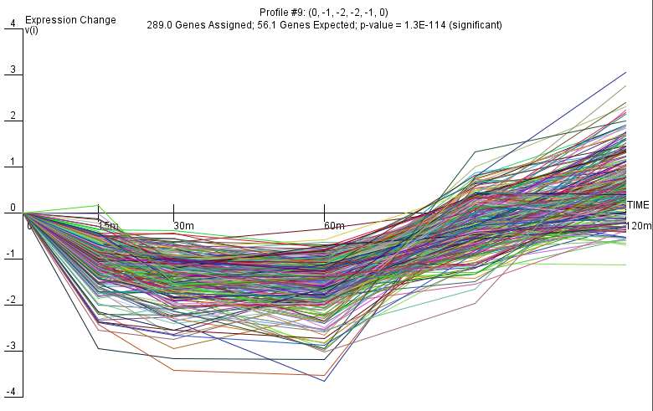

Slide 7
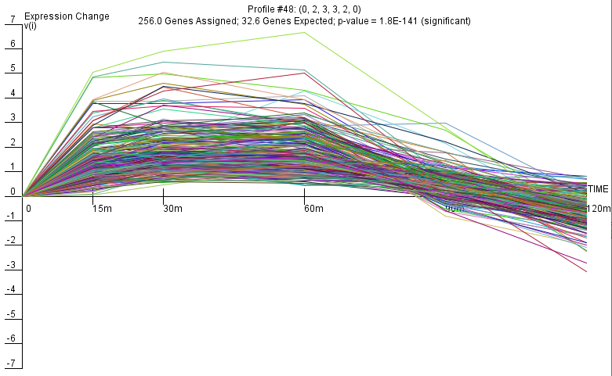

Slide 8
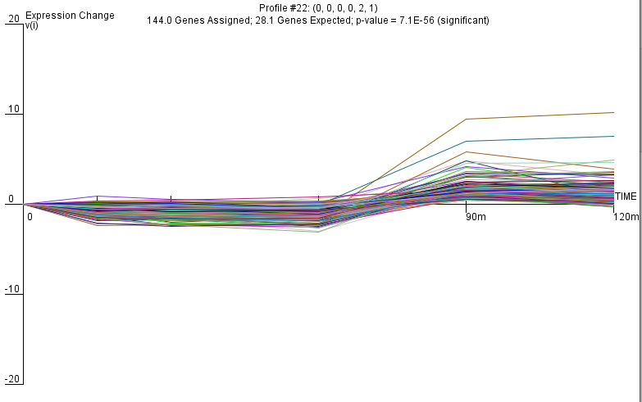

Slide 9
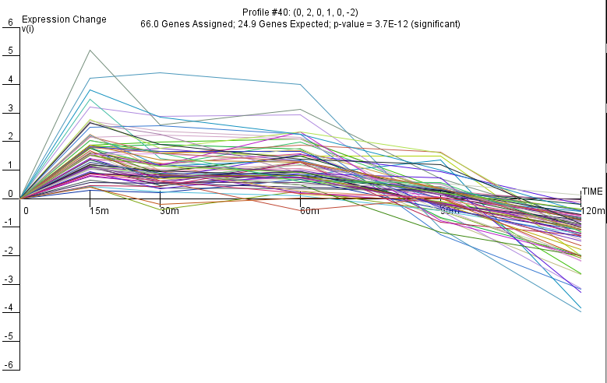

Slide 10
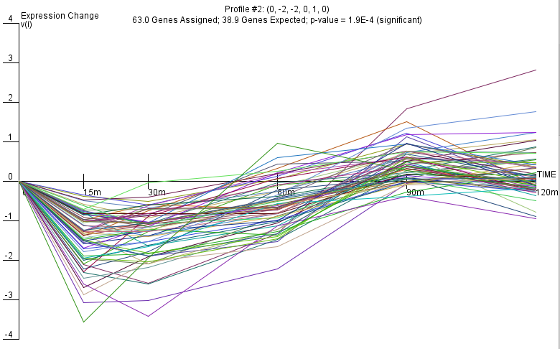

Slide 11
