Slide 1
CancerSEA:
A Database for the Classification of
Cancer Cells
Ivy Macaraeg and DeLisa Madere
BIOL 367-01: Biological Databases
Loyola Marymount University
Dr. Dhalquist
September 30, 2019

Slide 2
Overview
Purpose and unique components
Science quality
Database utilization
Summary judgements

Slide 3
Overview
Purpose and unique components
Science quality
Database utilization
Summary judgements

Slide 4
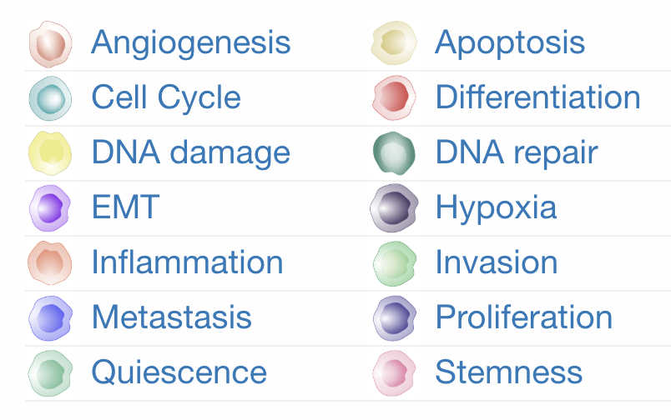
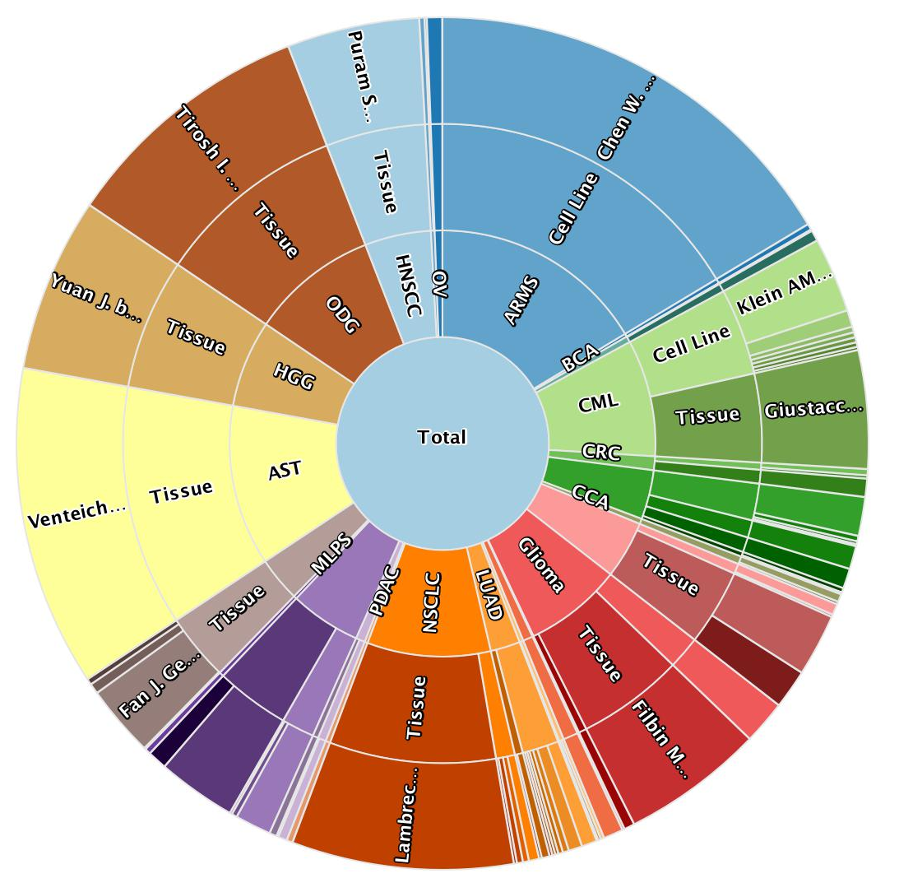
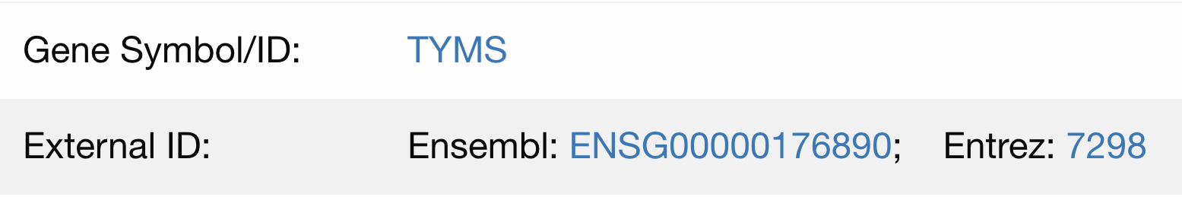
CancerSEA aims to categorize specific cancer cells
at the genetic level
Different cancers are organized by their cellular functionality.
CancerSEA specifies the location of each cancer cell in a tumor.
It lists the genes that are involved with each cell type.

Slide 5
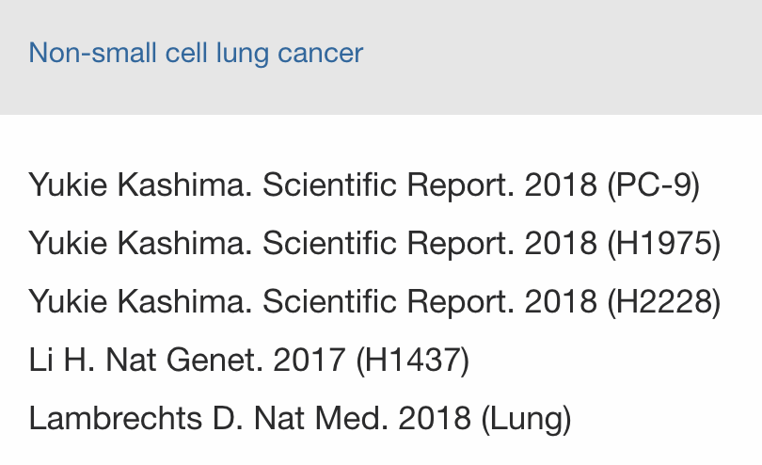
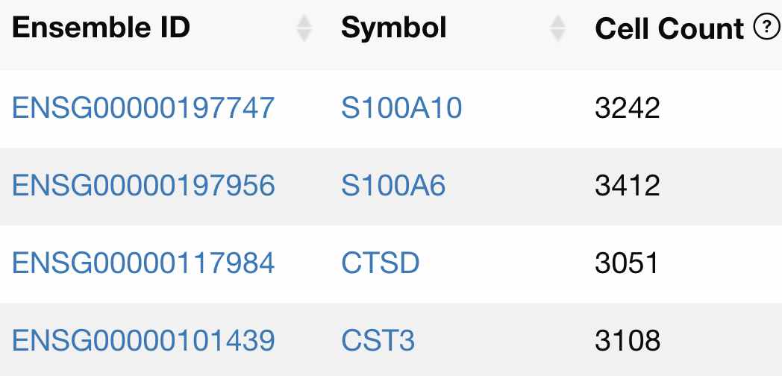
CancerSEA provides multiple levels of organization
to classify different cancer cells
CancerSEA categorizes multiple research studies that provides information on a specific cancer cell type.
  It provides links to primary sources that give experimental data.
  These sources are originally published by the NCBI PubMed database.
  These are called "datasets" by the CancerSEA.
This organization can help lead researchers or users to find specific details on a cancer type they are looking for.
  Cancer cells are categorized under 14 functions (ie. metastasis, DNA damage, apoptosis, invasion).
  Each cell is correlated with a specific cancer type.
  Genes are linked back to the Ensembl database.

Slide 6
Overview
Purpose and unique components
Science quality
Database utilization
Summary judgements

Slide 7


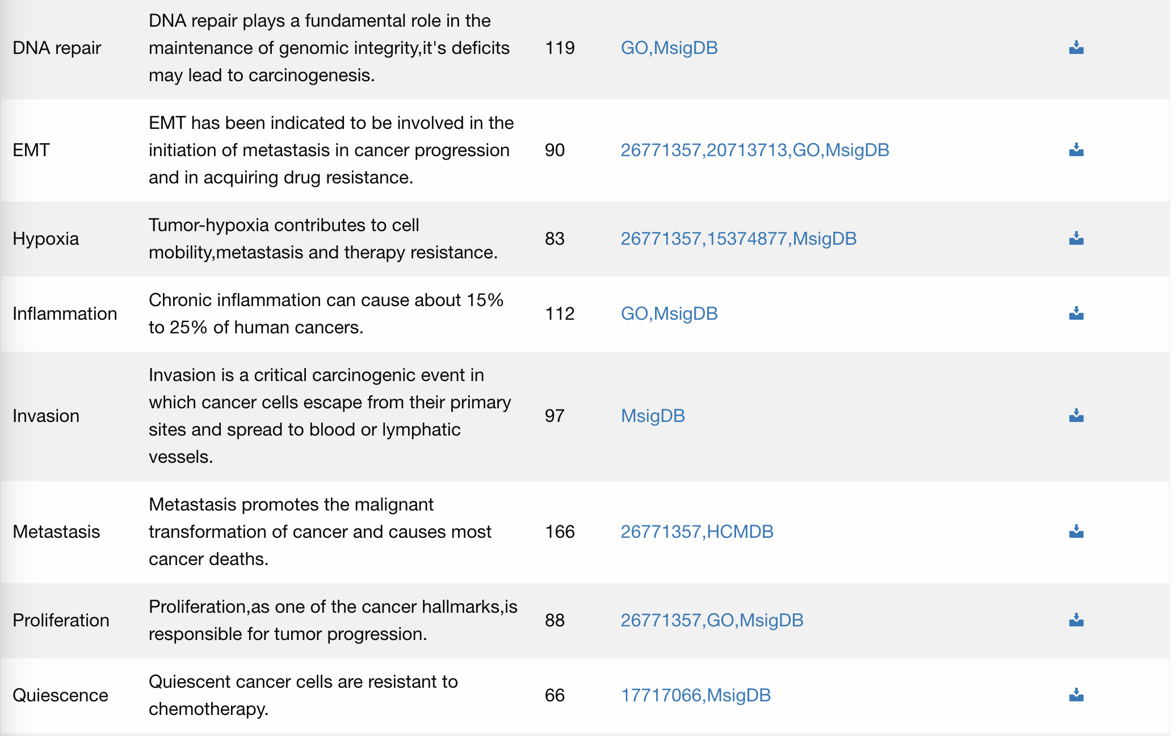
CancerSEA provides useful data for cancer research
CancerSEA allows users to query relationships between genes and the 14 listed functional states.
There are about 42,000 records of single cancer cell sets.
  The data provided can be downloaded and used for research analysis via .zip,.txt, and .xls.
The information provided in this database is critical to cancer research.
  The ability to determine heterogeneity of these cancers can be crucial to preventing excessive growth.

Slide 8
Overview
Purpose and unique components
Science quality
Database utilization
Summary judgements

Slide 9
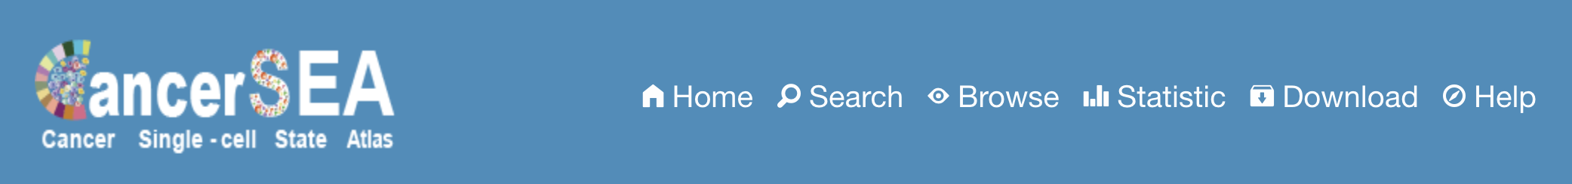
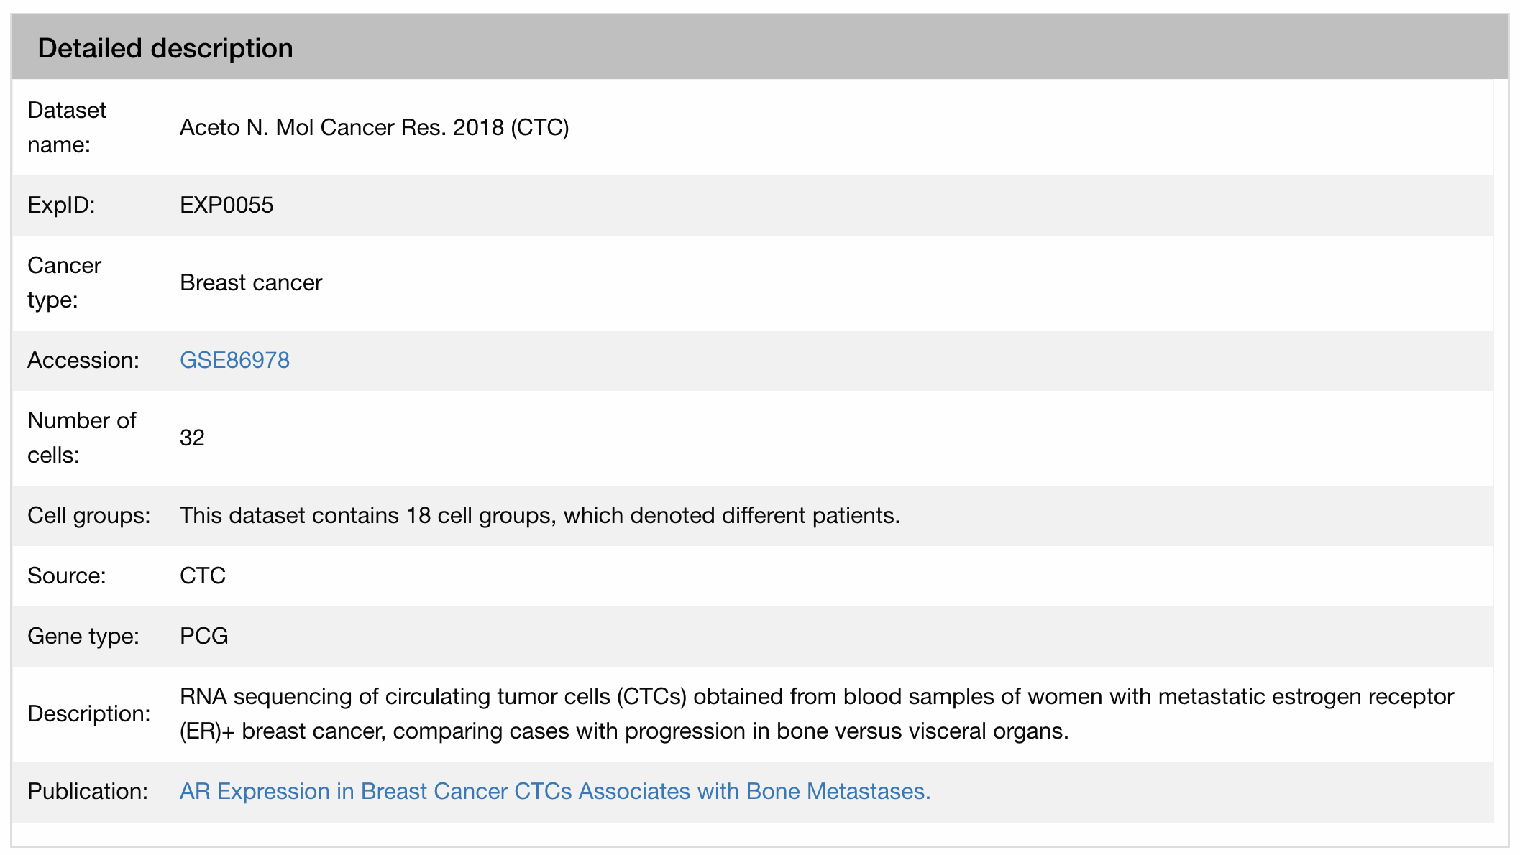
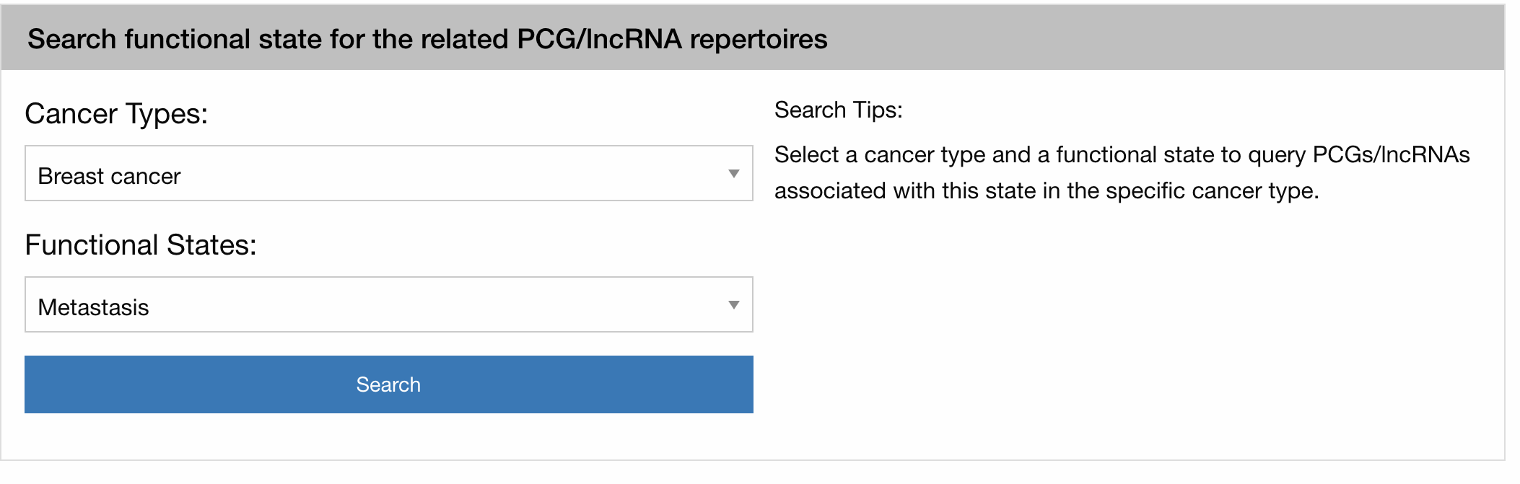
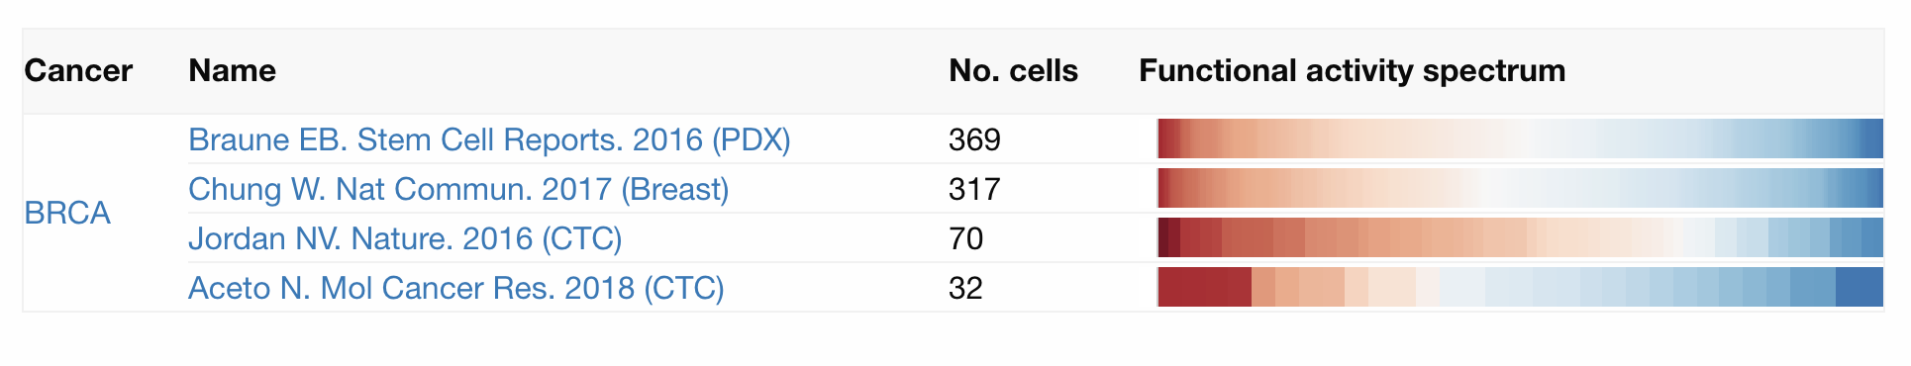
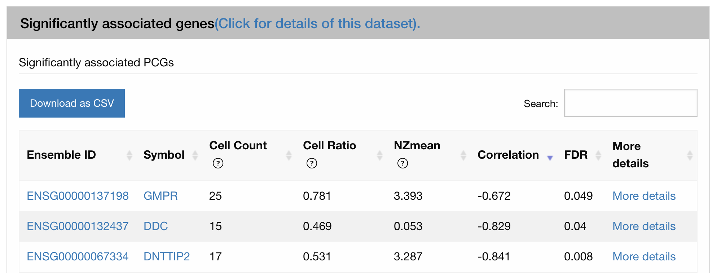
Searching for a general cancer cell from CancerSEA provides information based on the publication

Slide 10

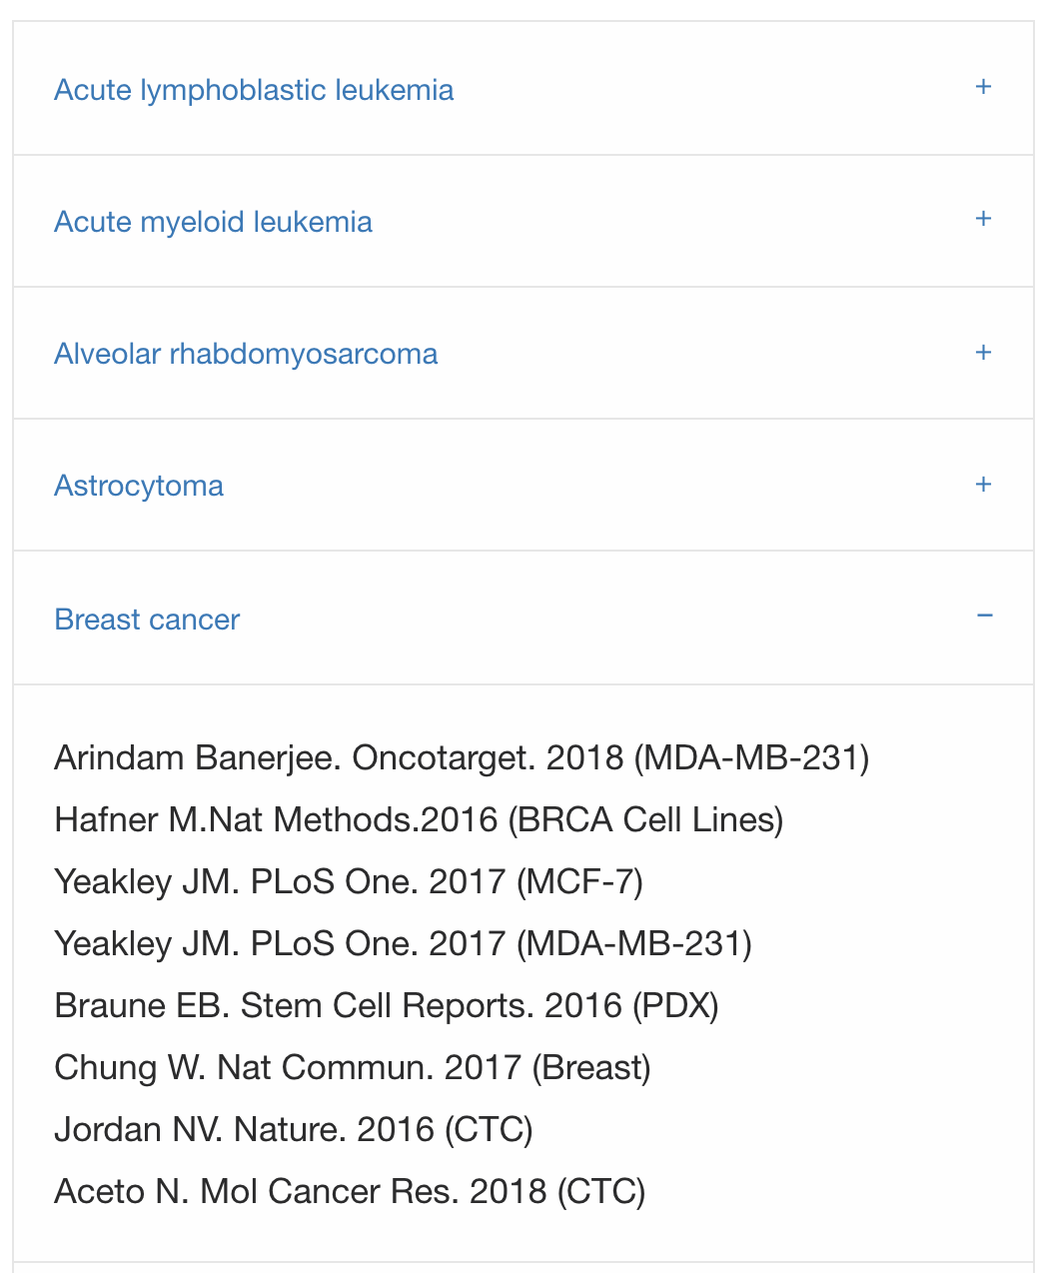

Similar data is not aggregated onto one page

Slide 11
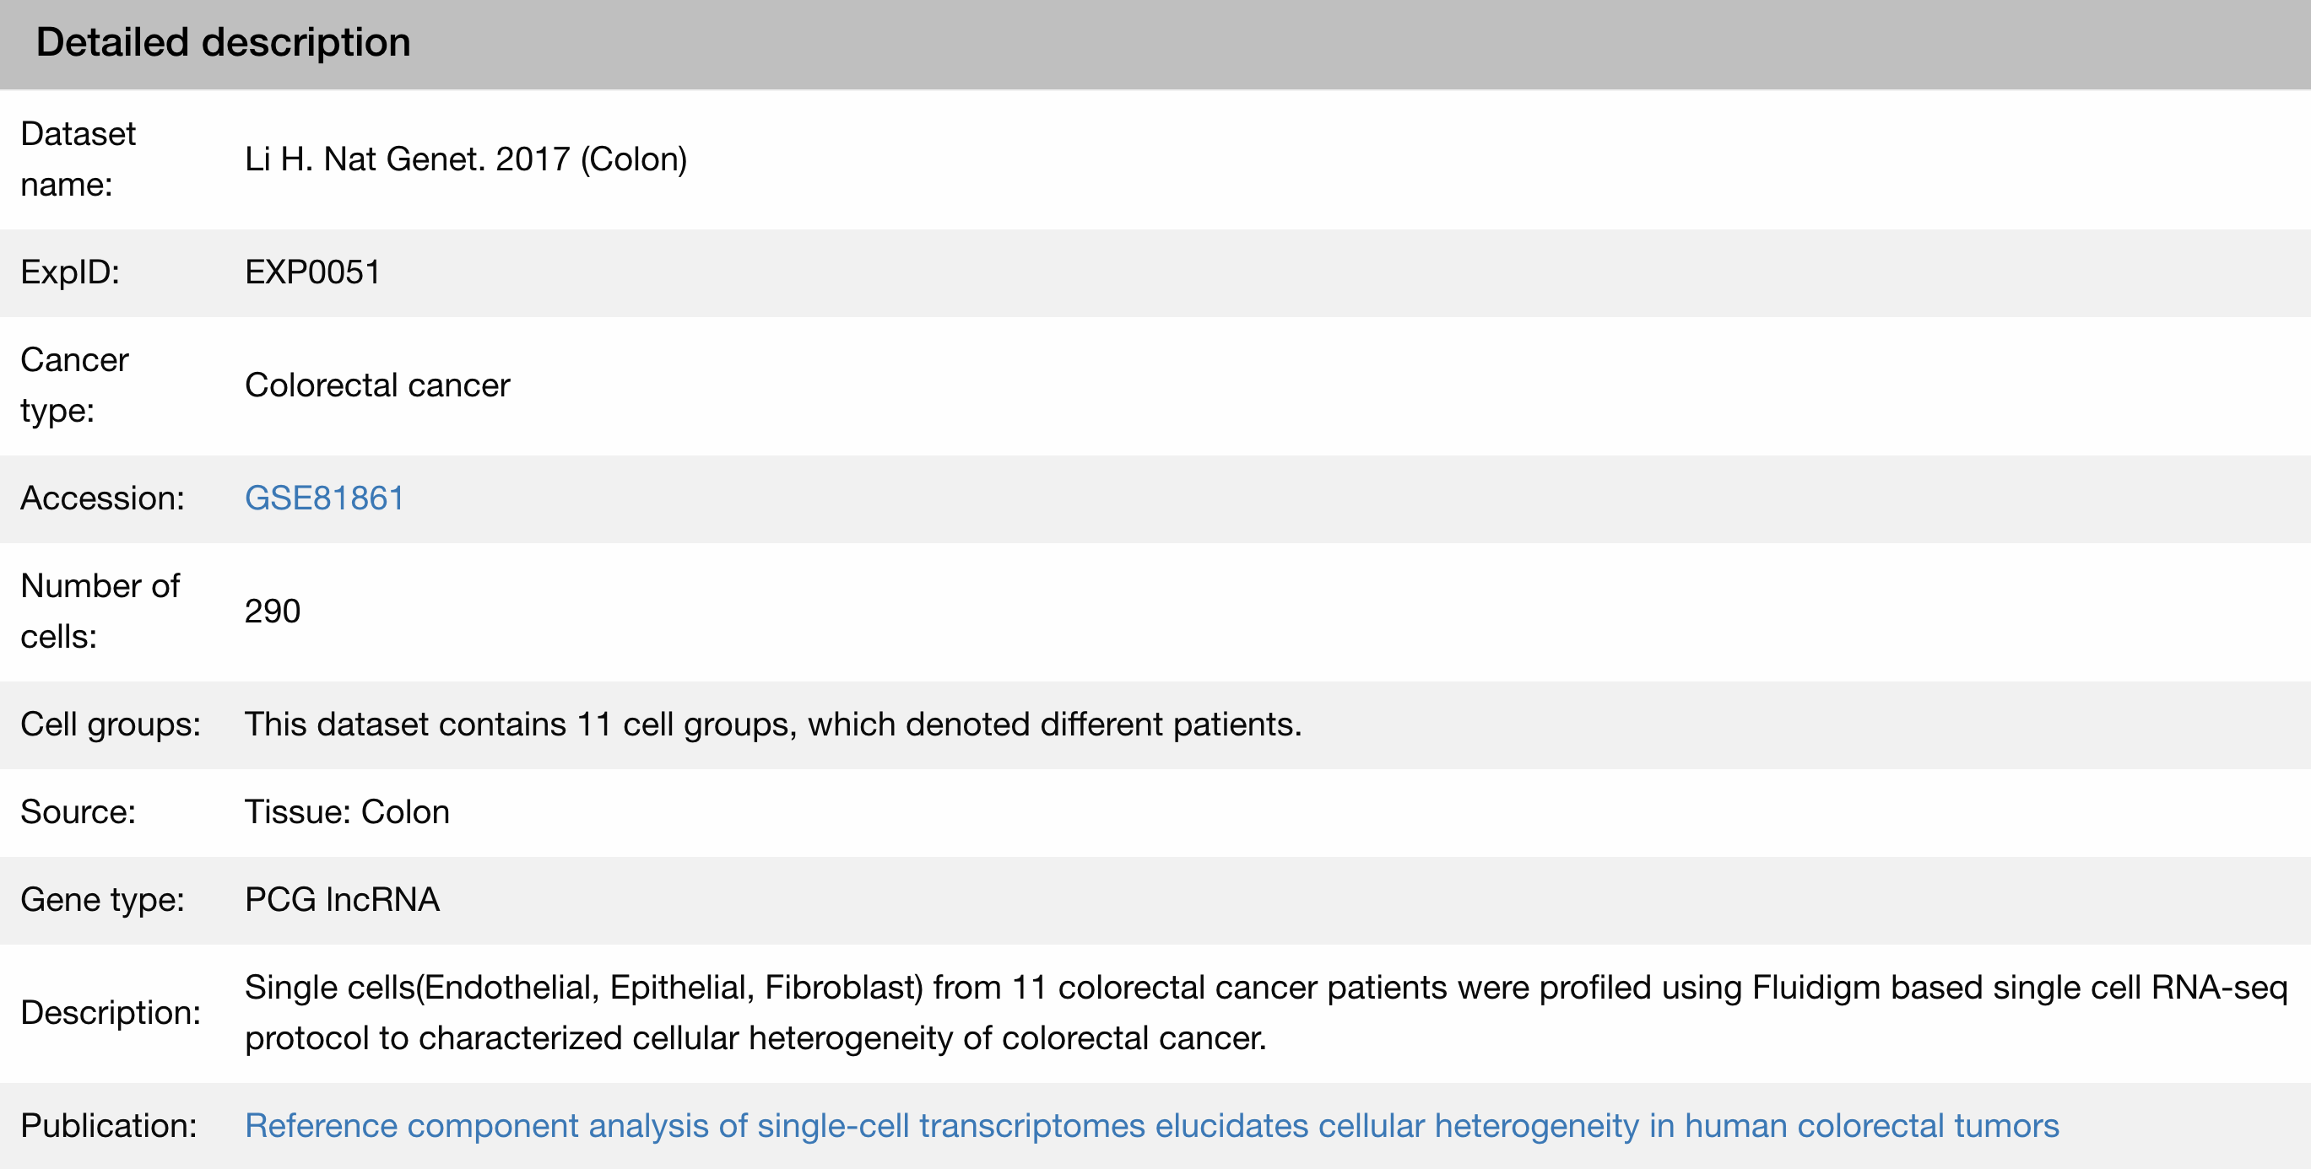
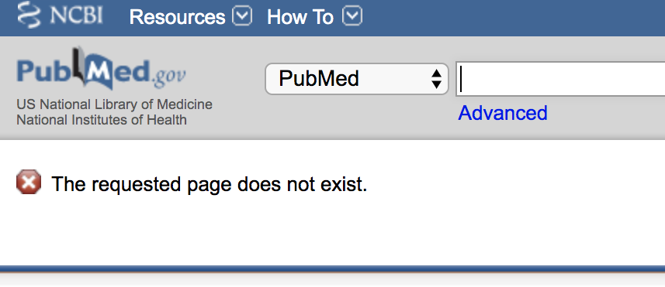
Linked datasets are not updated
Some links trace back to pages that have no content.
This makes it difficult for users or reseachers to study that specific cell.

Slide 12
Overview
Purpose and unique components
Science quality
Database utilization
Summary judgements

Slide 13
CancerSEA is catered towards scientists already studying cancer cell research
This professional database provides information aiming to decode the different functional states of cancer cells and genes relative to them.
CancerSEA is difficult to navigate for someone unfamiliar with cancer cell research.
  There are many acronyms, graphs, and terms that make it difficult to understand (I.e. PCG, IncRNA, and Glioblastoma).
  There is not much fluidity when navigating through the links.
The database has expressed their wish to include updating the database weekly, adding new functional states, and condensing single-cell data to assist in finding more diagnoses and treatments for cancer.

Slide 14
References
CancerSEA. (2018). College of Bioinformatics Science and Technology, Harbin Medical University. Retrieved September 30, 2019 from http://biocc.hrbmu.edu.cn/CancerSEA/home.jsp
Huating Yuan et, al. CancerSEA: a cancer single-cell state atlas. (2019). Nucleic Acids Research, Volume 47, Issue D1. Retrieved on September 30, 2019 from https://academic.oup.com/nar/article/47/D1/D900/5133662

Slide 15


Acknowledgements
We would like to thank Dr. Dahlquist and our Biological Databases classmates for listening to our presentation
Thank you to CancerSEA for providing the data for us to explore and analyze.

