Slide 1
ANOVA | dHAP4
p < 0.05 | 2,479 (40.00 %)
p < 0.01 | 1,583 (25.57 %)
p < 0.001 | 739 (11.94 %)
p < 0.0001 | 280 (4.50 %)
B & H p < 0.05 | 1,735 (28.00 %)
Bonferroni p < 0.05 | 75 (1.21 %)

Slide 2
Stem Profiles

Slide 3
Cluster 2

Slide 4
Cluster 9

Slide 5
Cluster 16

Slide 6
Cluster 22

Slide 7
Cluster 40

Slide 8
Cluster 45

Slide 9
Cluster 48

Slide 10
endoplasmic reticulum membrane (GO:0005789)
Definition: The lipid bilayer surrounding the endoplasmic reticulum

Slide 11
vacuolar membrane GO:0005774
Definition: The lipid bilayer surrounding the vacuole and separating its contents from the cytoplasm of the cell

Slide 12
cytosolic large ribosomal subunit GO:0022625
Definition: The large subunit of a ribosome located in the cytosol.

Slide 13
cytoplasmic translation GO:0002181
Definition: The chemical reactions and pathways resulting in the formation of a protein in the cytoplasm. This is a ribosome-mediated process in which the information in messenger RNA (mRNA) is used to specify the sequence of amino acids in the protein.

Slide 14
endoplasmic reticulum GO:0005783
Definition: The irregular network of unit membranes, visible only by electron microscopy, that occurs in the cytoplasm of many eukaryotic cells. The membranes form a complex meshwork of tubular channels, which are often expanded into slitlike cavities called cisternae. The ER takes two forms, rough (or granular), with ribosomes adhering to the outer surface, and smooth (with no ribosomes attached).

Slide 15
apoptotic process GO:0006915
Definition: A programmed cell death process which begins when a cell receives an internal (e.g. DNA damage) or external signal (e.g. an extracellular death ligand), and proceeds through a series of biochemical events (signaling pathway phase) which trigger an execution phase. The execution phase is the last step of an apoptotic process, and is typically characterized by rounding-up of the cell, retraction of pseudopodes, reduction of cellular volume (pyknosis), chromatin condensation, nuclear fragmentation (karyorrhexis), plasma membrane blebbing and fragmentation of the cell into apoptotic bodies. When the execution phase is completed, the cell has died.

Slide 16
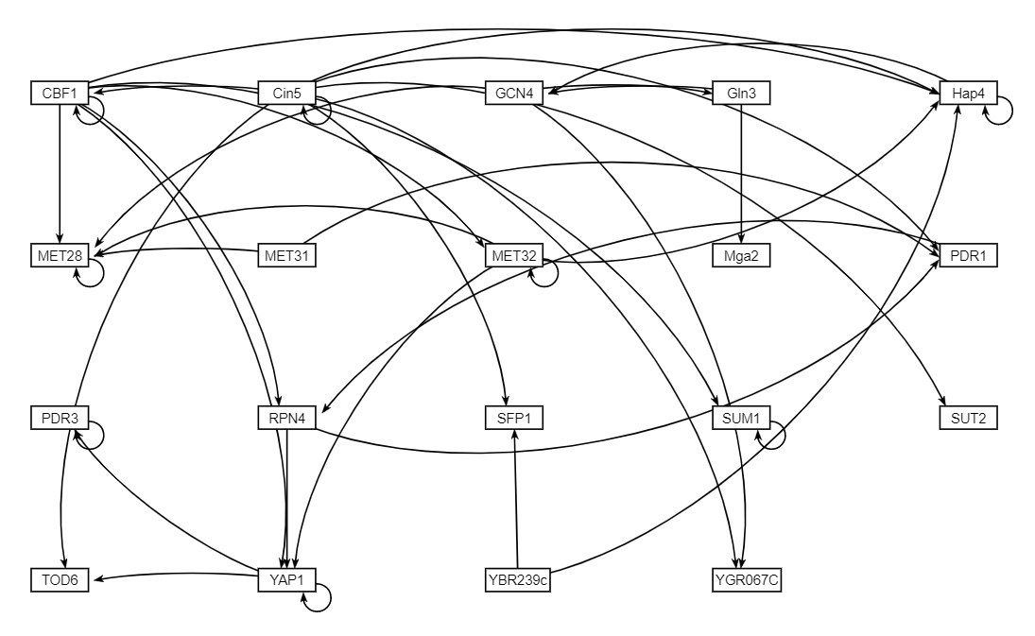
GRNsight of Adjacency Matrix

