Slide 1
Week 9: biological databases
Microarray Data Analysis
By: Kaitlyn Nguyen

Slide 2
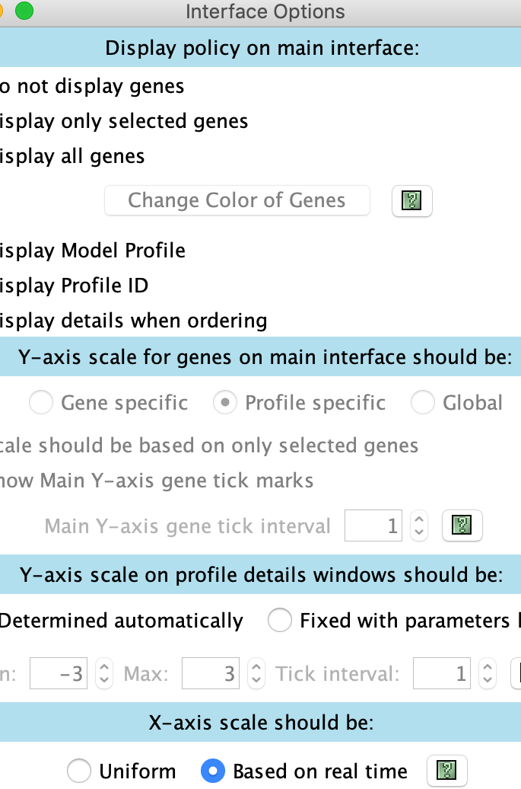
Viewing and saving stem results

Slide 3
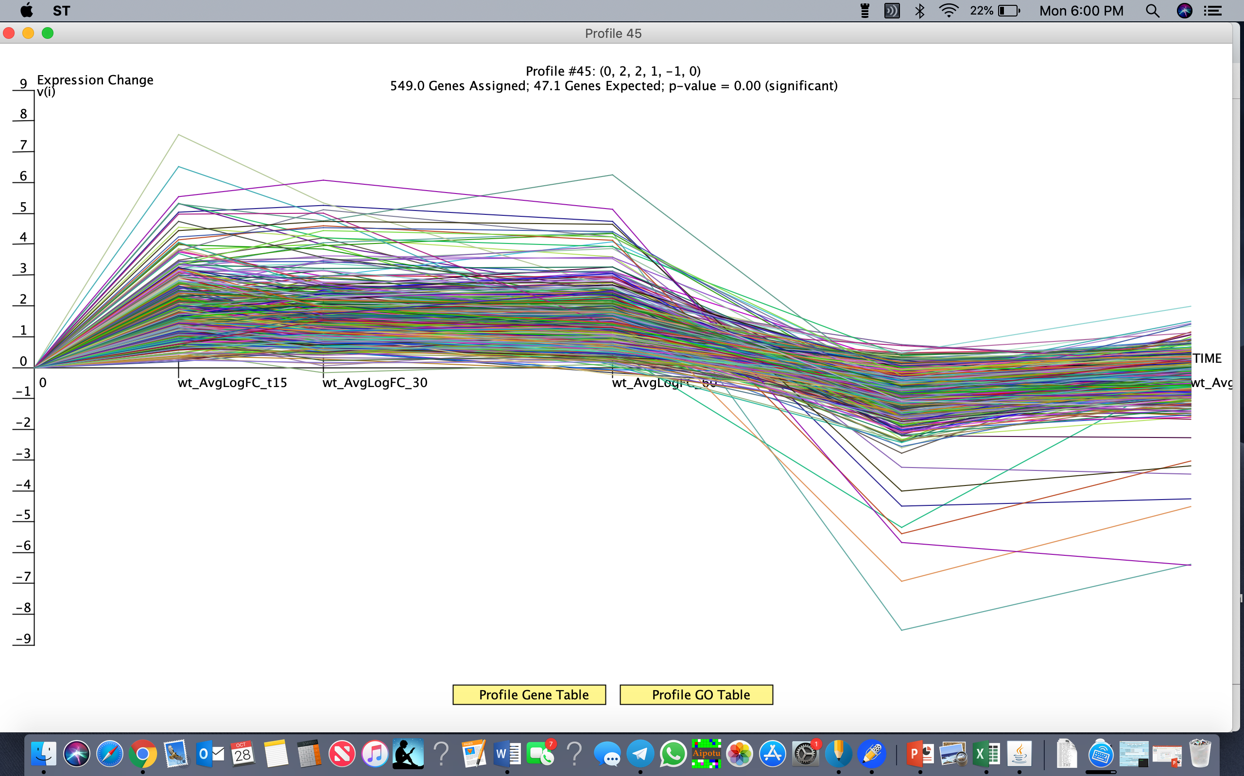
Profile #45

Slide 4
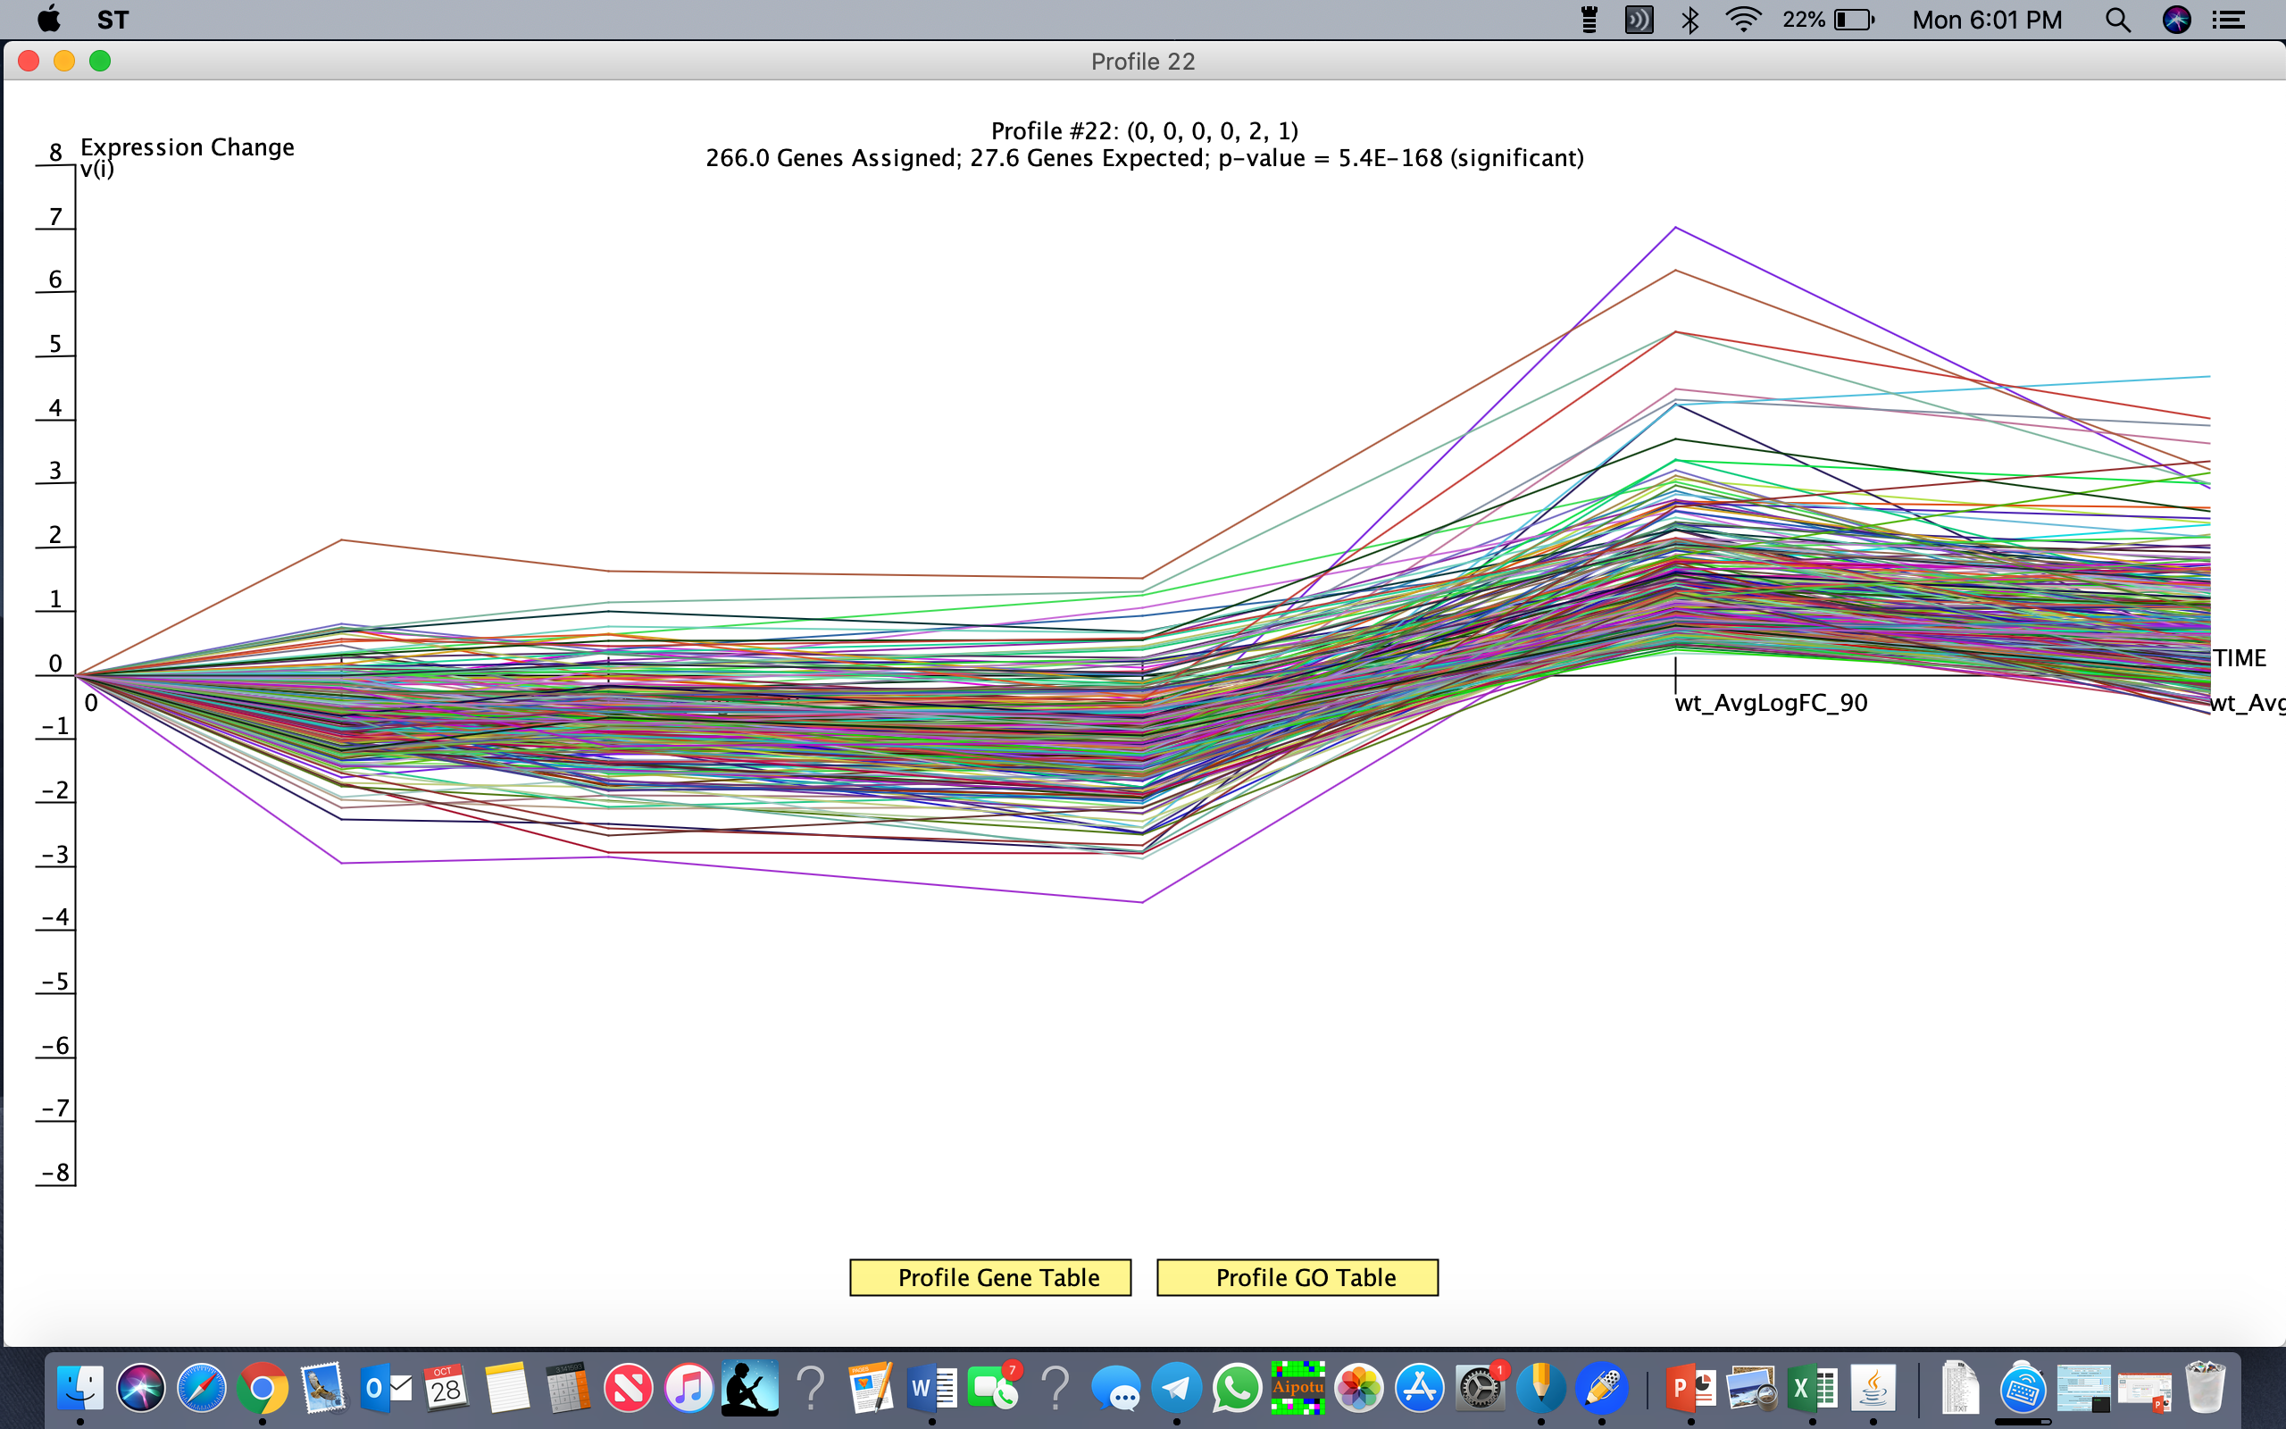
Profile #22

Slide 5
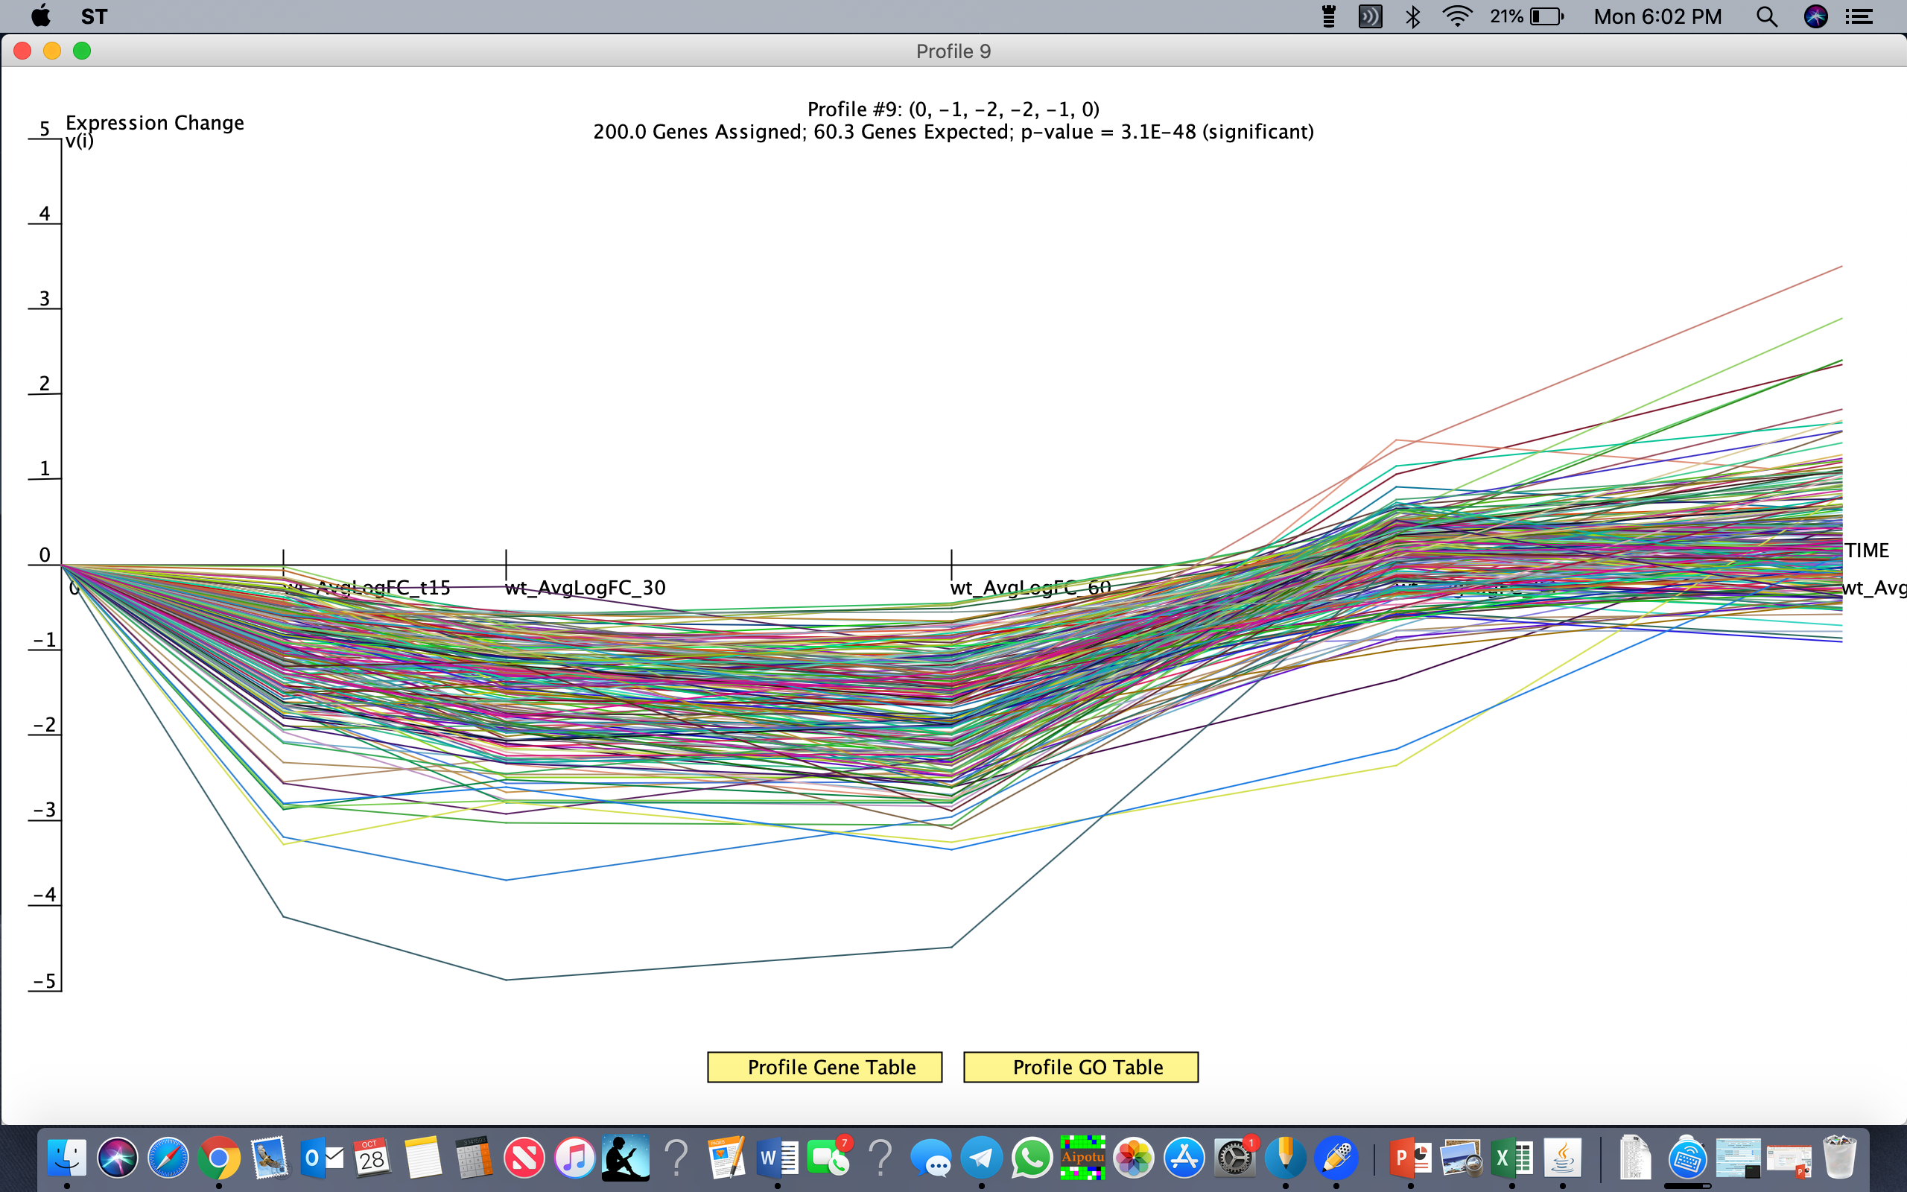
Profile #9

Slide 6
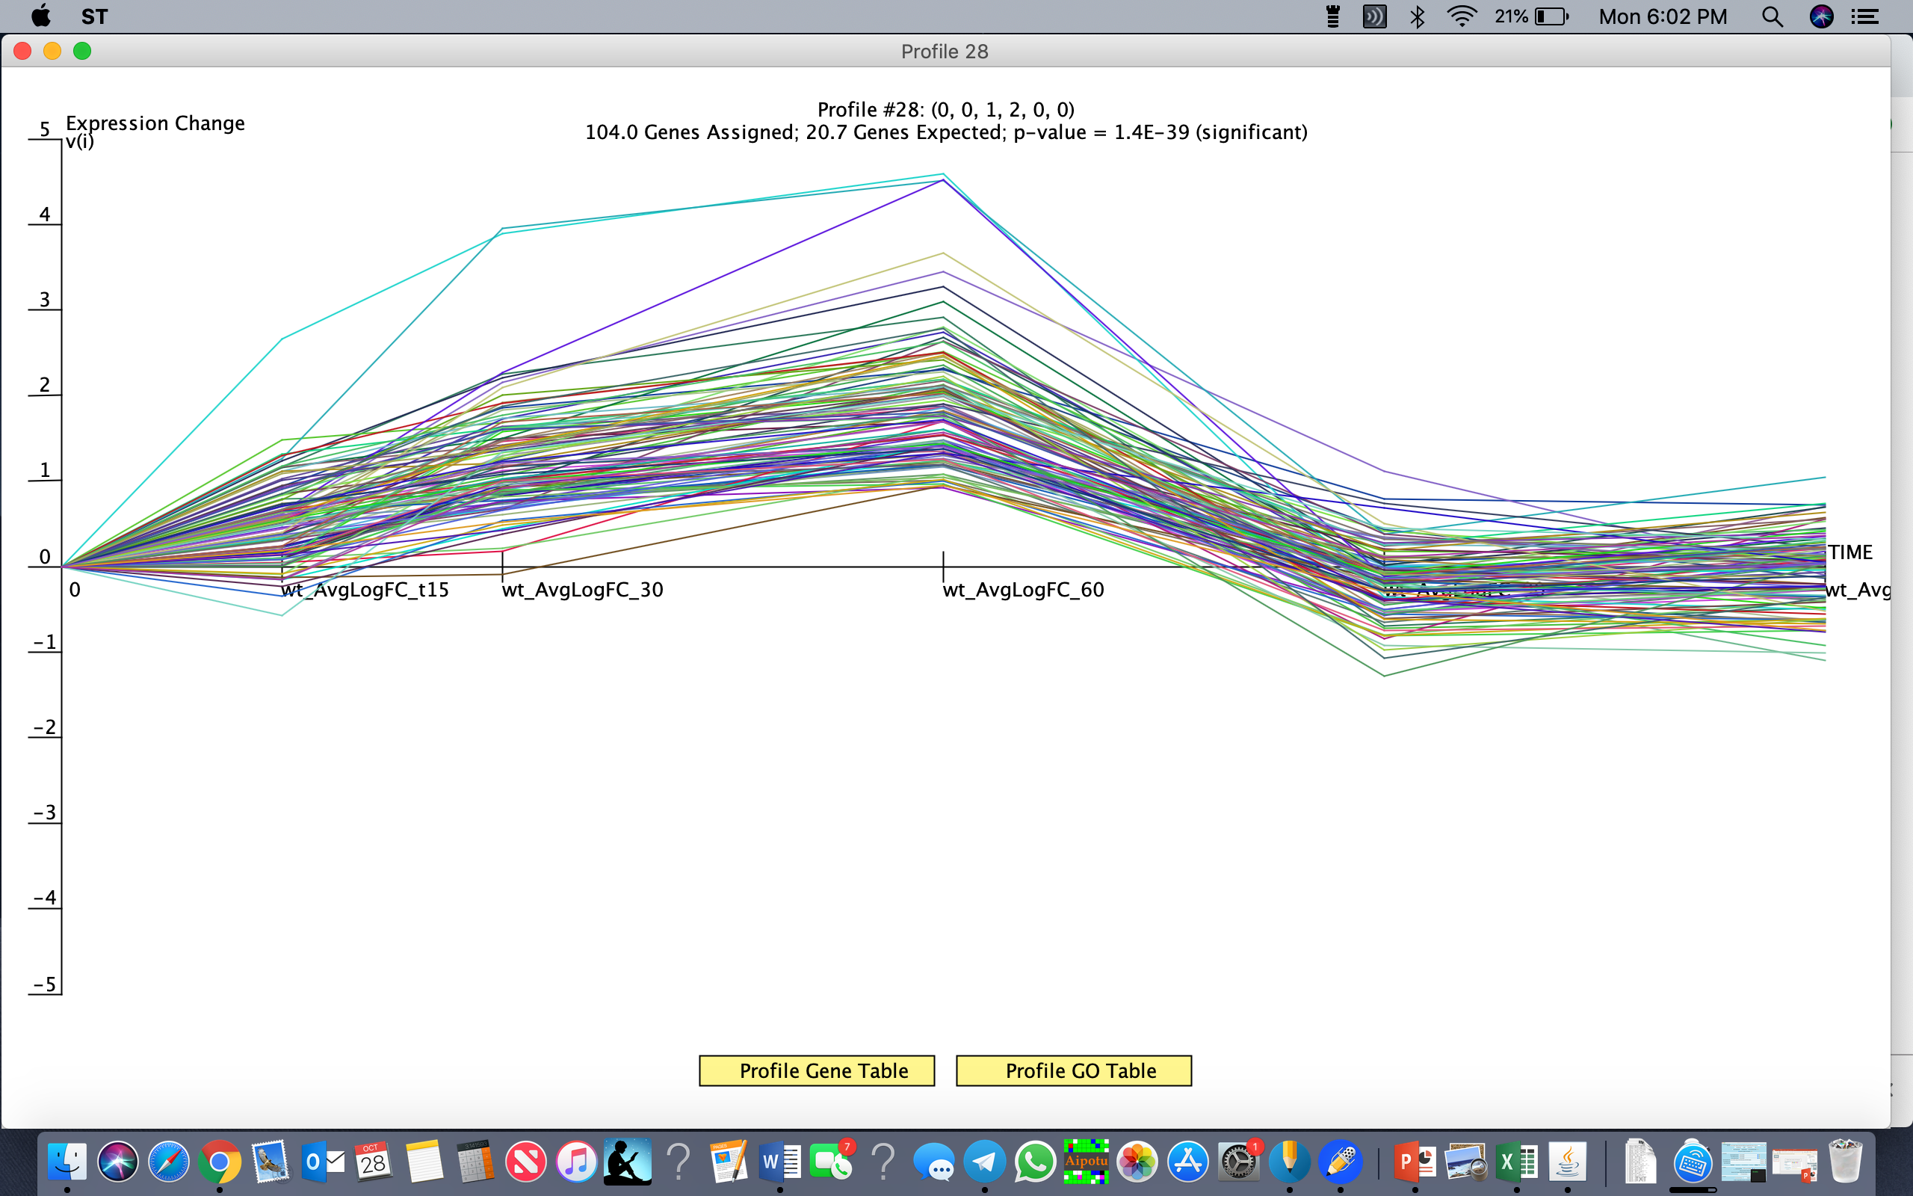
Profile #28

Slide 7
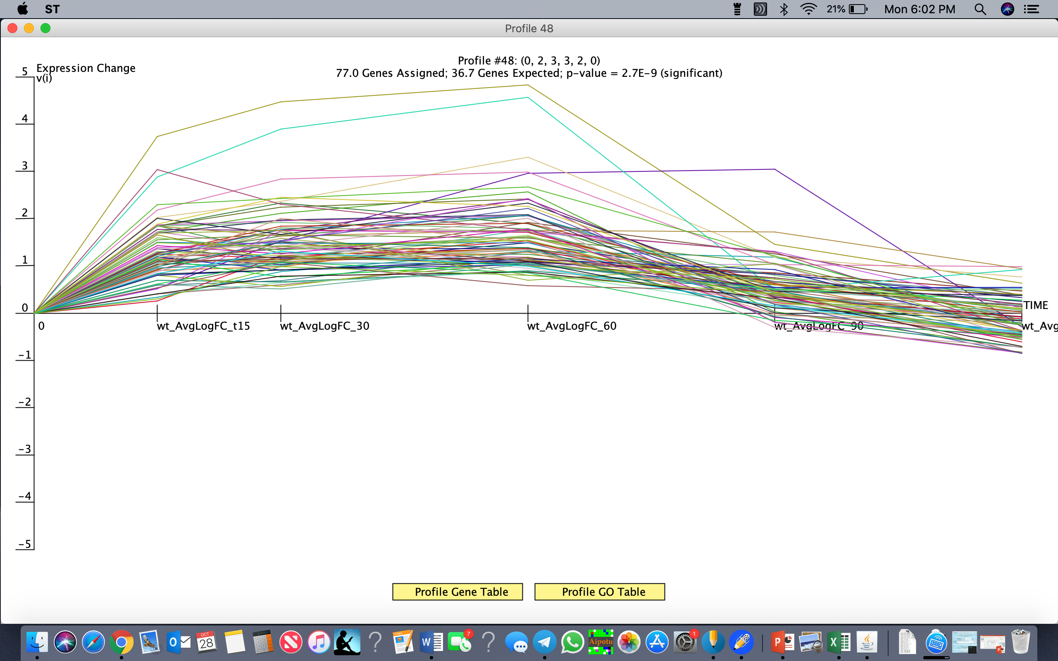
Profile #48

Slide 8
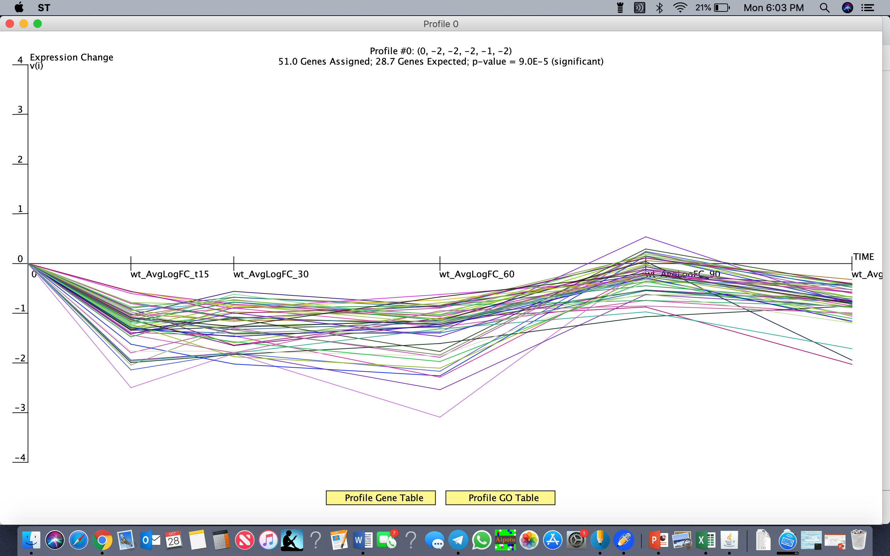
Profile #0

