Slide 1
ANOVA | dCIN5
p < 0.05 | 37.00%
p < 0.01 | 22.30%
p < 0.001 | 11.16%
p < 0.0001 | 5.784%
B & H p < 0.05 | 3.440%
Bonferroni p < 0.05 | 23.48%

Slide 2
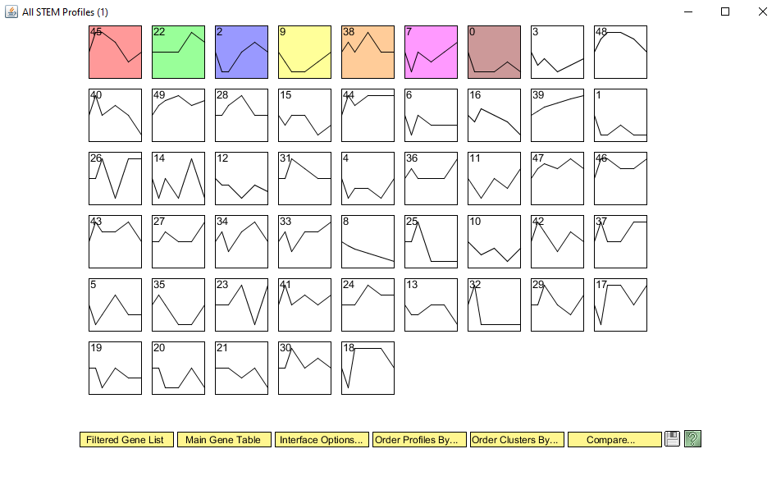

Slide 3
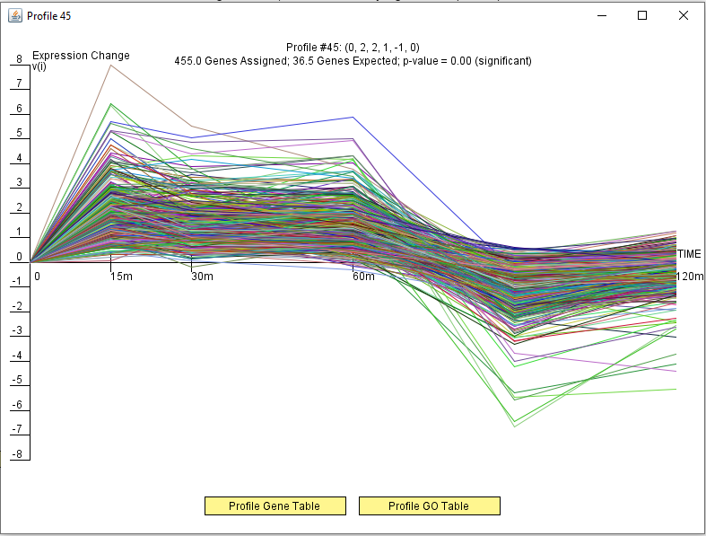
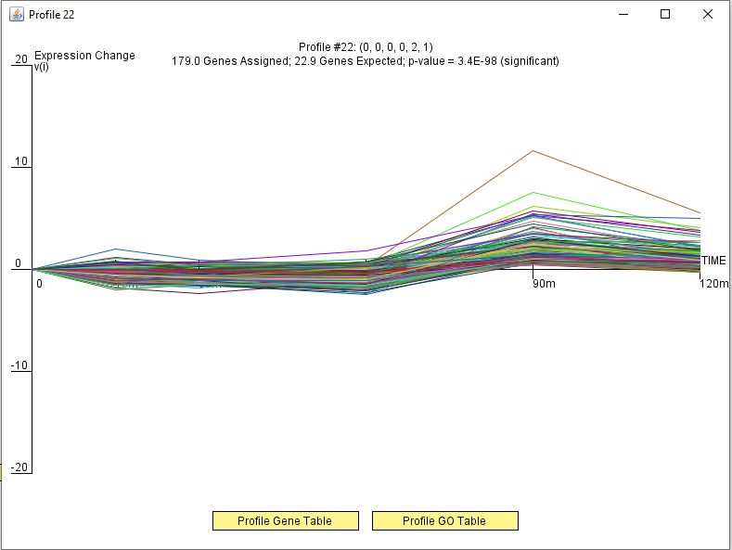

Slide 4
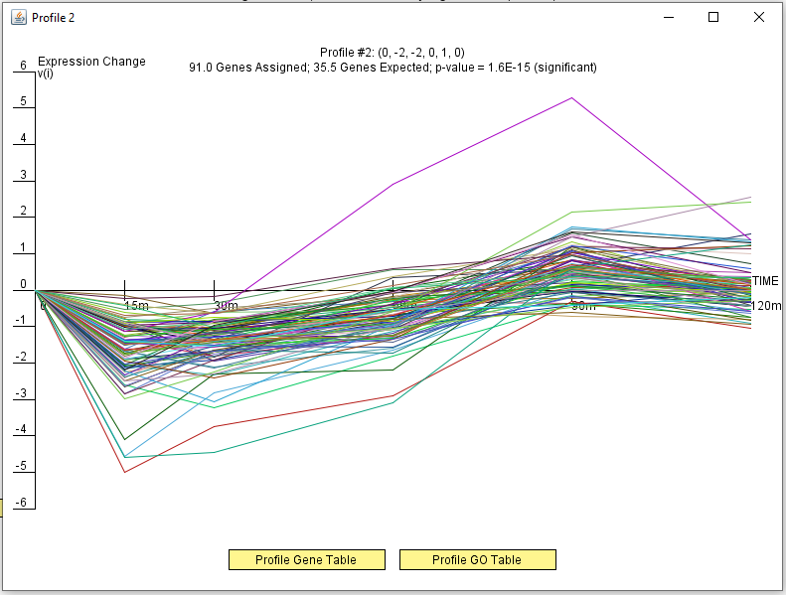
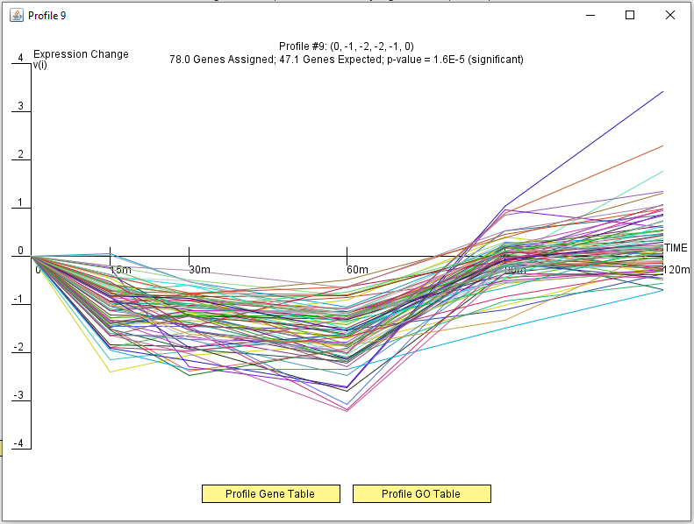

Slide 5
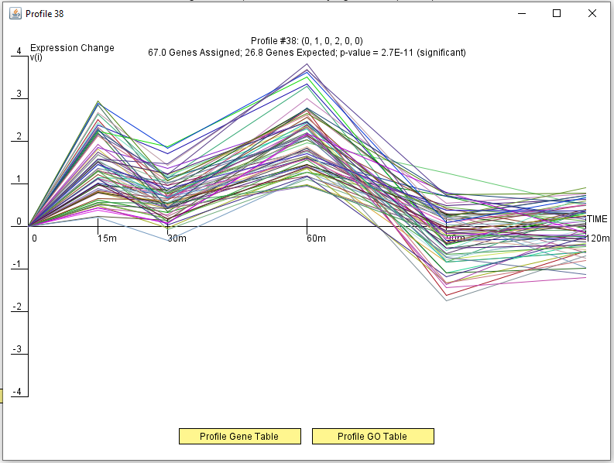
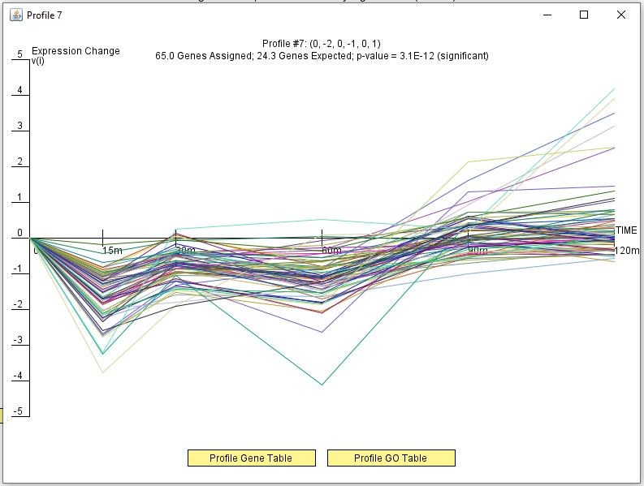

Slide 6
