Slide 1
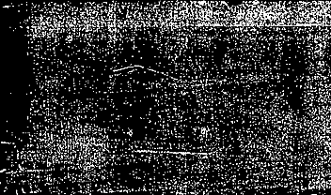

Effects of the Pesticide Thiuram
FunGals: Kaitlyn Nguyen, Michael Armas, Iliana Crespin, Emma Young
BIOL 367-01: Biological Databases
November 14, 2019
Kitagawa, E., Takahashi, J., Momose, Y., & Iwahashi, H. (2002). Effects of the pesticide thiuram: genome-wide screening of indicator genes by yeast DNA microarray. Environmental science & technology, 36(18), 3908-3915. DOI: 10.1021/es015705v

Slide 2
OUTLINE
WWW: Who, What, Where is this article?
What is Pesticide Thiuram? What is the purpose of this study?
Figures from the study: What do they mean?
Concluding thoughts on the article: Is it legit?
Acknowledgements
References
Methods: Microarray Assay, Promoter Activity Assay

Slide 3
Quick introduction to the article...
Effects of the Pesticide Thiuram: Genome-wide Screening of Indicator Genes by Yeast DNA Microarray
Author: Emiko Kitagawa, Junko Takahashi, Yuko Momose, Hitoshi Iwahashi
  Publication: Environmental Science & Technology
  Publisher: American Chemical Society
  Date: Sep 1, 2002
Combined study from different laboratories in Japan
  Research Institute of Biological Resources, National Institute of Advanced Industrial Science and Technology (AIST) - Tsukuba, Japan
  New Energy and Industrial Technology Development Organization – Tokyo, Japan
  Daikin Environmental Laboratory, Ltd. - Tsukuba, Japan

Slide 4
What is Thiuram?
Thiuram Fungicide and its Implications
Thiuram [bis(dimethyldithiocarbamoyl) disulfide] is a fungicide
  Used on vegetables and seeds
It is also used to accelerate the formation of rubber
There have been several tests run on the Mutagenicity and Oral Toxicity of thiuram
However the mechanisms of how this mutagenicity and toxicity occur are unknown

Slide 5
What was the sole purpose of the study?
The purpose of this study was to do a full genome-wide microarray analysis of the effects of thiuram on yeast
Select biomarker candidates for thiuram
This creates a list of effected genes that can be used in further research
  Developing a network of effected genes
  Using the network to discover mechanisms

Slide 6
Methods: Microarray Assay
Yeast was grown in lab, then RNA was extracted with the hot phenol method
cDNA was synthesized from the isolated RNA and linked with a fluorescent label.
The RNA of the control was labeled with Cy3 while the thiuram treatment samples were labeled with Cy5
Microarray slides were prepared by being hybridized at 65°C for 24-48 hours
Then the slides were washed twice with 2x SSC, 0.1% SDS Buffer, and then twice more with 0.2x SSC, 0.1% SDS Buffer
  Each wash was 20 minutes
The arrays were then rinsed with 0.2x SSC and 0.05x SSC for ten minutes each
The slides were then centrifuged and dried
The slides were then scanned and analyzed using the formula: (expression ratio)(normalized Cy5 intensity)/(normalized Cy3 intensity)

Slide 7
Methods: Microarray Assay Sequence Analysis
MIPS (Munich Information Center for Protein Sequences) was the database used for classification analysis
Modified the database classes to simplify analysis and better fit the experiment
  15 groups, 11 identical to the MIPS and 4 were modified
  The modified groups also contained unique subclasses
Notes:
11: the same “detoxification” (101 genes), “stress response” (168 genes), “cellular communication” (131 genes), “cellular transport” (474 genes), “ionic homeostasis” (118 genes), “amino acid metabolism” (204 genes), “lipid me- tabolism” (209 genes), “protein destination” (565 genes), “protein synthesis” (347 genes), “transcription” (762 genes), and “transport facilitation” (303 genes).
4: modifed: “cell growth” (680 genes), which was made from 9 subclasses: ‘cell growth, budding/cell polarity and filament formation,’ ‘pheromone response/mating-type de- termination/sex-specific proteins,’ ‘sporulation and germi- nation,’ ‘cell cycle control,’ ‘mitosis,’ ‘cytokinesis,’ ‘cell death,’ ‘aging,’ and ‘degradation of exogenous polynucleotides.’ The “DNA” (281 genes) was made from 4 subclasses: ‘DNA synthesis and replication,’ ‘recombination and DNA repair,’ ‘meiosis,’ and ‘DNA repair.’ The “carbohydrate metabolism” (522 genes) was made from 2 classes: ‘c-compound/ carbohydrate metabolism’ and ‘energy.’ The “unknown” (2475 genes) was established by putting together ‘not yet clear-cut’ and ‘unclassified proteins.’

Slide 8
Methods: Promoter Activity Assay
Assay was performed with a Green Fluorescence protein (GFP)
The GFP was inserted in a plasmid downstream of the promoter GAL1
Each promoter region and 1000bp upstream from each start codon were amplified with PCR
Then the promoter regions were inserted upstream of the GFP
The plasmids were then transformed into the S. cerevisiae
The cells were then treated with thiuram, DMSO and Cd for 2 hours
Fluorescence was then detected with flow cytometry
The difference between fluorescence in a treated vs. untreated was analyzed as promoter activity
Notes:
The act of inserting the promoter regions above the GFP insert that if the promoter was activated the fluorescence would be too

Slide 9
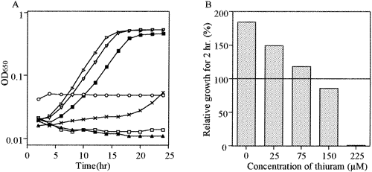
Figure 1.
Figure 1 Effects of different concentrations of thiuram on yeast growth and viability. (A) The yeast cells were inoculated in a YPD medium with different concentrations of thiuram and incubated for 24 h at 25 °C. Open circles, 0.45 mM; solid triangles, 0.14 mM; open squares, 44 μM; ×, 14 μM; solid squares, 4.4 μM; open triangles, 1.4 μM; open arrowheads, 0 mM. (B) Different concentrations of thiuram were added to the yeast cells at about OD = 1 and incubated for 2 h at 25 °C. Viability is expressed as percent CFU before the addition of thiuram.

Slide 10
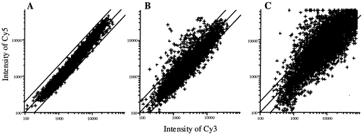
Figure 2.
Figure 2 Scatter plots of signal intensities from yeast DNA microarray experiments. Yeast cells were treated with thiuram for 15 (plot A), 30 (plot B), and 120 (plot C) min at 25 °C. Intensities of Cy3 and Cy5 show the amounts of mRNA in nontreated and treated cells, respectively. Each spot corresponds to one gene. Each intensity was averaged-out data from triplicate experiments.

Slide 11
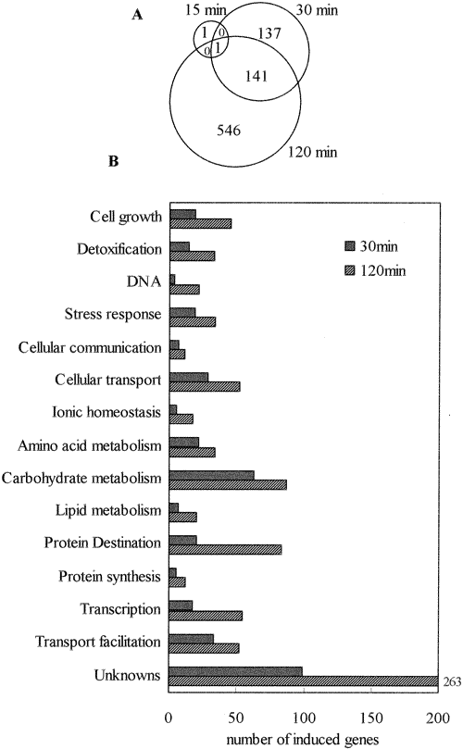
Figure 3.
Figure 3 Classification of genes induced by thiuram treatment. (A) The number of genes induced by each treatment is shown in the Venn diagram. (B) Genes induced at 30 and 120 min were classified by the modified MIPS classification. The horizontal axis indicates the number of induced genes. The gray bar and the shadowed bar indicate genes induced at 30 min and at 120 min, respectively.

Slide 12
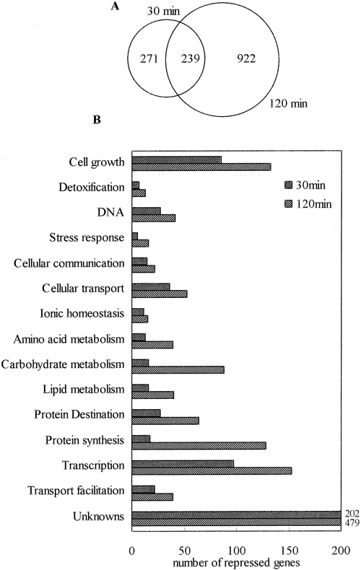
Figure 4.
Figure 4 Classification of genes whose expressions were repressed by thiuram treatment. (A) The number of repressed genes after each treatment is shown in the Venn diagram. (B) Repressed genes at 30 and 120 min were classified by the modified MIPS classification. The horizontal axis indicates the number of repressed genes. The gray bar and the shadowed bar show repressed genes at 30 min and at 120 min, respectively.

Slide 13
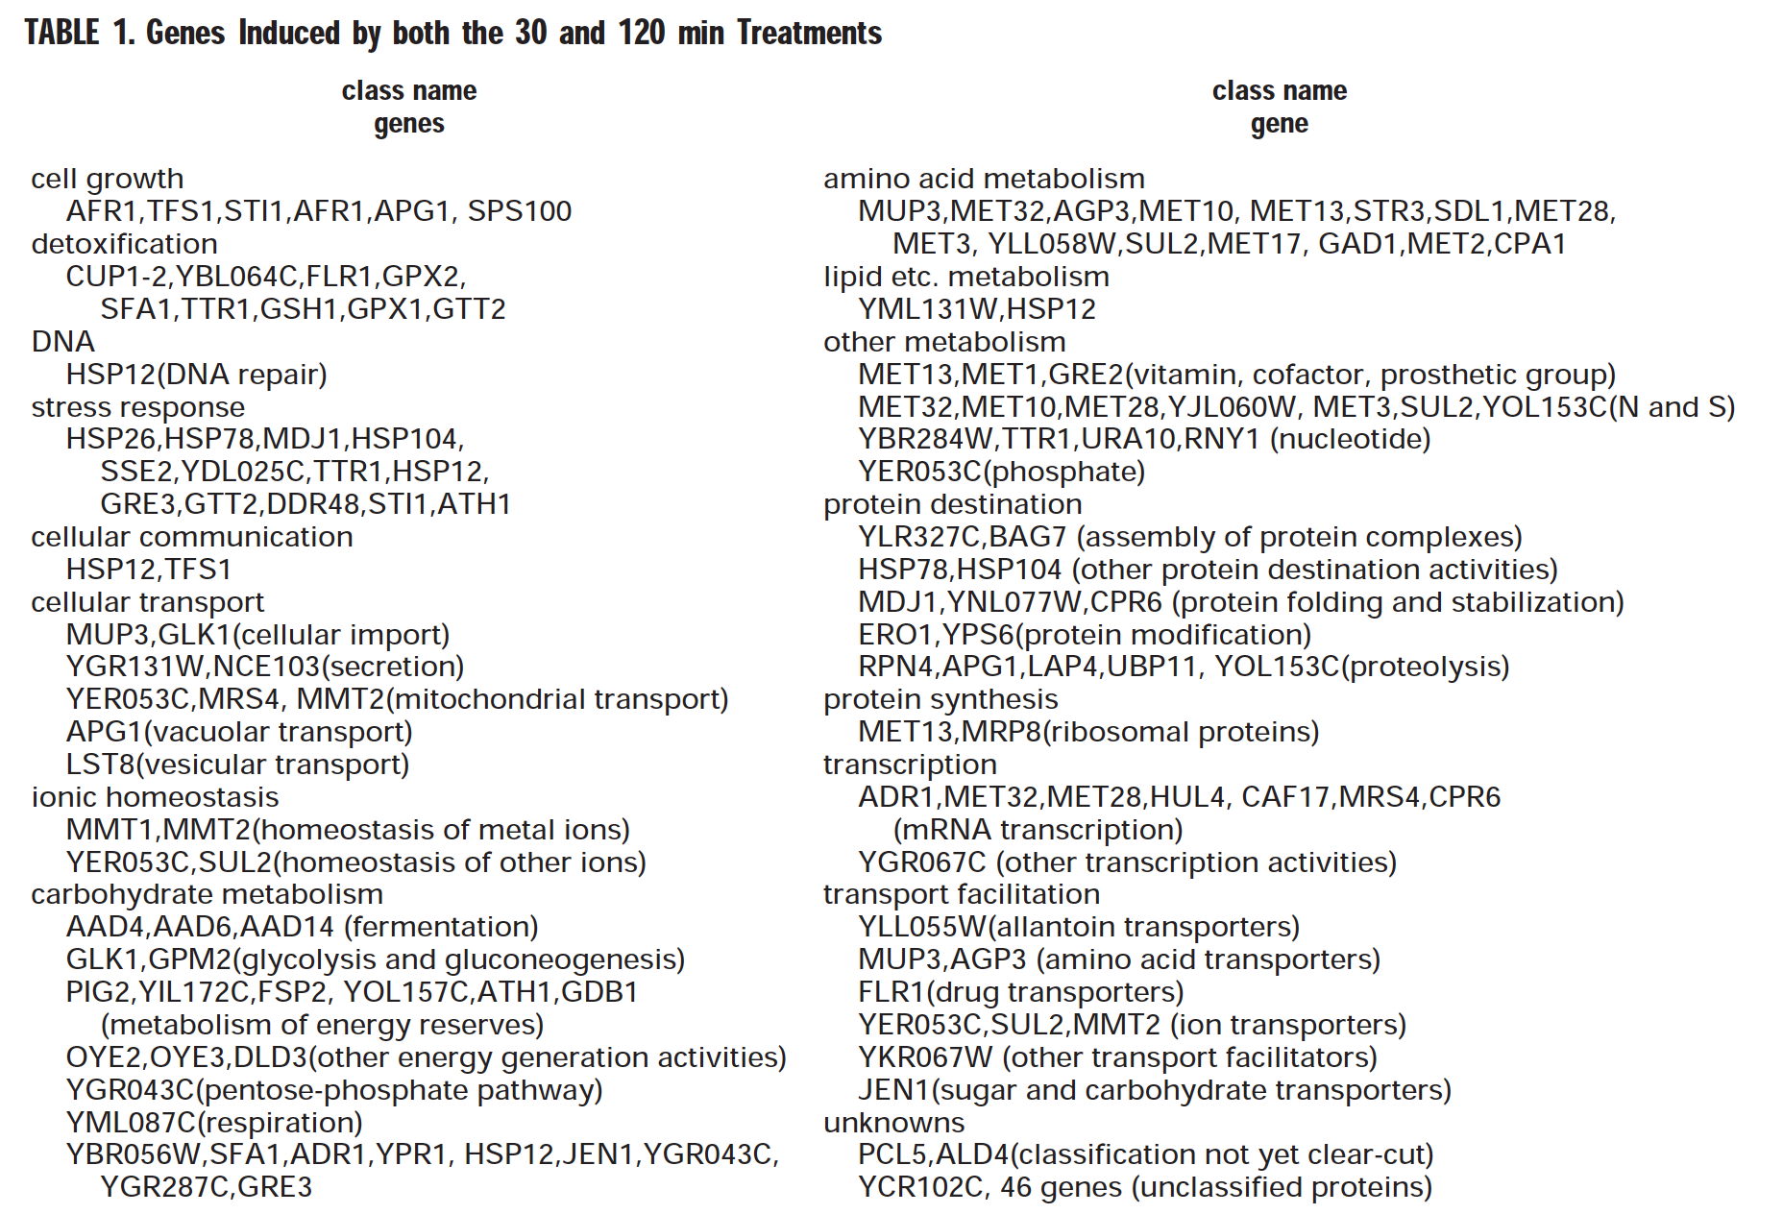
Table 1.

Slide 14
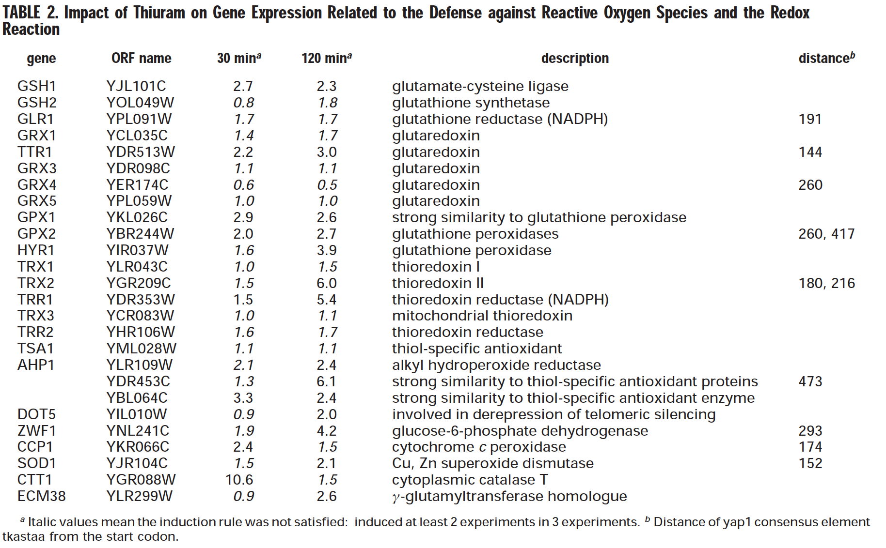
Table 2.

Slide 15
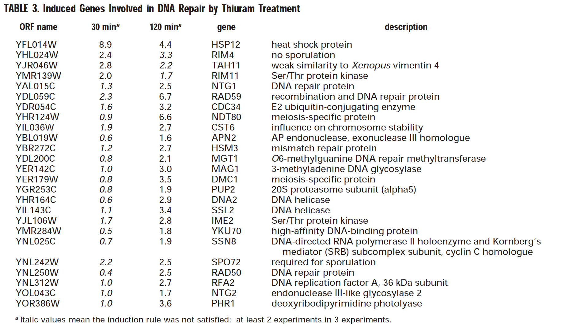
Table 3.

Slide 16
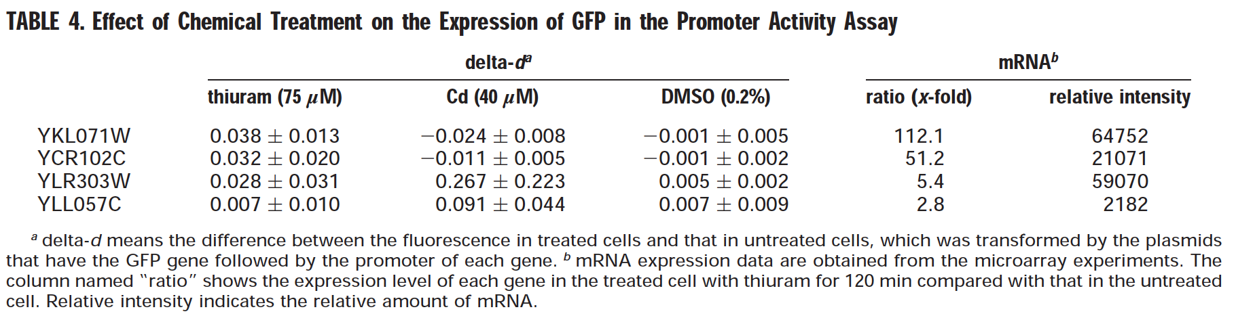
Table 4.

Slide 17
Conclusion of results
DNA microarray can be used to study biomarkers of the toxicity of known chemicals and unknown ones in the environment
As seen in the microarray data more genes were repressed then expressed in the prescence of Thiuram
YCR102C and YKL071W genes could be candidates for the specific detection of thiuram
YKL071W, YCR102C, YLR303W, and YLL057C are all candidates for further research and more promoter activity assays

Slide 18
Concluding thoughts on the article: Is it legit?
Are there any similar studies?
Article did not provide enough information EVEN THOUGH it is the first study of its kind to use DNA Microarray technology to analyze the whole genomic response
  Lack of information on preparation of the sample
    Was it prepared at 15min, 30min, and 120min OR between 15min-2hours? How many genes were replicated? How many times?
  Relied too heavily on reader's knowledge of previous studies, very little background information
  For an experiment focused on proposing a new method (DNA Microarray) to evaluate chemical toxicity to replace the short-term tests, and evaluate biomarker candidates for the specific detection of thiuram...
  There is only ONE section at the end dedicated to it.

Slide 19
Acknowledgements
This section is in acknowledgement to partners Michael Armas, Iliana Crespin, and Emma Young, and Kaitlyn Nguyen.
We would also like to acknowledge Dr. Dahlquist for introducing and teaching this topic and giving direction for this assignment to us.
"Except for what is noted above, this individual journal entry was completed by me and not copied from another source."
Thank you class!

Slide 20
References
Kitagawa, E., Takahashi, J., Momose, Y., & Iwahashi, H. (2002). Effects of the pesticide thiuram: genome-wide screening of indicator genes by yeast DNA microarray. Environmental science & technology, 36(18), 3908-3915. DOI: 10.1021/es015705v
Dahlquist, K. (2019, November 7). Week 11. In Wikipedia, Biological Databases. https://xmlpipedb.cs.lmu.edu/biodb/fall2019/index.php/Week_1https://xmlpipedb.cs.lmu.edu/biodb/fall2019/index.php/Week_11

