Slide 1
ANOVA | ΔCIN5
p < 0.05 | 2290 of 6189 (37.00%)
p < 0.01 | 1380 of 6189 (22.30%)
p < 0.001 | 691 of 6189 (11.16%)
p < 0.0001 | 358 of 6189 (5.784%)
B & H p < 0.05 | 151 of 6189 (2.440%)
Bonferroni p < 0.05 | 1453 of 6189 (23.48%)

Slide 2
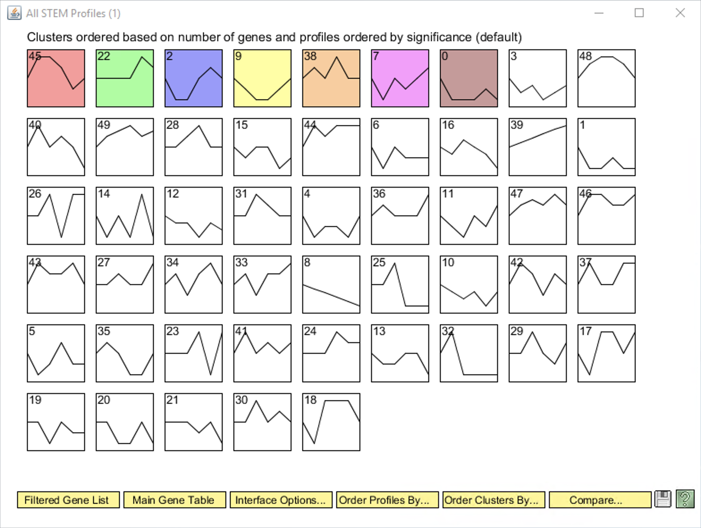

Slide 3
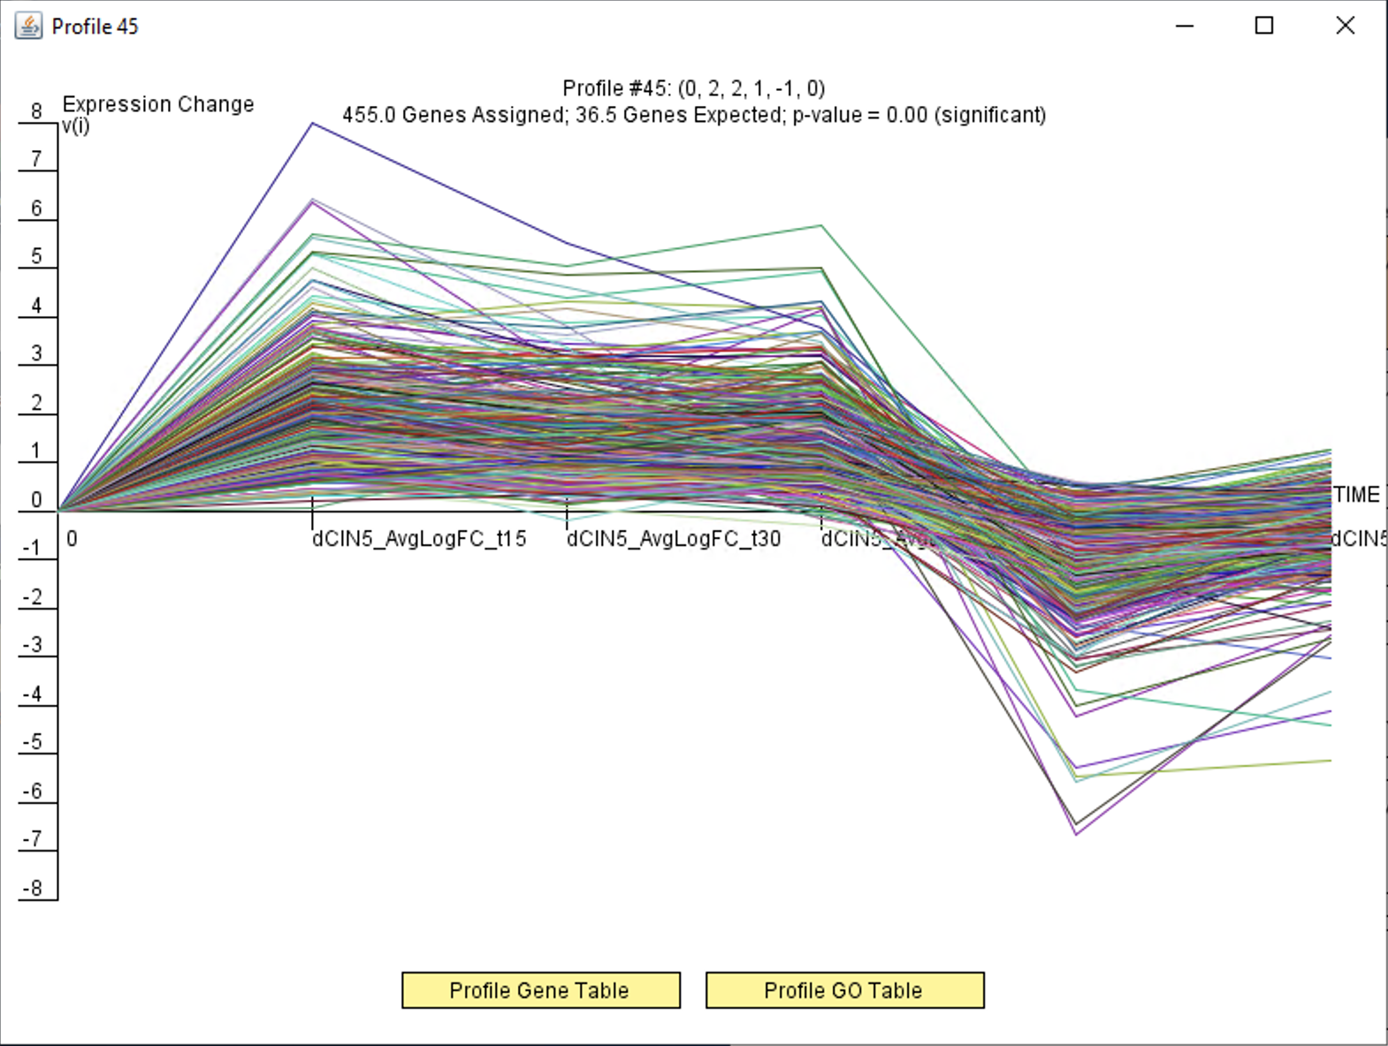

Slide 4
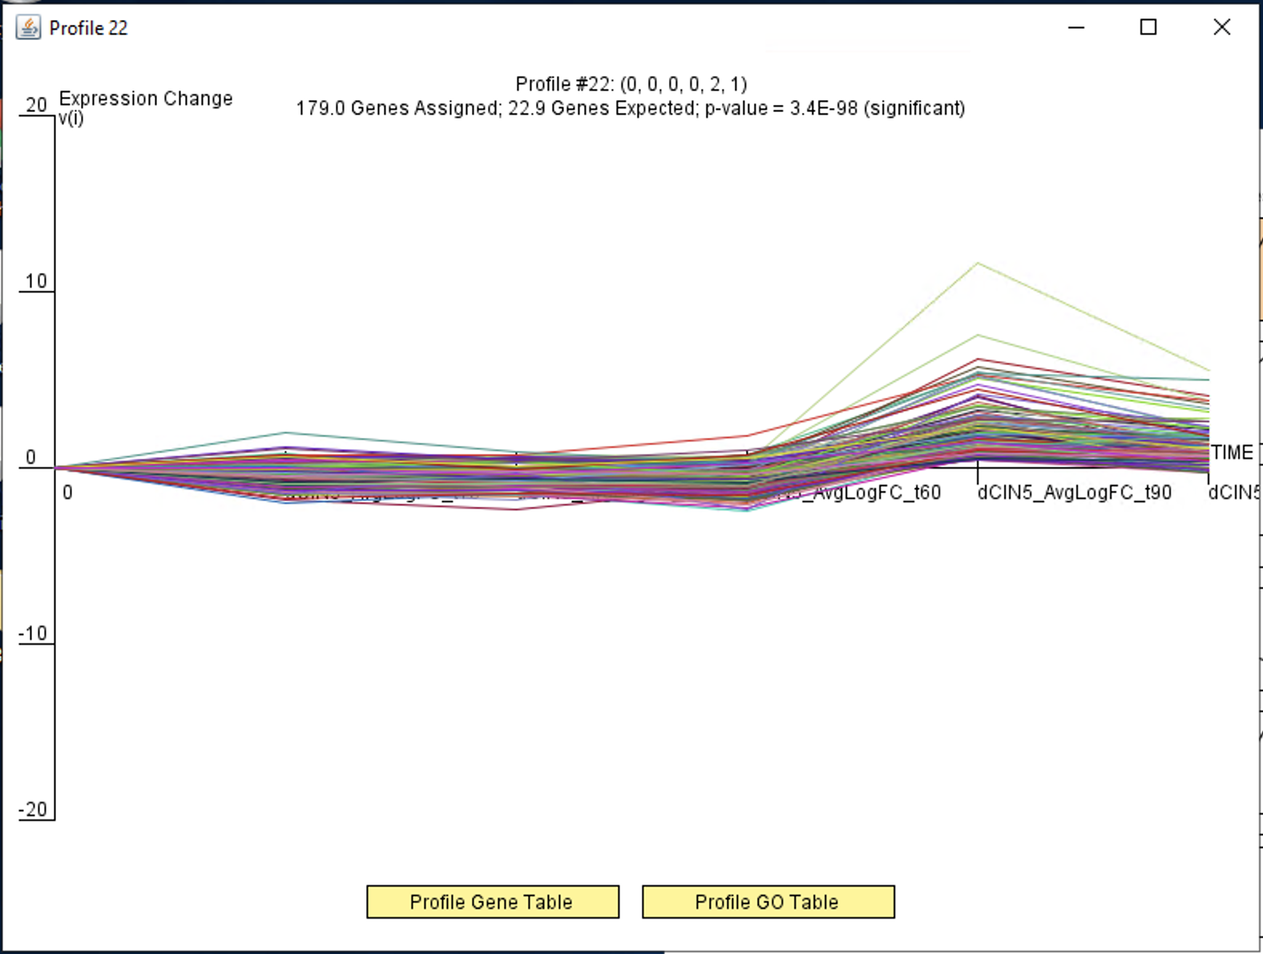

Slide 5
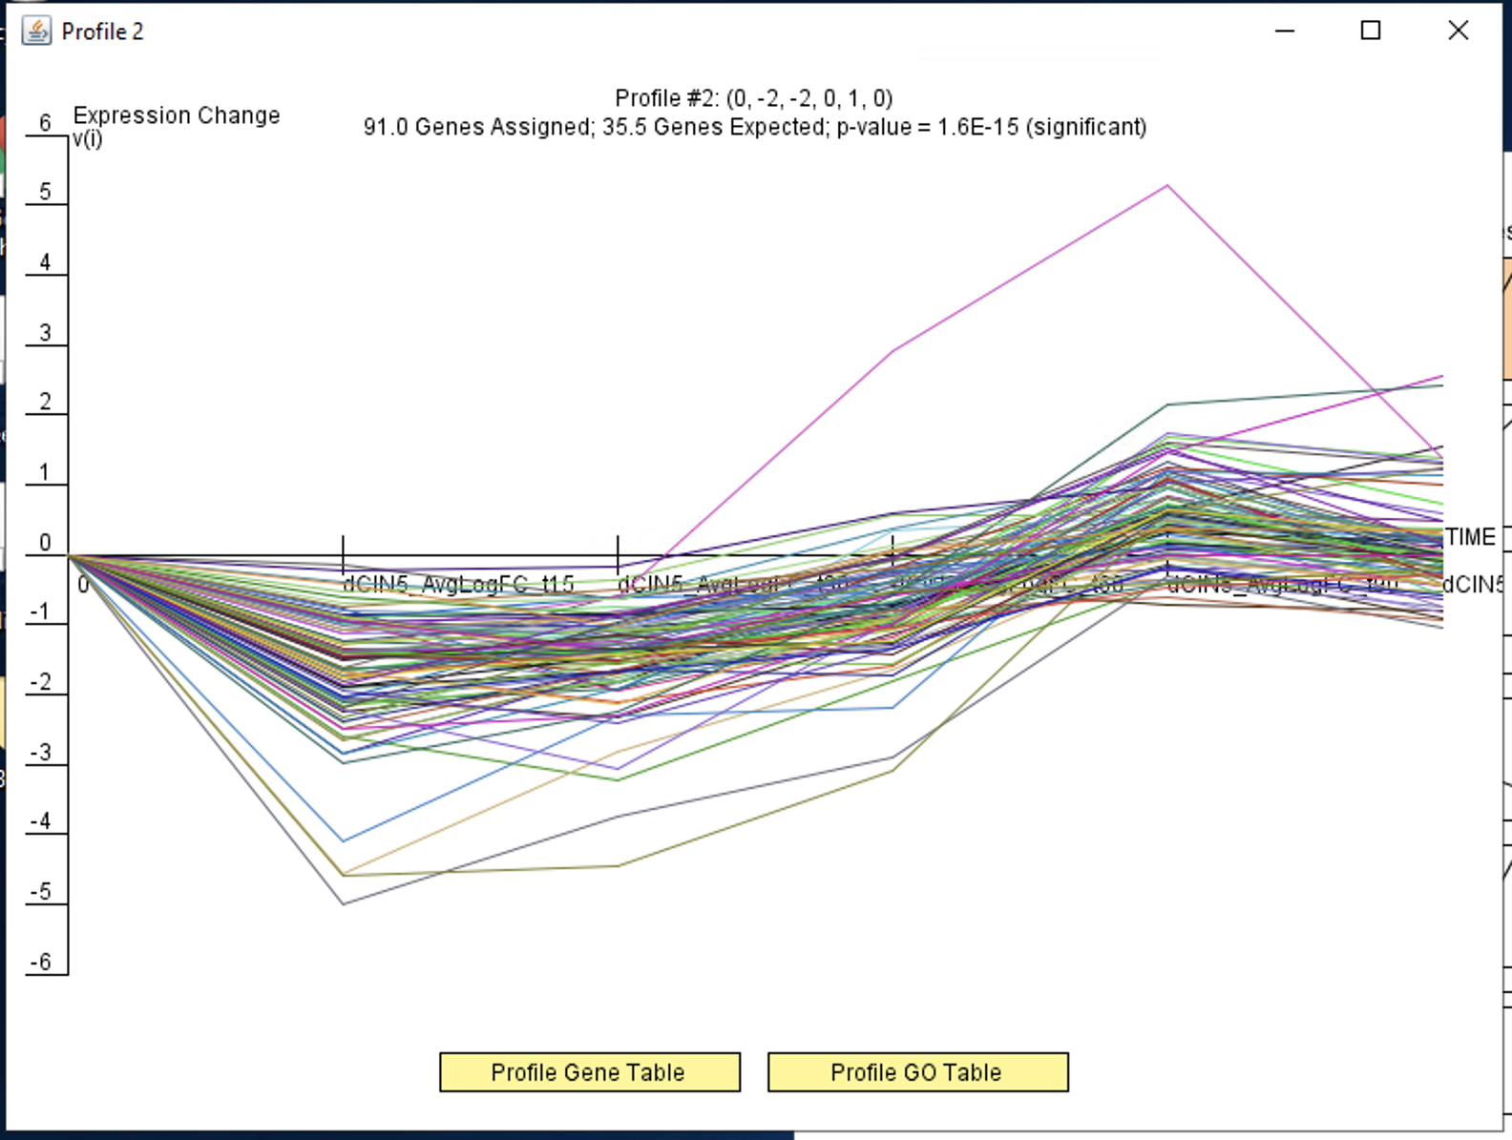

Slide 6
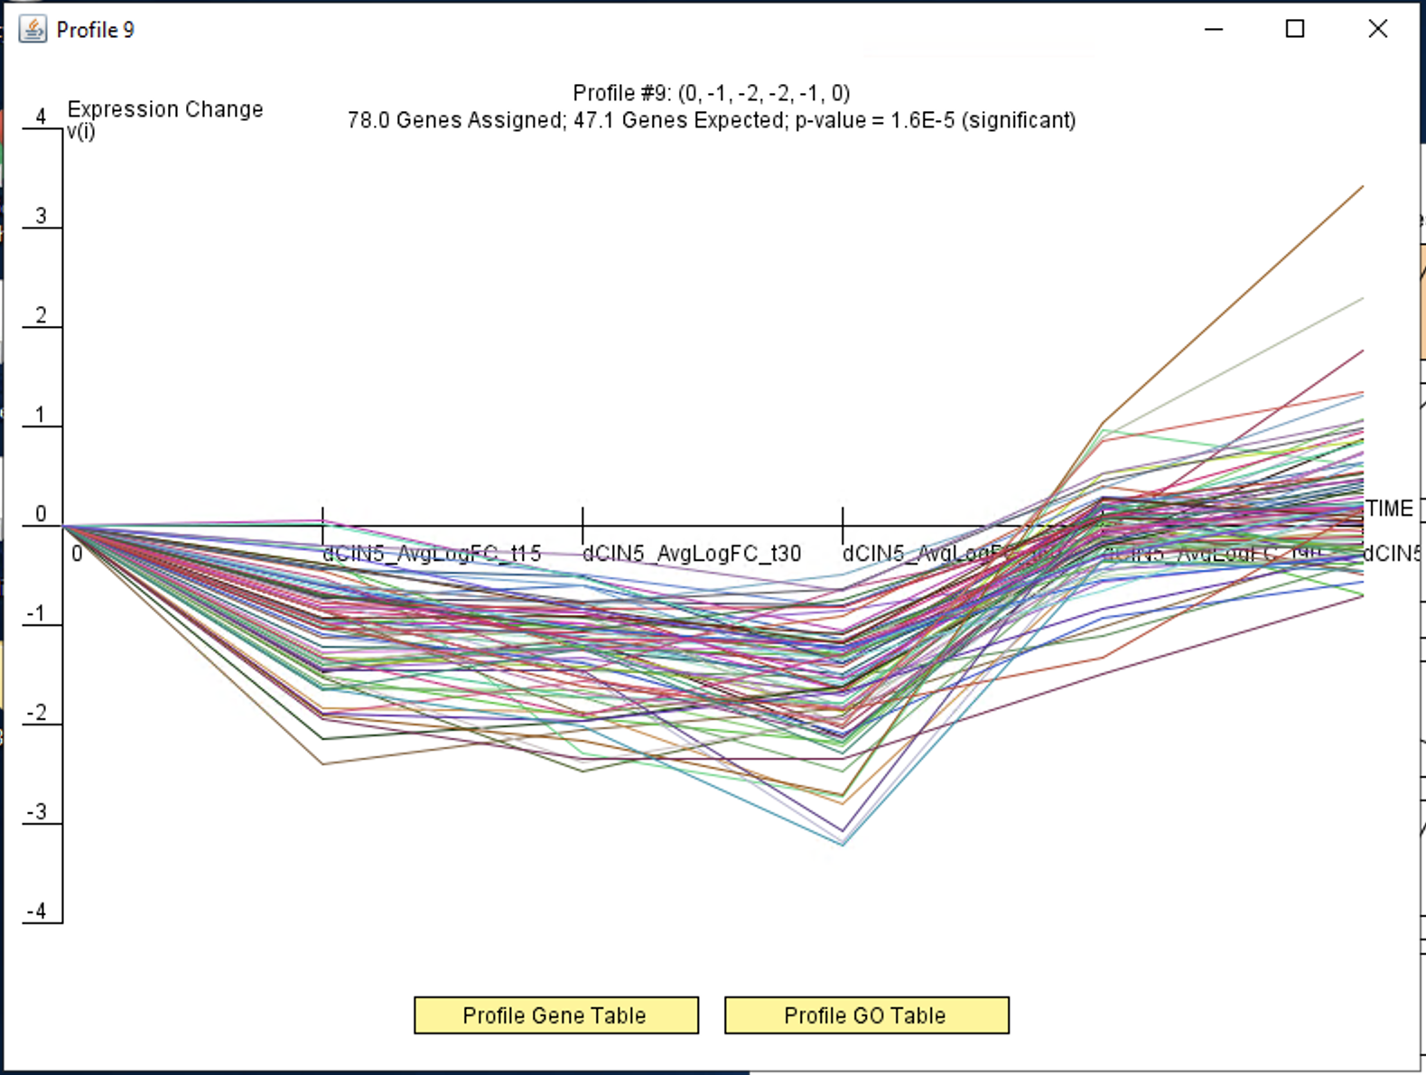

Slide 7
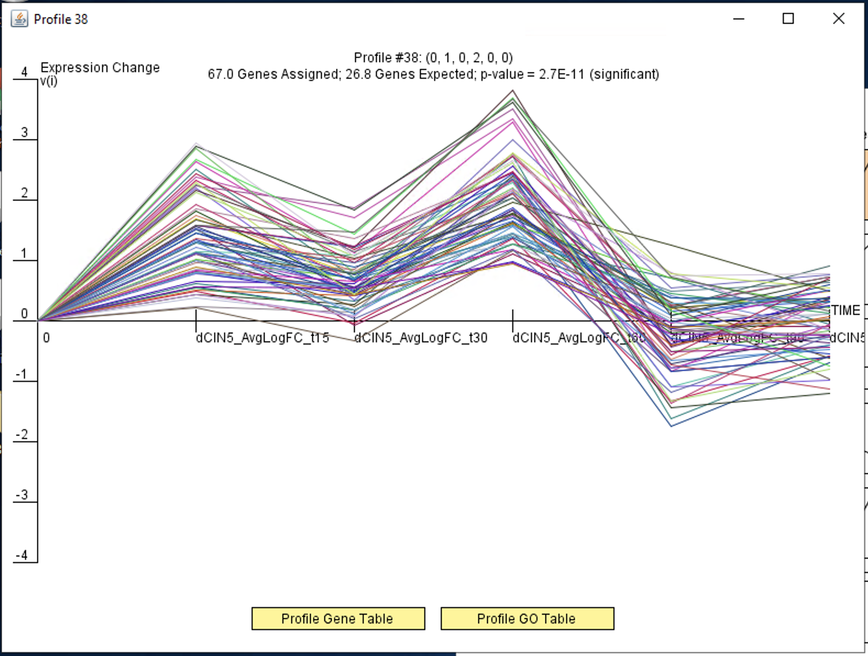

Slide 8
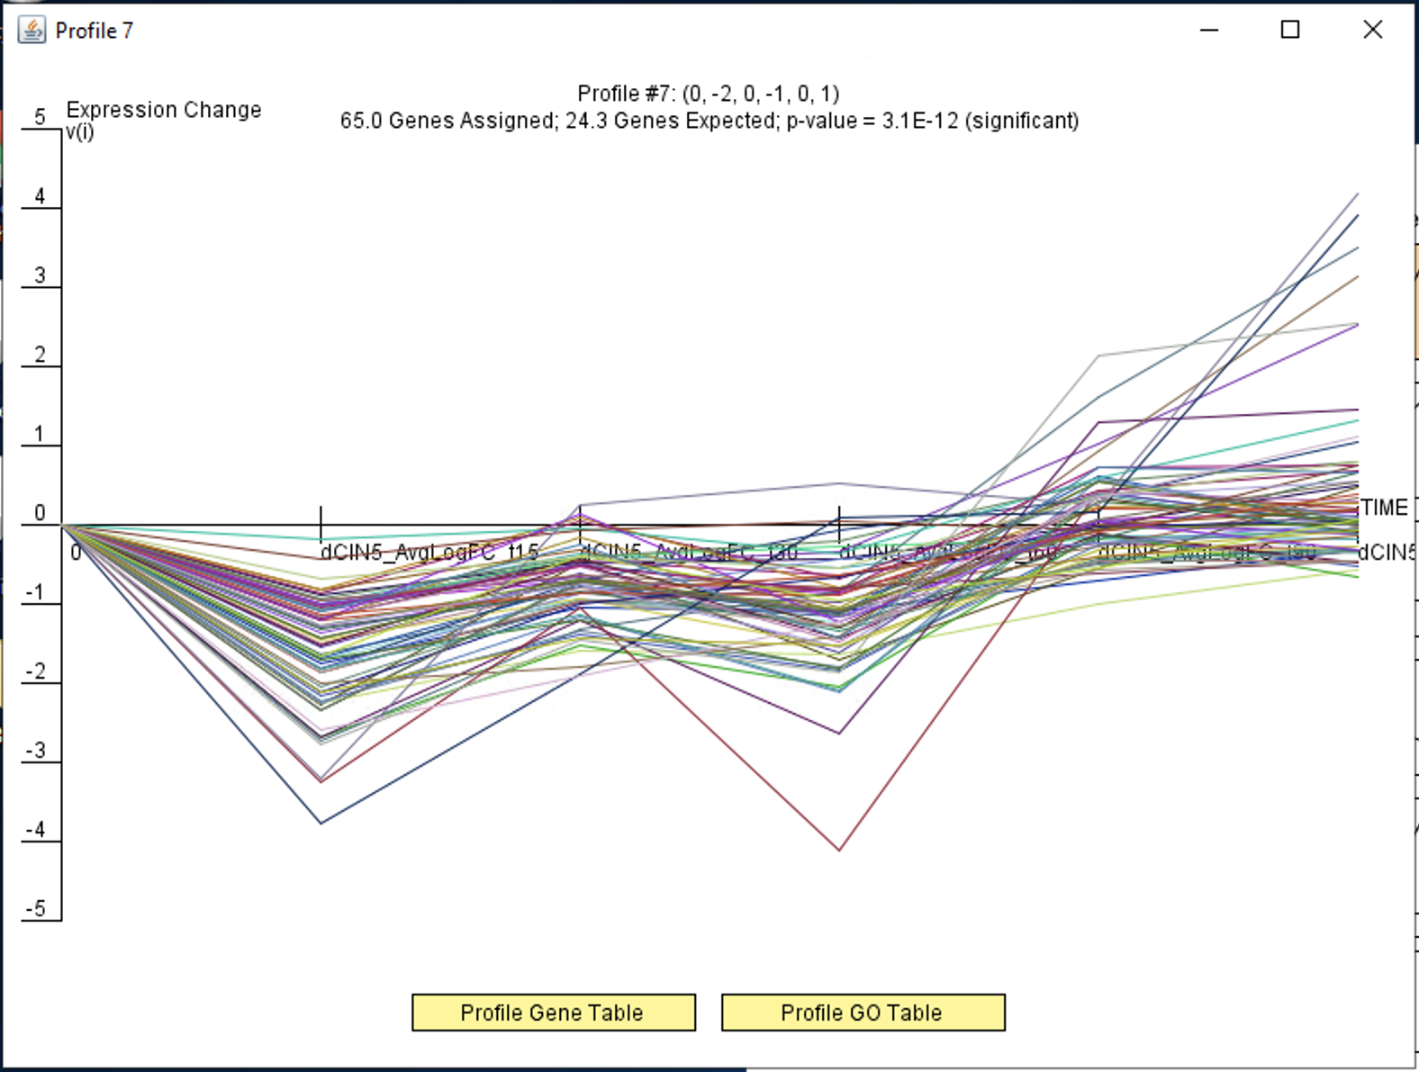

Slide 9
