Slide 1
Genome-wide DNA Microarray analysis of Yeast Treated with Thiuram:
A Reassessment of Data Published by Kitagawa et al.
Kaitlyn Nguyen, Michael Armas, Emma Young, Iliana Crespin
Biological Databases (BIOL-367-01)
Loyola Marymount University
December 10, 2019

Slide 2
Outline
Purpose and Significance of Journal Article
Introduction of Secondary Data Analysis Methods
Results and Discussion of Secondary Data Analysis
Assessment of Article
Conclusions
Future Directions Regarding Yeast Treated with Thiuram

Slide 3
Purpose and Significance of the Journal Article
Aims to identify biomarkers of Thiuram pollution
Treated yeast with Thiuram for varying amounts of time
Genome-wide microarray analysis observes changes in gene expression
Claim to be the first ones to use microarray analysis for biomarker identification
Some results seem skewed/rushed

Slide 4
Flow Chart of Methods
ANOVA Tests
Gene List and GO List for each significant profile
YEASTRACT and "Rank by TF," visualized in GRNsight
Create network, build GRNmap Input Workbook
Export GRNmap Output Workbook
Import and Run GRNmap using Input Workbook
Create MS Access Database
Retrieve original microarray dataset (Kitagawa et al. 2002)
STEM analysis
Visualize adjacency matrix using GRNsight
Notes:
using Query in designed Access Database

Slide 5
STEM Analysis
Short Time-series Expression Miner
Visualizes short time-series gene expression data from microarray experiments
Integrates the Gene Ontology (GO) database
Profiles with positive trend show induction, profiles with negative trend show repression

Slide 6

GRNmap
Gene Regulatory Network Modeling and Parameter Estimation
Differential equations model of changes in gene expression
Produces an adjacency matrix from an input workbook
  Can be used to make both weighted and unweighted matrices
https://kdahlquist.github.io/GRNmap/index.html

Slide 7
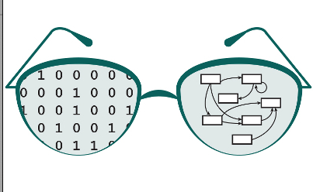
GRNsight
Produces visualization of adjacency matrix as a graph (network)
Can produce weighted and unweighted networks
https://dondi.github.io/GRNsight/

Slide 8
Table of ANOVA Results
ANOVA​ | S288C​
p < 0.05​ | 37.2 %​
p < 0.01​ | 18.26 %​
p < 0.001​ | 5.04 %​
p < 0.0001​ | 0.87 %​
B & H p < 0.05​ | 0.11 %​
Bonferroni p < 0.05​ | 16.36 %​

Slide 9
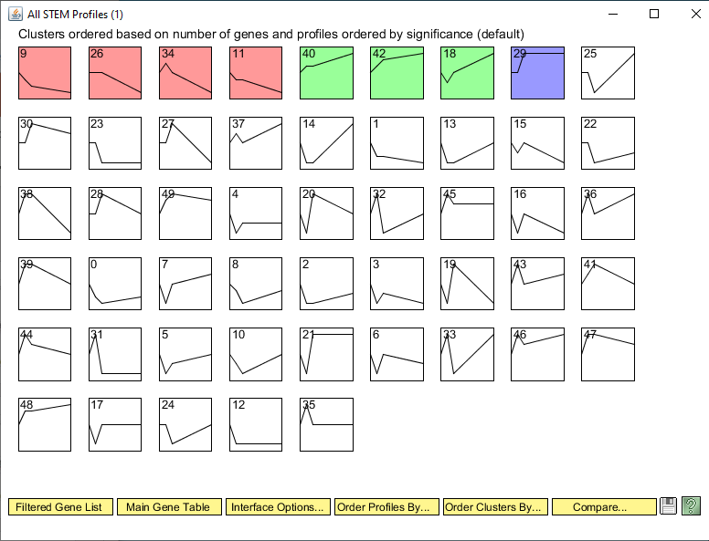
All STEM Profiles

Slide 10
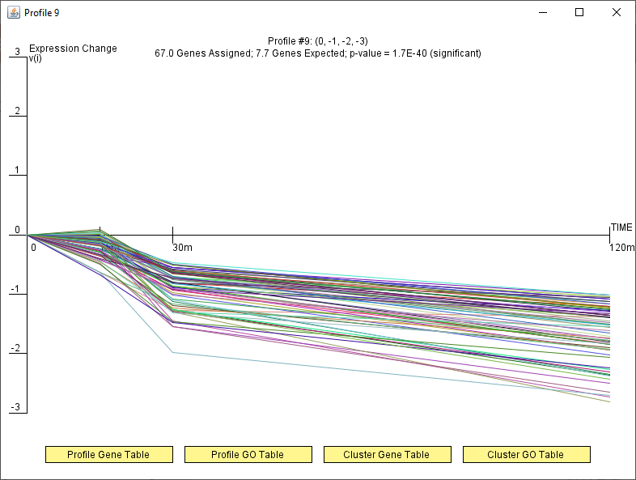
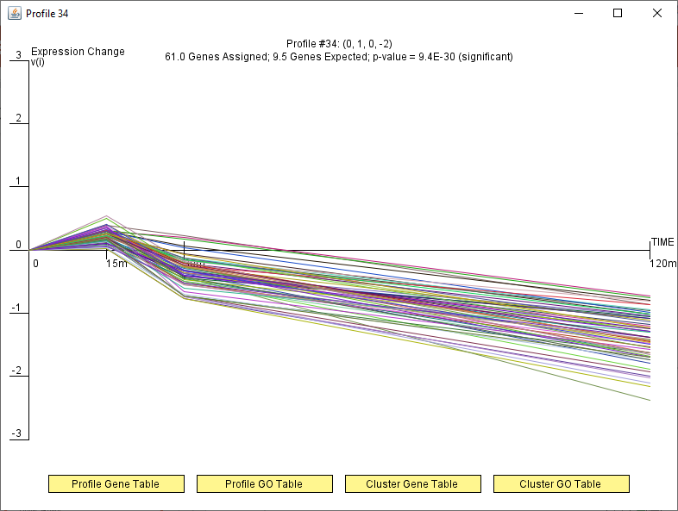
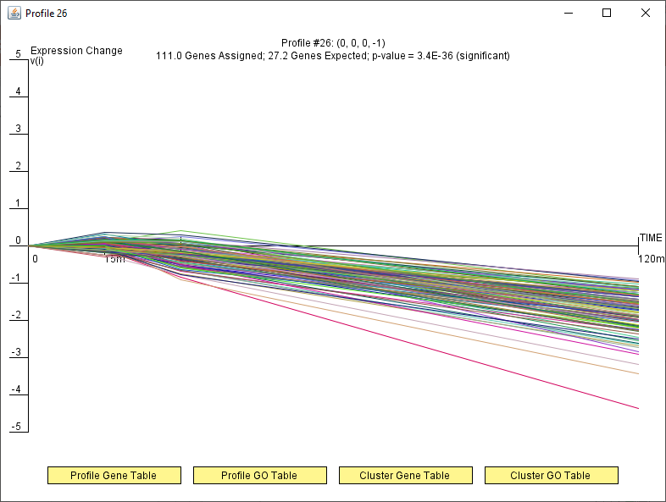
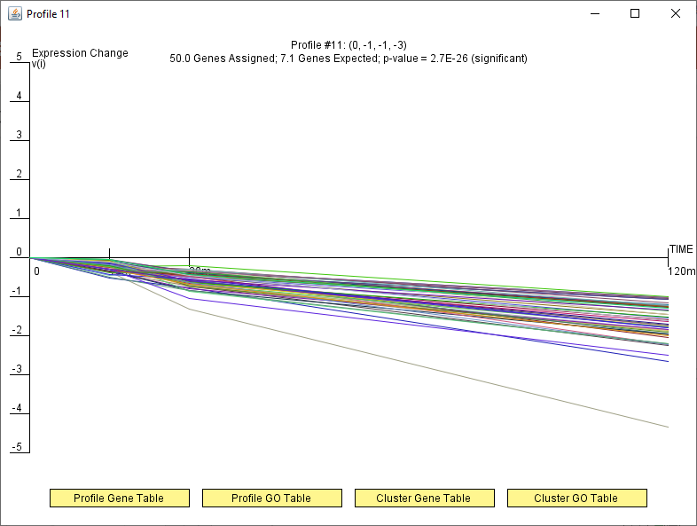
Red Profile (#9,26,34,11)
Notes:
Red Profile
-combine all red profiles together
-downward slope, repressed genes

Slide 11
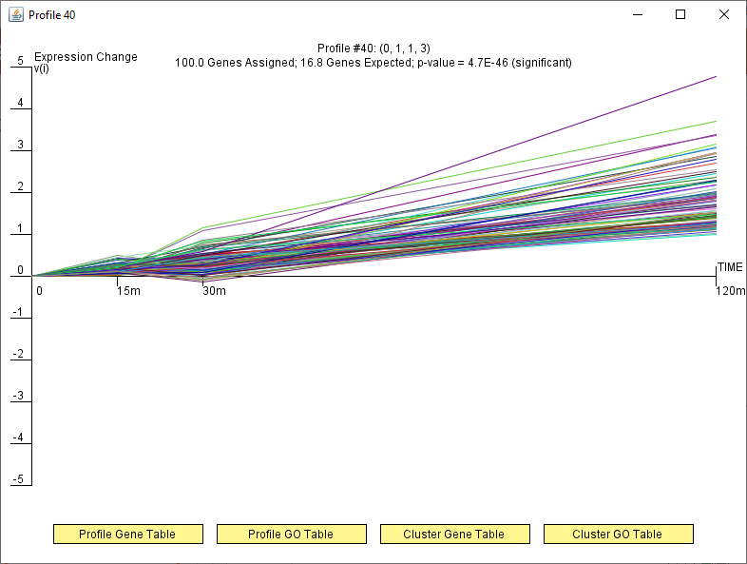
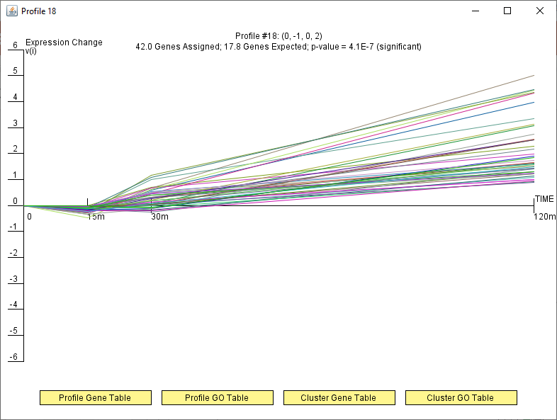
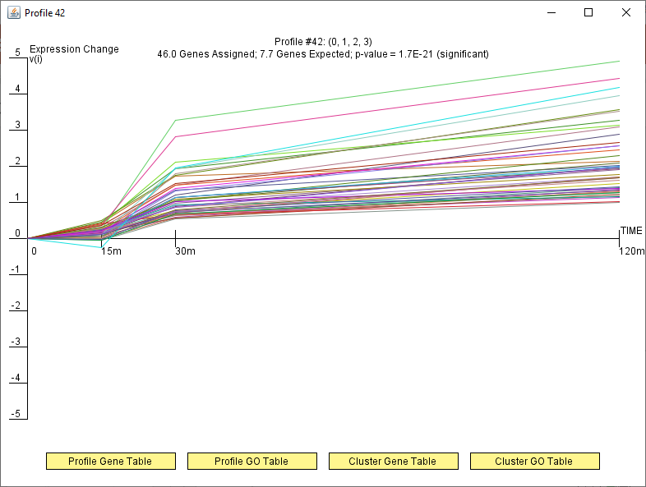
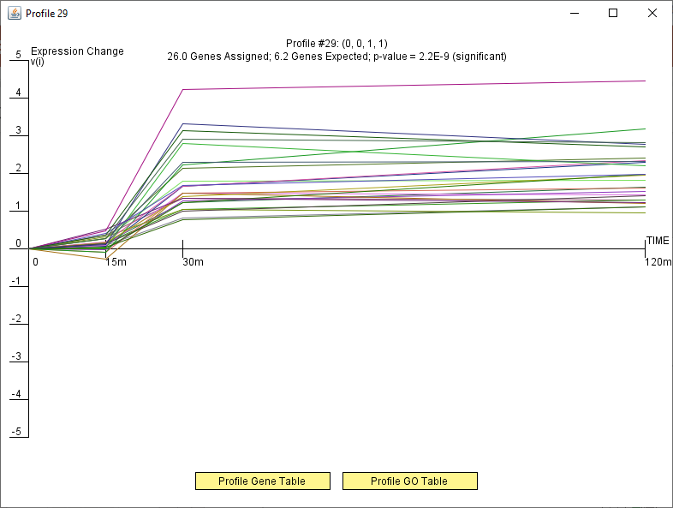
Green Profile (#40,42,18,29)
Notes:
Green Profile
-so few values in each, combine blue (#29) with all green profiles
-all have upward slope, induced genes

Slide 12
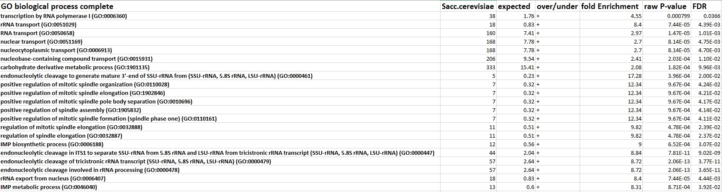
Example: GO terms for Red and Green Profiles
Red - repressed
Notes:
For repressed genes, there are more biological processes found from GO
Photo only pictures GO terms that correspond to categories from original article
Green – induced
-all processes included

Slide 13
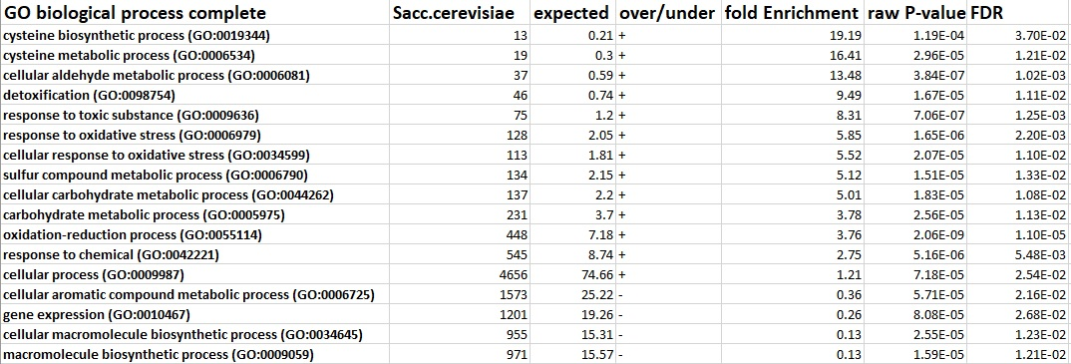
Example: GO terms for Red and Green Profiles
Green - induced
Notes:
For repressed genes, there are more biological processes found from GO
Photo only pictures GO terms that correspond to categories from original article
Green – induced
-all processes included

Slide 14
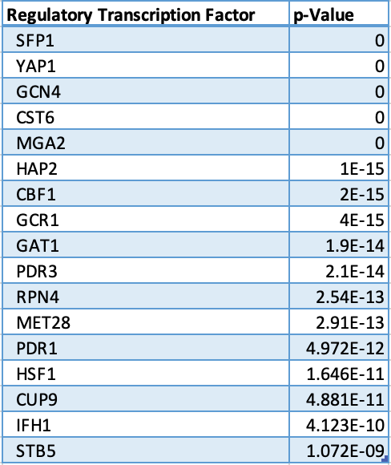
Regulatory Transcription Factors in Red Network
Notes:
Show the table of regulatory transcription factors in your network and their p values for enrichment.

Slide 15
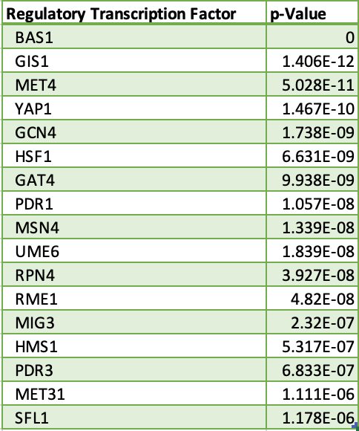
Regulatory Transcription Factors in Green Network
Notes:
Show the table of regulatory transcription factors in your network and their p values for enrichment.

Slide 16
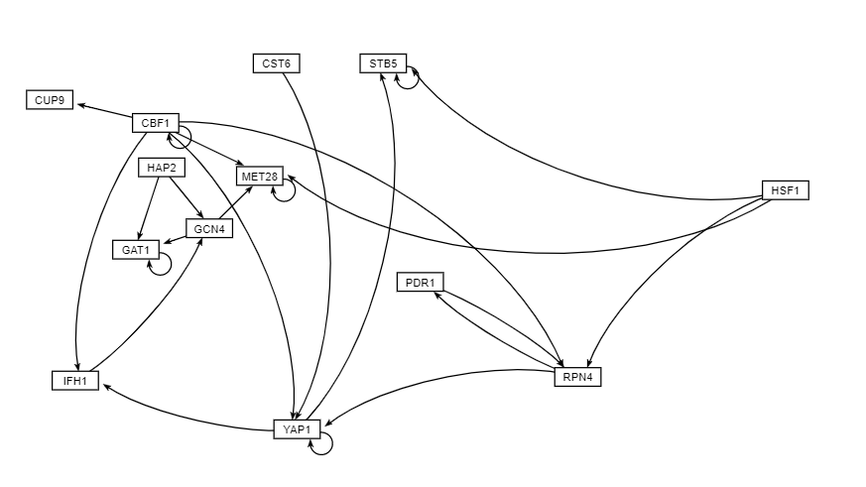
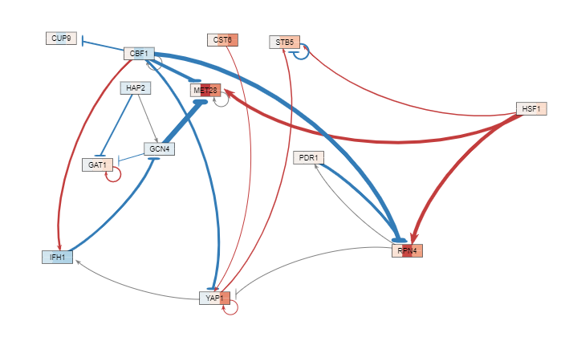
Unweighted and Weighted Networks in GRNsight for Red Profile from GRNsight
Unweighted
Weighted
Notes:
Unweighted Networks (from Access, running Query with production rates, etc. from regulation matrix/network and workbook for Coder/QA)
-
Weighted Networks (from Output Workbook, GRNmap)
-MG3 is a floater gene
-in weighted genes:
- gray indicated weak genes
-red: activation
-blue: induction

Slide 17
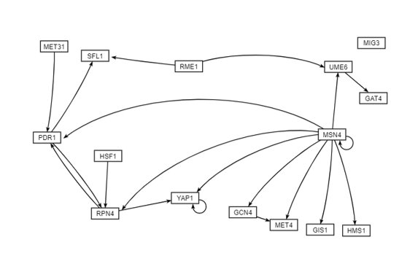
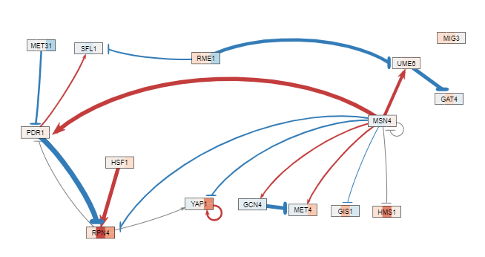
Unweighted and Weighted Networks in GRNsight for Green Profile from GRNsight
Unweighted
Weighted
Notes:
Unweighted Networks (from Access, running Query with production rates, etc. from regulation matrix/network and workbook for Coder/QA)
-
Weighted Networks (from Output Workbook, GRNmap)
-MG3 is a floater gene

Slide 18
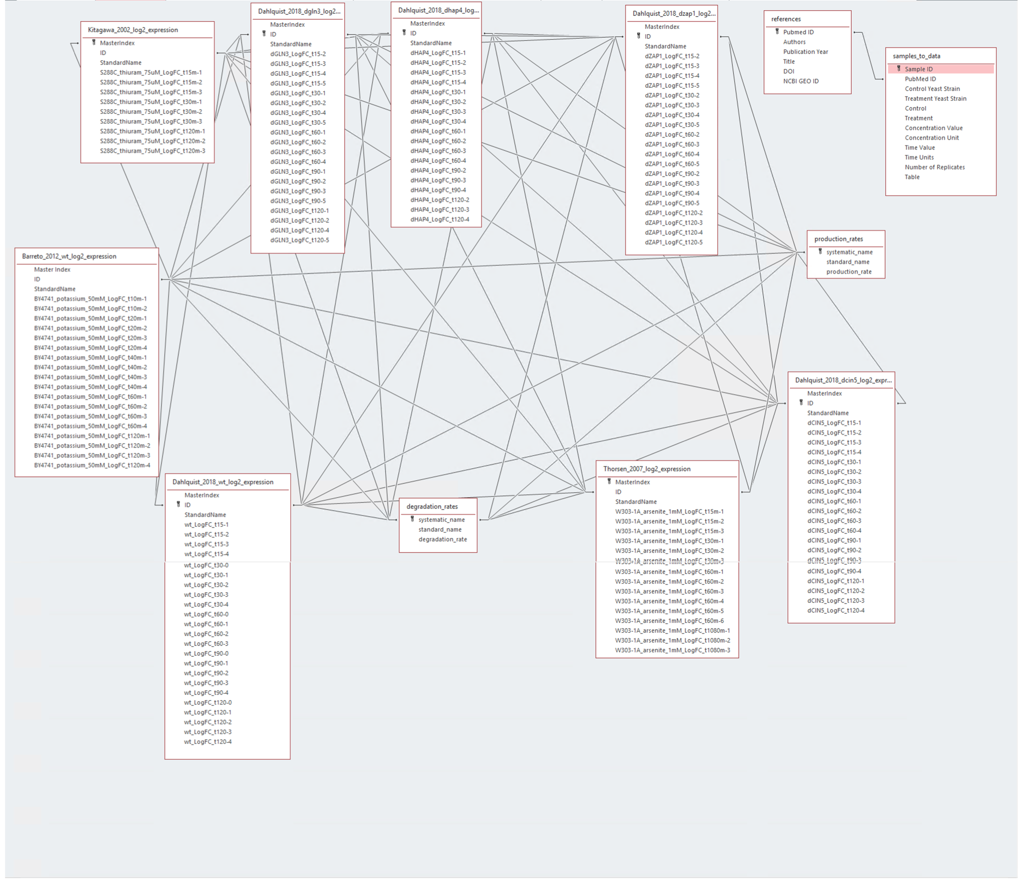
SMS Access Database Schema Diagram

Slide 19
Assessment of Article: Fold Change
Kitagawa et al. (2002)
FunGals
Observes whether fold change is greater than 2.0 or less than 0.5
Significance is based on ANOVA results showing a Benjamini-Hochberg p-value of less than 0.05

Slide 20
Assessment of Article: Categories of Biological Processes
Kitagawa et al. (2002)
FunGals
Uses MIPS database to categorize gene function
Uses GO terms to categorize gene function

Slide 21
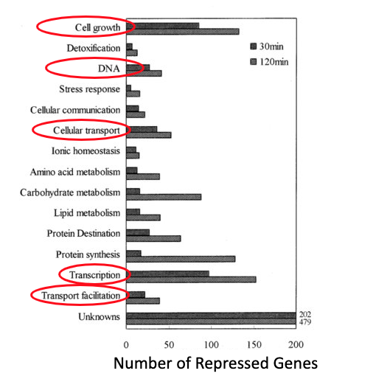
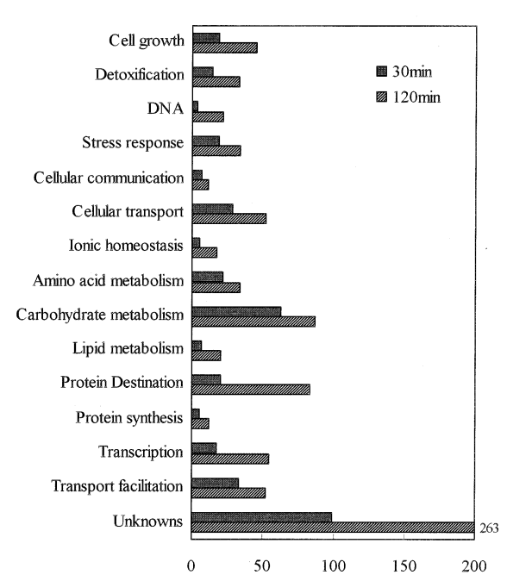
Assessment of Article: Categories of Biological Processes
Number of Repressed Genes
Number of Induced Genes
Notes:
Induced Genes (Green):
-there was a biological process/GO term labeled "Detoxification" from GeneOntology results that is comparable to original table from Kitagawa (used MiPS)
-"DNA" – corresponds to

Slide 22
Assessment of Article: Transcription Factor Relationship
Kitagawa et al. (2002)
FunGals
Observed YAP1 because if its significance in oxidative stress
Found genes with response element consensus sequence of TKASTAA
YAP1 was observed in the TFs in the Green profile
Found TF relationship to other genes through a gene regulatory network and adjacency matrix

Slide 23
Assessment of Article: Biomarkers
Kitagawa et al. (2002)
YKL071W was not found significant
YCR102C was not found significant
YLR303W (Met17) B-H p-value <0.05 in ANOVA Data
  Was not found in our results
YLL057C (JLP1) B-H p-value < 0.05 in ANOVA data
  Was not found in our results
Notes:
YLR303W and YLL057C were found to be significant in the ANOVA data due to there B-H p-value < 0.05, however once they were run through Stem they were not present in the 8 significant profiles we looked into.

Slide 24
Conclusions
Comparison of results differs between original article and our reassessment
  Categories of Biology Processes
  Transcription Factors
  Biomarkers
  Methods of finding significance
Credibility of the article findings is in question
  Lack of outlined methods
  Rushed analysis
  Lack of statistics
Notes:
Paper observed relevance but did not mention significance ( statistics). If FC was higher than 2 or less than .5, they thought it to be significant

Slide 25
Future Directions Regarding Yeast Treated with Thiuram
Rerunning the experiment using newer technology not available in 2002
Reassess biomarker candidates of thiuram pollution using new findings
Analyze gene ontology using standardized category names

Slide 26
Acknowledgements
Dr. Dahlquist, Ph.D.
BIO-367-01 Class
Loyola Marymount University
FunGals Partners
Kitagawa E, Takahashi J, Momose Y, Iwahashi H.

Slide 27
References
Kitagawa, E., Takahashi, J., Momose, Y., & Iwahashi, H. (2002). Effects of the pesticide thiuram: genome-wide screening of indicator genes by yeast DNA microarray. Environmental science & technology, 36(18), 3908-3915. DOI: 10.1021/es015705v

