Slide 1
Thorsen, M., Lagniel, G., Kristiansson, E., Junot, C., Nerman, O., Labarre, J., & Tamás, M. J. (2007). Quantitative transcriptome, proteome, and sulfur metabolite profiling of the Saccharomyces cerevisiae response to arsenite. Physiological genomics, 30(1), 35-43. DOI: 10.1152/physiolgenomics.00236.2006
Quantitative transcriptome, proteome, and sulfur metabolite profiling of the Saccharomyces cerevisiae response to arsenite
BIOL 367
November 14. 2019
Sulfiknights:
DeLisa Madere, Naomi Tesfaiohannes, Joey Nimmers-Minor, Marcus Avila, Ivy Macaraeg

Slide 2
An overview of S. cerevisiae in response to arsenic
Toxic substances, such as arsenic, have impacts on living organisms
Met4p and Yap1p are major players in the cells' response to arsenic
Experimental methods reveal the transcriptional regulation of genes
The stimulation of sulfur assimilation and GSH biosynthesis is important for arsenic tolerance

Slide 3
An overview of S. cerevisiae in response to arsenic
Toxic substances, such as arsenic, have impacts on living organisms
Met4p and Yap1p are major players in the cells' response to arsenic
Experimental methods reveal the transcriptional regulation of genes
The stimulation of sulfur assimilation and GSH biosynthesis is important for arsenic tolerance

Slide 4
Arsenic is toxic, but this toxicity can be used to treat acute cancers
In Bangladesh and West Bengal, arsenic contaminates drinking water through the earth's geographic supply.
  Chronic exposure to arsenic can cause different medical threats including cardiovascular diseases, neurological disorders, and liver injury.
Despite its harmful consequences, arsenic trioxide is used to treat acute promyelocytic leukemia (blood and bone marrow).

Slide 5
Saccharomyces cerevisiae experiences stress from arsenic metalloid
Saccharomyces cerevisiae can resist arsenic through the regulation of cytosolic redox and glutathione levels.
Certain transcription factors like Yap8p, control the expression of ACR2 and ACR3, which are genes that possess arsenic-specific detoxification properties.
The glutathione (GSH) biosynthesis pathway is essential for building resistance against oxidative stress and metal toxicity.

Slide 6
An overview of S. cerevisiae in response to arsenic
Toxic substances, such as arsenic, have impacts on living organisms
Met4p and Yap1p are major players in the cells' response to arsenic
Experimental methods reveal the transcriptional regulation of genes
The stimulation of sulfur assimilation and GSH biosynthesis is important for arsenic tolerance

Slide 7
Met4p & Yap1p
Met4p plays a role in cadmium tolerance. It controls sulfur assimilation and GSH biosynthesis. Met4p plays a role in AS(III) tolerance but its role in cadmium tolerance is more important
Yap1p controls transcription of genes encoding proteins. It contributes to YCF1 and ACR3
  Acr3 sequesters glutathione-conjugated As(III) in a vacuole and Ycf1p transports it as well as helps in reducing As(III) influx

Slide 8
An overview of S. cerevisiae in response to arsenic
Toxic substances, such as arsenic, have impacts on living organisms
Met4p and Yap1p are major players in the cells' response to arsenic
Experimental methods reveal the transcriptional regulation of genes
The stimulation of sulfur assimilation and GSH biosynthesis is important for arsenic tolerance

Slide 9
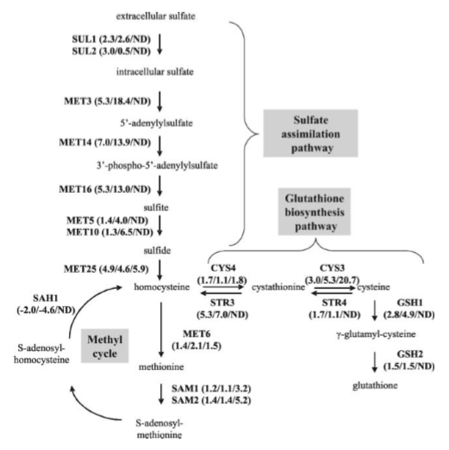
Figure 1: This figure gives us the flow chart extracellular sulfate must go through in order to become assimilated and ultimately assist in the Glutathione biosynthesis pathway. Sulfate must be converted to sulfide, which will enter the Methyl cycle and the glutathione biosynthesis pathway before it finishes as GSH2, or glutathione.

Slide 10
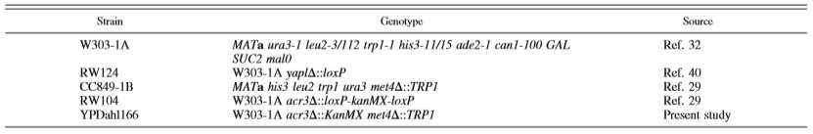
Table 1: This table presents the different stains that were utilized through this experiment. W303-1A, RW124, CC849-1B and RW104 information was obtained from previous source material, but YPDagl166 was used in the present study at hand.

Slide 11
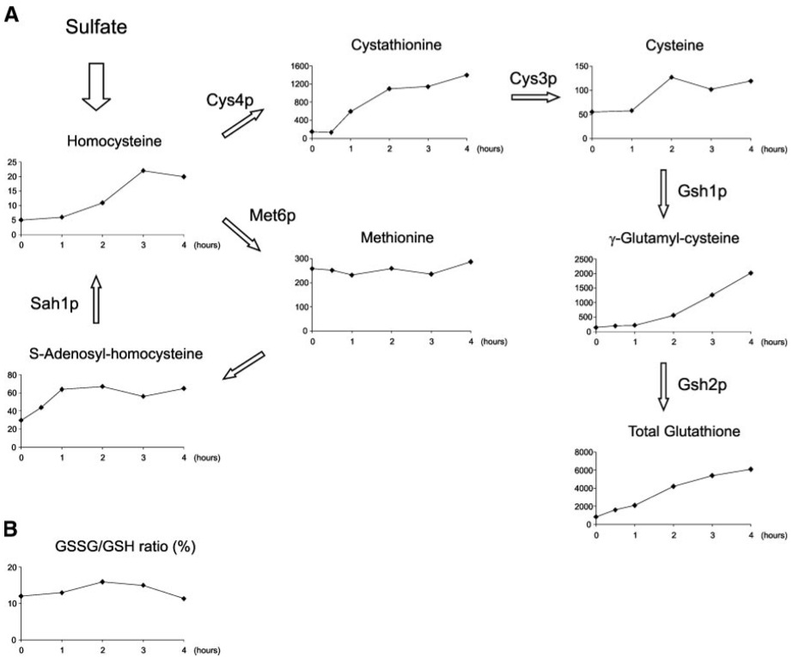
Figure 2: This figure shows the kinetic response of sulfur metabolites in response to arsenite (0.2mM). It also shows the ratio of oxidized to reduced GSH over time.

Slide 12
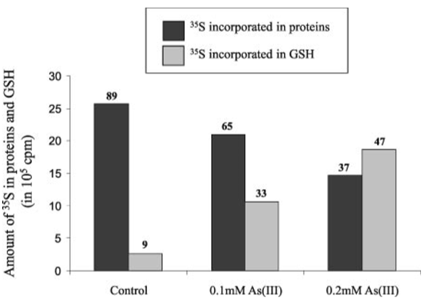
Figure 3: This shows the rise in GSH in response to increased concentration of As(III). Numbers at the top of the bars represent the percentage of assimilated sulfate in GSH proteins.
Notes:
Growing cells were separted into 3 aliquots, no arsenite, 0.1mM, and 0.2mM
They were exposed for one hour
Labeled with radioactive 35S (sulfate)
Results show radioactivity incorporated into the protein GSH

Slide 13
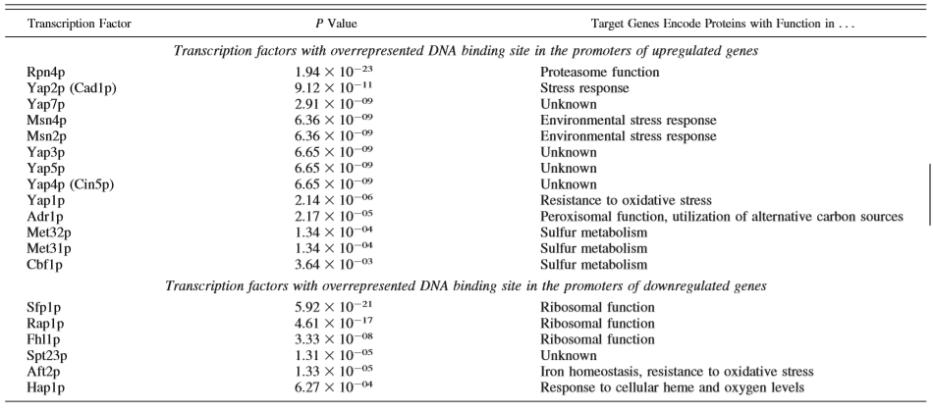
Table 2: This table displays the genes with transcripts found to be upregulated by more than twofold, 13 transcription factors were found to have highly overrepresented binding motifs, while of the genes with transcripts found to be downregulated by at least twofold, 6 transcription factors were found to have highly overrepresented binding motifs

Slide 14
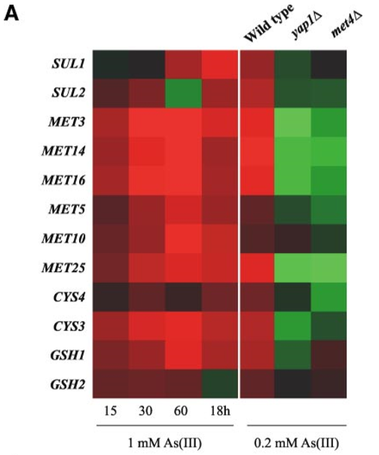
Figure 4: Heat map showing expression changes after 15min, 30min, 60min, and 18hrs of exposure to 1mM As(III), and the role of Yap1 and Met4 expression after 1hr of exposure to 0.2mM As(III)

Slide 15
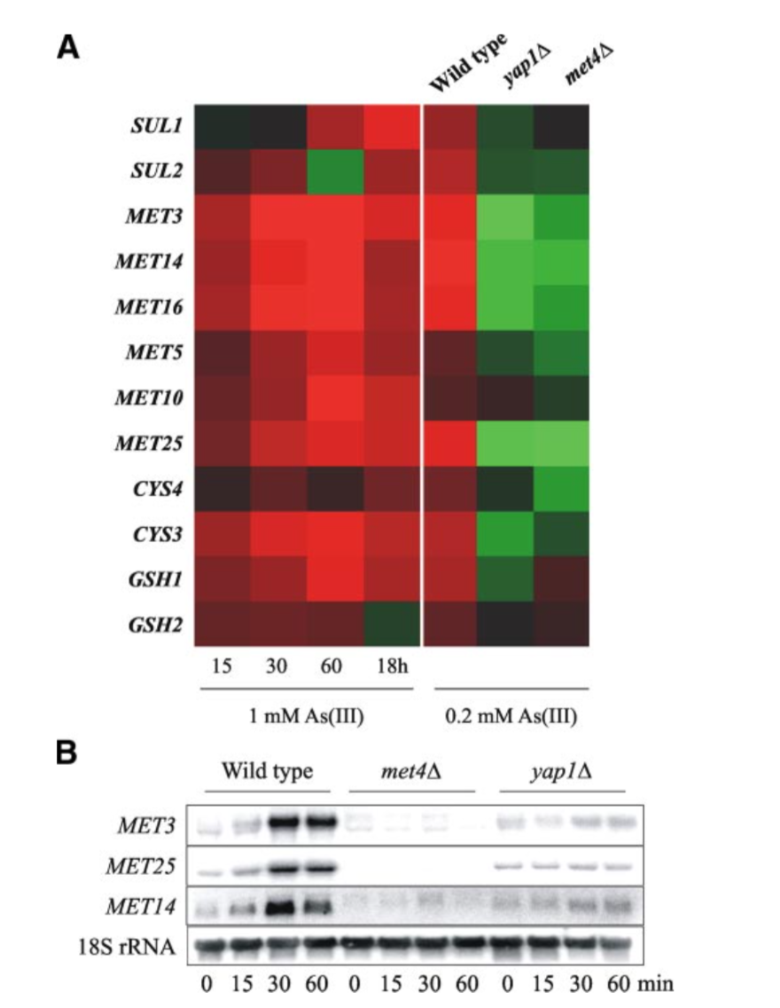
Figure 4B: This figure shows the expression of genes in RNA extracted from wildtype, met4Δ, and yap1Δ cells at certain time points after being exposed to 0.2 mM As(III). The X axis showed the time points at which the genes were analyzed for expression and the Y axis shows three MET genes being analyzed with 18s rRNA being the loading control. The measurements were made using 32P-labeled genes and a common trend of the Figure was that wild-type cells show high expression of their genes after exposure to As(III) than mutant met4Δ and yap1Δ cells.

Slide 16
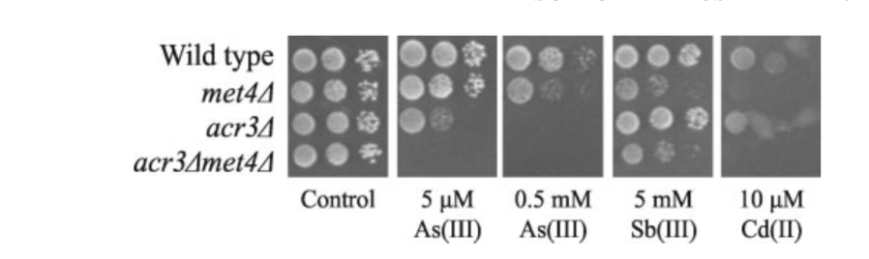
Figure 5: This figure shows the serial dilutions of wildtype, met4 mutant, acr3 mutant, and acr3met4 mutant. There was no observed growth on acr3met4 mutant plates in the presence of Sb(III) or Cd(II). Growth was monitored after 203 days at 30 °C

Slide 17
An overview of S. cerevisiae in response to arsenic
Toxic substances, such as arsenic, have impacts on living organisms
Met4p and Yap1p are major players in the cells' response to arsenic
Experimental methods reveal the transcriptional regulation of genes
The stimulation of sulfur assimilation and GSH biosynthesis is important for arsenic tolerance

Slide 18
Stimulation of the sulfur assimilation/GSH biosynthesis pathways is important for cellular arsenic tolerance acquisition
Controlled by YAP1p and Met4p transcription factors
Higher concentration of arsenic caused a greater concentration of sulfur metabolites
Sulfur is incorporated in glutathione biosynthesis in higher amounts in the presence of arsenite. During arsenic presence there is less sulfite found in proteins
Mutations in met4 and arc3 had a negative impact with the formation of cell cultures
Acr3 is necessary to defend against AS(III) when the cell does not have the necessary processes to undergo trivalent arsenite efflux

Slide 19
Source used for this presentation
Thorsen, M., Lagniel, G., Kristiansson, E., Junot, C., Nerman, O., Labarre, J., & Tamás, M. J. (2007). Quantitative transcriptome, proteome, and sulfur metabolite profiling of the Saccharomyces cerevisiae response to arsenite. Physiological genomics, 30(1), 35-43. DOI: 10.1152/physiolgenomics.00236.2006
(2006). Cammack, R., Atwood, T., Campbell, P., Parish, H., Smith, A., Vella, F., & Stirling, J. (Eds.), Oxford Dictionary of Biochemistry and Molecular Biology. : Oxford University Press. Retrieved 13 Nov. 2019, from https://www.oxfordreference.com/view/10.1093/acref/9780198529170.001.0001/acref-9780198529170.

Slide 20


Acknowledgements
Loyola Marymount University
Dr. Dahlquist
American Physiological Society
https://www.physiology.org/doi/full/10.1152/physiolgenomics.00236.2006
https://www.lmu.edu/

