Slide 1


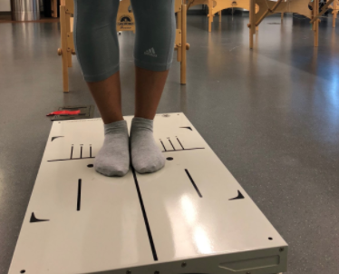
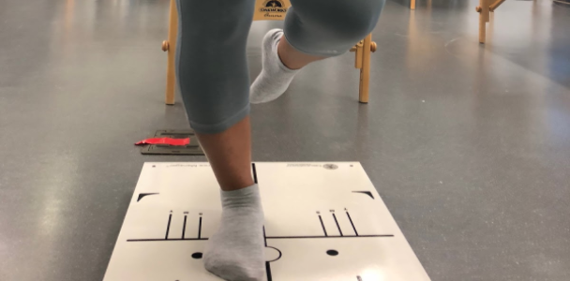
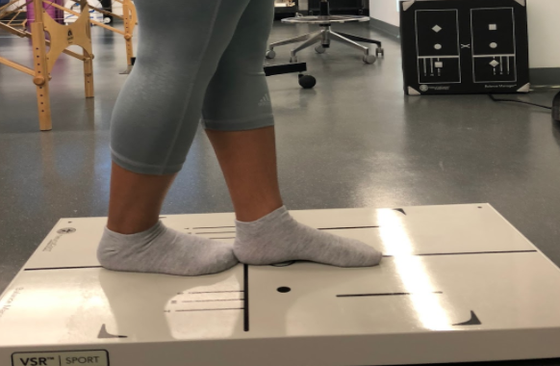
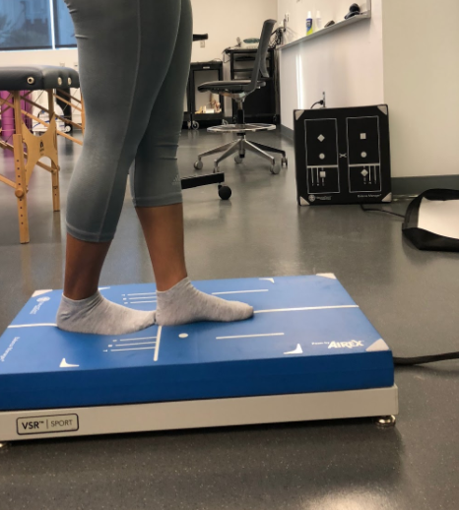
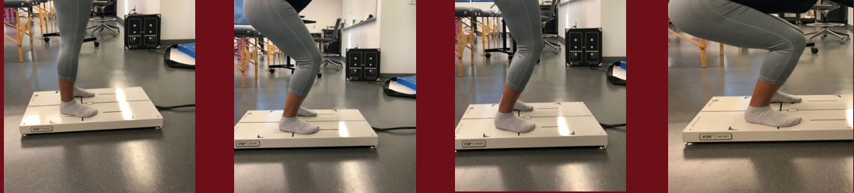
Stability, Weight Bearing and Squat Distribution between Female D1 Soccer Players and Non-Athletes
Courtney Spears, Naomi Tesfaiohannes, Sarah L. Strand
Sports Medicine Lab, Department of Health and Human Sciences, Loyola Marymount University
Abstract
Methods
Results
Background: Balance in athletics is important for performance and injuries. Low balance ability is generally associated with an increased risk of ligament injuries. The detection of a possible asymmetry in balance is important because a bilateral difference may be a contributing factor to injury. Soccer is unique in that participants plant and balance on their non-dominant leg. The purpose of this experiment is to determine if female soccer players have better stability, weight bearing and squat distribution, when compared to female non-athletes. There is a lack of information in this area of study.
Methodology: In this experiment, female soccer players (n=8) and female non-athletes (n=10) participated in a series of Neurocom® tests. Neurocom® is known worldwide as leading edge computerized tools for the assessment and rehabilitation of balance and mobility. The first test (Stability Evaluation Test) required an individual to stand on the platform (with both eyes closed) on both feet, one foot, and in a tandem stance for 15 seconds each. This process was performed on both a hard and foam surface. The second test (Weight Bearing/Squat) required an individual to stand on the platform with their feet apart and hold a squat position with their knees at 0°, 30°, 60° and 90°.
Results: The results revealed that there was no statistical significance for weight bearing squat and postural sway on a flat surface. The postural sway between athletes and female non-athletes on a foam surface standing on one leg (p=0.010) and tandem (p=0.033), were significant. The overall composition of the stability evaluation test of athletes compared to non-athletes was significant (p=0.031).
Discussion: The results showed that there is a statistically significant difference in sway between athletes and non-athletes in the single foam, tandem foam, and overall comp. However, there was no statistically significant difference between athletes and non-athletes in all weight-bearing squat analysis or stability tests on a flat surface. The insignificance on flat surfaces but significance on foam was likely due to an increase in difficulty with staying balanced on the foam padding.
In this experiment, female soccer players (n=8) and female non-athletes (n=10) participated in a series of NeuroCom® tests to evaluate weight bearing and degree of sway (balance). NeuroCom® is known worldwide as leading edge computerized tools for the assessment and rehabilitation of balance and mobility [4]. For the purpose of this experiment only females between age 20-21 were included in the final data analysis. For the athletes we evaluated players on the female soccer team. Non-Athletes were participants that do not participate in any D1 sports on campus. Before participating, all participants were informed of the nature and purpose of the experiment and asked to sign an informed consent form. They were then asked to provide basic information (i.e. age, gender, etc) and answer a series of questions to determine their past and current sports involvement and injury history. The participants were guided through the two tests by an examiner that was familiar with the NeuroCom® and accompanying procedures. The first test (Stability Evaluation Test) required the participant to stand on the platform (with both eyes closed) on both feet (Image 1), one foot (Image 2) and in a tandem stance (Image 3), for 15 seconds each. This process was performed on both a hard and foam surface (Image 4). The second test (Weight Bearing/Squat) required an individual to stand on the platform with their feet apart and hold a squat position with their knees at 0°, 30°, 60° and 90° (images 5-8).
The postural sway between athletes and non-athletes on a foam surface single (p=0.010) and tandem (p=0.033), were significant. The overall composition of the stability evaluation test of athletes compared to non-athletes was significant (p=0.031). The mean weight bearing values of non-athletes (at all degrees) suggest that they favor their dominant leg. While the mean weight bearing/squat of athletes suggested that they favored their dominant leg at 0° and 60° and favored their non dominant leg at 30° and 90°. When comparing the two groups statistically (mean value of dominant leg) at 0° (p=0.595), 30° (p=.164), 60° (p= .535) and 90° (p=.238); there is no significant difference between athletes and non-athletes. The non-dominant leg means between athletes and non-athletes had similar p-values and as a result were also insignificant. On a solid surface there were no significant p-values ,suggesting that athletes and non-athletes performed relatively the same. On a foam surface the p-values for single (p=0,010) and tandem (p=0.033) were significant. Observations from the stability evaluation test showed that the differences between the postural sway of athletes and non-athletes on a flat surface was insignificant. Also that the difference between the postural sway of athletes and non-athletes was significant (except for double stance). This suggest that as balancing tasks become more difficult athletes perform better than non-athletes.
.
Image 1 above shows a participant standing feet together
Image 2 above shows a participant standing on one foot (single)
Image 3 above shows a participant standing in a tandem stance
Image 4 above shows a participant standing on a foam in a tandem stance
Discussion
Background
There is not a lot of information regarding the performance of female athletes compared to non-athletes. This is most likely due to the lack of data collected by researchers in the past when comparing non-athletes and athletes. Most of the information found comparing athletes to non-athletes focused primarily on men. Observations from the weight distribution test showed that non-athletes consistently favored their dominant leg. Observations also showed that athletes favored their dominant leg at 0° and 60° and favored their non-dominant at 30° and 90°. However, statistics showed that there was no statistical significance between the mean distributions of athletes compared to non-athletes. We predicted that non-athletes would favor their dominant leg and athletes would favor their non- dominant leg as a result of training. Statistics show that there is no significant difference between the groups in terms of which leg they favor. The research suggests that as balancing tasks become more difficult (i.e. introducing foam) the difference between athletes and non-athletes become more significant. Outside research showed that athletes were superior to non-athletes in balance performance [3]. Future research would include more difficult balance analysis of athletes (non-athletes being a control).
NeuroCom ® is a product used to measure sensory and voluntary motor control of balance[1].
It is used by clinicians to assess a patient’s performance in a wide range of activities and skills analysis. With athletes, balance is an important indicator to physical therapists in determining the athlete’s ability to perform efficiently or return from a recent injury [2]. Research shows that athletes have greater balance than non-athletes [3] The question was if there is a statistically significant difference between the stability and weight bearing distribution of female D1 soccer players and females that do not participate in sports?
The hypothesis was that there would be a statistical difference between females aged 20-21 participating in D1 soccer and females that do not participate in any sports on campus when performing weight bearing and stability tests in a controlled lab setting.
The predictions were that soccer players would have better balance (stability evaluation test) and non-athletes would have better weight bearing distribution (Weight bearing/squat test)
Image 5 above shows a participant squatting at 0°
Image 6 above shows a participant squatting at 30°
Image 7 above shows a participant squatting at 60°
Image 8 above shows a participant squatting at 90°
Results
 | ND | D | ND | D | ND | D | ND | D
Athletes | 49.4 | 50.6 | 50.4 | 49.6 | 49.1 | 50.9 | 50.3 | 49.8
Non-Athletes | 48.4 | 51.6 | 47.5 | 52.5 | 47.9 | 52.1 | 48.1 | 51.9
Figure 1 Key D= Dominant ND= Non-Dominant Four shades of orange represent 0°,30°, 60° and 90°, chronologically
Acknowledgements
References
We would like to thank Loyola Marymount University, the Health & Human Sciences Department, Makeen Yasar, Olivia Abdoo, and all research participants
Figure 1 shows the means of the weight distributions of Athletes and non-athletes
[1] “Natus®.” Natus Medical Incorporated - Natus Balance + Mobility. Retrieved from http://www.natus.com/index.cfm?page=products_balance_mobility&crid=268
[2] Guskiewicz, M. Kevin, Perrin, H. David. (1996). Research and Clinical Applications of Assessing. Retrieved from https://journals.humankinetics.com/doi/abs/10.1123/jsr.5.1.45
[3] Davlin, C. Christina. (2004). Retrieved from http://journals.sagepub.com/doi/abs/10.2466/pms.98.3c.1171-1176
[4] “About Our Company.” About Our Company |. Retrieved from balanceandmobility.com/about/.
 | Double | Single | Tandem | Double | Single | Tandem
Athletes | .725 | 1.70 | 1.2 | 1.8 | 2.9 | 3.1
Non-Athletes | .750 | 2.48 | 2.2 | 1.9 | 4.3 | 5.4
Figure 2 Key Light Blue = flat surface Medium Blue = foam surface
Figure 2 shows the mean degree of sway of athletes and non-athletes on both a solid and foam surface in the three positions (double, single and tandem)
Notes:
The Stability Evaluation Test (SET) is a computerized Balance Error Scoring System (BESS) assessment on the NeuroCom® Balance Manager that uses a force plate to objectively measure a subject’s postural sway velocity rather than the usual assessment that involves a clinician providing subjective feedback based on perceived number of errors.

