Slide 1
CRISPRlnc
By: David Ramirez and John Nimmers-Minor

Slide 2
The Plan for Today’s Presentation
General information and introduction of the CRISPR database.
“What is lncRNA?”
A Walkthrough of the Database.
CRISPR’s Significance.
Final Statements and Thoughts.
Acknowledgements and References.

Slide 3
What is CRISPR used for?
CRISPR is one of the largest collections of data on long, non-coding (lnc) RNA.
The database is used to find sequences, function, and studies surrounding different lncRNA of different model organisms
Humans, Mice and Flies are the most documented species, but there are 8 model organism species in the database.

Slide 4
What is lncRNA & Why is it Important?
Long non-coding RNA is a strand of RNA that, instead of being folded into a protein, carry out cellular functions in RNA form.
lncRNA is relatively unstudied.
Importance and diversity is recorded in lncRNA functions, but lncRNA is still largely a mystery for now.

Slide 5
Walkthrough of the Database
We will now introduce you to a few aspects of the CRISPR database, as well as how to utilize and navigate through the database itself.
Navigation
Database tabs
Functions of tabs

Slide 6
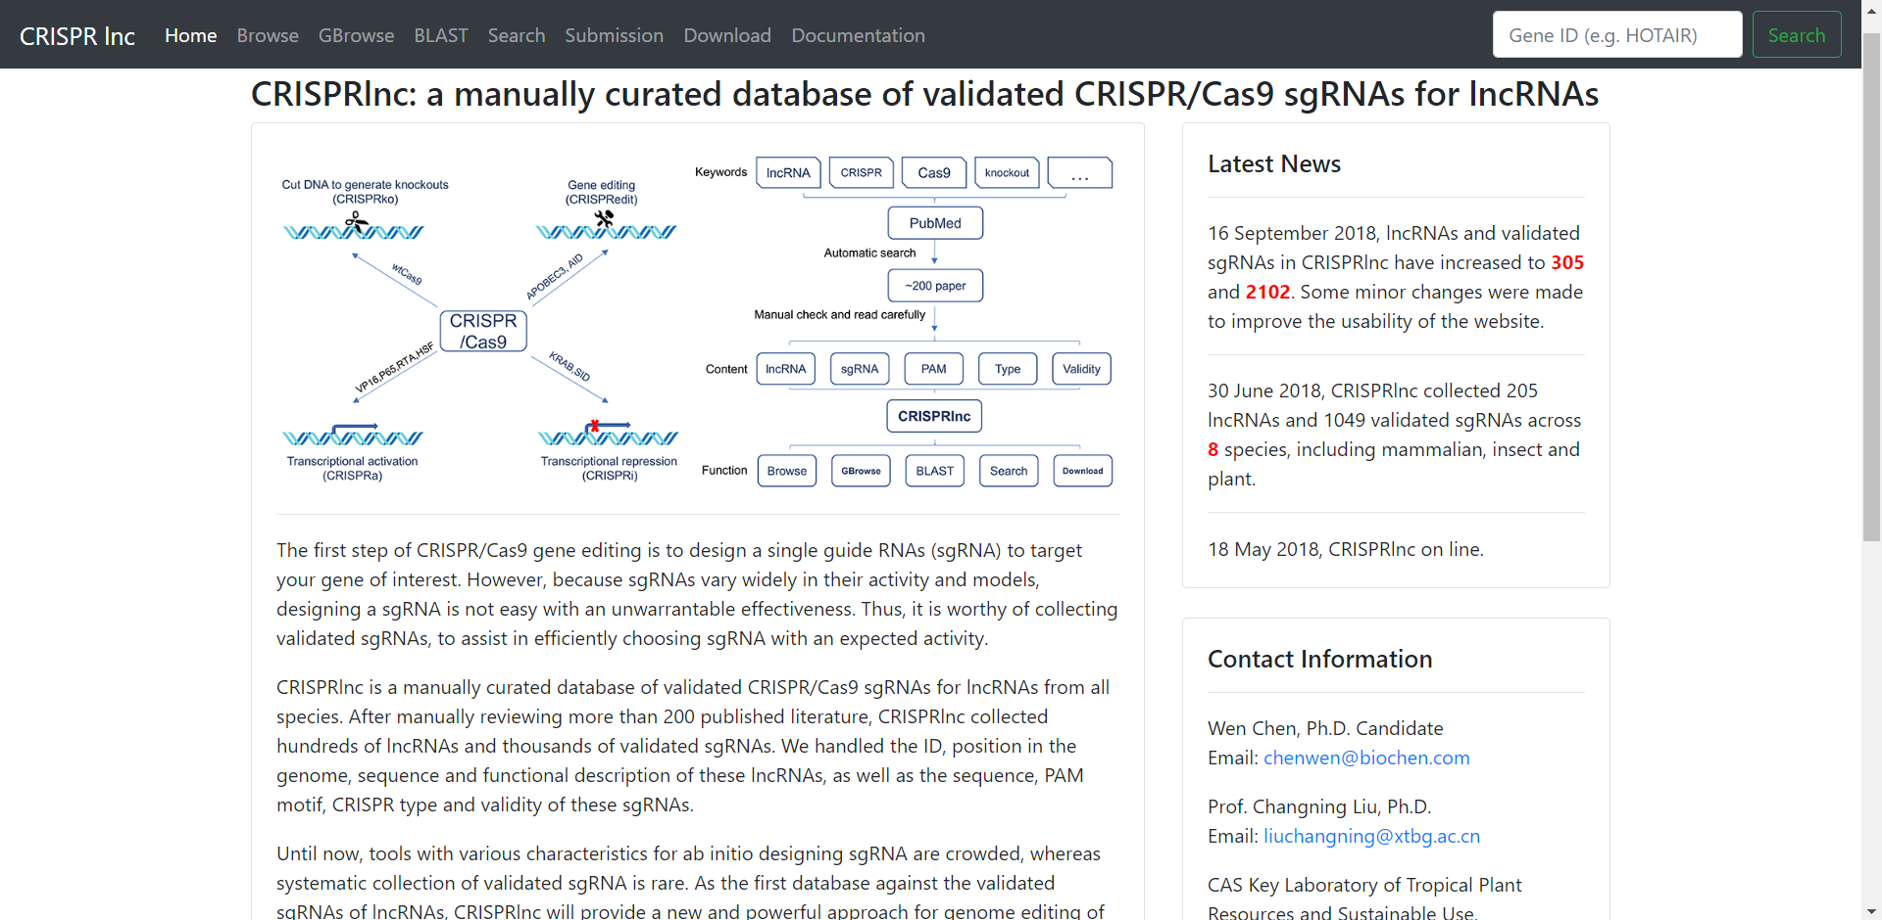
Home

Slide 7
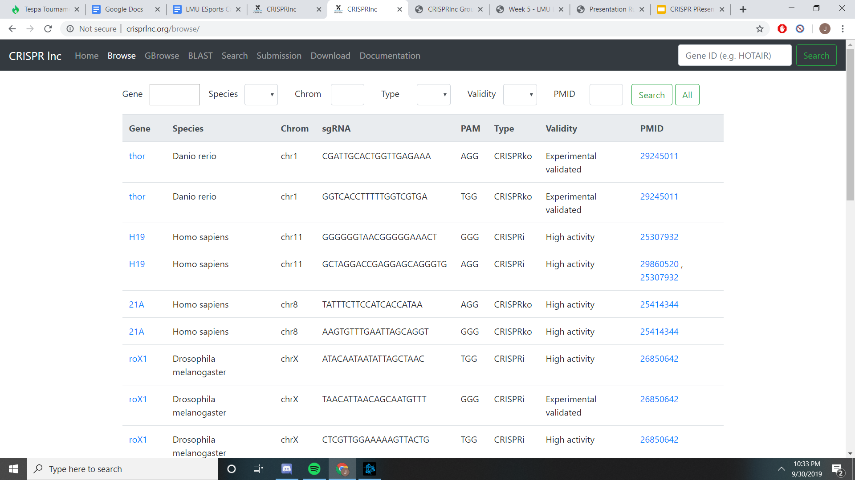
Browse

Slide 8
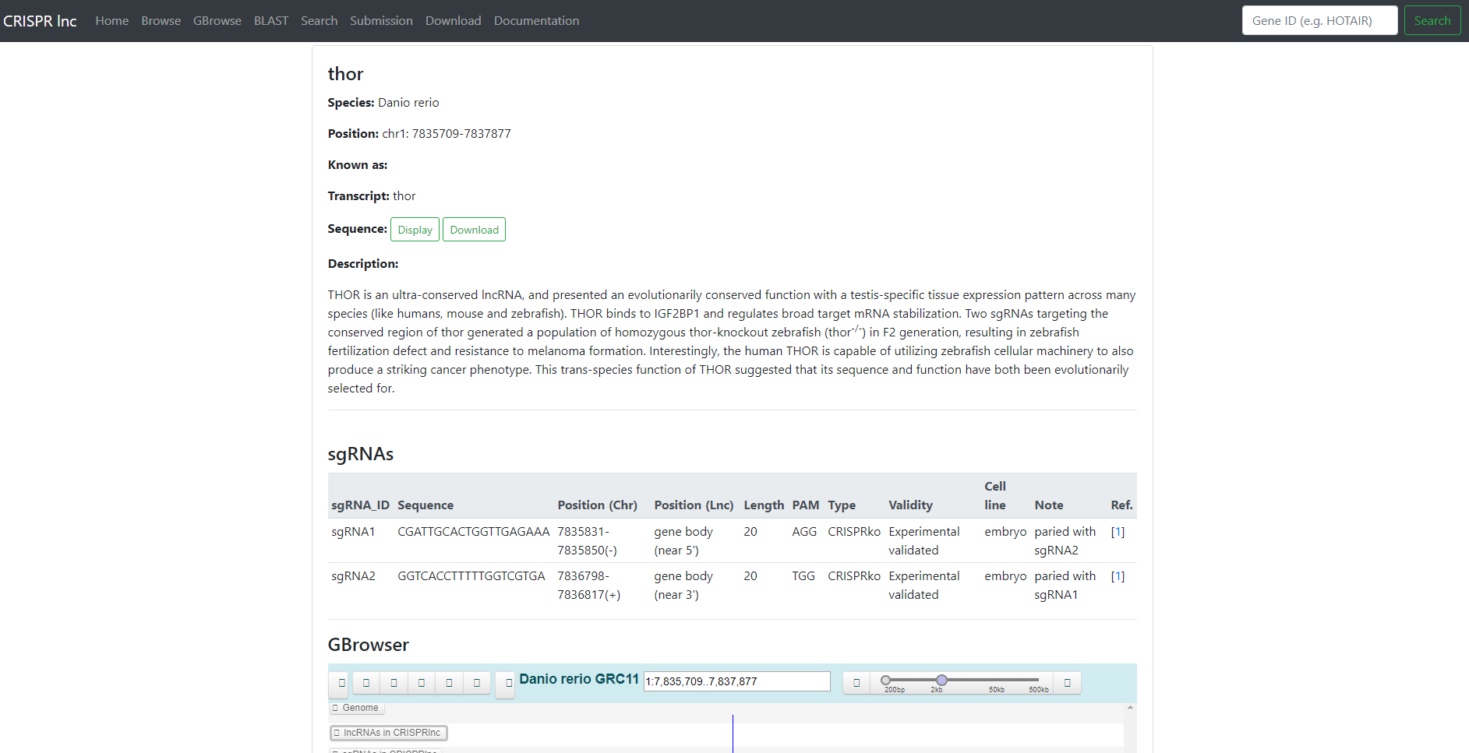
Example of a Gene Page

Slide 9
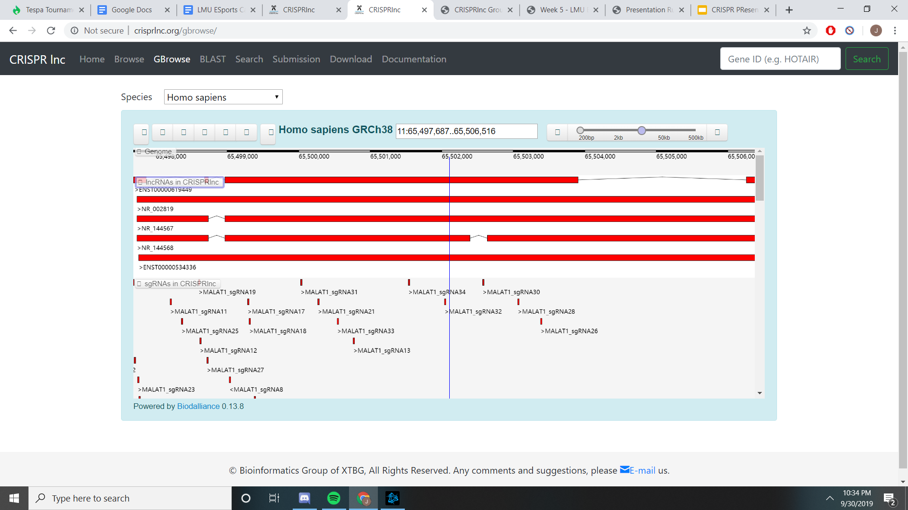
GBrowse

Slide 10
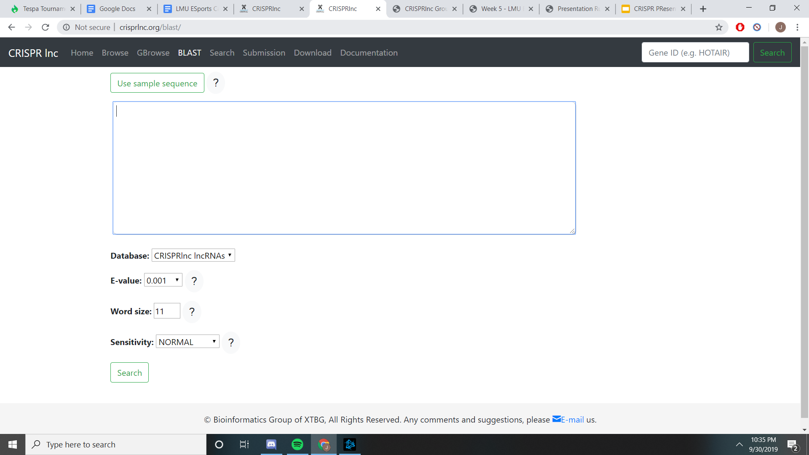
BLAST

Slide 11
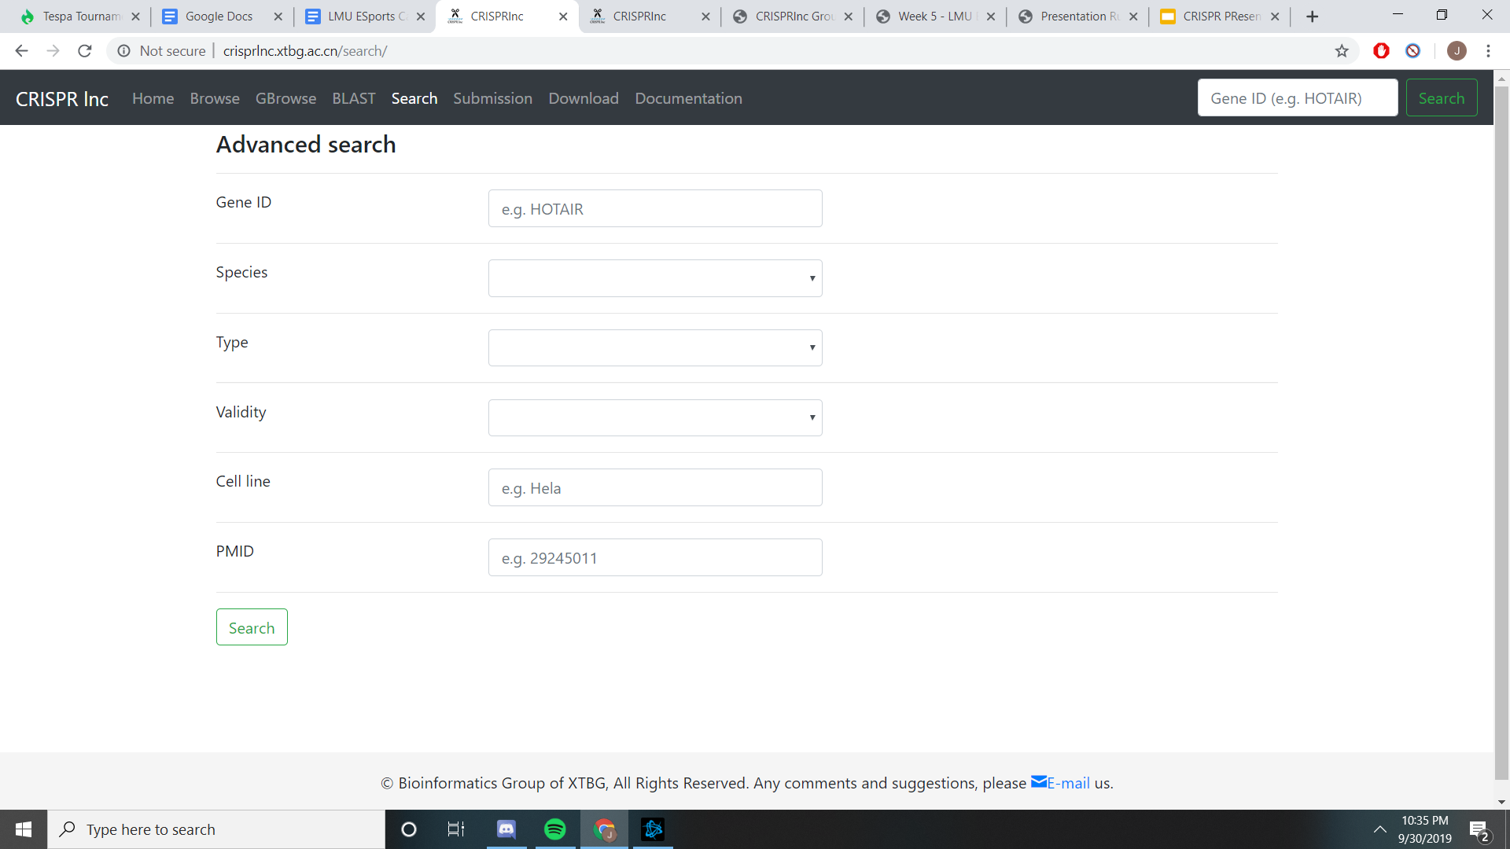
Search

Slide 12
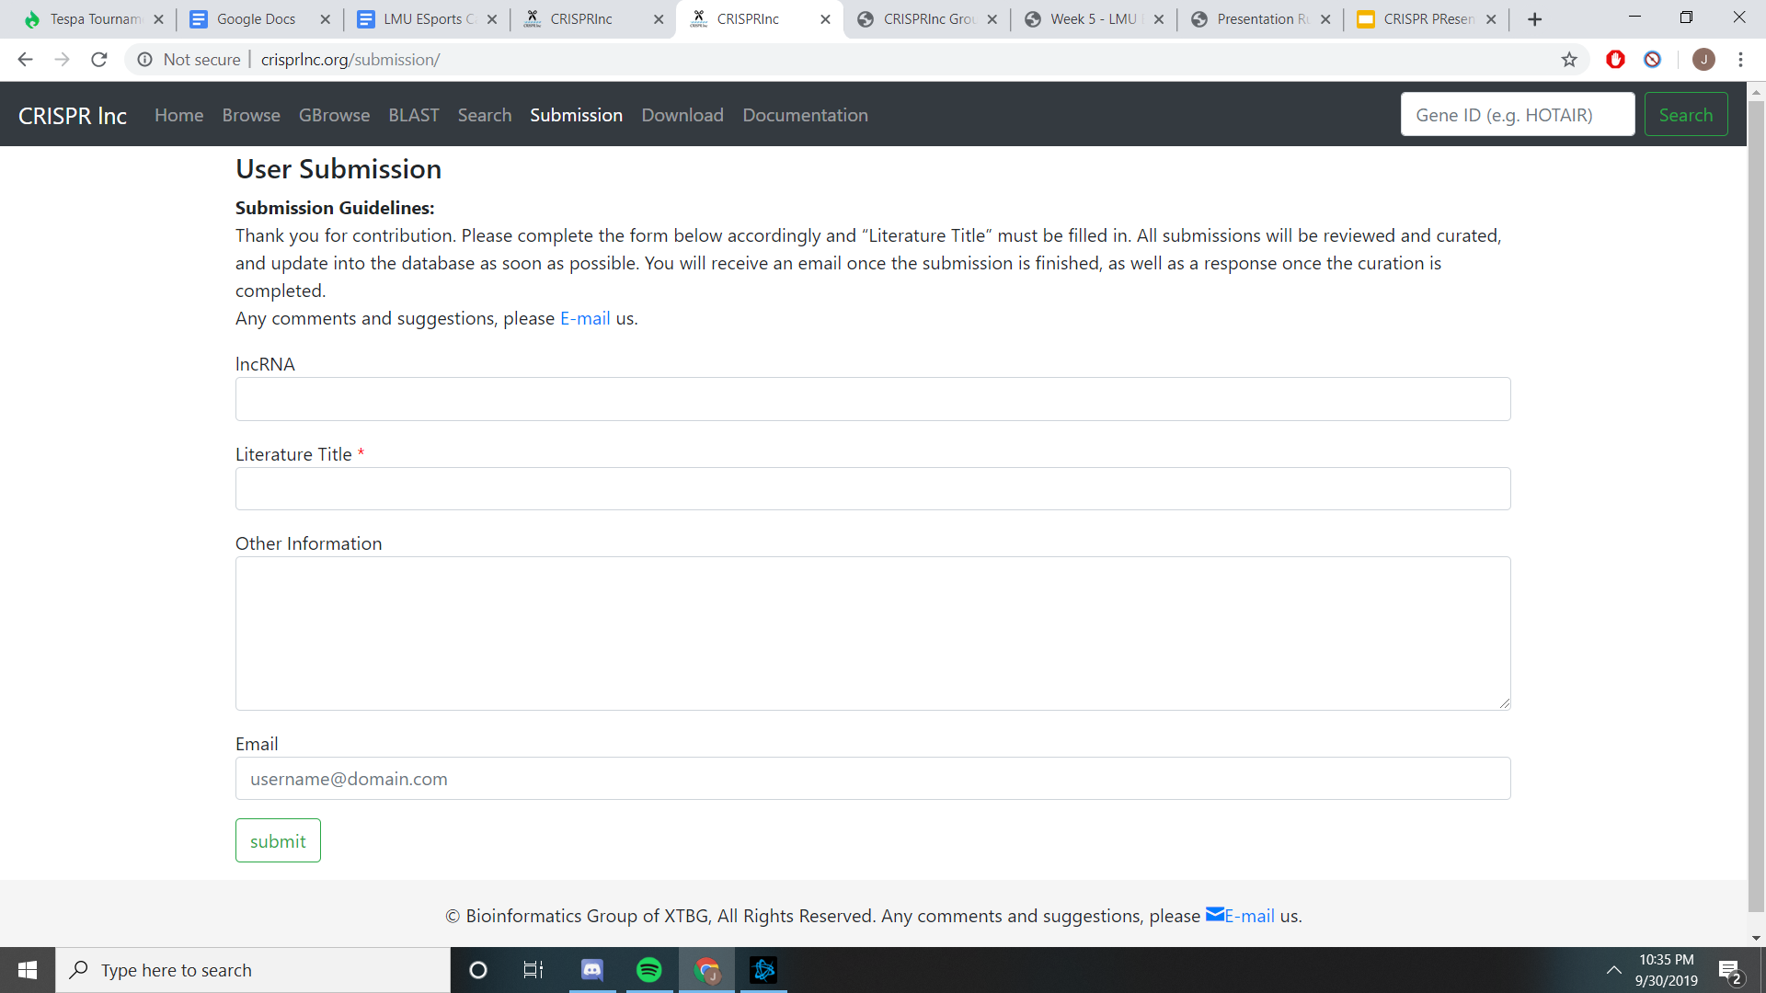
Submission

Slide 13
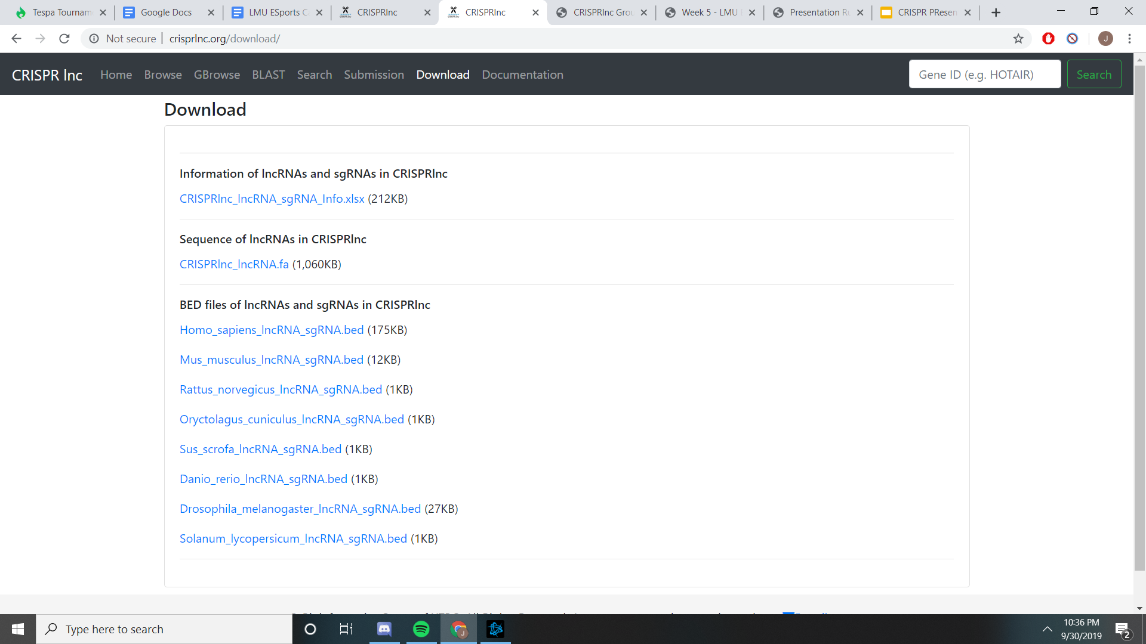
Download

Slide 14
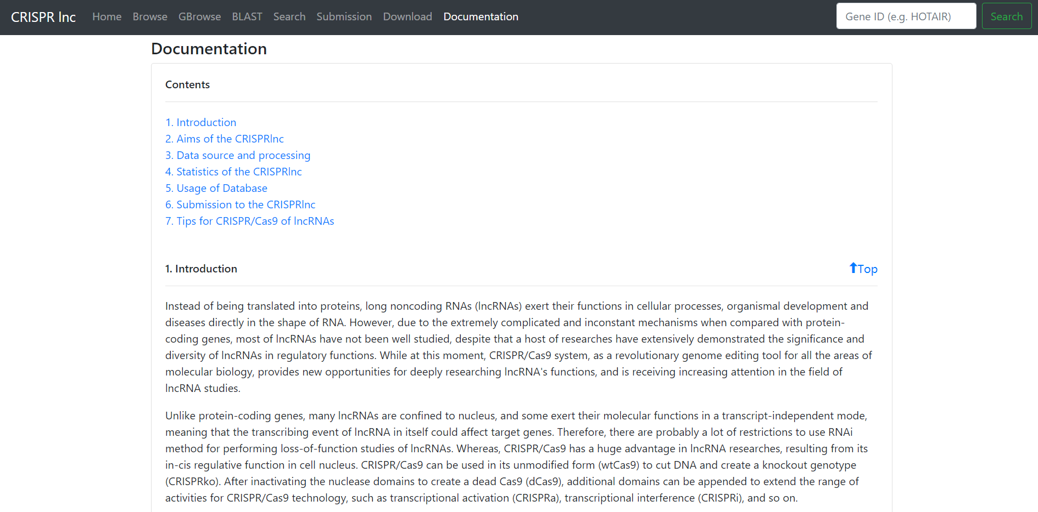
Documentation

Slide 15
Significance of CRISPR
CRISPR is world renowned for being a very large and very simple database to navigate.
Databases similar to CRISPR are not abundant.
Verified, hand-checked information of CRISPR/Cas9 and have established CRISPR as highly reliable by many utilizing the data within it.

Slide 16
Final Statements & Thoughts
CRISPR provides a large, free, and easily accessible database on lncRNA.
lncRNA is still being studied extensively and CRISPR allows for the collection of all new and old lncRNA data.
CRISPR is easy to use and contains a large amount of validated sequences.
Ease of access and use can help push ideas on lncRNa and this database will continue to assist in lnaRNA learning and data condensing.

Slide 17
Acknowledgements
Thank you to Dr. Dahlqust who taught us usage of databases as well as helped us find the CRISPR database.
Thank you to the LMU Biology Department
Acknowledgements to the CRISPRlnc team for access to their databases which assisted in answering questions about the database itself .

Slide 18
References
“CRISPRlnc.” CRISPRlnc, http://crisprlnc.xtbg.ac.cn/.
Chen, et al. “CRISPRlnc: a Manually Curated Database of Validated SgRNAs for LncRNAs.” OUP Academic, Oxford University Press, 4 Oct. 2018, https://academic.oup.com/nar/article/47/D1/D63/5115215.

Slide 19
Thank You For Your Time!
Any Questions?

