Slide 1
FunGals:Data
Michael Armas, Kaitlyn Nguyen, Emma Young, and Iliana E Crespin
BIOL 367-01: Biological Databases
Tuesday, December 10, 2019

Slide 2
Table of ANOVA Results
ANOVA​ | S288C​
p < 0.05​ | 37.2 %​
p < 0.01​ | 18.26 %​
p < 0.001​ | 5.04 %​
p < 0.0001​ | 0.87 %​
B & H p < 0.05​ | 0.11 %​
Bonferroni p < 0.05​ | 16.36 %​

Slide 3
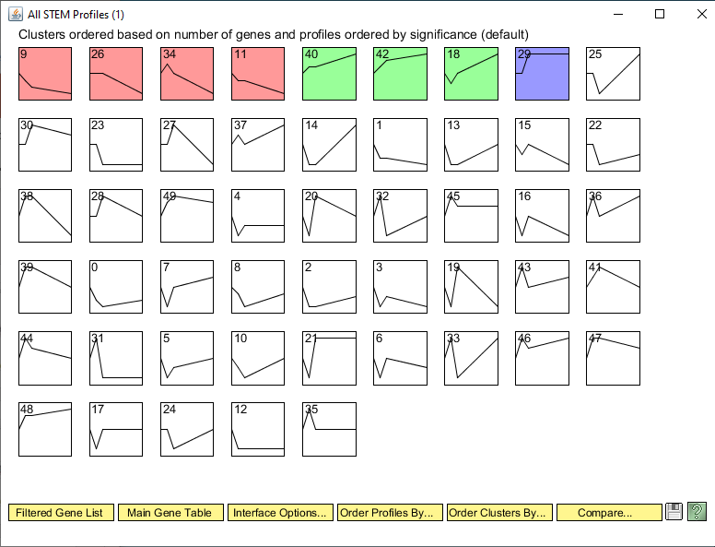
ALL STEM Profiles

Slide 4
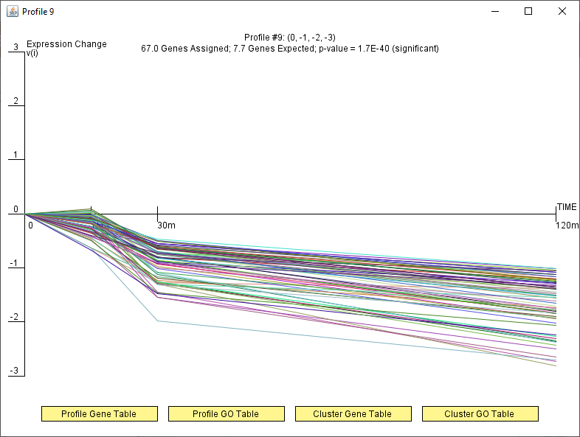
Profile 9 (red)

Slide 5
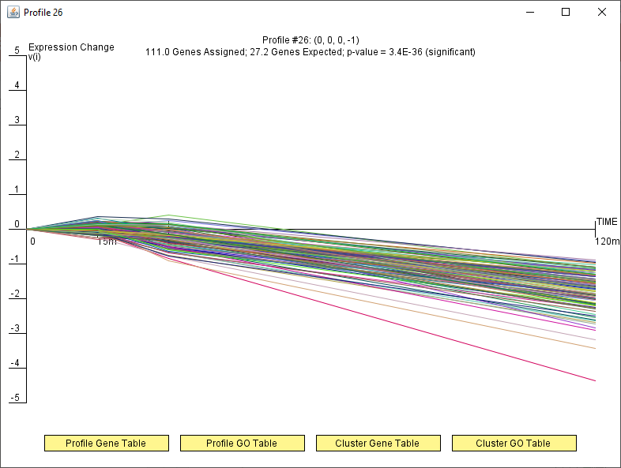
Profile 26 (red)

Slide 6
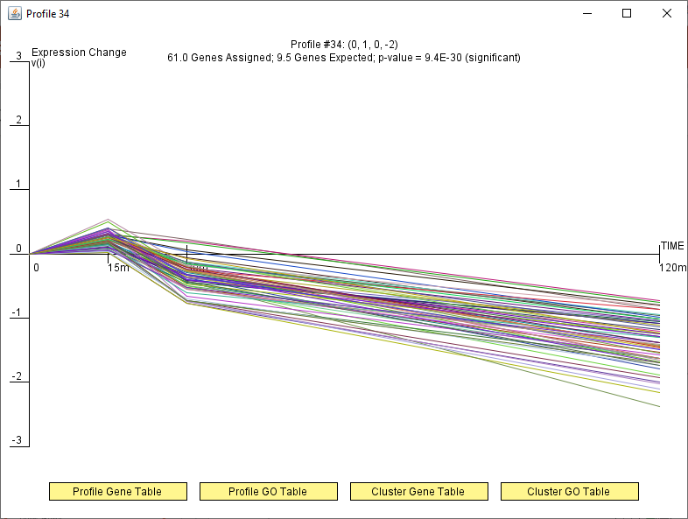
Profile 34 (red)

Slide 7
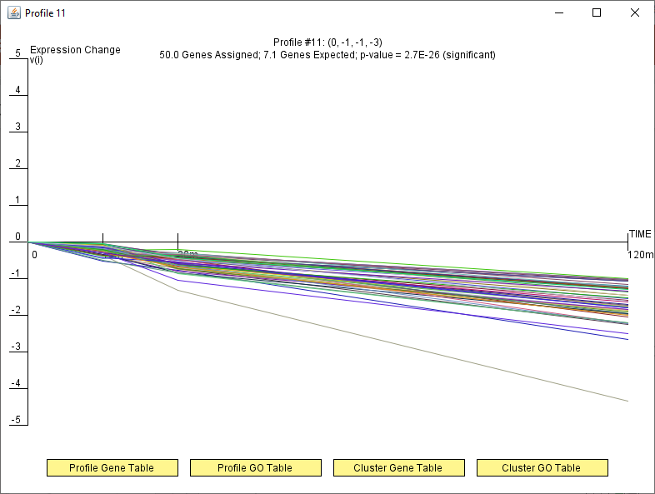
Profile 11 (red)

Slide 8
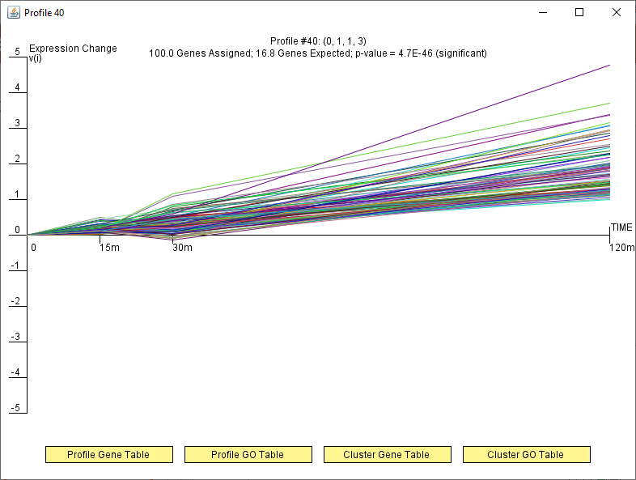
Profile 40 (green)

Slide 9
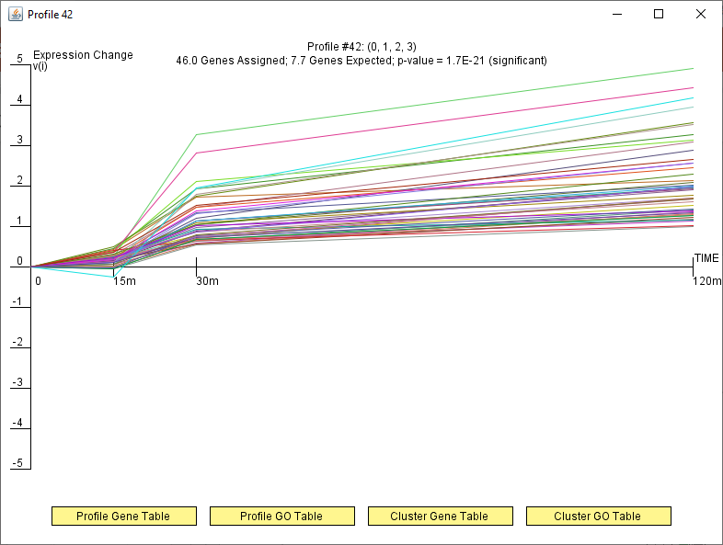
Profile 42 (green)

Slide 10
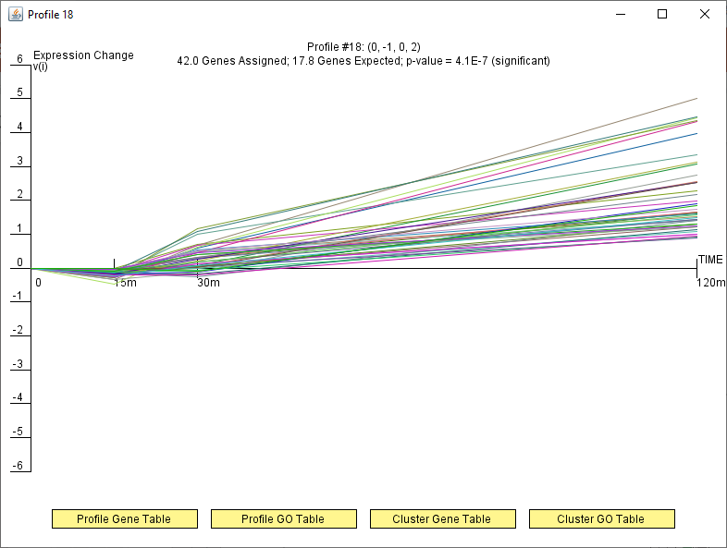
Profile 18 (green)

Slide 11
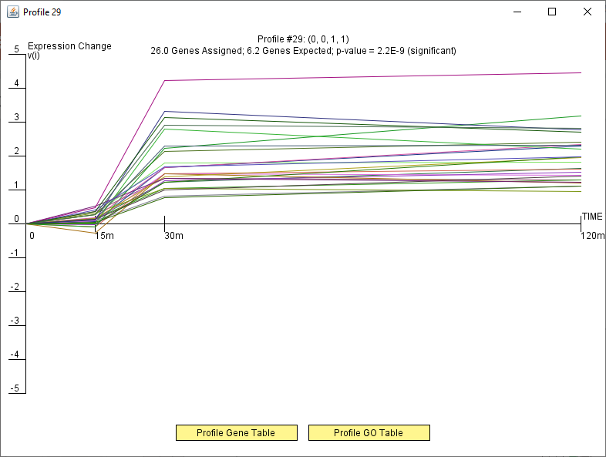
Profile 29 (blue)

Slide 12
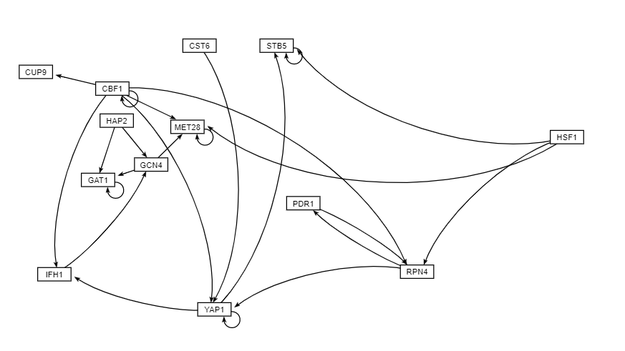
Red Profile grnsight unweighted profile

Slide 13
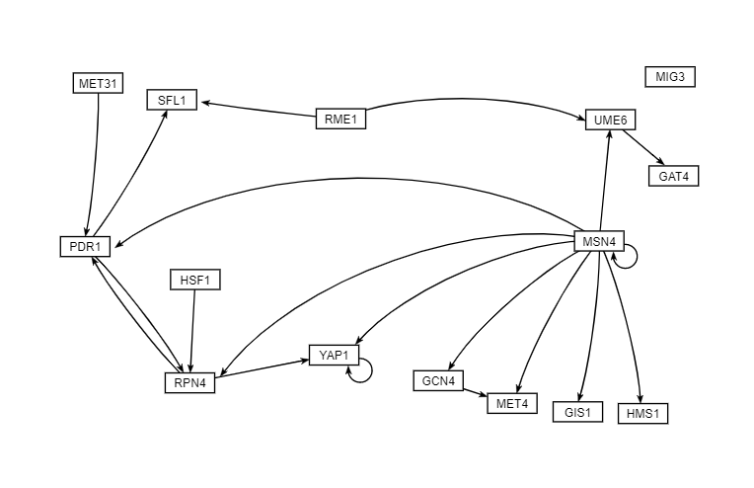
Green Profile GRNrnsight unweighted profile

Slide 14
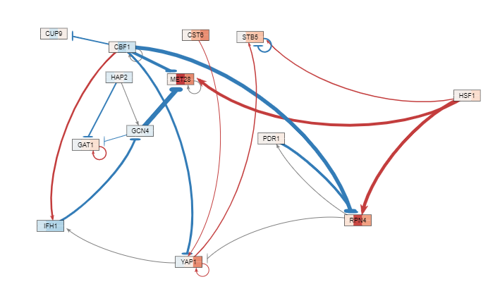
Red Profile Grnsight Weighted Profile

Slide 15
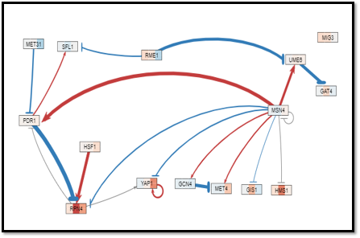
Green Profile GRNrnsight weighted profile

