Slide 1
dCIN5 STEM Results
DeLisa Madere

Slide 2
ANOVA | dCIN6
p < 0.05 | 37.00%
p < 0.01 | 22.30%
p < 0.001 | 11.16%
p < 0.0001 | 5.784%
B & H p < 0.05 | 2.440%
Bonferroni p < 0.05 | 23.48%

Slide 3
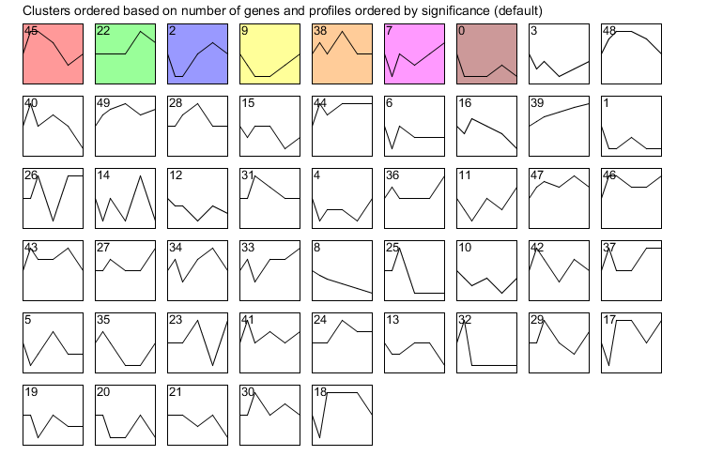

Slide 4
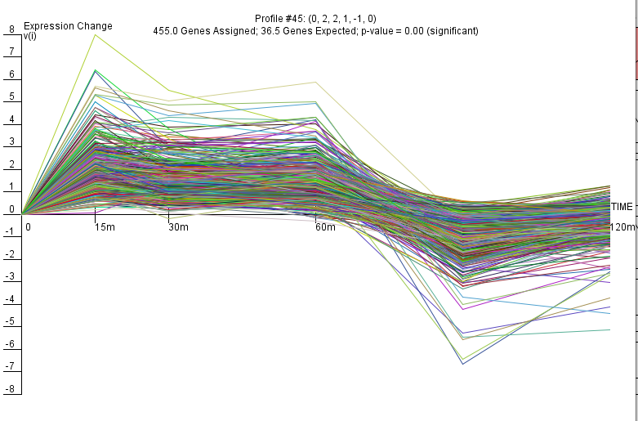

Slide 5
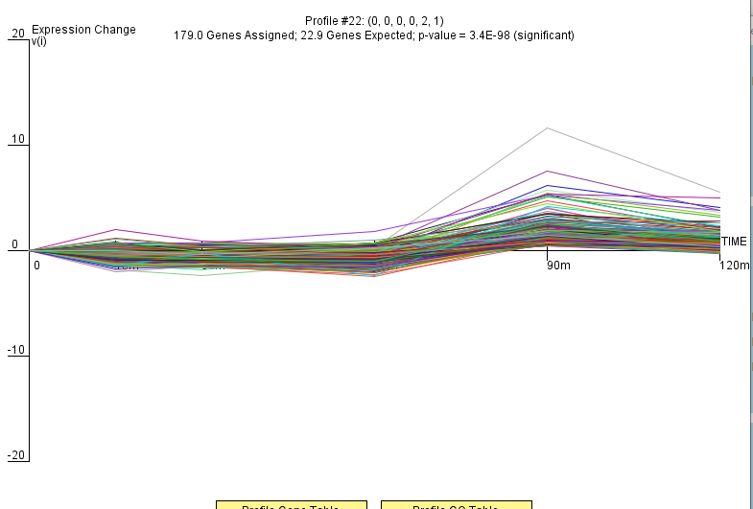

Slide 6
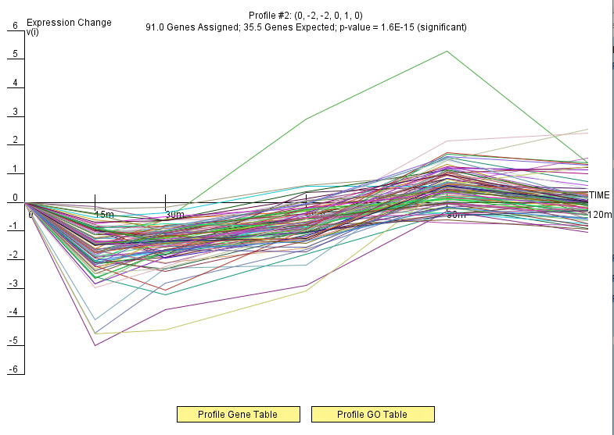

Slide 7
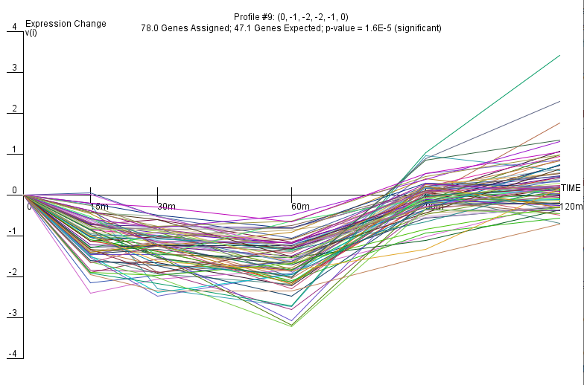

Slide 8
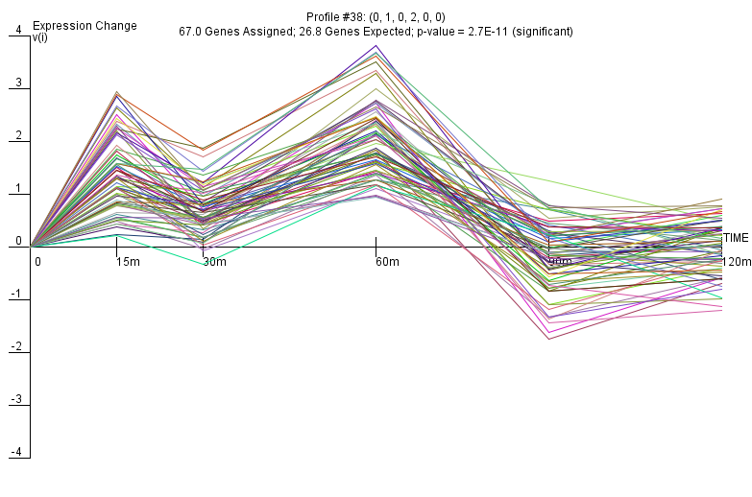

Slide 9
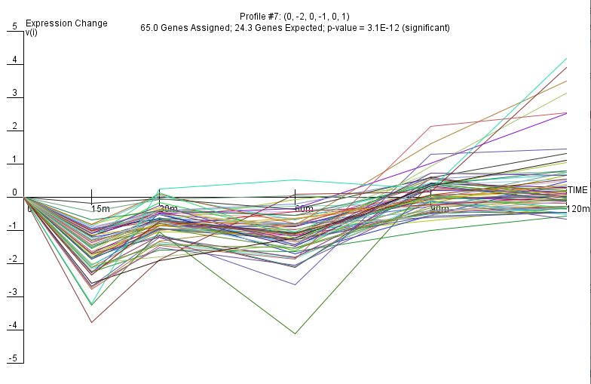

Slide 10
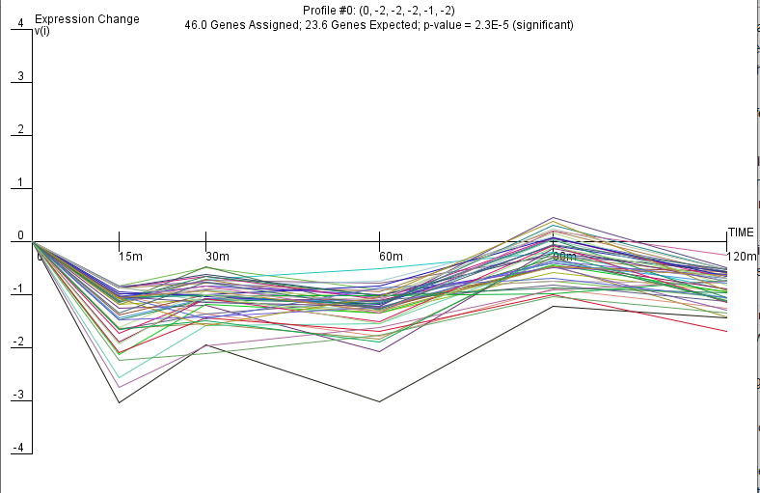

Slide 11
GRNsight Results

