Slide 1
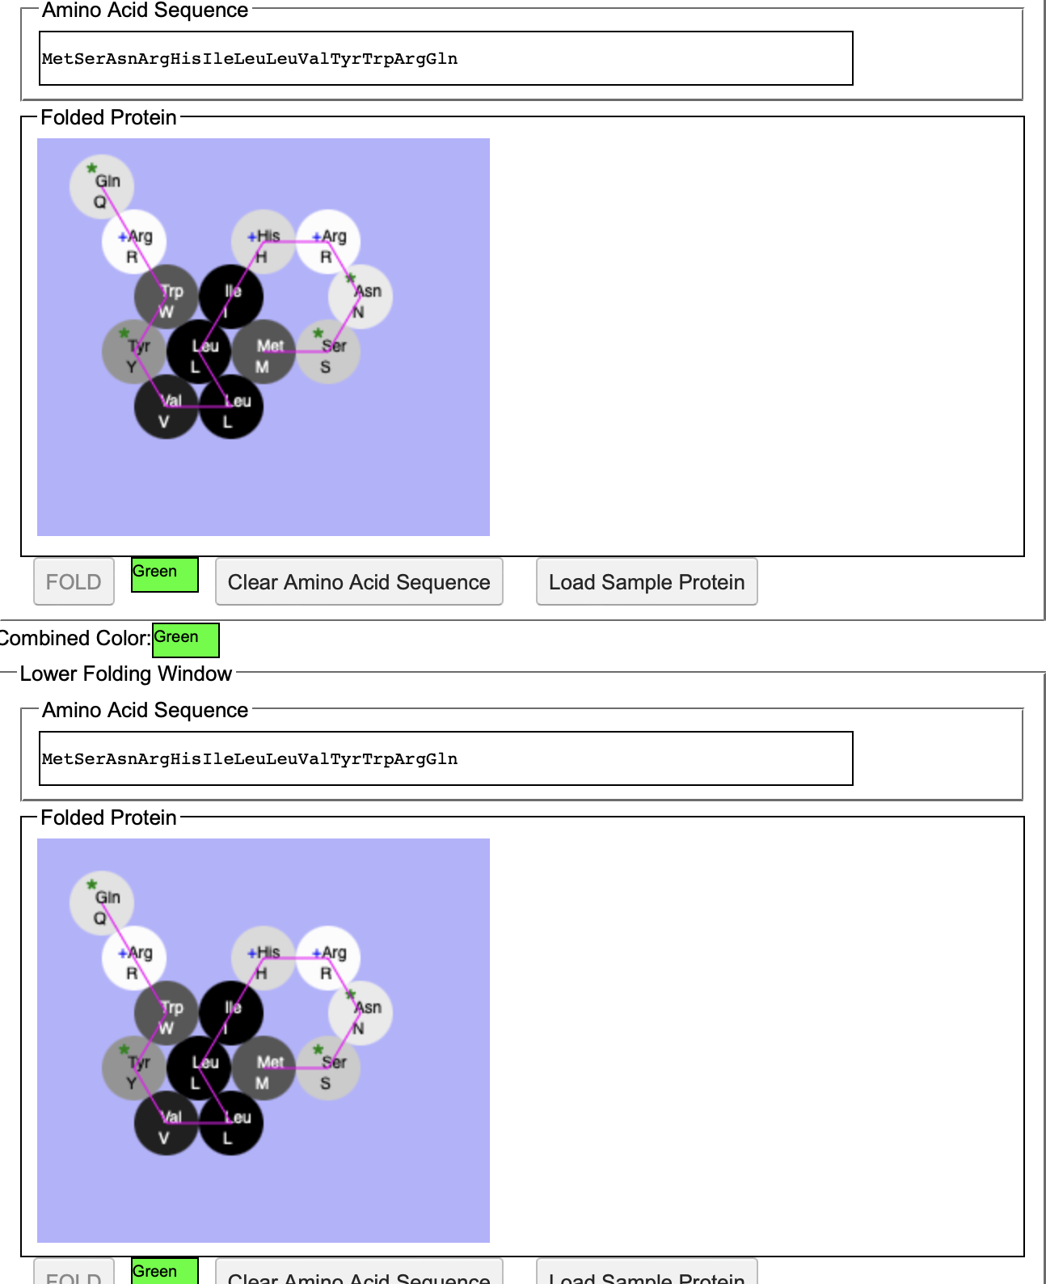
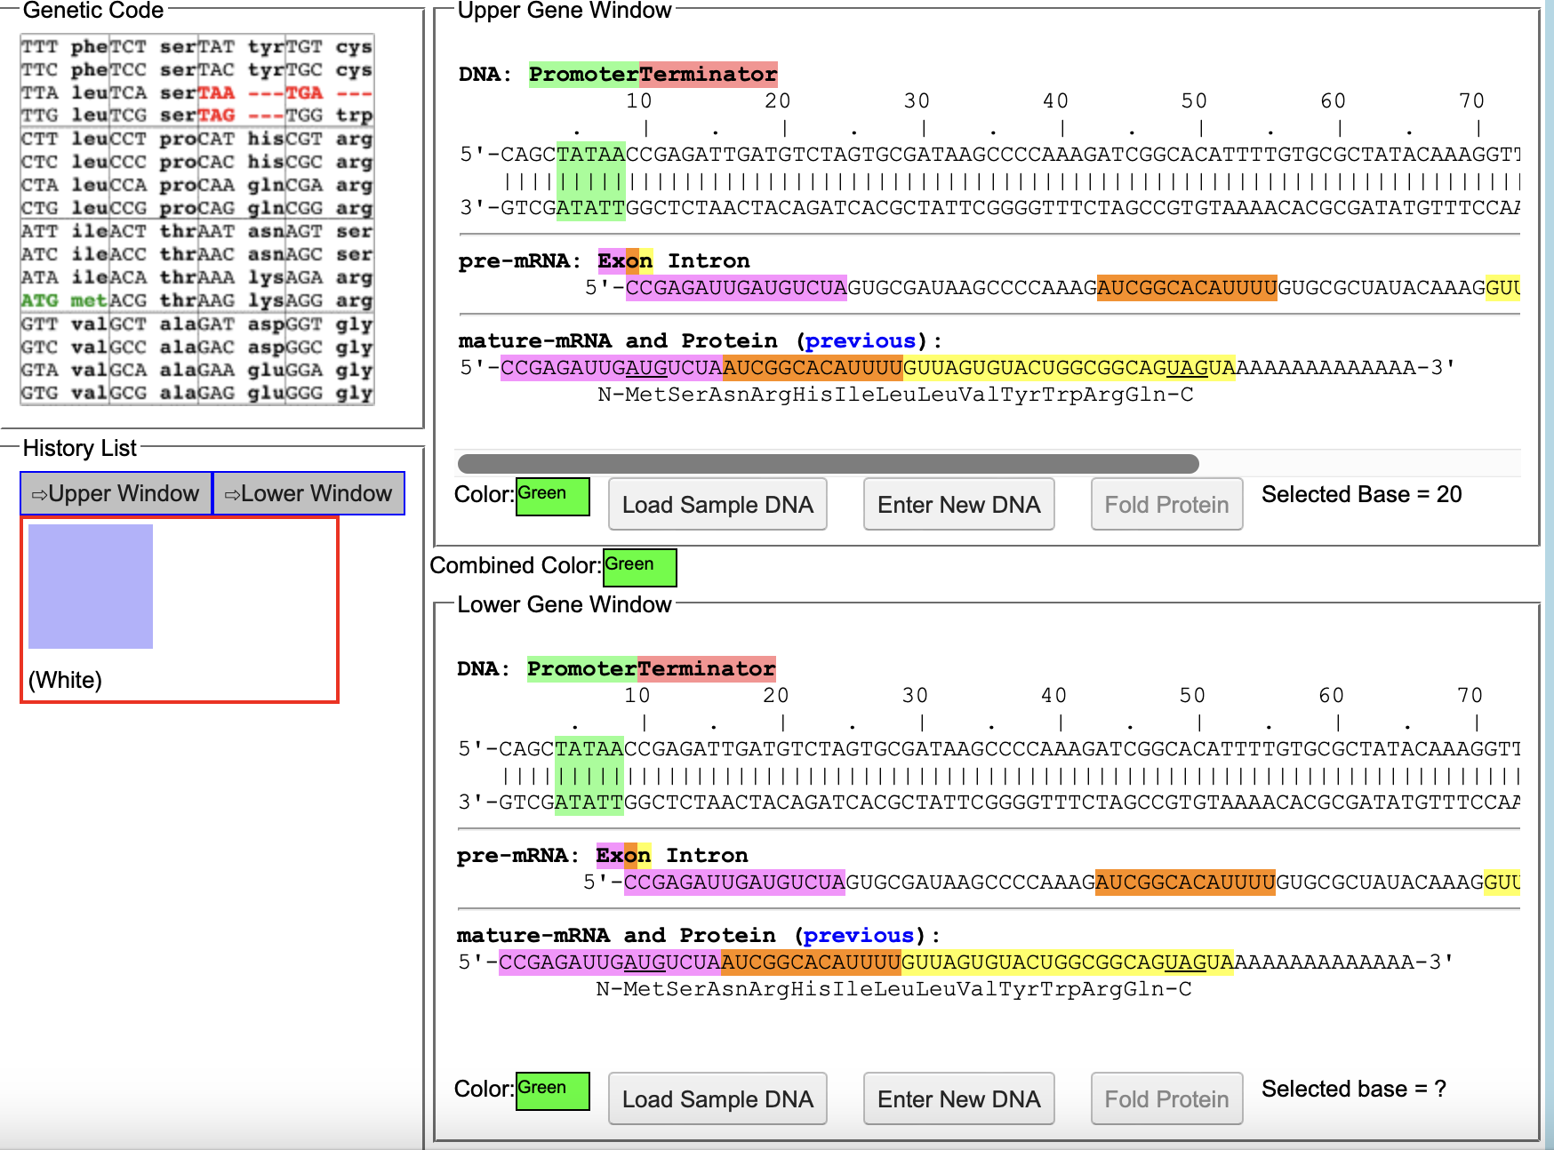
Green-1
Changes in amino acid sequence
Changes in DNA sequence

Slide 2
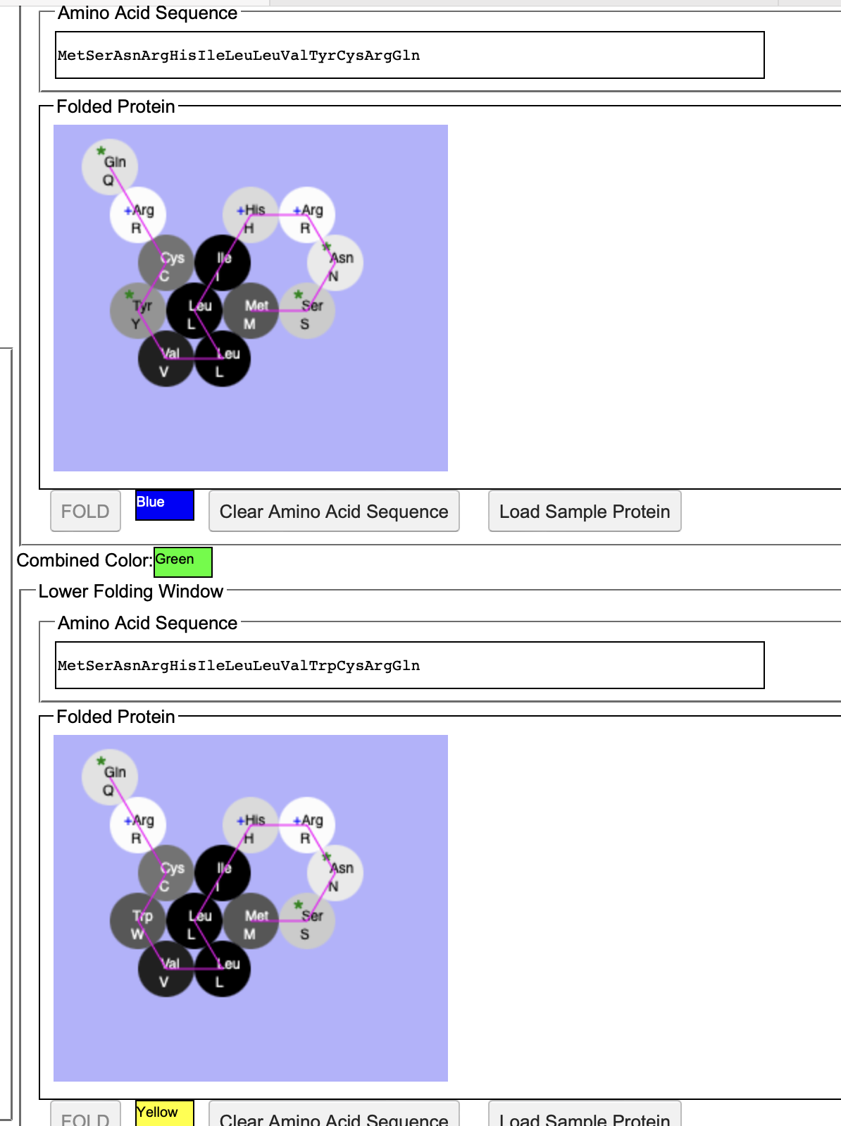
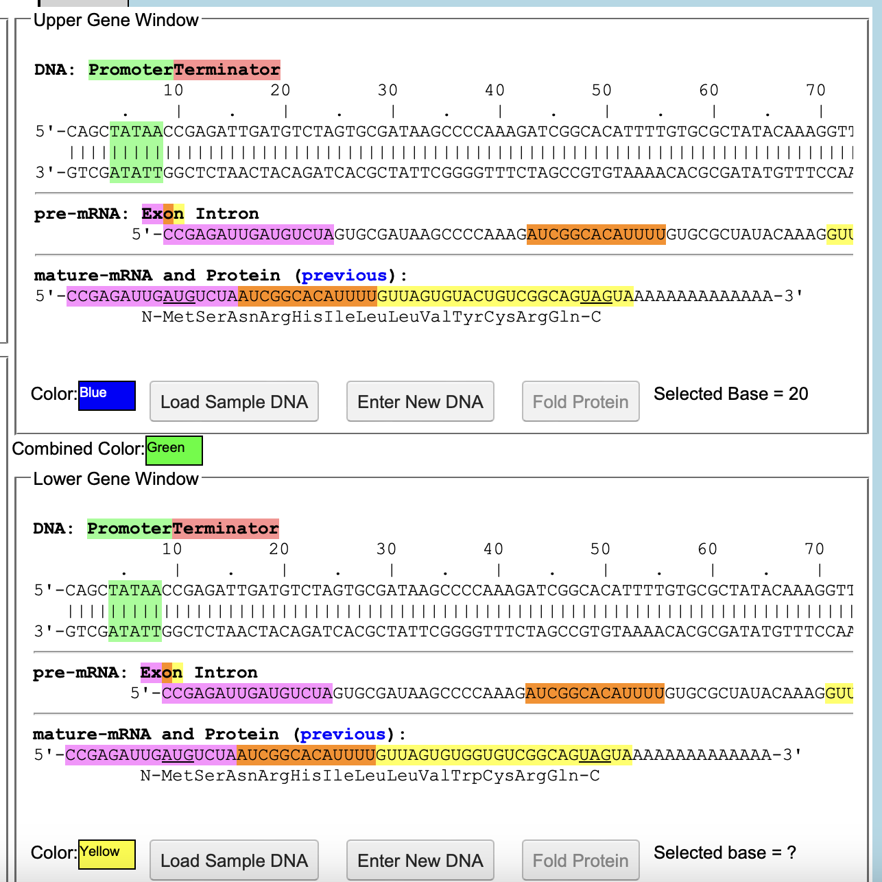
Green-2
Changes is amino acid sequence
Change in DNA sequence

Slide 3
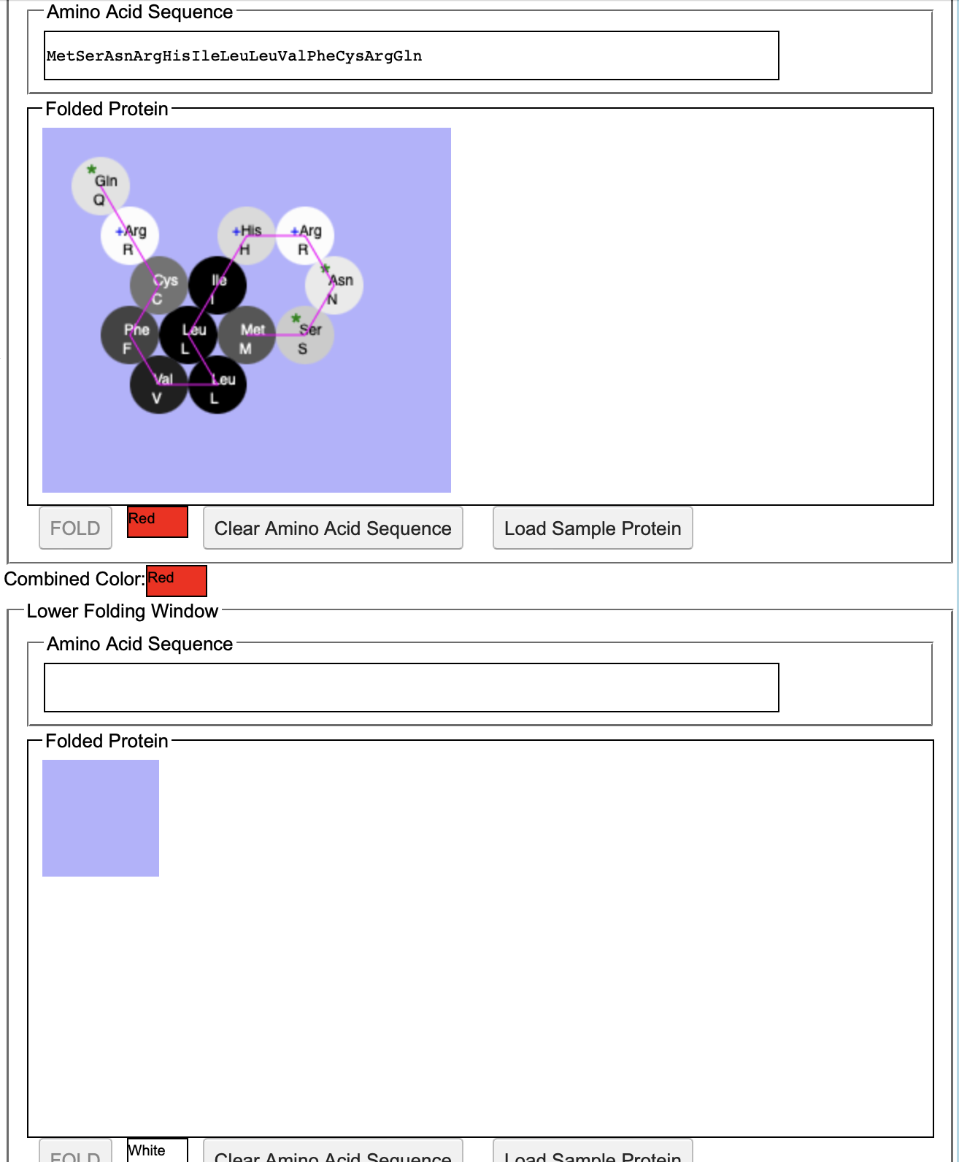
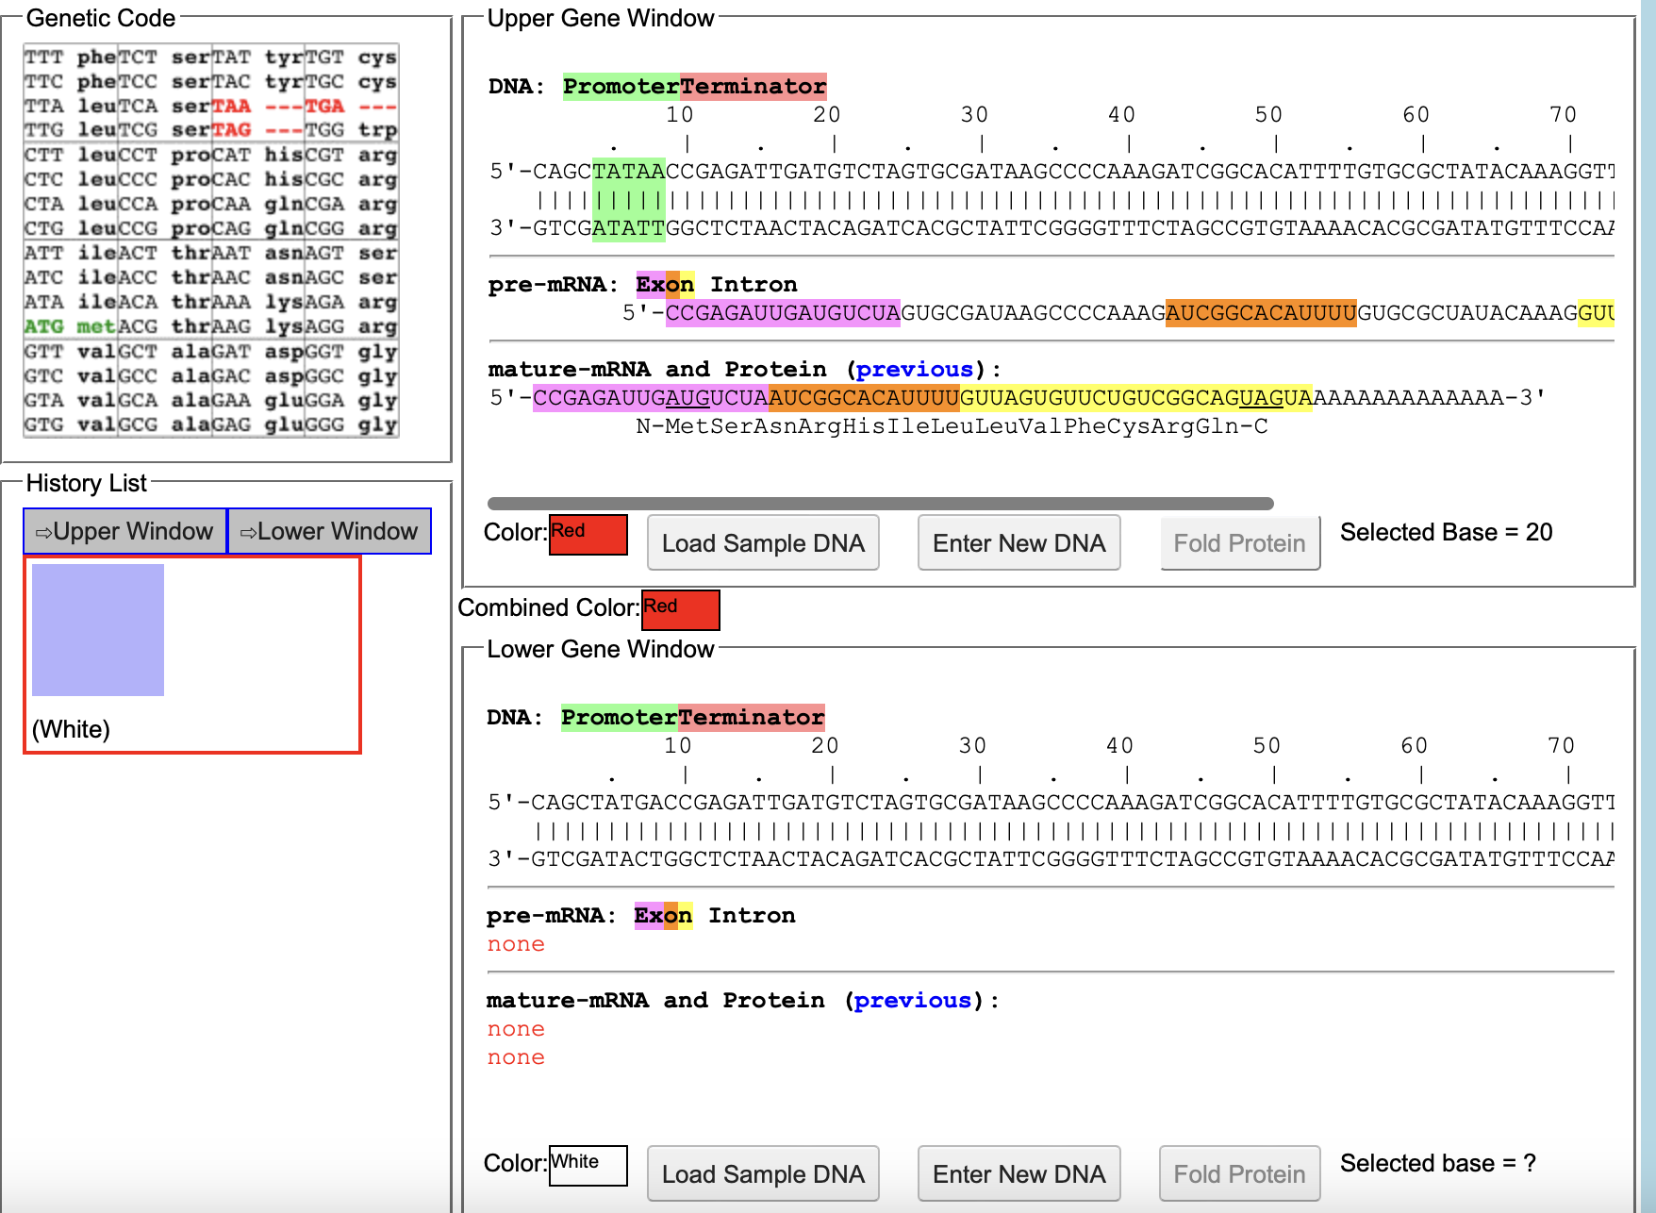
Red
Change in amino acid sequence
Change in DNA sequence

Slide 4
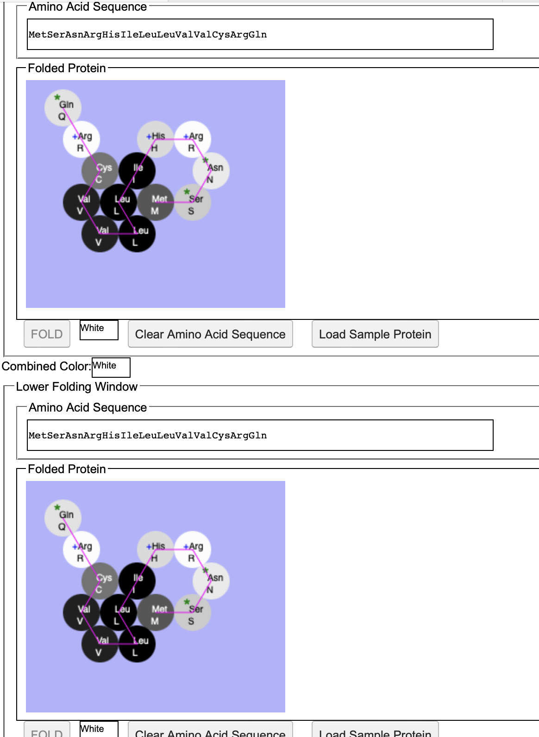
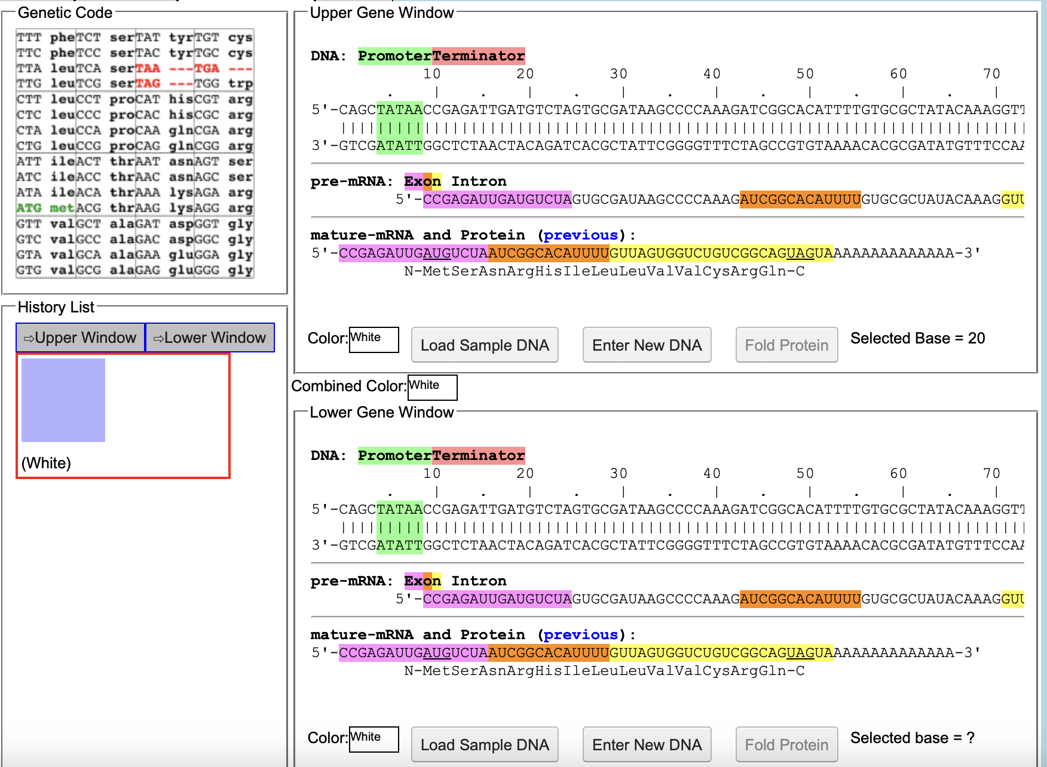
White
Change in amino acid sequence
Change in DNA sequence

Slide 5
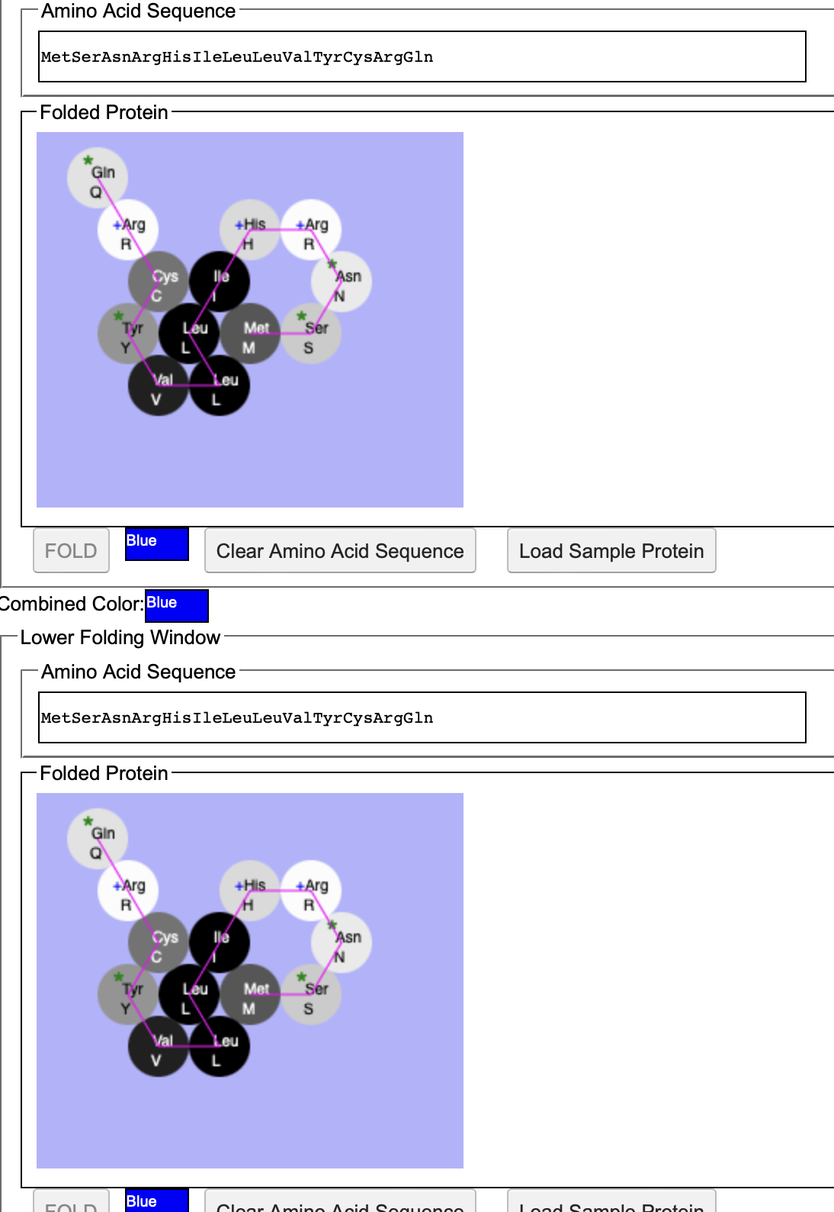
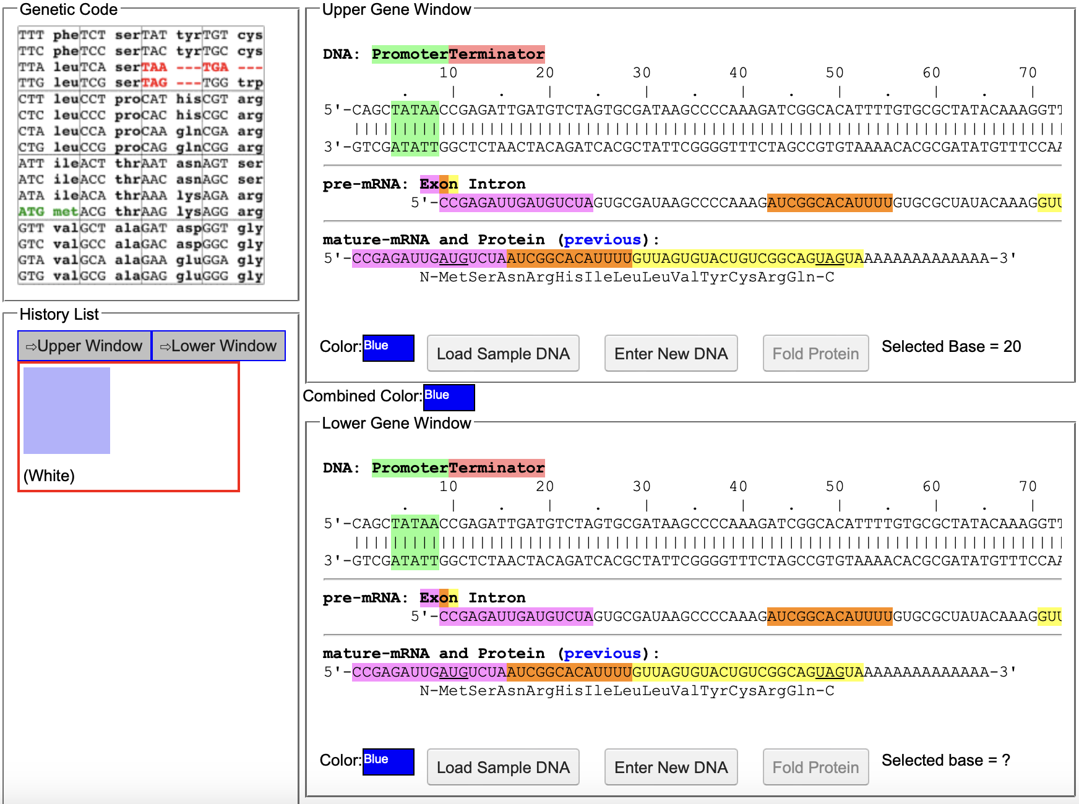
Blue
Changes in amino acid sequence
Changes in DNA sequence

Slide 6
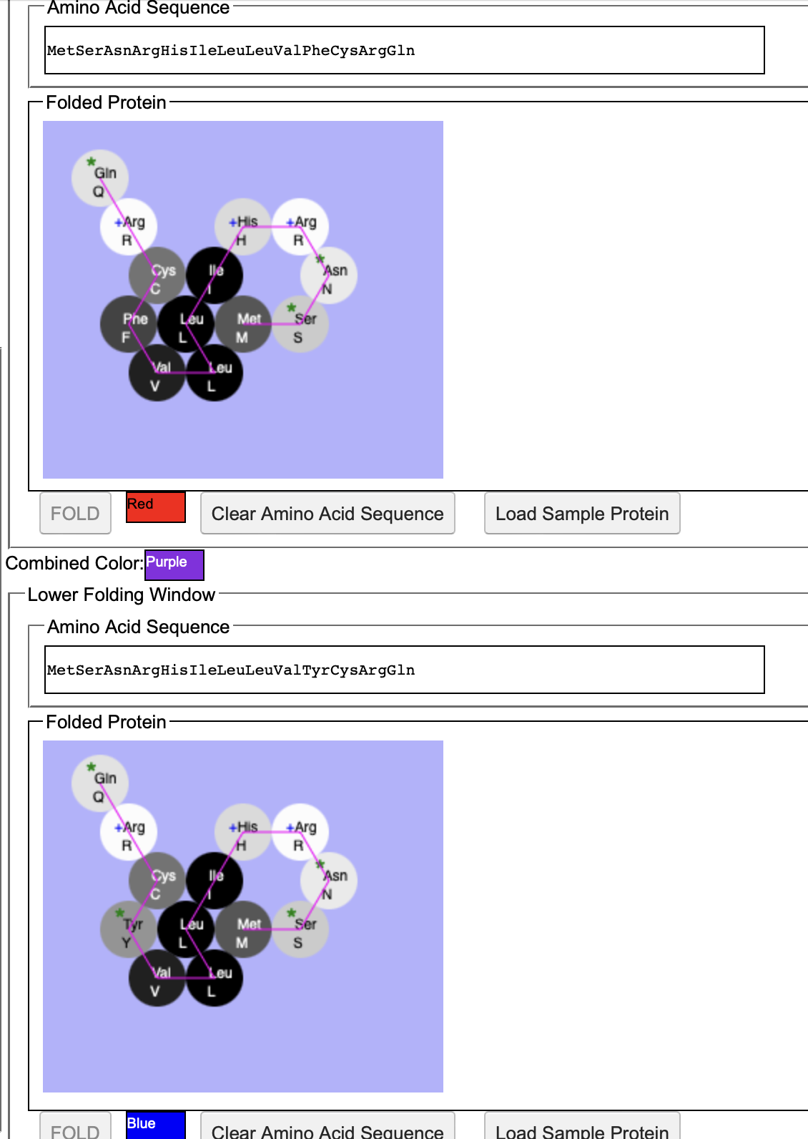
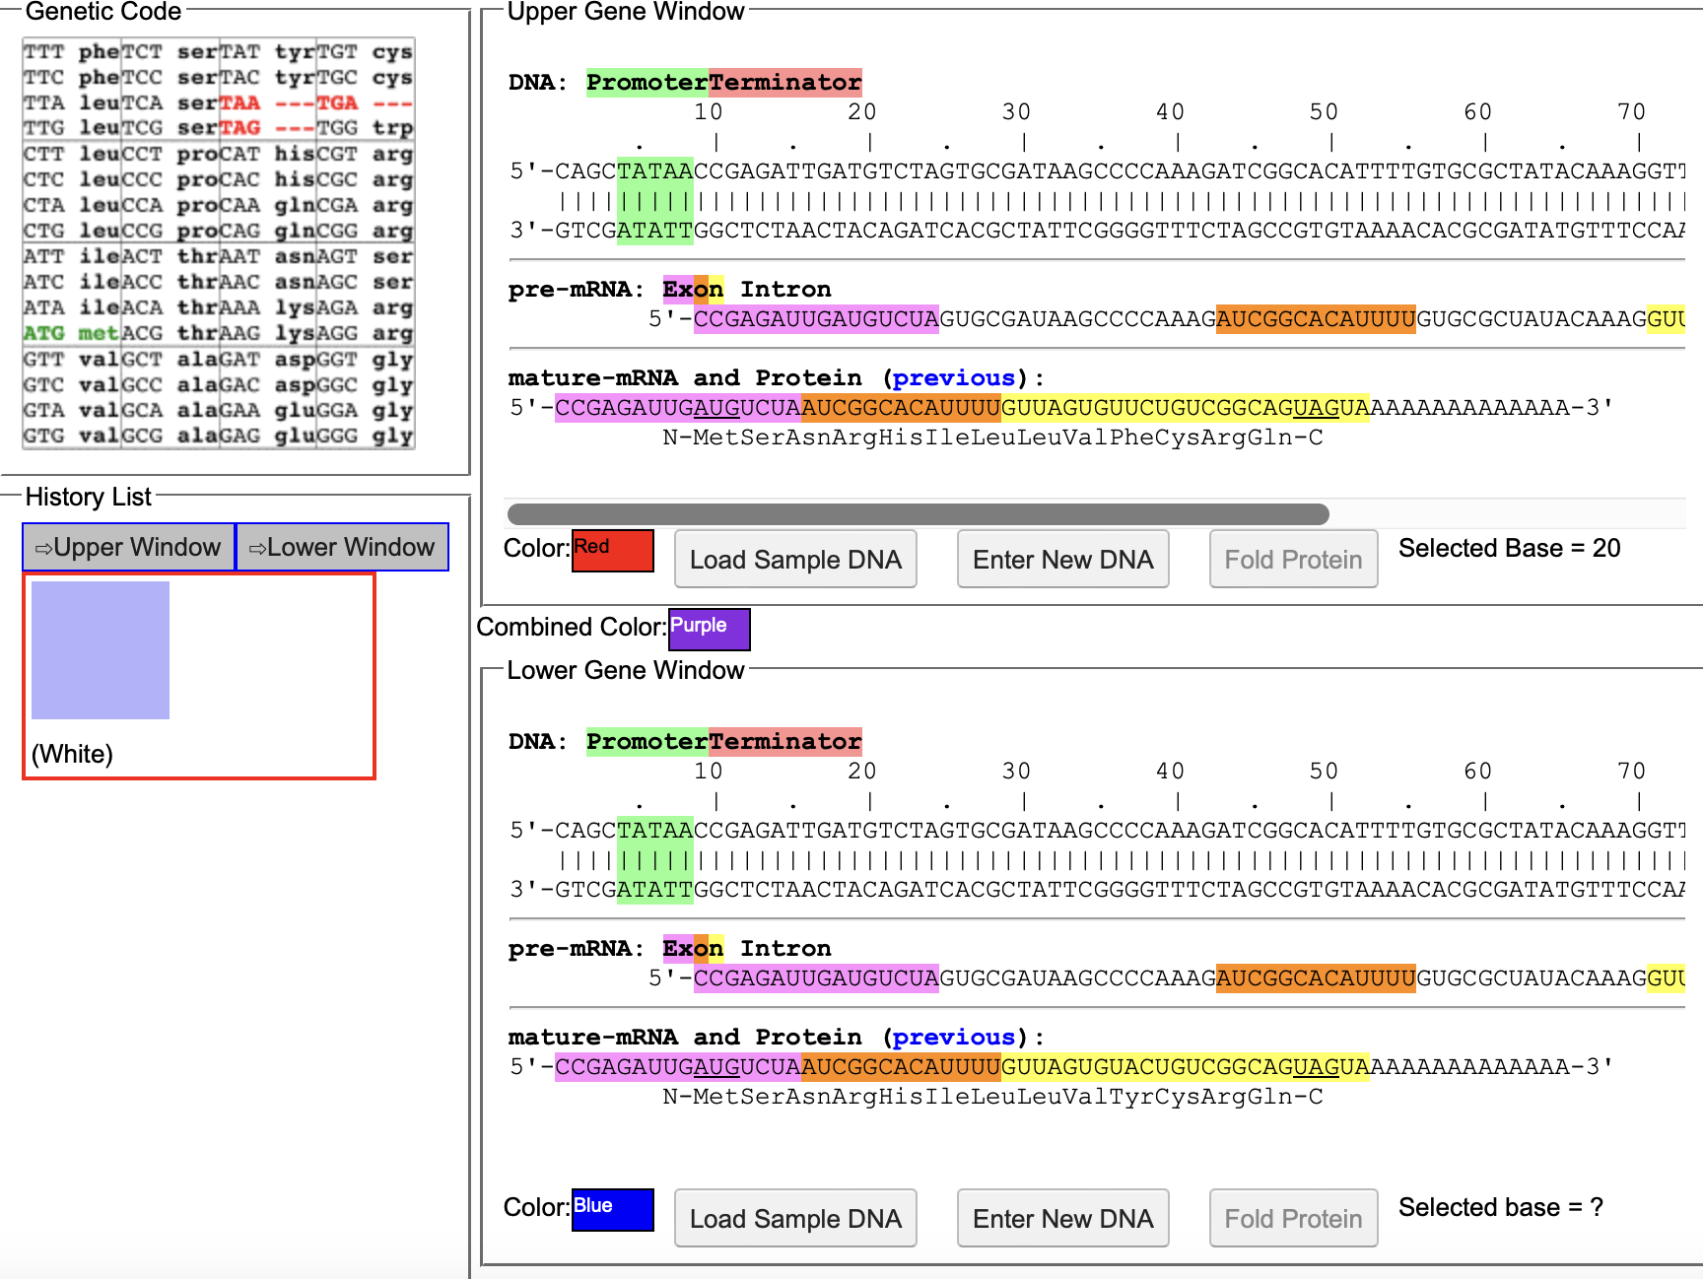
Purple
Changes in amino acid sequence
Changes in DNA sequence

Slide 7
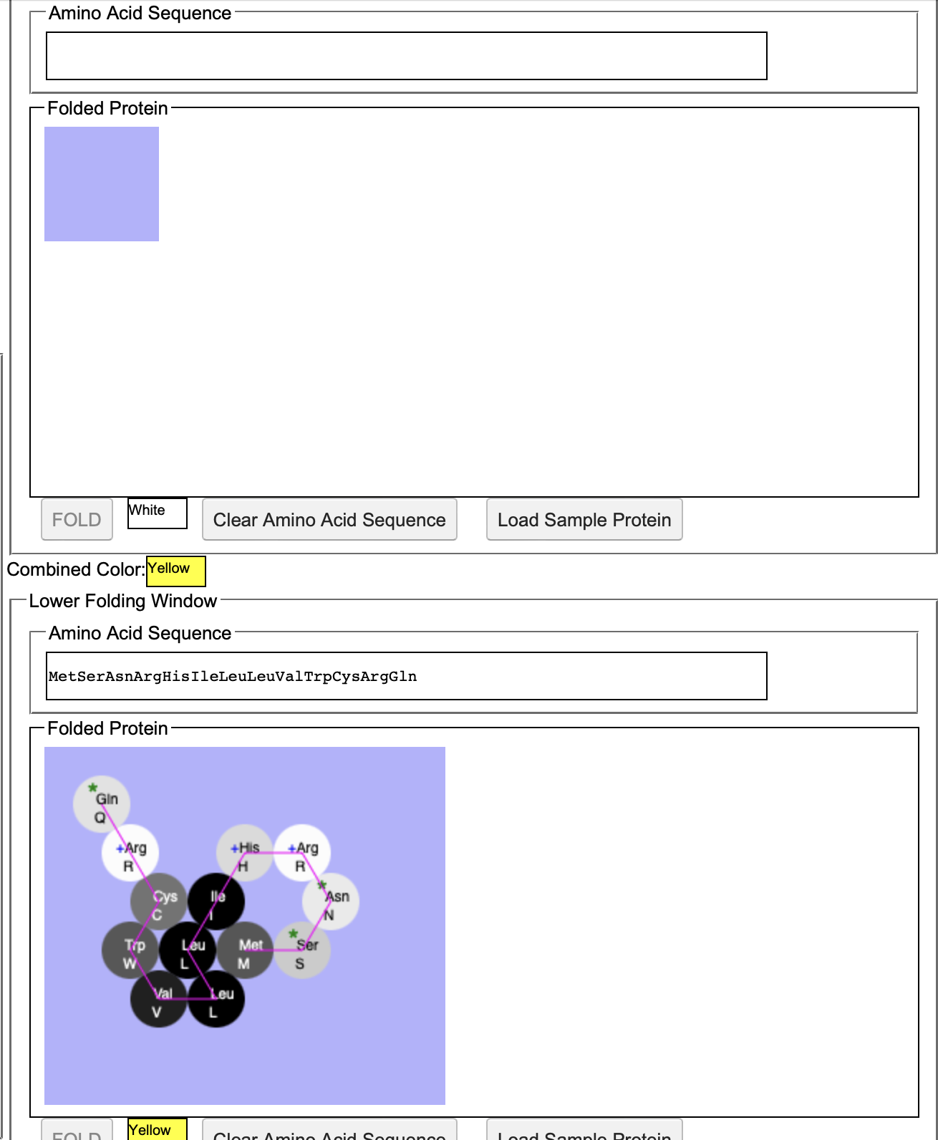
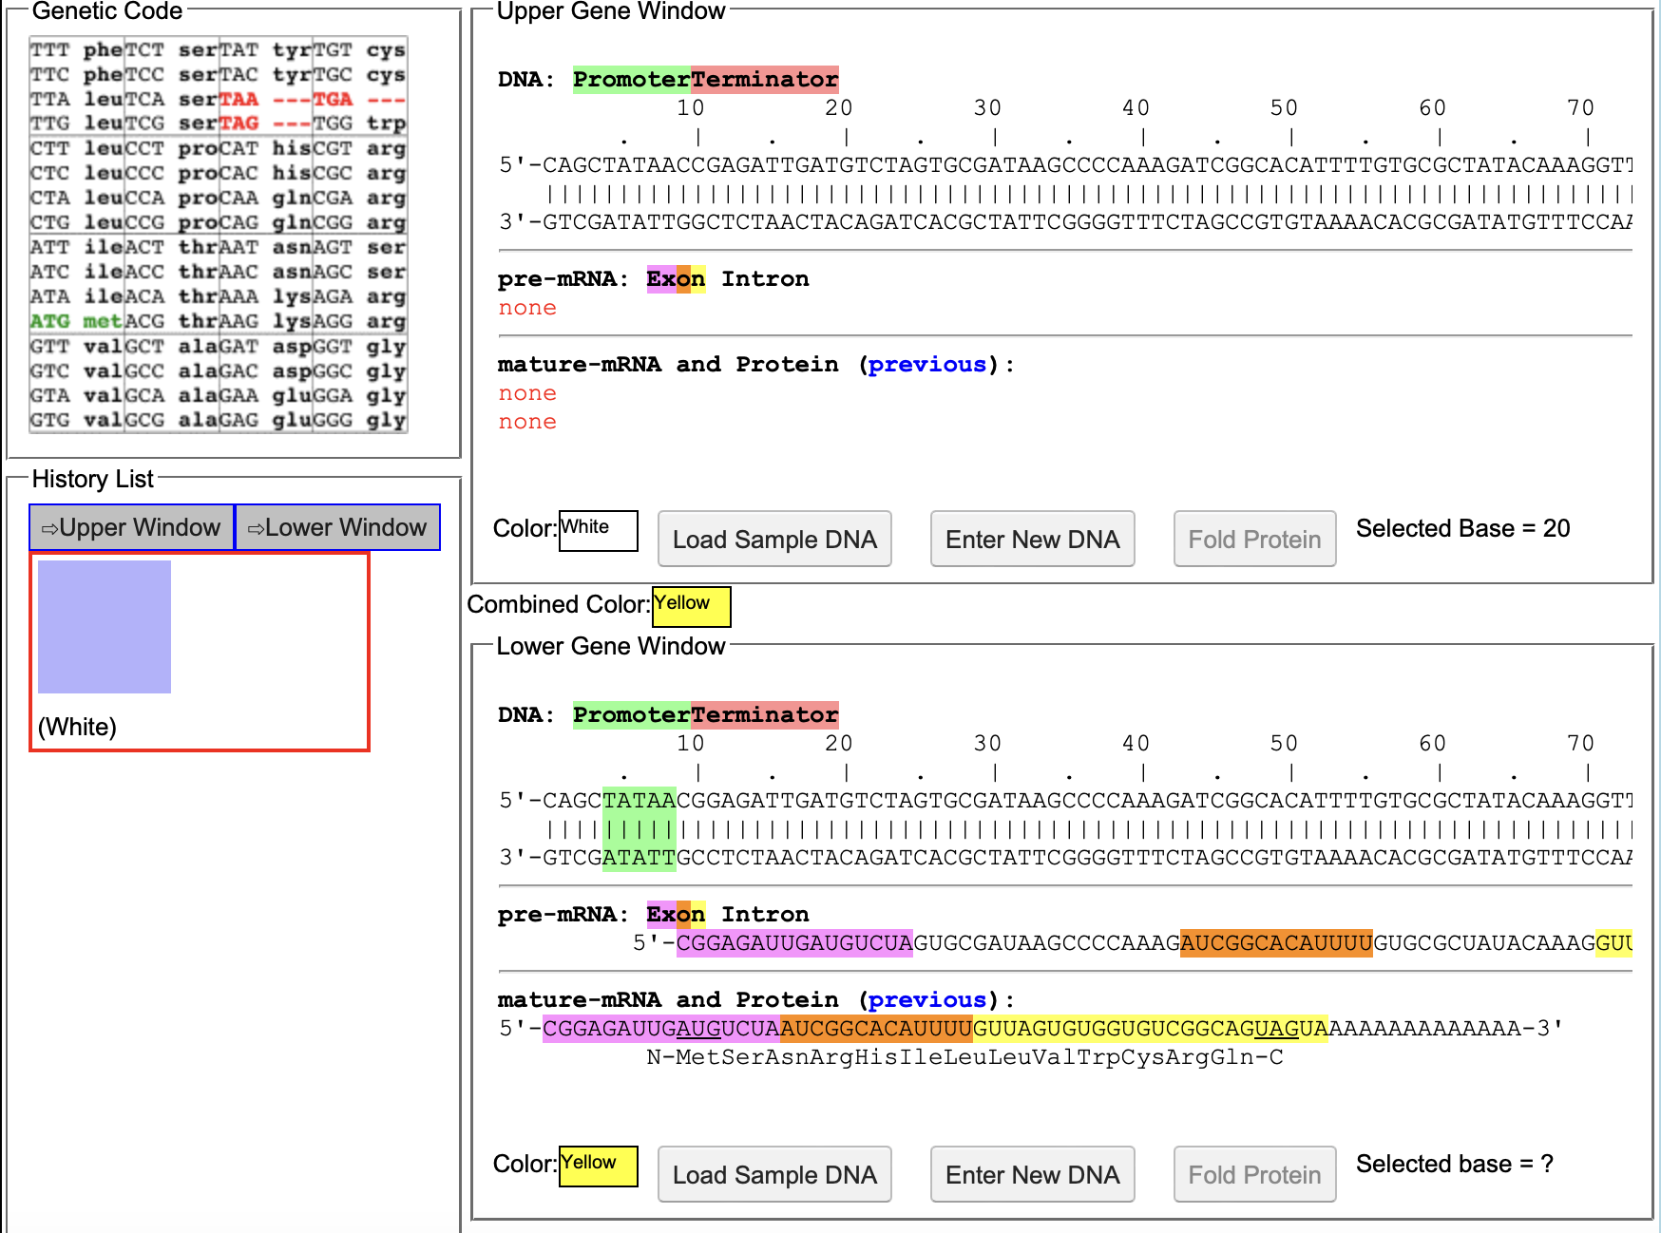
Yellow
Changes in amino acid sequence
Changes in DNA sequence

Slide 8
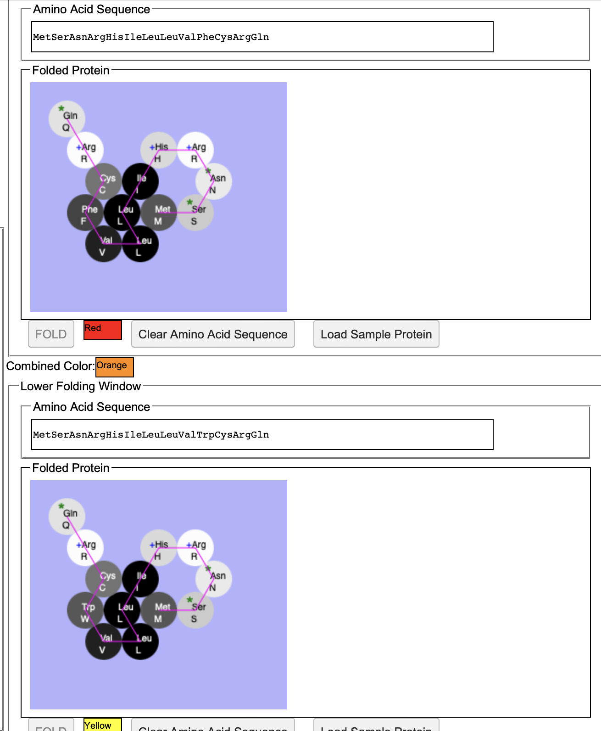
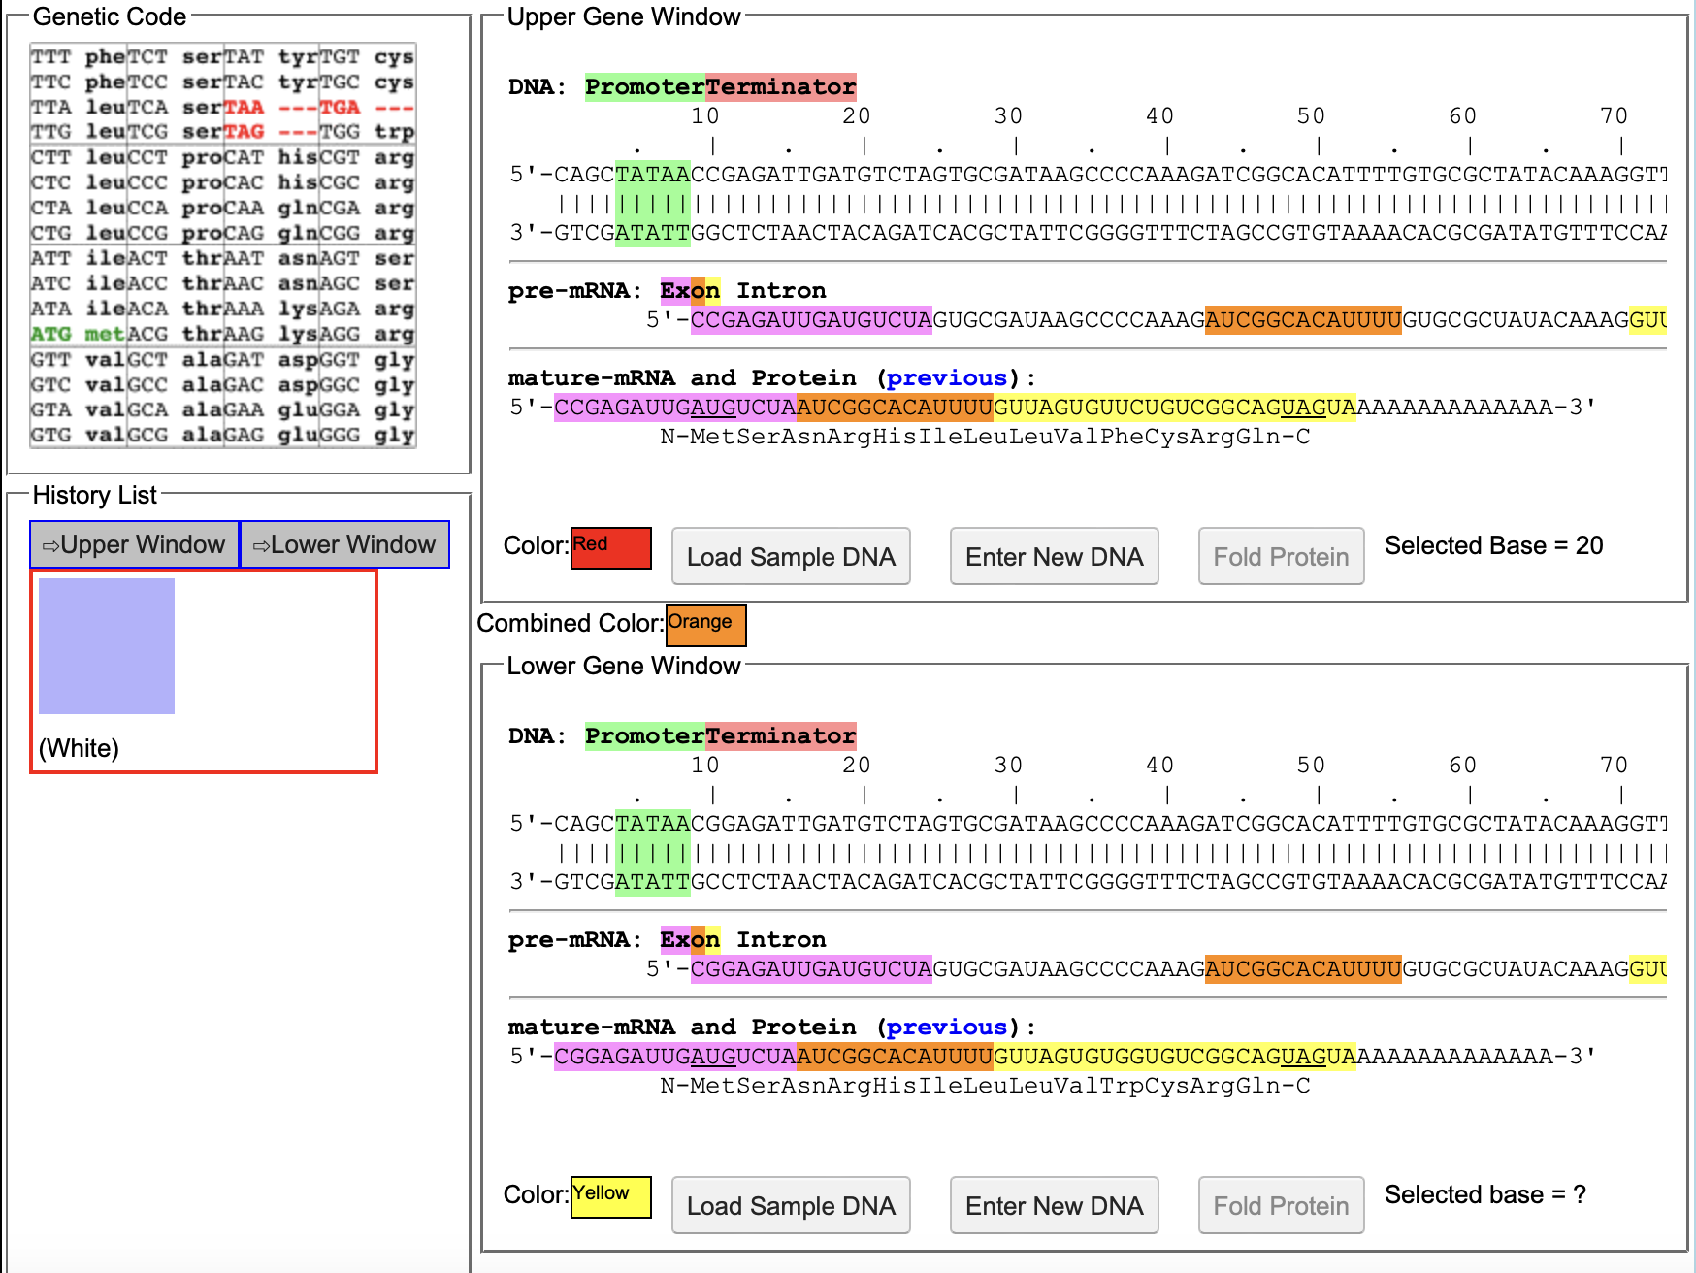
Orange
Changes in amino acid sequence
Changes in DNA sequence

Slide 9
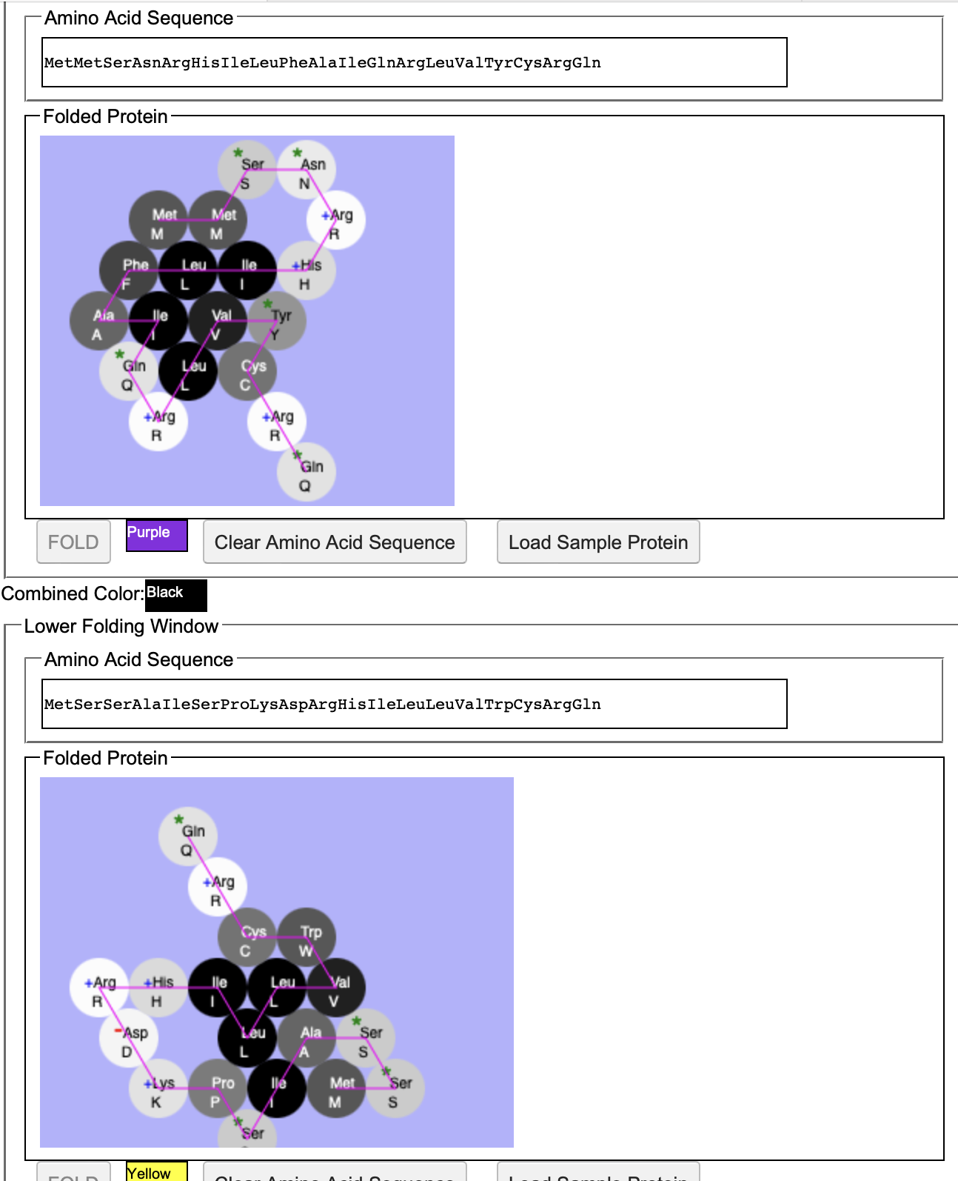
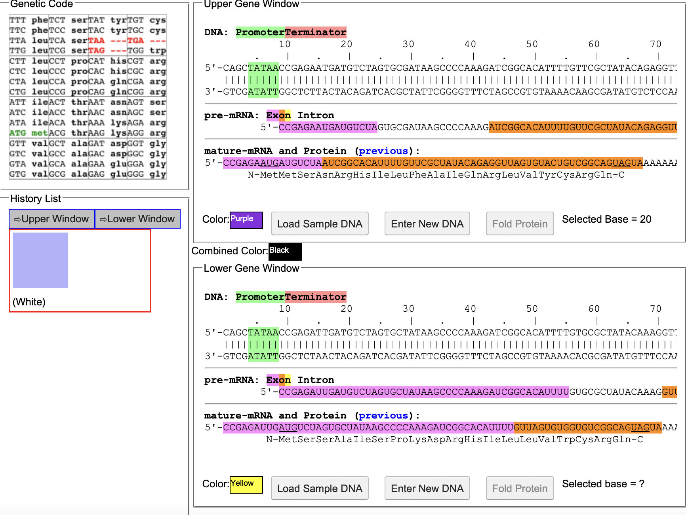
Black
Changes in amino acid sequence
Changes in DNA sequence

Slide 10
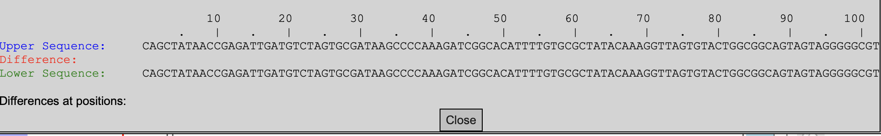
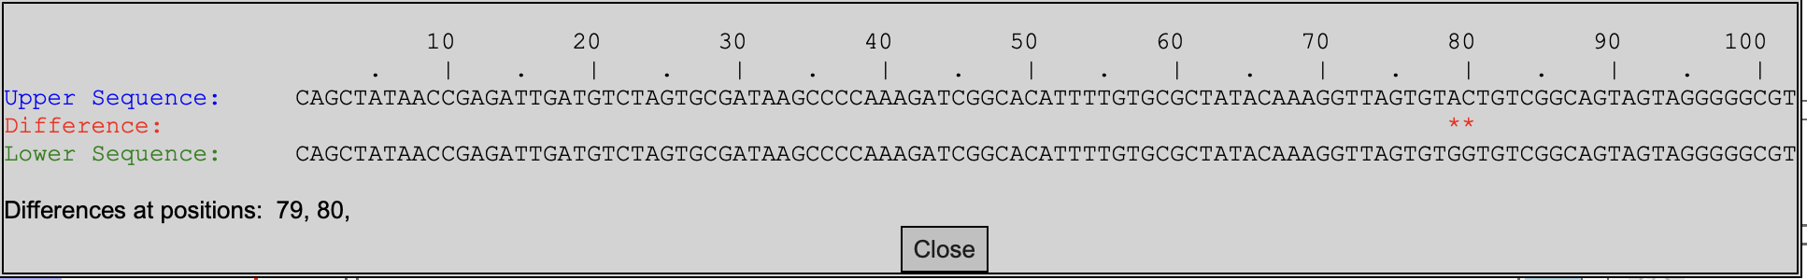
DNA sequences in 4 starting organisms
Green-1
Green-2

Slide 11
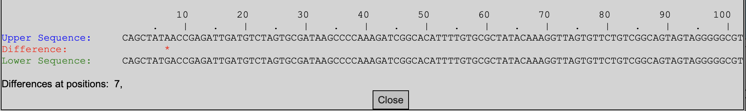
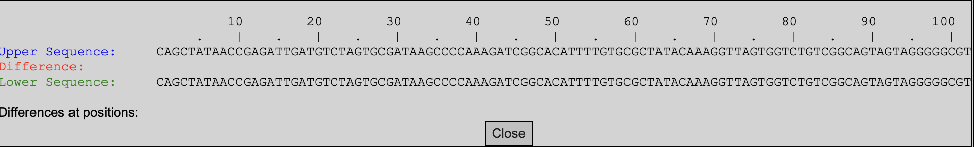
DNA sequence in 4 starting organisms
Red
White

