Slide 1
ANOVA | wt
p < 0.05 | 2528 (40.85%)
p < 0.01 | 1652 (26.69%)
p < 0.001 | 919 (14.85%)
p < 0.0001 | 496 (8.01%)
B & H p < 0.05 | 1822 (29.44%)
Bonferroni p < 0.05 | 248 (4.01%)

Slide 2
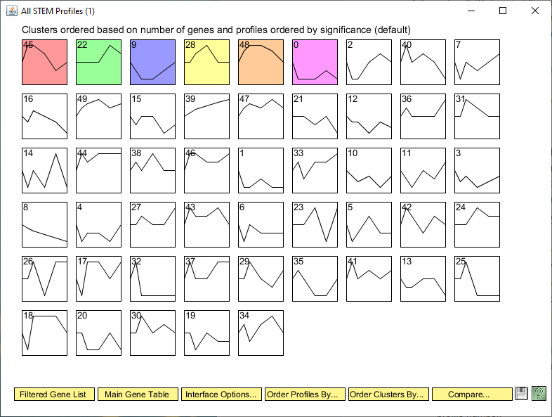

Slide 3
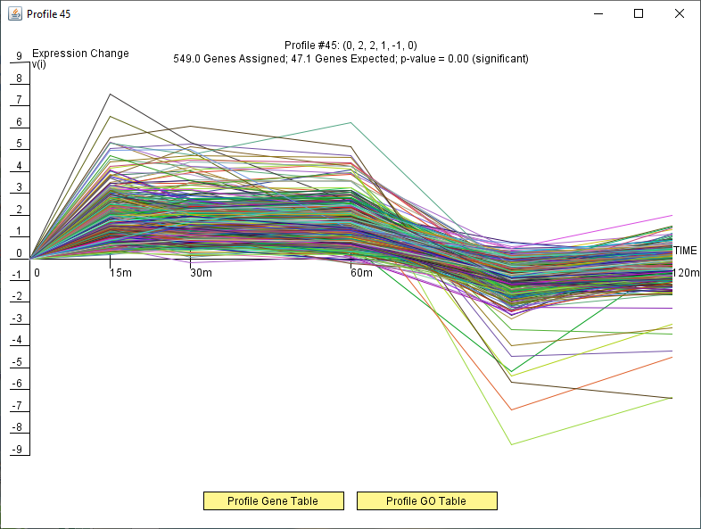

Slide 4
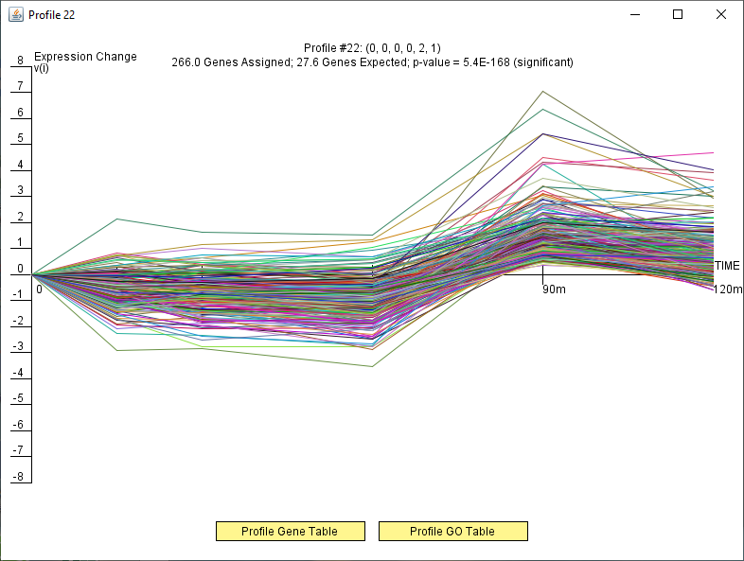

Slide 5
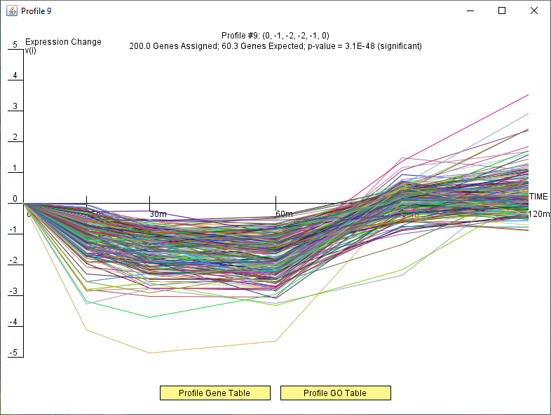

Slide 6
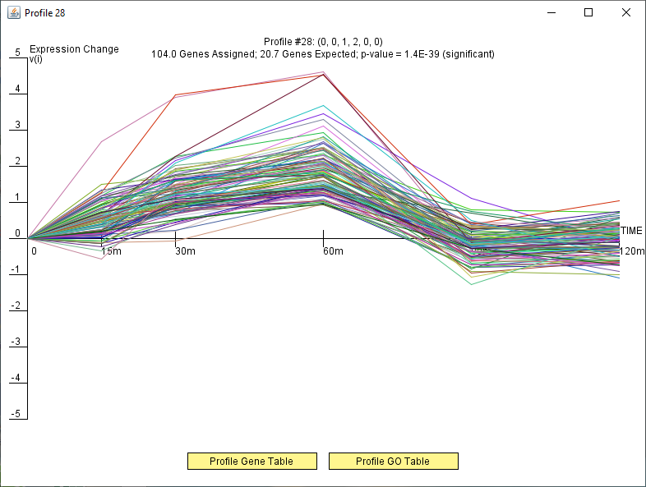

Slide 7
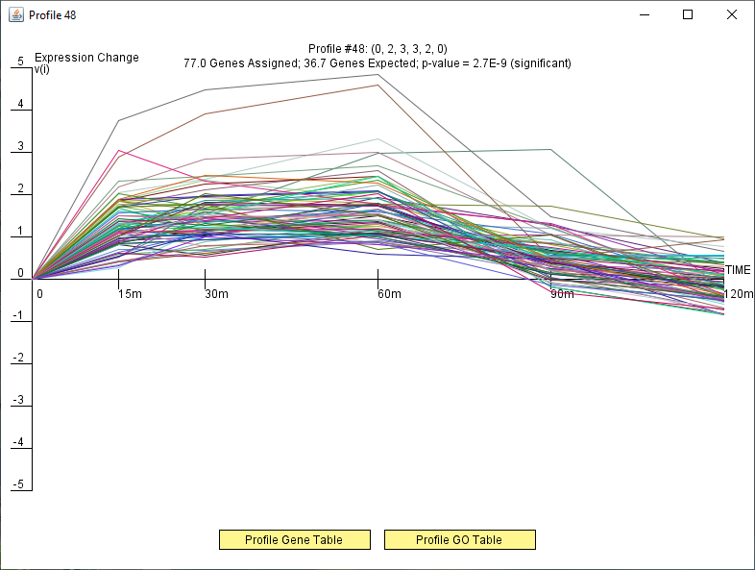

Slide 8
