Slide 1
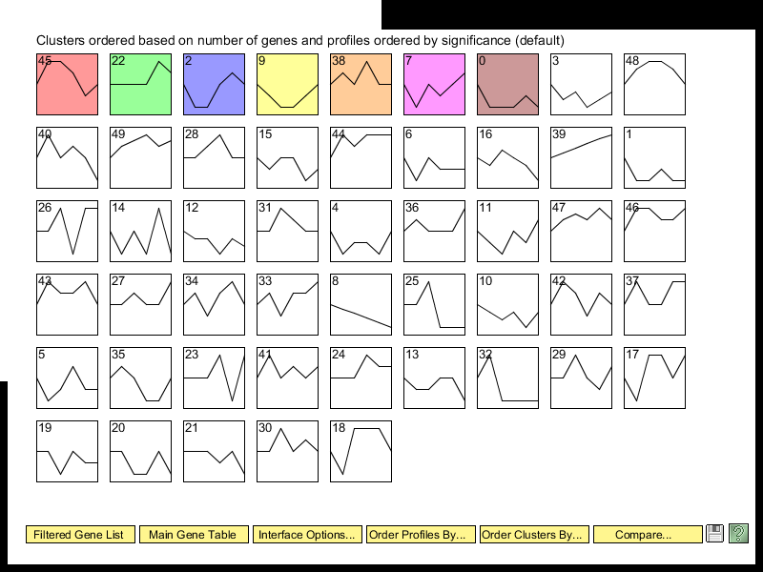

Slide 2
Viewing and Saving

Slide 3
Profile 45

Slide 4
Profile 22

Slide 5
Profile 2

Slide 6
Profile 9

Slide 7
Profile 38

Slide 8
Profile 7

Slide 9
Profile 0

